Slide 1
Notes:
Part 1 of 2. This presentation covers the information required to complete the LO1 The Air Training Corps topic.
For best results, these instructor notes should be read and discussed with the cadets in conjunction with this presentation and the lesson plan.

Slide 2
LEARNING OUTCOMES
LO1: Know about the history and organisation of the Air Training Corps.
Describe the origins of the ATC.
Identify key developments in the history of the ATC.
Notes:
LO1: Know about the history and organisation of the Air Training Corps.
P1: Describe the origins of the ATC.
P2: Identify key developments in the history of the ATC.

Slide 3
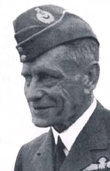
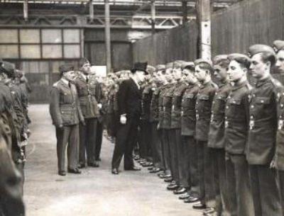
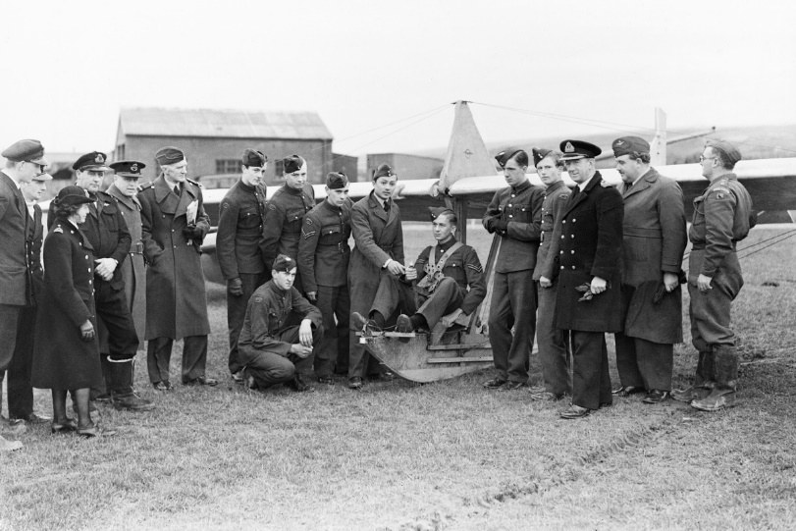
THE AIR DEFENCE CADET CORPS
Resource Book
Page 8
Air Commodore Chamier – father of the Air Cadet Movement.
Formed the Air Defence Cadet Corps (ADCC) in 1938.
Forerunner of the Air Training Corps.
Notes:
Air Commodore Chamier is often called the father of the air cadet movement. He joined the army as an officer and transferred to the Royal Flying Corps, which later turned into the RAF. After he retired in 1929 he joined the Air League, an organization interested in aviation. In 1938, through this organization, Air Commodore Chamier created the ADCC, the Air Defence Cadet Corps.
The aim of the ADCC was to provide training to young men interested in aviation, and prepare them for service in the RAF or Fleet Air Arm. When war broke out in 1939 ADCC cadets provided valuable assistance to the RAF.
In the First World War, young men were sent to fight with only a few hours of training.
In 1938, the country was again preparing for the possibility of war. Air Commodore Chamier knew that effective air combat requires lots of training, so ADCC squadrons were set up in towns and cities across the country. To encourage the creation of new squadrons, the first 50 'founder squadrons' were allowed to put an F in their squadron number. For example, 14F (Northolt) Squadron is a founder squadron.
The most important aim of the ADCC was to prepare the cadets for the RAF. This included drill, discipline exercises and uniform upkeep. Cadets were also taught about the military and about aviation in general.

Slide 4
ORIGINS OF THE AIR TRAINING CORPS
Resource Book
Page 8
The RAF was so impressed by the contribution of the ADCC that it absorbed it and established the Air Training Corps (ATC).
Air Commodore JA Chamier was appointed as Commandant.
King George VI became Air Commodore In Chief and issued a Royal Warrant on 5th February 1941.
Notes:
By 1939 the ADCC was very restricted. Many of its staff had been called up for military service, and its buildings and resources were taken to help the war effort. The organization now helped on RAF stations across the country. Things like carrying messages and moving stores and equipment were very important, and were things cadets were proud to help with.
Towards the end of 1940 the government realised how useful the ADCC was and agreed to support it officially. This meant a lots of changes to the Corps. This resulted in a new organisation being created called the Air Training Corps. On 5 February 1941 the Air Training Corps was officially established, with King George VI agreeing to be Air Commodore-in-Chief.
The number of young men joining the new ATC was spectacular. Within the first month the size of the old ADCC had nearly doubled (more than 400 squadrons) and after 12 months it was about 8 times as big.
The new ATC crest was approved by the King. The crown on top is an Astral Crown, a symbol of the military air service. The falcon is a good choice for the ATC crest because it has many of the qualities a good cadet should have: remarkable vision, enormous strength and incredible courage. The motto 'Venture Adventure' was devised by Air Commodore Chamier, was adopted by the ATC and incorporated into the badge which, together with the ATC Ensign (flag), was approved by the King.

Slide 5
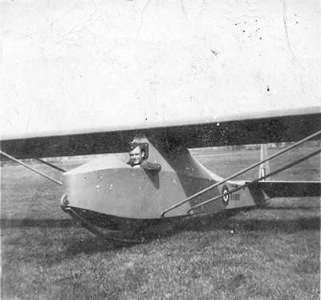
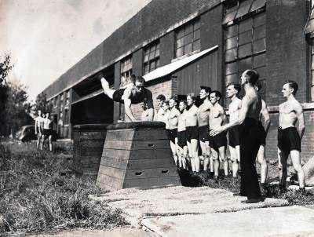
THE ATC AND WORLD WAR II
Resource Book
Page 10
Cadets took a fitness test and Training became more academic and fitness focused.
Gliding was introduced.
First aircraft for ATC use were introduced.
Kirby Cadet Glider
Notes:
The new ATC prepared young men for specific roles in the RAF, so the training programme became more academic and fitness-focused. The old fitness test isn't required any more, but it's something for cadets to aim for!
Squadrons would visit RAF and Fleet Air Arm stations to get as much flying experience as possible, but nearly all the aircraft were required for the war effort and it was difficult to spare them for cadet use.
The solution was to introduce cadets to gliding. Gliders are aircraft without engines, so are cheaper and easier to run. This let the cadets get a feel for flying and a chance to take control. The aim was to let every cadet have at least one glider flight each year.
The flying situation was improved when the government set up a special ATC flight with 10 Oxfords and Dominies specially for letting cadets experience flying. They also allowed cadets to fly in normal RAF aircraft and set up overseas flights to take cadets to places like Egypt and India.

Slide 6
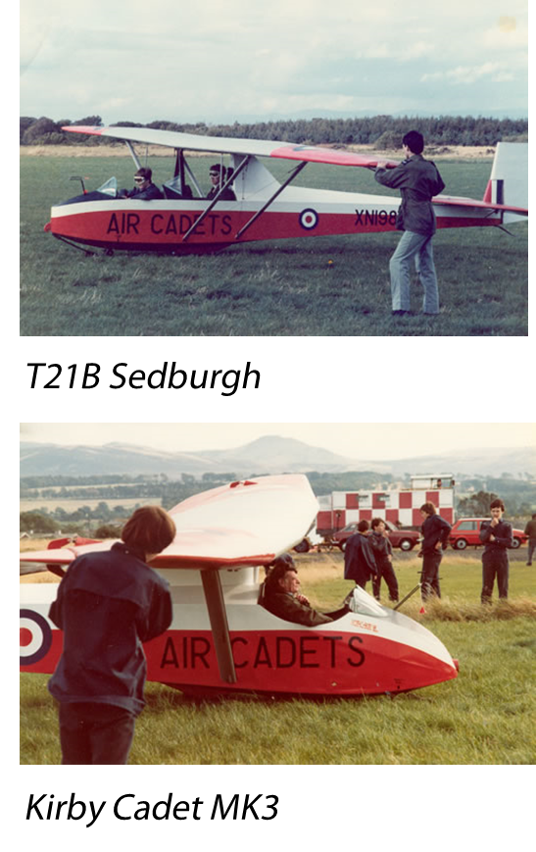
THE ATC AFTER WORLD WAR II
Resource Book
Page 11
ATC became part of Royal Air Force Reserve Command When the Second World War ended in 1945.
When King George VI died, HRH Duke of Edinburgh became Air Commodore in Chief in 1953.
In 1950, the Sedburgh was introduced, the Air Cadet’s first two seater glider.
Gliders were upgraded in the 1980’s.
Notes:
The war ended in 1945 and the ATC was left with a large number of well-trained cadets with no war to go to! Some people were worried that the ATC would no longer be needed, but the government quickly announced that it would become part of the recently-created Reserve Command. This helped the ATC lots, because it was now officially a part of the RAF, led by RAF officers.
HRH Duke of Edinburgh became Air Commodore in Chief in 1953 and in 2015 he handed over the reigns to HRH The Duchess of Cambridge as patron. She is an Honory Air Commandant.
The ATC soon settled down to a regular membership of around 30,000. New activities were introduced, for example the International Air Cadet Exchange (IACE) which was started when 46 cadets and 2 officers went on a 3 week visit to Canada and brought back some Canadian cadets with them. This exchange now happens every year, with cadet forces all around the world.
Gliding training continued to grow, and by 1946 the Corps had 350 Kirby Cadet gliders, with a further 50 waiting to be delivered and 115 on order, spread between 84 Gliding Schools located at various RAF stations around the country. In 1950 2 seater gliders were introduced, the first being the T21B Sedburgh. The gliding feet were updated during the 1980s to the Viking and Vigilant. Cadets still fly in Viking gliders today.

Slide 7
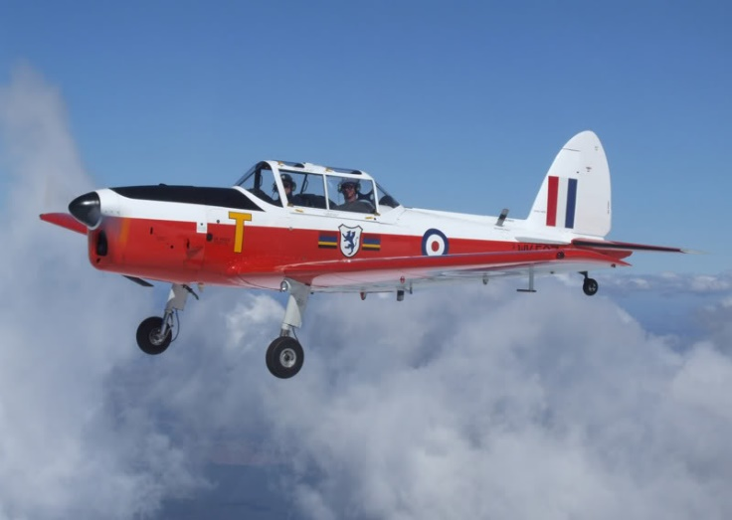
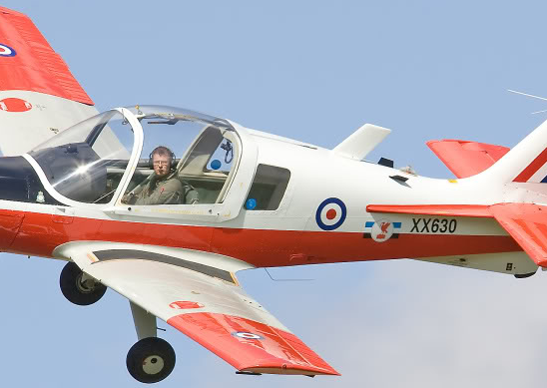
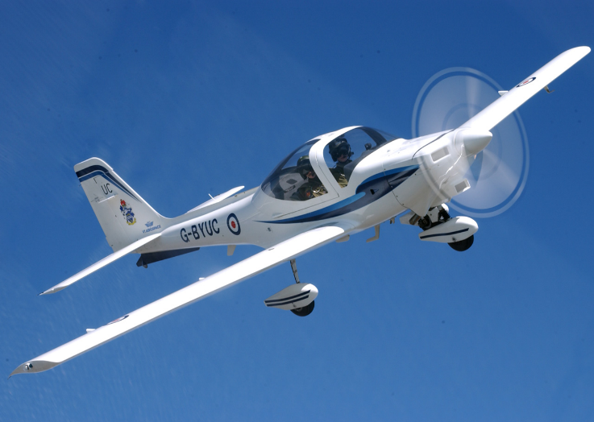
ATC FLYING AFTER WORLD WAR II
Resource Book
Page 11
In 1957 Air Experience Flights (AEF’s) were set up to provide Cadets with flying experience and training.
13 AEF’s were set up throughout the UK.
Since their inception, AEF’s have used these aircraft:
Chipmunk
1957 - 1996
Bulldog
1996 - 1999
Tutor
1999 - present
Notes:
In 1957 Air Experience Flying (AEF) was set up so that cadets had the opportunity to fly and gain training in this area. These aircraft were 2 seaters to allow the cadets and the instructor to use the instruments. The chipmunk was designed for the instructor to sit behind the cadets whereas the Bulldog and Tutor are designed to have the instructor next to the cadet.
1957-1996 de Havilland Canada Chipmunk
1996-1999 Scottish Aviation Bulldog
1999- Present Grob Tutor
In 1957 the Corps got its' own fleet of 50 Chipmunk aircraft organized into 13 Air Experience Flights. Later, Bulldog aircraft were used, until the Grob Tutor was introduced in 1999.

Slide 8
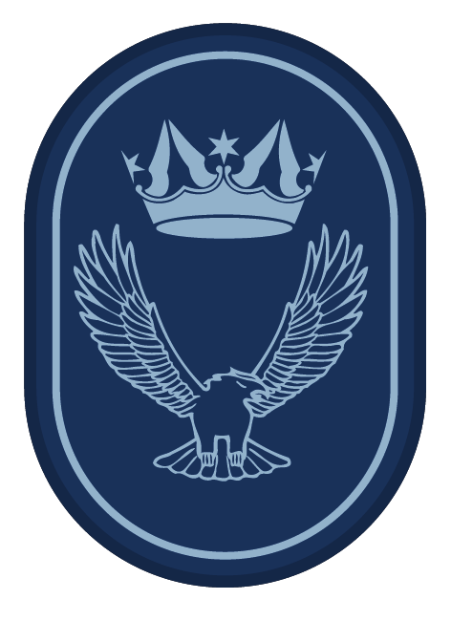
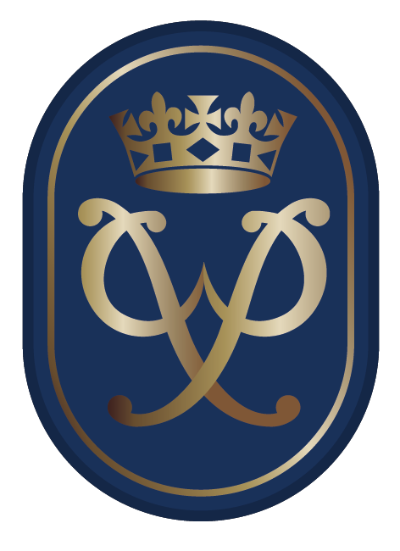
THE DUKE OF EDINBURGH AWARD
Resource Book
Page 12
In 1956 the ATC was asked to trial the new Duke of Edinburgh Award scheme.
Cadets can take part in the D of E Award scheme at all three levels.
The Air Cadets also run a pre-DofE scheme.
Notes:
The Duke of Edinburgh's Award was first tested on seven Air Cadet squadrons in 1956, and opened to everybody in 1960.
There are 3 levels bronze silver and gold. The air cadets also run their own pre-DofE blue badge scheme.
All levels require a greater level of commitment as you go up. The awards are split into key areas; skill, service, physical, and expedition and for gold, residential
Any cadet aged14 or over can start the Bronze award. Any cadet can undertake the pre-DofE award.

Slide 9
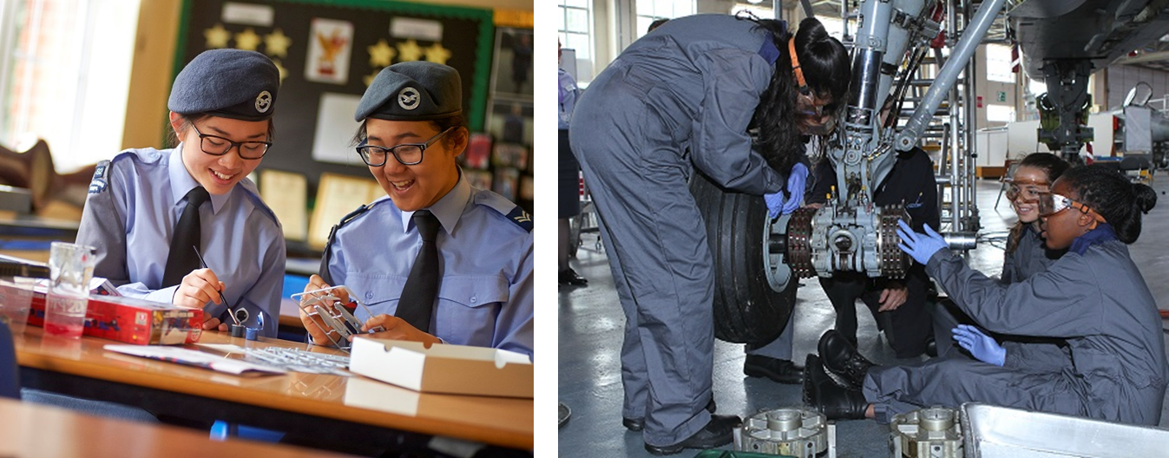
GIRLS IN THE ATC
Resource Book
Page 11
1980 girls were allowed to join the ATC.
Females now make up just over ¼ of all cadets in the Air Training Corps.
Notes:
In April 2016, Females made up 28.4% of the total number of cadets in the ATC.
6 ATC squadrons admitted girls as a trial in 1980. Soon after, every ATC unit was permitted to admit females.

Slide 10
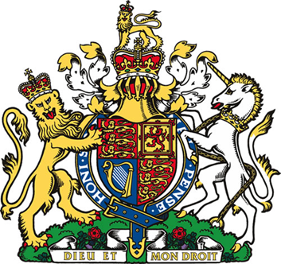
THE AIMS OF THE AIR TRAINING CORPS
The ATC has changed considerably over the years but it’s aims have remained broadly the same from the Royal Warrant of 1941:
To promote and encourage among young people a practical interest in aviation and the Royal Air Force.
To provide training which will be useful both in the Services and in civilian life.
To foster the spirit of adventure, and to develop the qualities of leadership and good citizenship.
Notes:
In 1990 the Royal Warrant was updated. It sets out the current aims of the ATC:
To promote and encourage among young people a practical interest in aviation and the Royal Air Force.
To provide training which will be useful both in the Services and in civilian life.
To foster the spirit of adventure, and to develop the qualities of leadership and good citizenship.

Slide 11
ANY QUESTIONS?
Are there any final questions?
?
Notes:
A chance to ask or answer any final questions.

Slide 12
LEARNING OUTCOMES
LO1: Know about the history and organisation of the Air Training Corps.
Describe the origins of the ATC.
Identify key developments in the history of the ATC.
Notes:
LO1: Know about the history and organisation of the Air Training Corps.
P1: Describe the origins of the ATC.
P2: Identify key developments in the history of the ATC.

Slide 13
QUESTION 1
Who is known as the father of the ATC?
a. HRH the Duke of Edinburgh.
b. King George VI.
c. Air Commodore Chamier.
d. Air Commodore Skelley.
Notes:
Who is known as the father of the ATC?
Answer: c. Air Commodore Chamier.

Slide 14
QUESTION 1
Who is known as the father of the ATC?
a. HRH the Duke of Edinburgh.
b. King George VI.
c. Air Commodore Chamier.
d. Air Commodore Skelley.
Notes:
Who is known as the father of the ATC?
Answer: c. Air Commodore Chamier.

Slide 15
QUESTION 2
The ATC grew from which organisation?
a. Air Cadet Defence League.
b. Air Defence Cadet Corps.
c. Air Cadet Defence Corps.
d. Air Defence Cadet League.
Notes:
The ATC grew from which organisation?
Answer: b. Air Defence Cadet Corps.

Slide 16
QUESTION 2
The ATC grew from which organisation?
a. Air Cadet Defence League.
b. Air Defence Cadet Corps.
c. Air Cadet Defence Corps.
d. Air Defence Cadet League.
Notes:
The ATC grew from which organisation?
Answer: b. Air Defence Cadet Corps.

Slide 17
QUESTION 3
When did the ATC come into existence?
a. 1941
b. 1938
c. 1944
d. 1930
Notes:
When did the ATC come into existence?
Answer: a. 1941

Slide 18
QUESTION 3
When did the ATC come into existence?
a. 1941
b. 1938
c. 1944
d. 1930
Notes:
When did the ATC come into existence?
Answer: a. 1941

Slide 19
QUESTION 4
When was the Duke of Edinburgh (DofE) award first introduced, on a trial basis?
a. 1949
b. 1956
c. 1960
d. 1962
Notes:
When was the Duke of Edinburgh (DofE) award first introduced, on a trial basis?
Answer: b. 1956

Slide 20
QUESTION 4
When was the Duke of Edinburgh (DofE) award first introduced, on a trial basis?
a. 1949
b. 1956
c. 1960
d. 1962
Notes:
When was the Duke of Edinburgh (DofE) award first introduced, on a trial basis?
Answer: b. 1956

Slide 21
LEARNING OUTCOMES
LO1: Know about the history and organisation of the Air Training Corps.
Recognise cadet badges and ranks, ATC ensigns, ATC adult ranks and RAF ranks.
Notes:
LO1: Know about the history and organisation of the Air Training Corps.
P3: Recognise cadet badges and ranks, ATC ensigns, ATC adult ranks and RAF ranks.

Slide 22
STRUCTURE OF THE AIR TRAINING CORPS
Resource Book
Page 18
Corps |  | Headquarters Air Cadets
Region |  | 6 Regions
Wing |  | 34 Wings
Squadron |  | Around 930 Air Cadet Squadrons
Detached Flight |  | Attached to a squadron

Slide 23
DETACHED FLIGHTS
Resource Book
Page 18
Around 15 Cadets
Reports to a local Squadron and staff are volunteers
Normally commanded by a Flying Officer
Can apply ‘upgrade’ to squadron status if they have more than 30 cadets.
Share the attached squadrons number with DF at the end.
Corps
Region
Wing
Squadron
Detached Flight
Notes:
Detached flights report to a local squadron as they have below 30 cadets and have on average 15 cadets. The detached flight acts as part of its squadron and will be allocated activities like flying though their squadron.
Detached flights share the attached squadrons number with DF at the end (e.g 123DF).

Slide 24
SQUADRONS
Resource Book
Page 19
The basic unit of the ATC.
Minimum of 30 Cadets.
Normally Commanded by a Flight Lieutenant and staff are volunteers.
Has a Civilian Committee and a Padre.
What is the name of your squadron’s Commanding Officer?
Corps
Region
Wing
Squadron
Detached Flight
Notes:
These have on average 30 or more cadets. You have both open and closed squadrons. Closed squadrons are attached to school and are run by the staff of that school. Open squadrons are open to anyone over the age of 12 and in year 8 who the squadron commander has approved. These are run by volunteers.

Slide 25
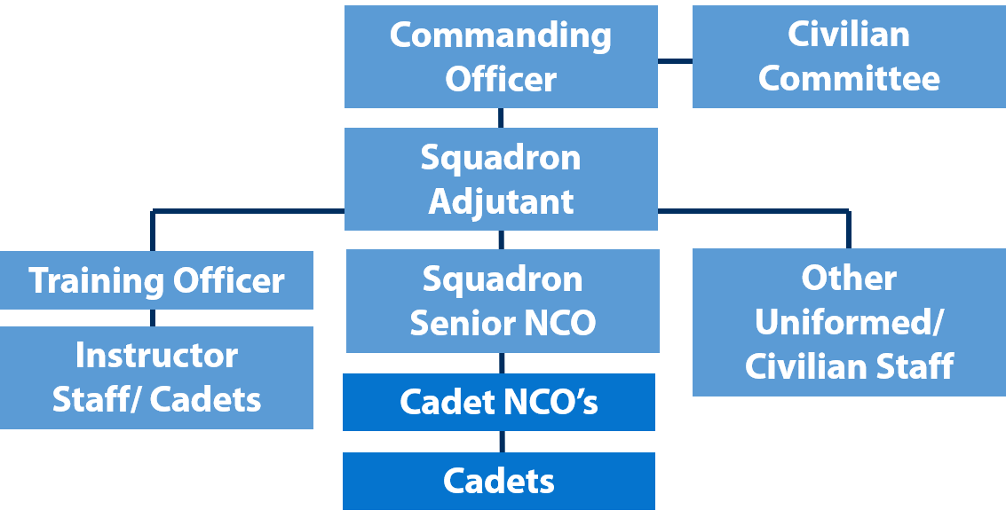
SQUADRON STRUCTURE
Resource Book
Page 19
Notes:
A squadron is run by a Commanding Officer. They normally hold the rank of Flight Lieutenant. They are assisted by a Civilian Committee who help raise funds for the squadron, control the squadron finances and help with cadet welfare issues.
The adjutant will normally manage all of the squadron’s administration and take charge of Health and Safety. They support the Officer Commanding in the management of the squadron.
Other key staff include the training officer who looks after all of the training needs on the unit, and the squadron Senior NCO (SNCO)/ Warrant Officer (WO) who manages drill and discipline.
There are also other instructor cadets/ staff who teach lessons and run individual parade evenings.
Cadet NCOs look after the discipline and welfare of the cadets. They also often look after the day to day running of a parade evening. They are under the control of the Officer Commanding and Squadron SNCO. Cadet NCOs are promoted on merit.
Cadets are sometimes put into different groups known as flights.

Slide 26
WINGS
Resource Book
Page 20
Squadrons are grouped into wings.
Three full-time staff and volunteer staff officers.
Commanded by a volunteer Wing Commander.
Has a Civilian Committee and a Padre.
What wing is your squadron in?
What is the name of your Wing Commander?
Corps
Region
Wing
Squadron
Detached Flight
Notes:
Squadrons are grouped together in wings. The number in a wing can change due to squadrons gaining squadron status or becoming detached flights. A wing commander will be in charge of the wing and will be assisted by 3 full members of staff. It has a civilian committee and Padre.

Slide 27
REGIONS
Resource Book
Page 20
6 Regions.
Each have four full-time staff and volunteer staff officers.
Commanded by a full time Group Captain.
It has a Civilian Committee and a Padre.
What region is your Wing in?
What is the name of your Regional Commandant?
Corps
Region
Wing
Squadron
Detached Flight
Notes:
There are 6 regions in the ATC. Each region is run by Full time RAF Group Captain. See the map on the next slide to see the names of each region. Each Region has a civilian committee and Padre.

Slide 28
REGIONS
Resource Book
Page 20
Scotland and Northern Ireland Region
North Region
Wales and West Region
Central and East Region
London and South East Region
South West Region

Slide 29
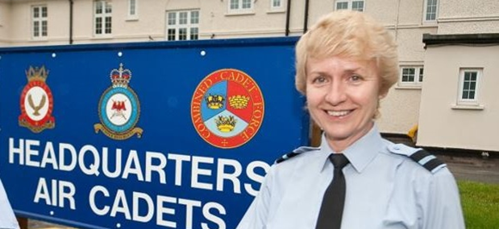
HEADQUARTERS AIR CADETS
Resource Book
Page 21
Based at RAF College Cranwell.
A Large group of full-time staff and some volunteers.
Commanded by an Air Commodore.
What is the name of the current Commandant Air Cadets?
Corps
Region
Wing
Squadron
Detached Flight
Notes:
This is based at RAF College Cranwell. It is run by an Air Commodore and full time members of staff.

Slide 30
ANY QUESTIONS?
Are there any final questions?
?
Notes:
A chance to ask or answer any final questions.

Slide 31
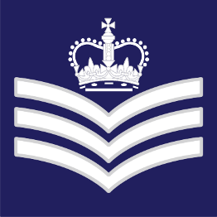
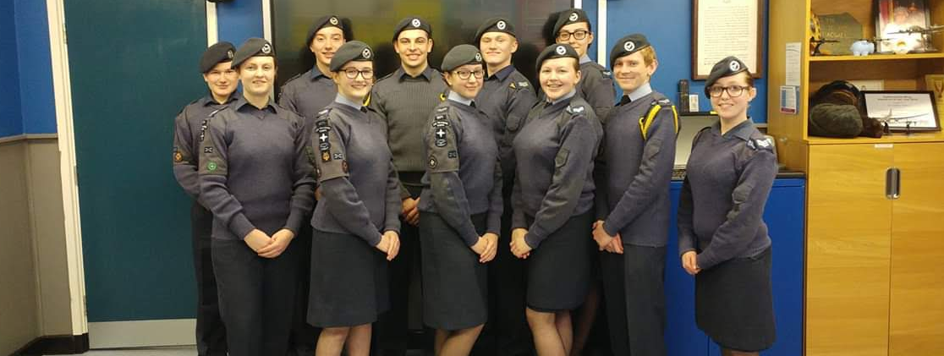
CADET NCO RANKS
Resource Book
Page 14
Cadets under 18 can gain the following ranks and become a cadet Non-commissioned Officer (NCO).
Corporal
(Cpl)
Sergeant
(Sgt)
Flight Sergeant
(FS)
Notes:
Ranks listed are in order of seniority. Corporal is a Junior NCO rank (JNCO). Sergeant and Flight Sergeant is a Senior NCO rank (SNCO). Over 18 cadets wear different rank slides. See the next slide for details. The squadron’s commanding officer promotes cadets to these ranks.

Slide 32
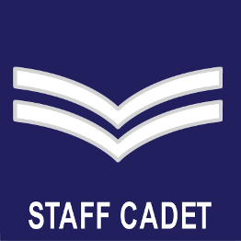
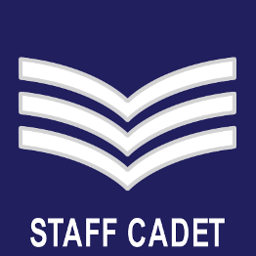
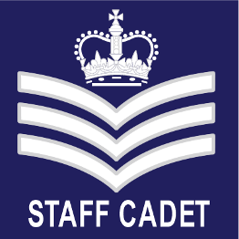
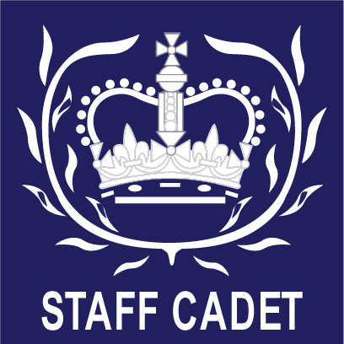
CADET NCO RANKS
Resource Book
Page 14
Cadets over 18 have ‘STAFF CADET’ written under their rank slides.
They can also be promoted to Cadet Warrant Officer (CWO).
CWO’s are promoted by the Wing Commander.
Flight Sergeant
(FS)
Warrant Officer
(CWO)
Corporal
(Cpl)
Sergeant
(Sgt)
Notes:
Cadets over the age of 18 are staff cadets, and this is shown on their rank slide. There is a also a staff cadet rank slide with no rank on it. This is for cadets who have not achieved an NCO rank but are over 18.
CWO’s are promoted by the Wing Commander and prospective candidates for the rank are recommended by their Commanding Officer. A cadet can stay in the Air Cadet Organisation until their 20th birthday.

Slide 33
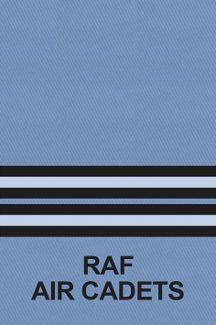
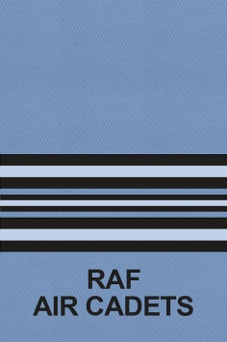
STAFF OFFICER RANKS
Resource Book
Page 15
Officers in the ATC wear the same rank slides as the Royal Air Force, with ‘RAF Air Cadets’ written underneath.
Officers should be saluted and addressed as Sir / Ma’am.
Acting Pilot Officer (APO) | Pilot Officer (Plt Off) | Flying Officer (Fg Off)
Flight Lieutenant (Flt Lt) | Squadron Leader (Sqn Ldr) | Wing Commander (Wg Cdr)
Notes:
Officers commissioned in the Air Training Corps have a cadet forces commission.
They are addressed by their rank or Sir/ Ma’am (as in jam!).
Ranks are listed across in order of seniority. All officers should be saluted.
Officer Cadet to Flight Lieutenant are junior officer posts. Squadron Leader and Wing Commander are senior officer posts.

Slide 34
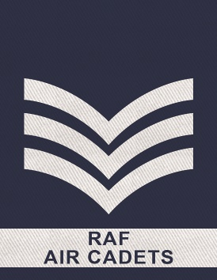
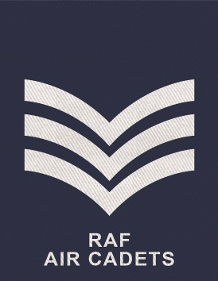
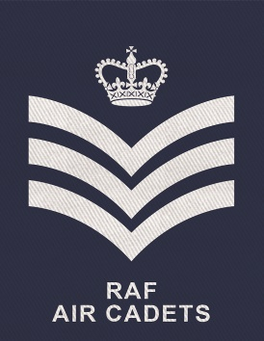
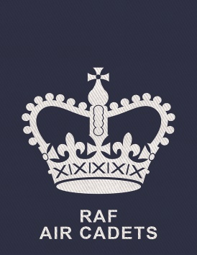
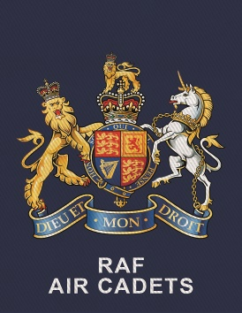
STAFF NCO RANKS
Resource Book
Page 16
Senior NCOs (SNCOs) are not saluted. Sgt and FS addressed by rank. WO addressed Sir/ Ma’am.
SNCOs in the ATC wear ‘RAF Air Cadets’ underneath their rank slide.
Some senior WO’s have a more intricate rank slide.
Acting
Sergeant
(Sgt)
Sergeant
(Sgt)
Flight
Sergeant
(FS)
Warrant Officer
(WO)
Warrant Officer
(WO)
Notes:
All SNCOs should be referred to by their rank except Warrant Officer who should be referred to as Sir or Ma’am. You don’t salute NCOs.
Some senior WO’s have a more intricate rank slide to denote their role or position. Regional Warrant Officers wear this slide. It is often called a ‘Tate and Lyle’ slide.

Slide 35
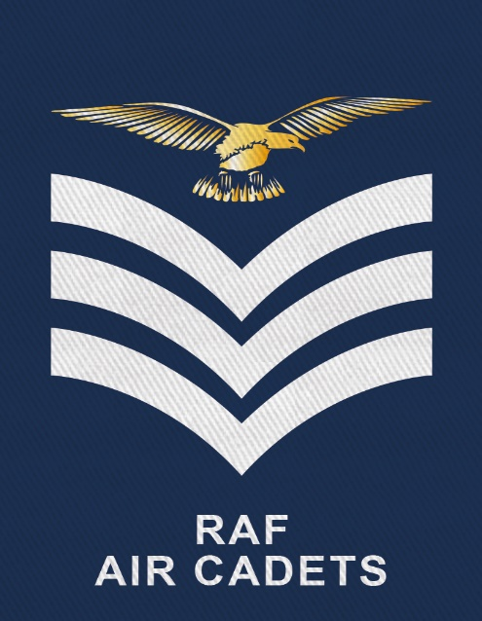
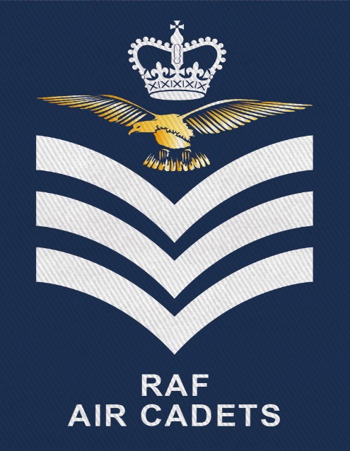
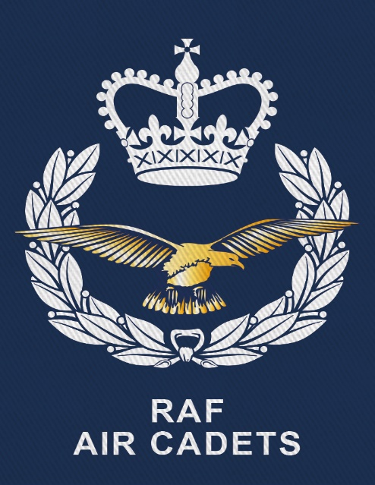
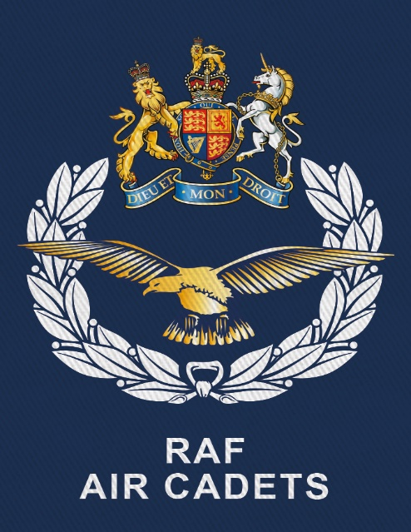
STAFF NCO AIRCREW RANKS
Resource Book
Page 16
SNCOs working with aircraft wear these rank slides.
Otherwise, the ranks are the same as the previous slide.
Sergeant
(Sgt)
Flight
Sergeant
(FS)
Warrant Officer
(WO)
Warrant Officer
(WO)
Notes:
All SNCOs should be referred to by their rank except Warrant Officer who should be referred to as Sir or Ma’am. You don’t salute NCOs.
Some senior WO’s have a more intricate rank slide to denote their role or position. Regional Warrant Officers wear this slide. It is often called a ‘Tate and Lyle’ slide.

Slide 36
ANY QUESTIONS?
Are there any final questions?
?
Notes:
A chance to ask or answer any final questions.

Slide 37
LEARNING OUTCOMES
LO1: Know about the history and organisation of the Air Training Corps.
Recognise cadet badges and ranks, ATC ensigns, ATC adult ranks and RAF ranks.
Notes:
LO1: Know about the history and organisation of the Air Training Corps.
P3: Recognise cadet badges and ranks, ATC ensigns, ATC adult ranks and RAF ranks.

Slide 38
INSTRUCTOR INFORMATION
This presentation is provided free of charge with the 1st class cadet training system with no warranty or support.
Every effort has been made to ensure the information is correct, but the author accepts no responsibility for any errors or omissions.
Official information on Ultilearn or Bader SharePoint should be checked before using these presentations.
These presentations may be distributed to other Air Cadet squadrons free of charge, but do not place them on the internet.
For best results, use with the 1st class resource book and 1st class instructor handbook, available from cadetdirect.com.
Version 19/04

