Slide 1
Notes:
Part 2 of 2. This presentation covers the information required to complete the LO2 The Air Training Corps topic.
For best results, these instructor notes should be read and discussed with the cadets in conjunction with this presentation and the lesson plan.

Slide 2
LEARNING OUTCOMES
LO2: Be able to wear an ATC uniform correctly.
Identify elements of the ATC uniform.
Notes:
LO2: Be able to wear and ATC uniform correctly
P4: Identify elements of the ATC uniform.

Slide 3
DISCIPLINE
Resource Book
Page 5
Air Cadets are the public face of the RAF in large parts of the country.
Must have the highest standards of behaviour and discipline.
Self discipline is vital.
Notes:
Cadets in uniform are seen much more often by the public than regular members of the Royal Air Force. Therefore, it is essential that cadets behave well, wear the uniform exactly in accordance with the regulations, and so uphold the good name of the Corps and the Royal Air Force. At all times the uniform is to be clean, complete and properly pressed.
The Royal Air Force is justly proud of its achievements and tradition. Its members reflect that pride in their behaviour, appearance and dress - and above all, a willingness to obey orders instantly and without question. These qualities are necessary in any civilised community, providing a code of behaviour for all to follow. They are particularly necessary in a military service where efficiency and swift reactions are vital.
In a highly technical service like the Royal Air Force, a high degree of self discipline is required, and it is this which is fostered in the Air Training Corps.
Self discipline is the ability to display responsible and sensible behaviour without supervision or the fear of punishment. The Royal Air Force, the parent Service of the ATC, looks to each cadet to uphold its good name.

Slide 4
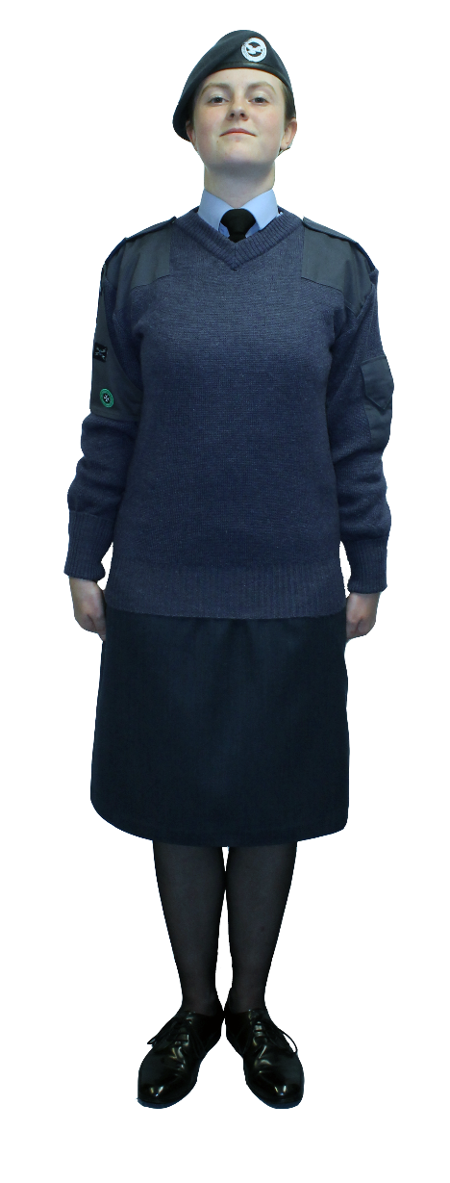
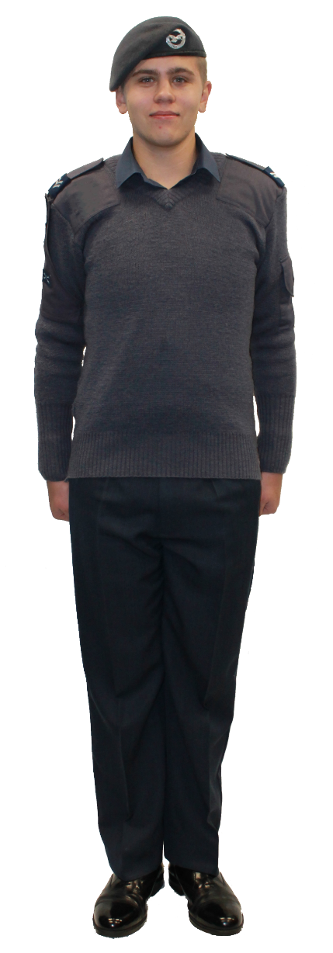
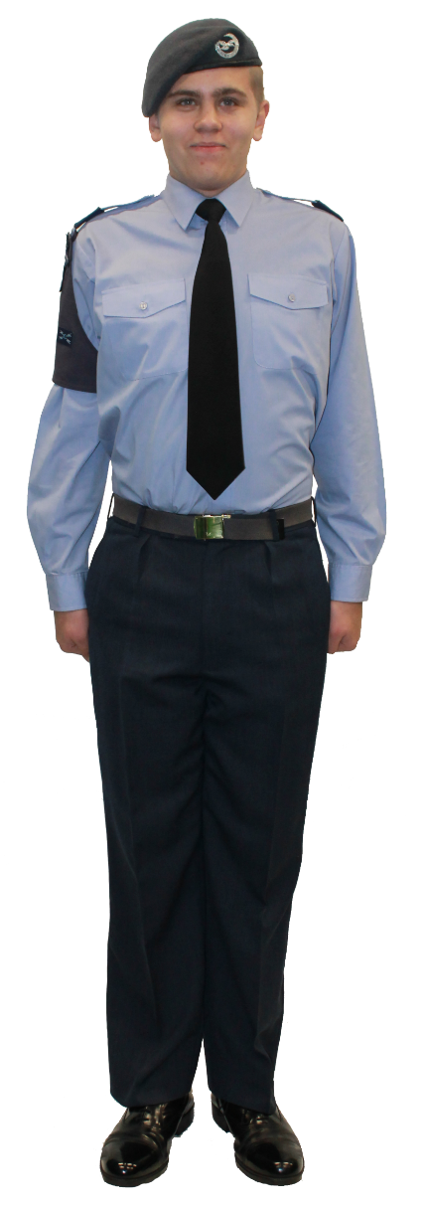
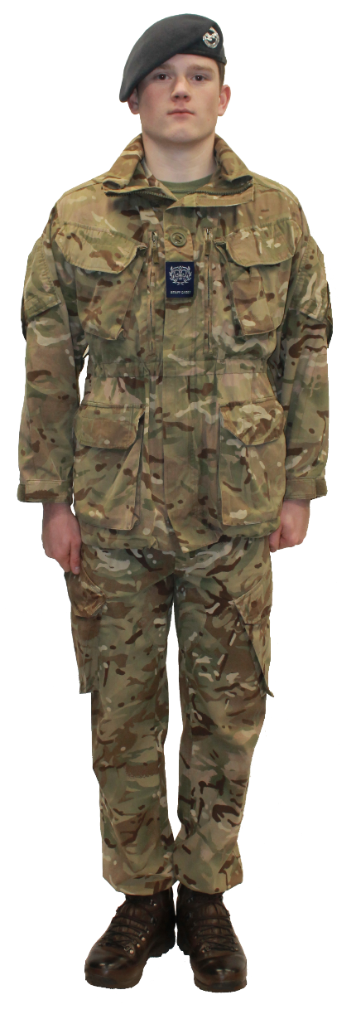
THE AIR CADET UNIFORM
Resource Book
Page 22
3 types of uniform:
Wedgwood Blue Uniform
Working Blue Uniform
MTP/DPM Uniform
Notes:
The ATC uniform is a way of dressing, decided on by those in authority and
approved by HM The Queen. Because it is “uniform” - the same for all - deviations from or additions to, the approved pattern are forbidden. Nor is any ornament, emblem or badge to be worn unless it is officially authorised. Ornamental chains, tie pins and trinkets, if worn, are not to be visible.
Air Cadets normally wear three types of uniform:
Wedgwood blue uniform or ‘light blues’ consists of a Wedgwood blue shirt and black tie. Females normally wear skirts with this uniform. A jumper can be worn.
Working blue uniform or ‘dark blues’ consists of a dark blue shirt. Sleeves can be rolled up in warm weather. Females normally wear skirts with this uniform. A jumper can be worn.
MTP stands for Multi Terrain Pattern and is a newer form of combat clothing. Cadets can wear MTP PCS. DPM stands for Disruptive Pattern Material and is an older combat uniform. Cadets can wear CS95 DPM.
Cadets can wear either MTP or DPM but they cannot mix the two uniform types together. For example, cadets cannot wear MTP shirt and trousers with a DPM jacket over the top.

Slide 5
Resource Book
Page 22
Notes:
Show cadets wearing real examples of the uniforms if possible.

Slide 6
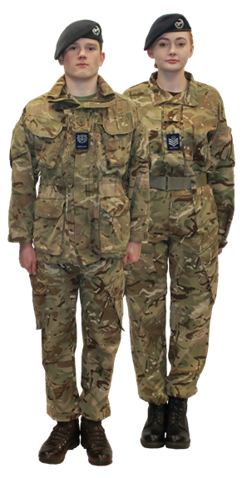
Resource Book
Page 23
Cadets also wear:
Sports kit for physical activities.
Coveralls for messy activities.
Flying suits when flying.
Notes:
Show cadets wearing real examples of the uniforms if possible.

Slide 7
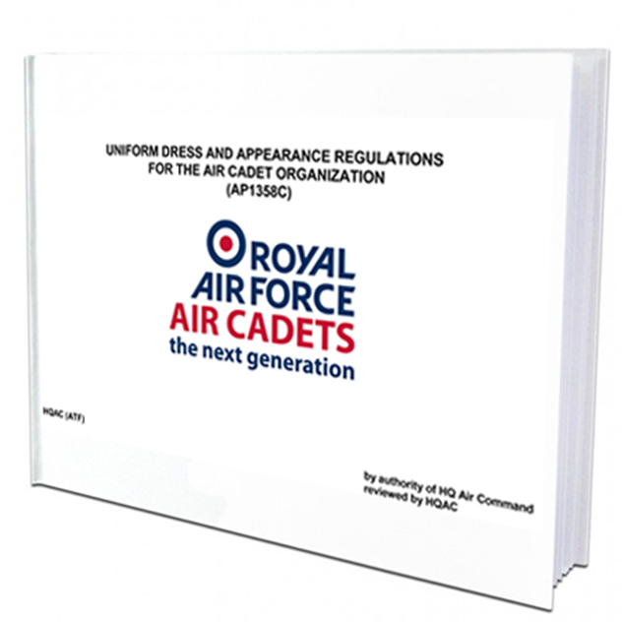
AP1358C
AP1358C is the Air Training Corps uniform regulations.
It instructs personnel how to wear the uniform and explains how it should be looked after.
Ask a member of staff to view a copy.
Notes:
AP1358c is a derivative of the RAFs own uniform regulations, AP1358
The latest version of AP1358c can be viewed on Bader SharePoint. Changes in this document are normally highlighted in red.

Slide 8
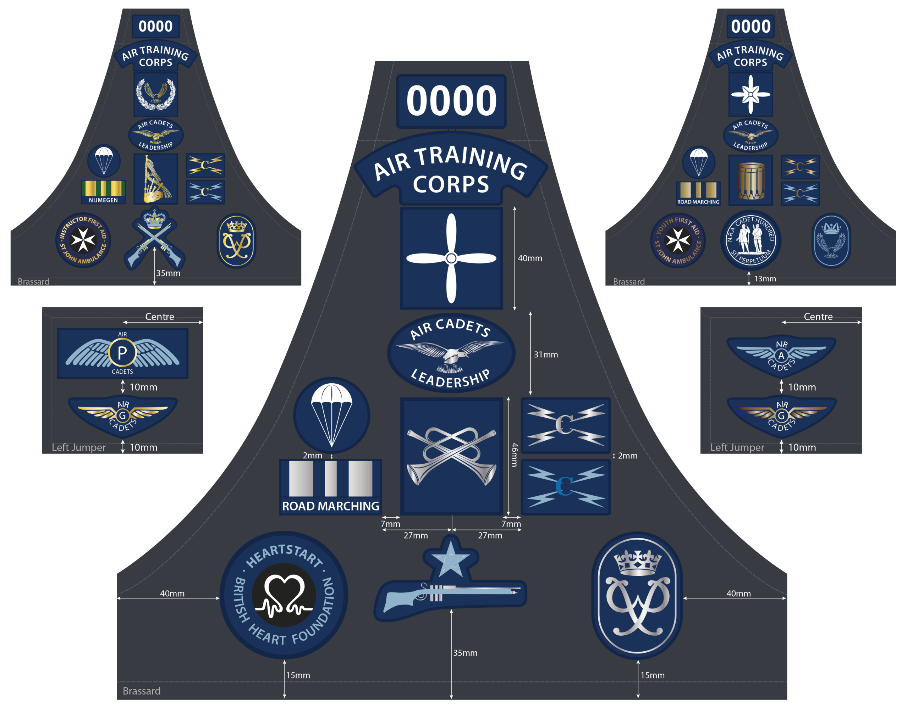
BRASSARD
Cadets wear a brassard on their right arm.
It shows which unit they belong to.
Cadets gain badges for completing activities or passing courses.

Slide 9
CLASSIFICATION BADGES
Classification badges are awarded when you complete sections of the BTEC in Aviation Studies.
When cadets have finished the BTEC they are awarded the Master Cadet badge.
Cadets who pass an instructor course are awarded a yellow lanyard and can instruct younger cadets.
First Class
Cadet
Leading
Cadet
Senior
Cadet
Master
Cadet
Instructor
Cadet
Notes:
Classification badges are awarded when cadets complete sections of the BTEC in Aviation Studies.
They are listed across in order of importance. When cadets have finished the BTEC they are awarded the Master Cadet badge. Cadets must be 16 before they are authorised to wear the master cadet badge.
Cadets who pass the methods of instruction course are awarded a yellow lanyard and then instruct younger cadets.

Slide 10
ANY QUESTIONS?
Are there any final questions?
?
Notes:
A chance to ask or answer any final questions.

Slide 11
LEARNING OUTCOMES
LO2: Be able to wear an ATC uniform correctly.
Identify elements of the ATC uniform.
Notes:
LO2: Be able to wear and ATC uniform correctly
P4: Identify elements of the ATC uniform.

Slide 12
LEARNING OUTCOMES
LO2: Be able to wear an ATC uniform correctly.
Demonstrate how to wear and maintain the uniform.
Notes:
LO2: Be able to wear and ATC uniform correctly
P5: Demonstrate how to wear and maintain the uniform.

Slide 13
CARING FOR YOUR UNIFORM
Resource Book
Page 24
Go to page 24 of your First Class Resource Book to find out how to care for your uniform.
Alternatively, the following website will show how to care for your uniform. You will need internet access to view the content.
Click here to go to the
Interactive Uniform Care Guide
Notes:
The First Class Cadet Resource Book gives advice to cadets on how to look after their uniform.
Cadets can also visit this website: www.training.staffswing.org.uk/uniform
Cadets should be encouraged to use these instructions whilst at home, when they are ironing their uniform. It could also be used on a parade night if you have the resources for cadets to prepare their uniform on the unit.
An alternative could be to get senior cadets to show cadets practically how to look after their uniform.

Slide 14
ANY QUESTIONS?
Are there any final questions?
?
Notes:
A chance to ask or answer any final questions.

Slide 15
LEARNING OUTCOMES
LO2: Be able to wear an ATC uniform correctly.
Demonstrate how to wear and maintain the uniform.
Notes:
LO2: Be able to wear and ATC uniform correctly
P5: Demonstrate how to wear and maintain the uniform.

Slide 16
INSTRUCTOR INFORMATION
This presentation is provided free of charge with the 1st class cadet training system with no warranty or support.
Every effort has been made to ensure the information is correct, but the author accepts no responsibility for any errors or omissions.
Official information on Ultilearn or Bader SharePoint should be checked before using these presentations.
These presentations may be distributed to other Air Cadet squadrons free of charge, but do not place them on the internet.
For best results, use with the 1st class resource book and 1st class instructor handbook, available from cadetdirect.com.
Version 19/04

