Slide 1
Notes:
Part 1 of 4. This presentation covers the information required to complete PASS criteria of the LO1 Principles of Airmanship topic.
For best results, these instructor notes should be read in conjunction with this presentation and the lesson plan.

Slide 2
LEARNING OUTCOMES
LO1: Know the features of an airfield.
Describe types of runway layouts found on airfields.
Notes:
LO1: Know the features of an airfield.
P1: Describe types of runway layouts found on airfields.

Slide 3
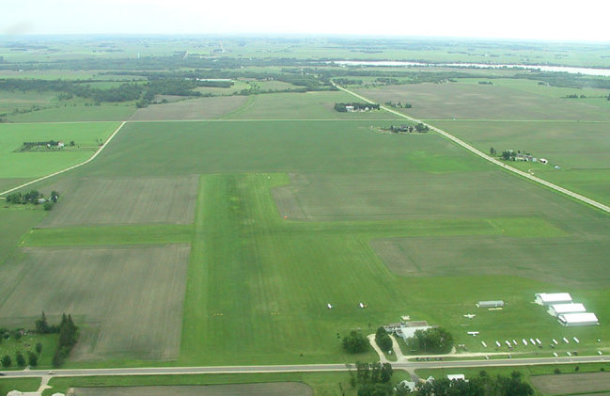
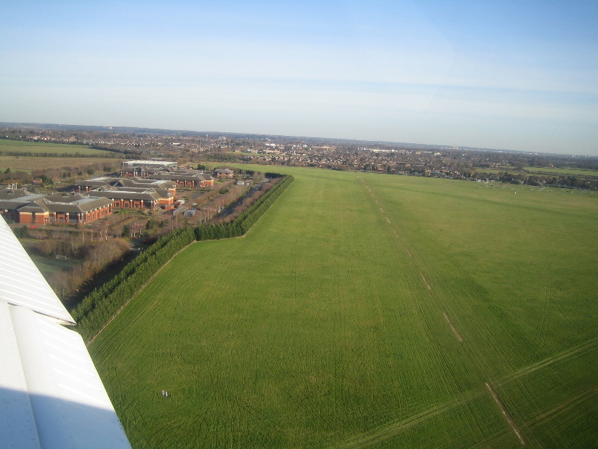
THE GRASS AIRFIELD
Resource Book
Page 54
Normally used for light aircraft like gliders.
What do you think are the pros and cons of an airfield like this?
Pros | Cons
Cheap to build. No designated runway. Aircraft can take of in any direction. | Susceptible to wet weather. Rough terrain = bumpy landings! Would not normally support large aircraft.
Notes:
Before revealing the pros and cons, ask cadets if they can think of any. Click once to reveal pros and cons.
Pros
Cheap to build – don’t need to lay tarmac.
No Designated Runway so aircraft can take of or land in any direction.
Cons
Susceptible to wet weather - Aircraft can bog down in the mud.
Rough Terrain makes for bumpy landings and can cause maintenance issues for both the land and the aircraft using the airfield.
Would not normally support large aircraft because of their weight.

Slide 4
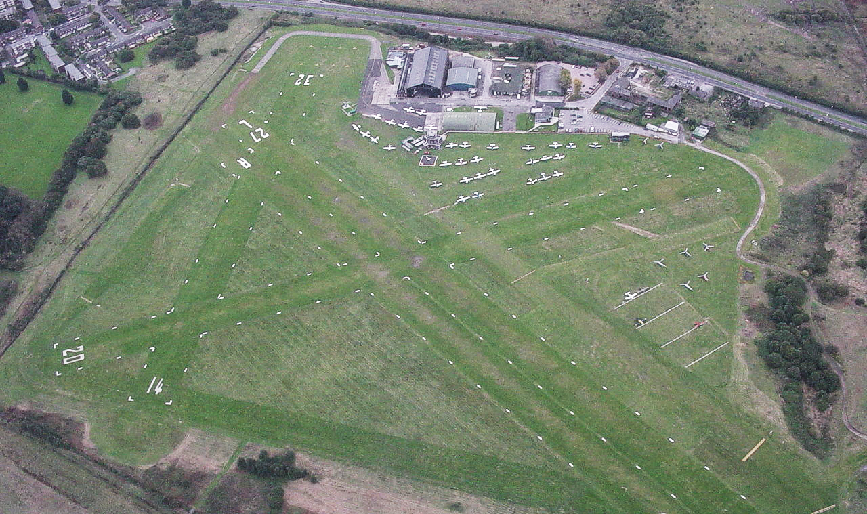
THE GRASS AIRFIELD
Resource Book
Page 54
Barton Aerodrome, Greater Manchester.
Notes:
Early aircraft were very light and used grass airfield with variable take off direction. This made it easier to take off into the wind.
Today grass strips are used for light aircraft operations at civil flying clubs and some Air Experience Flights and Volunteer Gliding Squadrons.

Slide 5
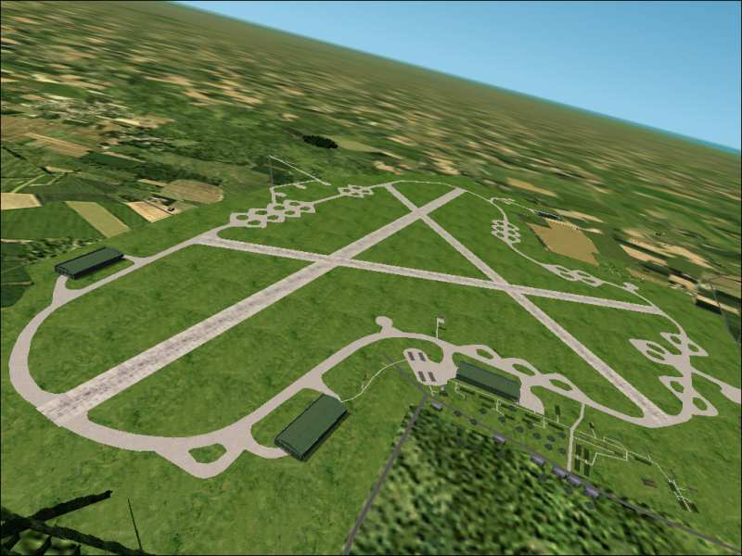
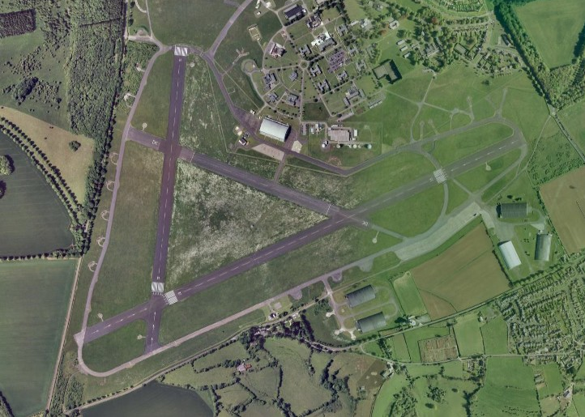
THE TRIANGULAR PATTERN RUNWAY
Resource Book
Page 55
These are for heavier and faster aircraft that need hard runways.
What do you think are the pros and cons of a runway like this?
Pros | Cons
Longer runway – for heavy or large aircraft. Three runway directions. Aircraft easier to control on the ground – designated taxiways. More difficult to attack. | More costly to build. Harder to repair if attacked.
Notes:
Before revealing the pros and cons, ask cadets if they can think of any. Click once to reveal pros and cons.
Pros
Longer runway – for heavy or large aircraft who need a longer runway to take off or land.
Three runway directions, to take off and land closer to the wind direction.
Aircraft easier to control on the ground – designated taxiways are like roads meaning aircraft can only be in certain areas. This makes the airfield safer for other users.
More difficult to attack – if one runway is damaged the others are usually OK.
Cons
More costly to build – lots of concrete or tarmac is needed for the lengths required.
Harder to repair if attacked – tarmac needs to be replaced.

Slide 6
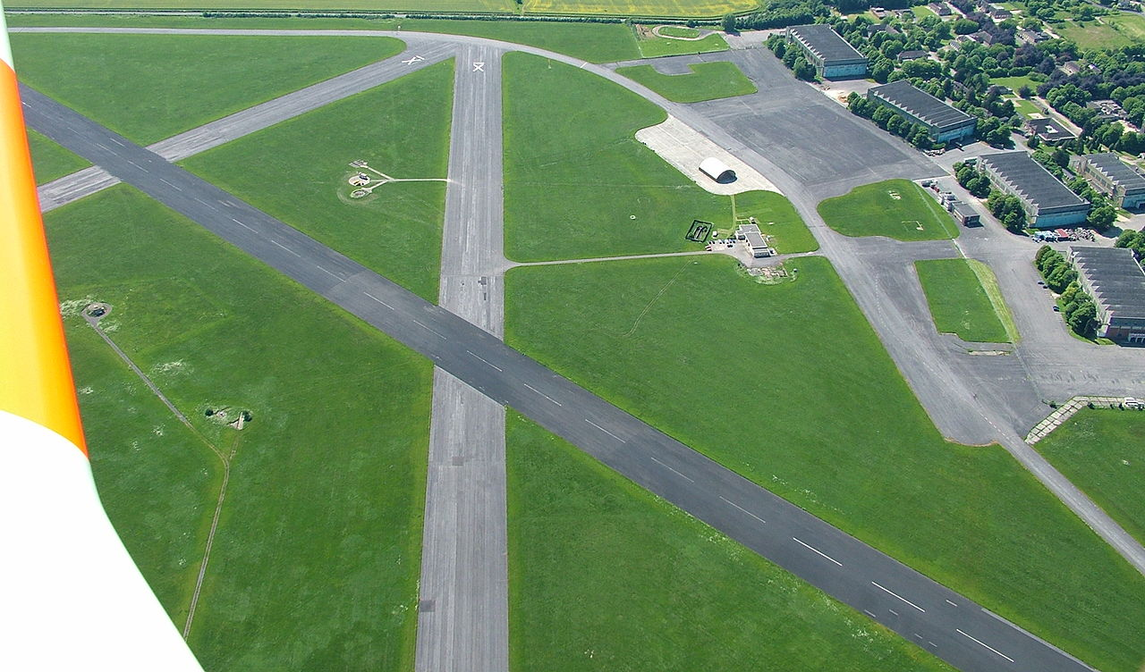
THE TRIANGULAR PATTERN RUNWAY
Resource Book
Page 55
RAF Little Rissington, Gloucestershire
.
Notes:
During the Second World War, 1940s aircraft became heavier and needed hard runways. Heavier aircraft require more lift and thus greater runway length. The triangular pattern was developed to give length required as well as choice of take off/landing direction into wind and to avoid the cross wind issues. The layout of the airfield makes it more difficult to attack and completely disrupt operations.

Slide 7
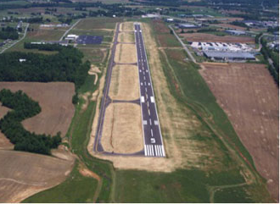
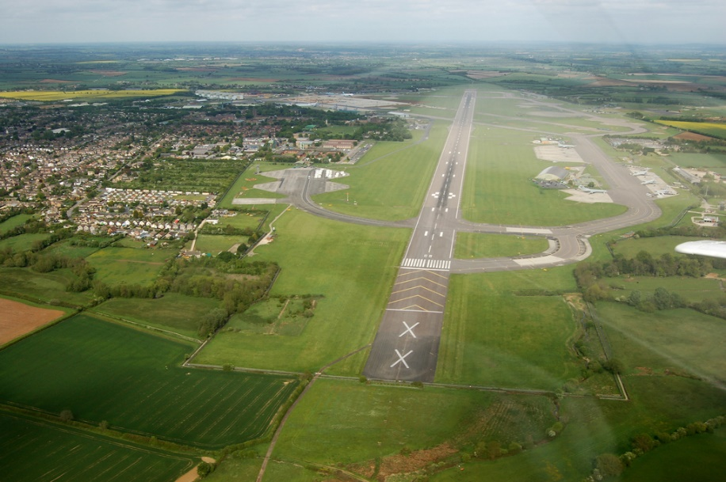
THE MAIN INSTRUMENT RUNWAY
Resource Book
Page 56
These are for very heavy aircraft that require fast take off speeds.
What do you think are the pros and cons of a runway like this?
Pros | Cons
Length suitable for modern high performance aircraft. Has many landing aids. Faster approach speeds mean that cross wind has less effect. | Only for large or high performance aircraft and instrument landing.
Notes:
Before revealing the pros and cons, ask cadets if they can think of any. Click once to reveal pros and cons.
Pros
Length of runway suitable for modern high performance aircraft.
Has many landing aids to aid a successful descent.
Faster approach speeds mean that cross wind has less effect.
Cons
Only for large or high performance aircraft and instrument landing. Smaller aircraft do not need the length of runway or cannot land with instruments.

Slide 8
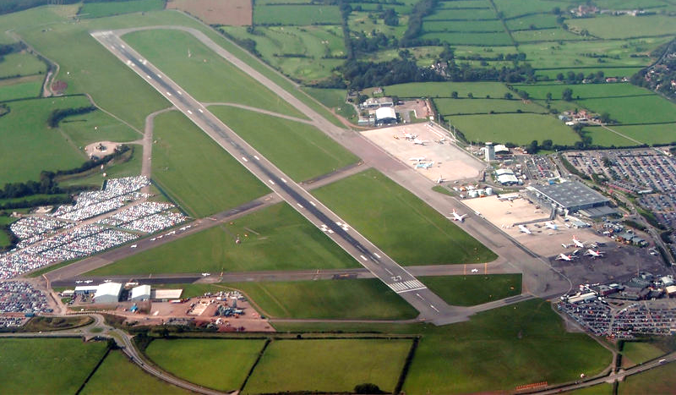
THE MAIN INSTRUMENT RUNWAY
Resource Book
Page 56
Bristol Airport
Attribution: Tomcoll at the English language Wikipedia
Notes:
Over recent years aircraft have become heavier and have faster take off speeds, so one long runway has evolved. This is known as the main instrument runway as it has many landing aids. Additionally, faster approach speeds mean that cross wind has less effect.
Major airports may have multiple runways with often airliners taking off and landing simultaneously (on adjacent different runways).

Slide 9
ANY QUESTIONS?
Are there any final questions?
?
Notes:
A chance to ask or answer any final questions.

Slide 10
LEARNING OUTCOMES
LO1: Know the features of an airfield.
Describe types of runway layouts found on airfields.
Notes:
LO1: Know the features of an airfield.
P1: Describe types of runway layouts found on airfields.

Slide 11
AIRFIELD FEATURES TASK 1
Logbook
Page 8
In your logbook name three types of runway layout and list an advantage and disadvantage for each one.
When this is complete your instructor should check and sign page 8 of your First Class Logbook.
Notes:
This task covers the mandatory requirement for objectives P1 for LO1.
Cadets must name three types of runway layout and list an advantage and disadvantage for each one.
Once satisfied that all cadets have an understanding of the topic, instructors must check and sign:
Page 8 of the cadet’s first class log book.

Slide 12
LEARNING OUTCOMES
LO1: Know the features of an airfield.
Describe the main features of airfields.
Notes:
LO1: Know the features of an airfield.
P1: Describe the main features of airfields.

Slide 13
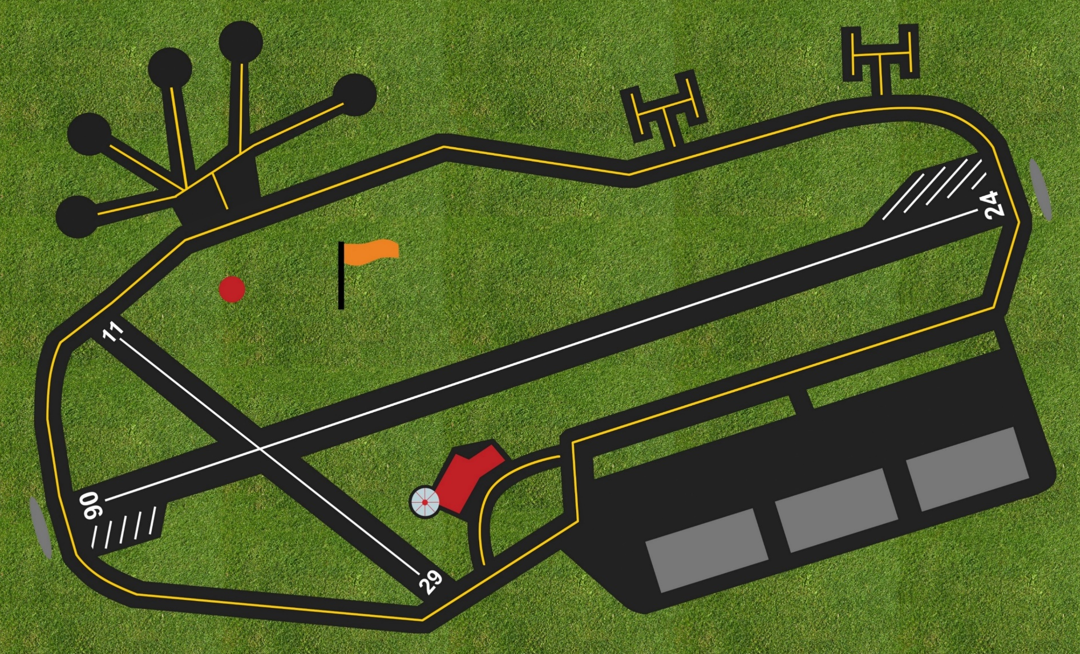
LAYOUT OF AN AIRFIELD
Resource Book
Page 57
1
2
3
17
13
16
14
4
12
15
Click on a number for a more detailed description of each feature.
18
ASG
6
5
8
7
11
10
9
Click here to skip this section

Slide 14
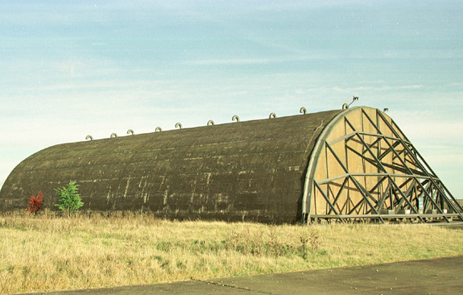
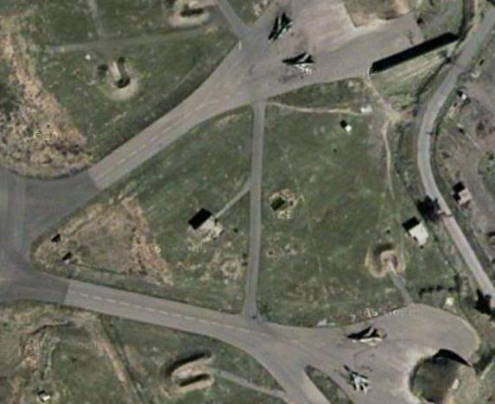
DISPERSAL HARD STANDING
1
Resource Book
Page 58
Used for parking aircraft.
The aim is to spread the aircraft around the airfield, to make it more difficult for enemy aircraft to damage or destroy all the aircraft in one go.
Some airfields may have hardened aircraft shelters, which protect the aircrews and ground crews as well as aircraft.
Click to return to the airfield
Notes:
Many RAF airfields still use widely-dispersed areas, known as “dispersal hard standings” or “dispersals”, for parking aircraft. The aim is to spread the aircraft around the airfield, to make it more difficult for enemy aircraft to damage or destroy all the parked aircraft during an attack. Some airfields may have hardened aircraft shelters (HAS), which protect the aircrews and ground crews as well as aircraft. The walls of a HAS are made of very thick reinforced concrete, and it is capable of “stand alone” operations, with its own air supply and other essential services.

Slide 15
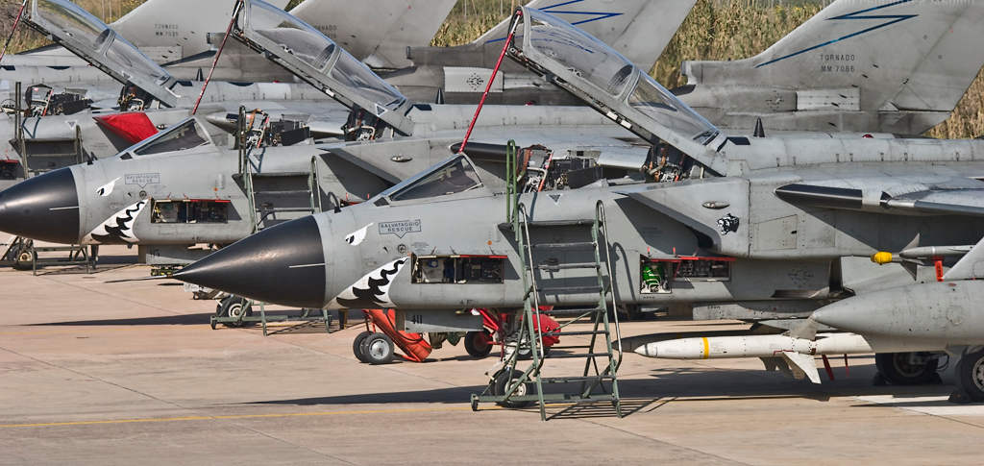
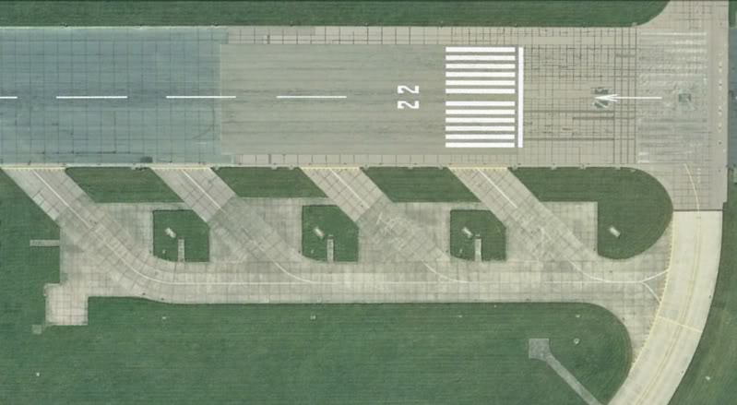
OPERATIONAL READINESS PLATFORM
2
Resource Book
Page 58
Special Areas for fighter of strike aircraft on the end of the runway.
Parking for aircraft to take off rapidly with little warning.
Often has space for essential ground equipment.
Click to return to the airfield
Notes:
ORPs are specially-prepared areas (associated with fighter or strike airfields) built alongside the end of a runway. They are used for parking aircraft, either for rapid take-off with minimal warning (“scramble”) or for final flight preparation. To provide the maximum safe use of the space available, the platforms are usually marked with taxying lines for individual aircraft, with areas set aside for essential ground equipment.

Slide 16
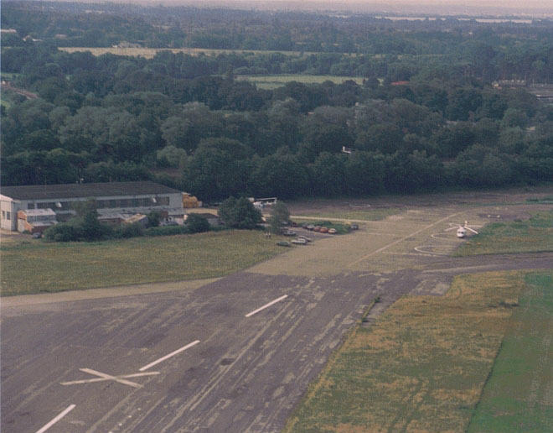
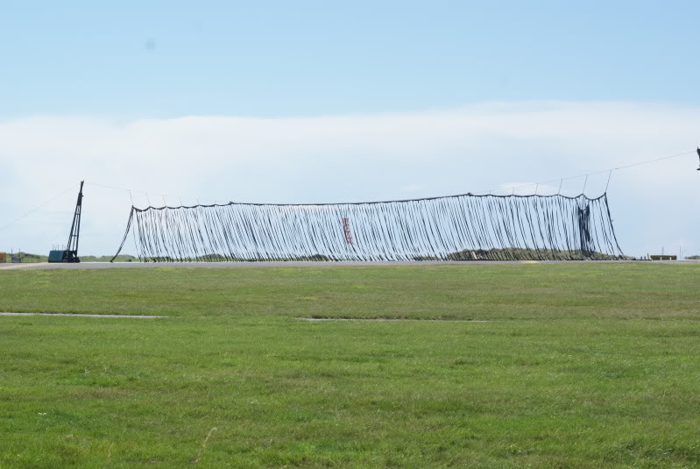
BARRIER
3
Resource Book
Page 58
A large net designed to slow down an aircraft in case of brake failure.
They can be raised and lowered by the airfield controller by remote control.
Click to return to the airfield
Notes:
Where space permits, areas beyond the ends of the runways are provided for accidental or emergency use by aircraft over-running or under-shooting the runway. These “over-run areas” are cleared of obstacles, have a reasonably even surface, and are capable of supporting an over-running aircraft without seriously damaging the undercarriage. Over-run areas can also have barriers consisting of large strong nets made of nylon rope. They can be raised and lowered by the airfield controller by remote control. If a fast jet aircraft experiences a brake failure on landing and overruns, the net will literally “catch” the aircraft, stopping it with minimum risk of damage to the aircraft or injury to the crew.

Slide 17
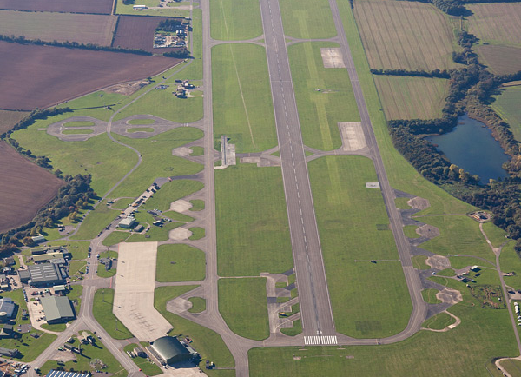
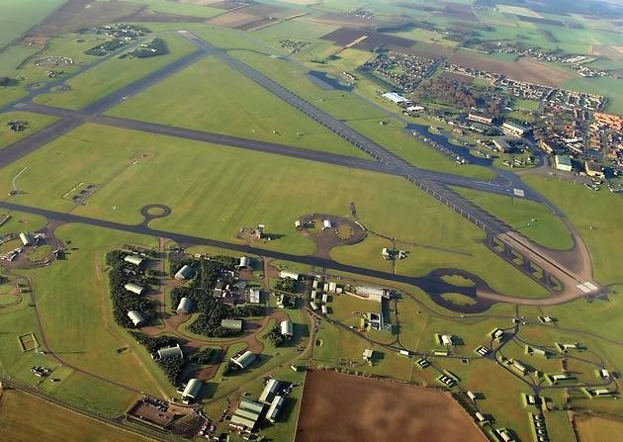
MAIN INSTRUMENT RUNWAY
4
Resource Book
Page 58
An RAF main instrument runway will normally be 45m wide and 1,800m or more long.
Secondary runways are normally the same width, but not necessarily as long.
For transport aircraft, the main runway is normally 60m wide and 2,700m or more long.
Click to return to the airfield
Notes:
At a typical RAF airfield, the main instrument runway will normally be 45m wide and 1,800m or more long, with subsidiary runways of the same width, but not necessarily as long. At airfields where transport aircraft operate, the main runway is normally 60m wide and 2,700m or more long.

Slide 18
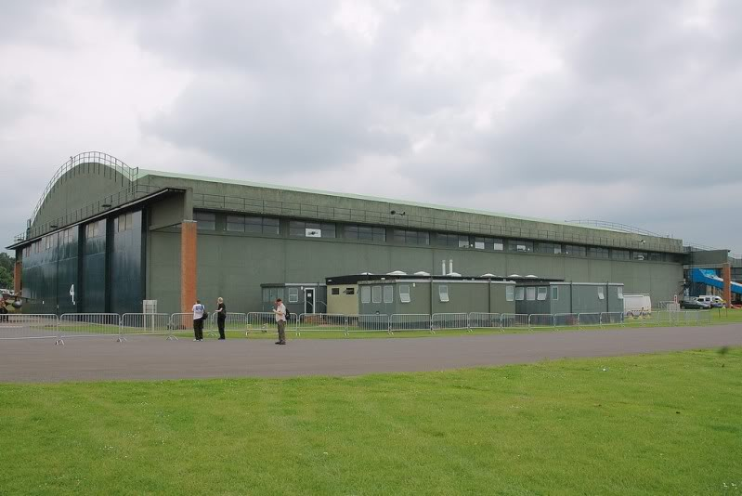
HANGER
5
Resource Book
Page 58
Where aircraft and associated equipment is stored.
Protect aircraft from the weather and direct sunlight.
Used for maintenance and repair of aircraft.
Click to return to the airfield
Notes:
A hangar is a closed building structure to hold aircraft in protective storage. Most hangars are built of metal, but other materials such as wood and concrete are also used. Hangars are used for protection from the weather, protection from direct sunlight, maintenance, repair, manufacture, assembly and storage of aircraft on airfields.

Slide 19
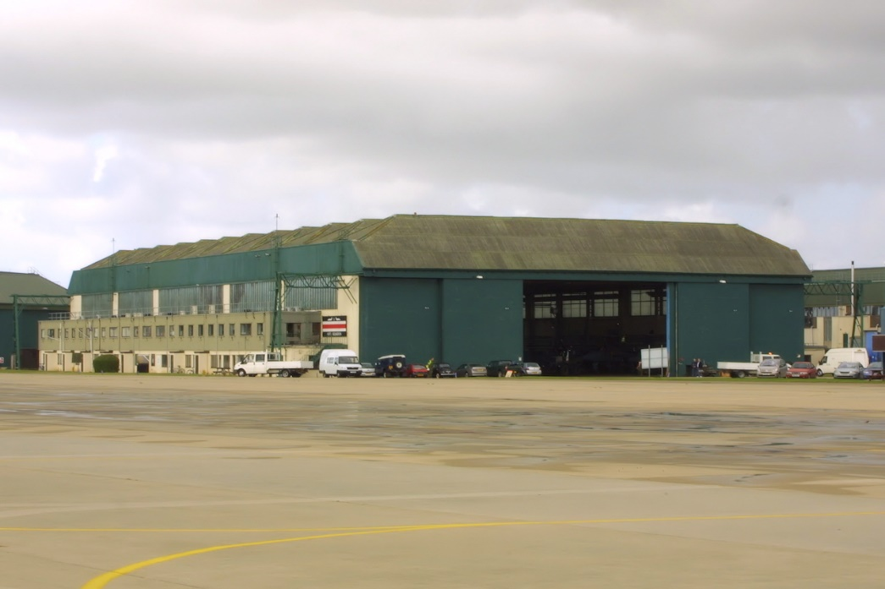
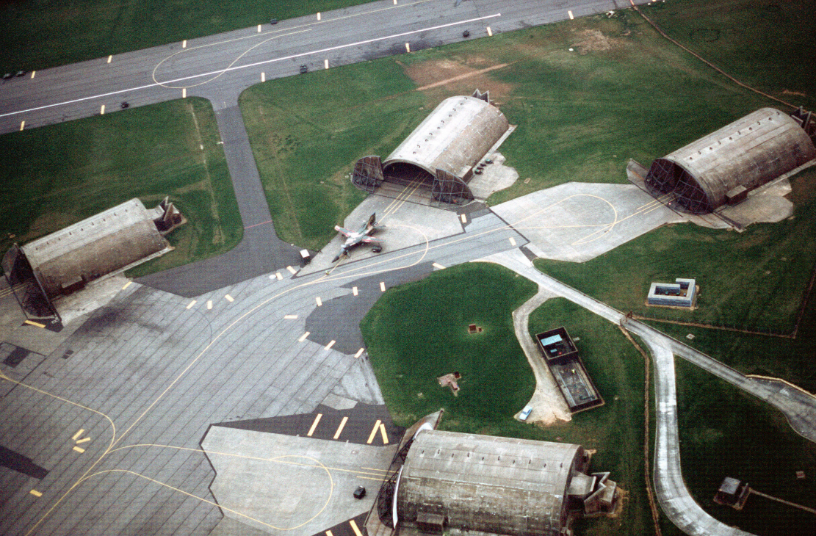
AIRCRAFT SERVICING PLATFORM
6
Resource Book
Page 58
Large paved areas for the servicing and turn-round of aircraft.
Help handle passengers and freight quickly.
Click to return to the airfield
Notes:
Aircraft Servicing Platforms are large paved areas for the servicing and turn-round of aircraft. They also facilitate the speedy handling of passengers and freight. They are usually rectangular, with wide access tracks, and are normally close to hangars or airport terminal buildings.

Slide 20
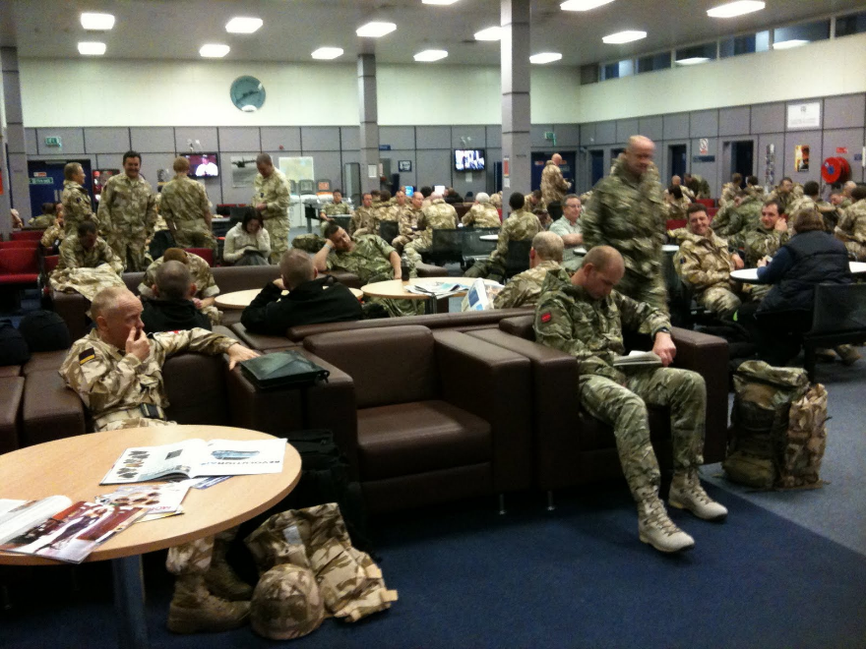
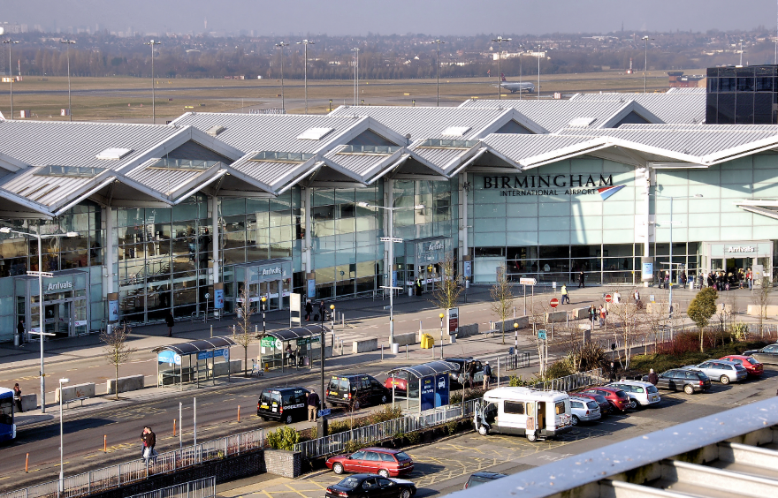
TERMINAL BUILDING
7
Resource Book
Page 58
A building for personnel or passengers allowing them to board or leave an aircraft.
Tickets, luggage and security are all dealt with in the terminal building.
Click to return to the airfield
Notes:
An airport terminal is a building at an airport where passengers transfer between ground transportation and the facilities that allow them to board and disembark from aircraft. Within the terminal, passengers purchase tickets, transfer their luggage, and go through security.

Slide 21
HANGER
8
Resource Book
Page 59
Where aircraft and associated equipment is stored.
Protect aircraft from the weather and direct sunlight.
Used for maintenance and repair of aircraft.
Click to return to the airfield
Notes:
A hangar is a closed building structure to hold aircraft in protective storage. Most hangars are built of metal, but other materials such as wood and concrete are also used. Hangars are used for protection from the weather, protection from direct sunlight, maintenance, repair, manufacture, assembly and storage of aircraft on airfields.

Slide 22
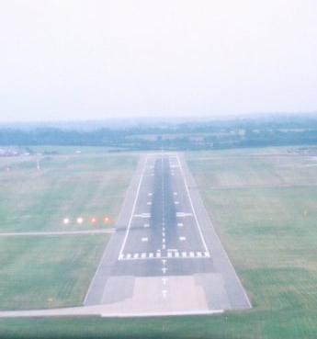
STERILE AREA
9
Resource Book
Page 59
An area on the runway that shouldn’t be used if there is an obstruction before the start of the runway, like a railway line.
This prevents accidents by moving the start of the runway further forward.
Click to return to the airfield
Notes:
If there is an obstruction near the beginning (threshold) of a runway which cannot be moved, such as a railway line, a new threshold is designated further down the runway which allows a new glidepath to give adequate clearance from the obstruction.
The area between the normal threshold and the displaced threshold is known as a sterile area and is marked with large white inverted ‘V’s.

Slide 23
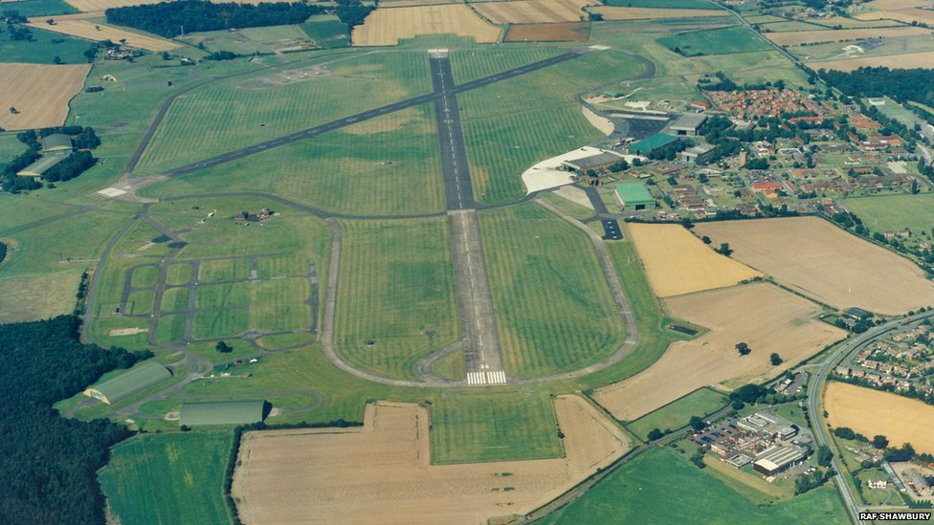
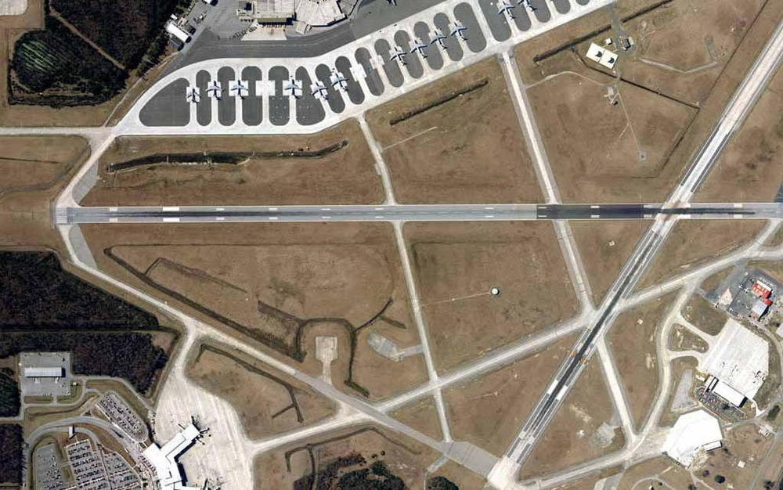
SECOND RUNWAY
10
Resource Book
Page 59
Usually shorter than the primary runway.
Used if the main runway is out of service or because of wind direction.
Click to return to the airfield

Slide 24
BARRIER
11
Resource Book
Page 59
A large net designed to slow down an aircraft in case of brake failure.
They can be raised and lowered by the airfield controller by remote control.
Click to return to the airfield
Notes:
Where space permits, areas beyond the ends of the runways are provided for accidental or emergency use by aircraft over-running or under-shooting the runway. These “over-run areas” are cleared of obstacles, have a reasonably even surface, and are capable of supporting an over-running aircraft without seriously damaging the undercarriage. Over-run areas can also have barriers consisting of large strong nets made of nylon rope. They can be raised and lowered by the airfield controller by remote control. If a fast jet aircraft experiences a brake failure on landing and overruns, the net will literally “catch” the aircraft, stopping it with minimum risk of damage to the aircraft or injury to the crew.

Slide 25
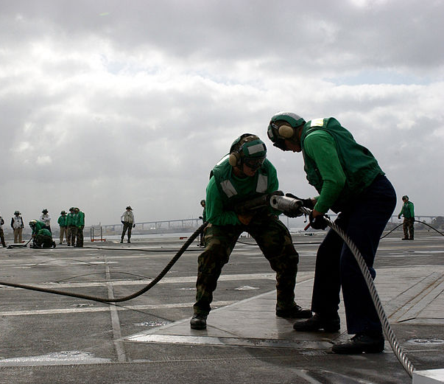
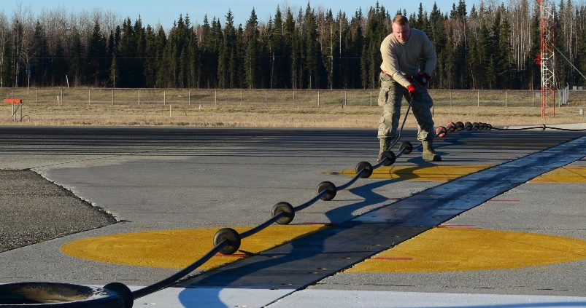
ARRESTER GEAR
12
Resource Book
Page 59
Military airfields sometimes use this to stop aircraft quickly.
Aircraft hook onto a cable suspended across the runway, releasing a cable slowly to stop the aircraft.
Click to return to the airfield
Notes:
Some runways are equipped with “arrester gear”, which can bring an aircraft to a stop in a very short distance.
To use this system aircraft must be equipped with a strong hook which is lowered for landing, to engage a cable suspended across the runway.
When the hook engages the cable, the cable is played out, cable braking occurs to bring the aircraft swiftly to rest. The cable can be braked in a variety of ways: the system in use in the Royal Air Force is the Rotary Hydraulic Arrester Gear (RHAG), which relies on large paddles rotating in liquid for its braking effect.

Slide 26
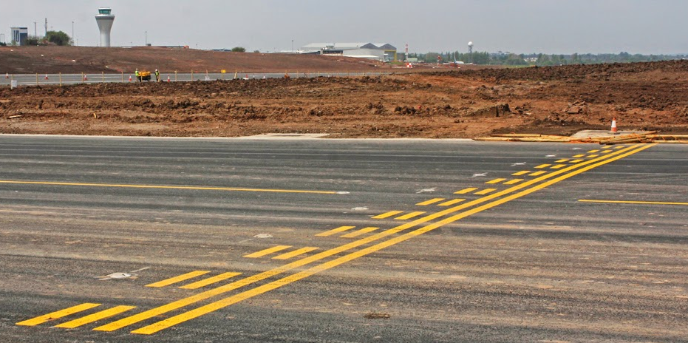
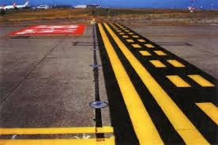
HOLDING POINTS
13
Resource Book
Page 59
A line on the taxiway either side of the runway.
Aircraft cannot pass without permission from Air Traffic Control.
Click to return to the airfield
Notes:
A line across the taxiway, either side of the runway threshold, which aircraft are not allowed to cross without Air Traffic Control permission.

Slide 27
AERODROME ID BEACON
14
Resource Book
Page 59
Was used at night.
Flashed the airfield identification letters in Morse code using a high-intensity red light.
Not now normally used, due to improvements in aircraft navigation.
Click to return to the airfield
Notes:
Airfield Identification Beacon. The airfield identification beacon is in an open space on the airfield and it flashes the airfield identification letters in Morse code using a high-intensity red light for military airfields. Not now normally used, due to improvements in aircraft navigation, making it easier for the pilot to see where he is.

Slide 28
AERODROME IDENTIFICATION
15
Resource Book
Page 60
This is a 2 or 3 letter identifier for the airfield which is marked on the ground in large letters. Each airfield has it’s own identifier.
Not now normally used, due to improvements in aircraft navigation.
Click to return to the airfield
Notes:
This is a 2 or 3 letter identifier for the airfield which is marked on the ground in large letters. Each airfield has it’s own identifier.

Slide 29
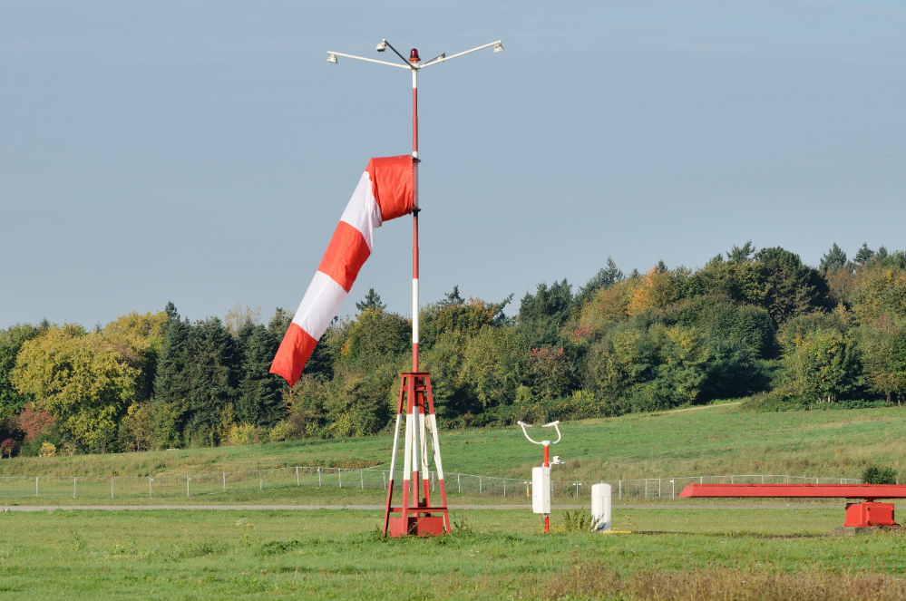
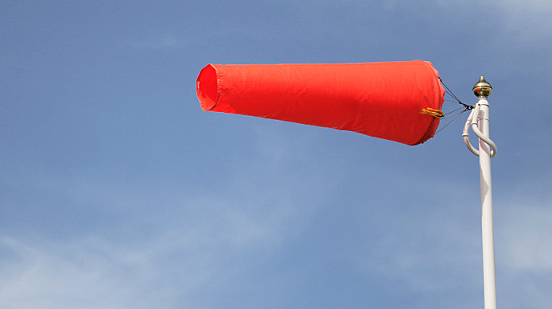
WINDSOCK
16
Resource Book
Page 60
Allows pilots to see what direction and strength of the wind.
When horizontal, wind is 25 knots or greater.
Click to return to the airfield
Notes:
A visual aid to pilots to allow them to see what direction the wind is coming
from and to give an idea of the strength of the wind.
When the wind has blown them horizontal, most windsocks indicate that the
wind is 25 knots or greater.

Slide 30
ARRESTER GEAR
17
Resource Book
Page 60
Military airfields sometimes use this to stop aircraft quickly.
Aircraft hook onto a cable suspended across the runway, releasing a cable slowly to stop the aircraft.
Click to return to the airfield
Notes:
Some runways are equipped with “arrester gear”, which can bring an aircraft to a stop in a very short distance.
To use this system aircraft must be equipped with a strong hook which is lowered for landing, to engage a cable suspended across the runway.
When the hook engages the cable, the cable is played out, cable braking occurs to bring the aircraft swiftly to rest. The cable can be braked in a variety of ways: the system in use in the Royal Air Force is the Rotary Hydraulic Arrester Gear (RHAG), which relies on large paddles rotating in liquid for its braking effect.

Slide 31
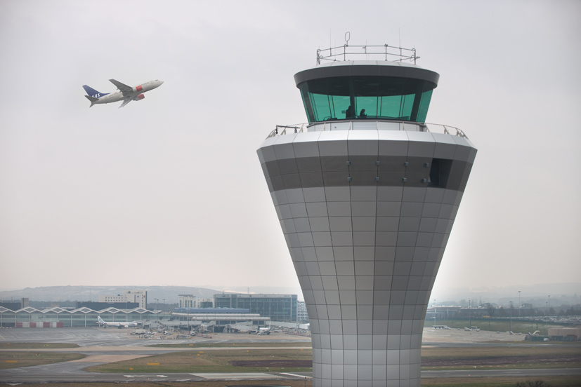
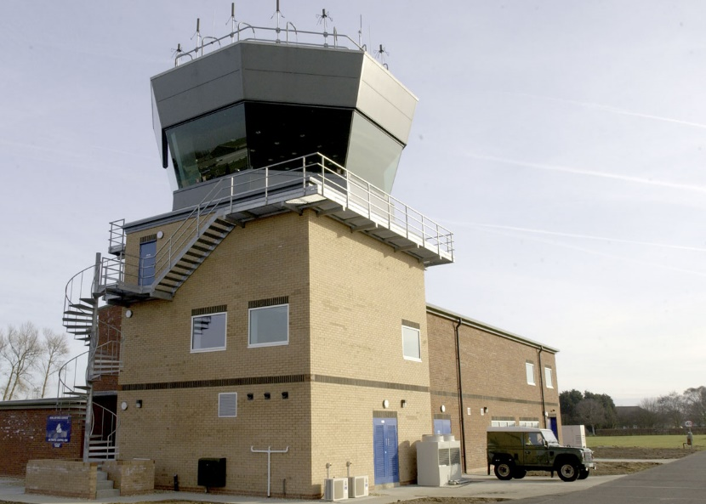
CONTROL TOWER
18
Resource Book
Page 60
This building is centrally located on the airfield with good visibility of the whole airfield and the airspace around.
The Control Tower houses various controllers who control all aircraft, vehicular and pedestrian traffic.
It also houses the communications and radar equipment used by the airfield.
Click to return to the airfield
Notes:
This building is centrally located on the airfield with good visibility of the whole airfield and the airspace around.
The Control Tower houses various controllers who control all aircraft, vehicular and pedestrian traffic.
It also houses the communications and radar equipment used by the airfield.

Slide 32
ANY QUESTIONS?
Are there any final questions?
?
Click to return to the airfield
Notes:
A chance to ask or answer any final questions.

Slide 33
LEARNING OUTCOMES
LO1: Know the features of an airfield.
Describe the main features of airfields.
Notes:
LO1: Know the features of an airfield.
P1: Describe the main features of airfields.

Slide 34
AIRFIELD FEATURES TASK 2
Logbook
Page 9
List the features of a typical military airfield.
Use your First Class Resource Book to help you.
When this is complete your instructor should check and sign page 9 of your First Class Logbook.
Notes:
This task covers the mandatory requirement for objectives P2 for LO1.
Cadets must identify airfield features. They can use their First Class Resource Book to help them.
Once satisfied that all cadets have an understanding of the topic, instructors must check and sign:
Page 9 of the cadet’s first class log book.

Slide 35
INSTRUCTOR INFORMATION
This presentation is provided free of charge with the 1st class cadet training system with no warranty or support.
Every effort has been made to ensure the information is correct, but the author accepts no responsibility for any errors or omissions.
Official information on Ultilearn or Bader SharePoint should be checked before using these presentations.
These presentations may be distributed to other Air Cadet squadrons free of charge, but do not place them on the internet.
For best results, use with the 1st class resource book and 1st class instructor handbook, available from cadetdirect.com.
Version 19/04

