Slide 1
Notes:
Part 3 of 4. This presentation covers the information required to complete PASS criteria of the LO3 Principles of Airmanship topic.
For best results, these instructor notes should be read in conjunction with this presentation and the session plan.

Slide 2
LEARNING OUTCOMES
LO3: Know the features and types of aircraft used for air experience flights and gliding.
Describe key features of Tutor and Viking aircraft.
Notes:
LO3: Know the features and types of aircraft used for Air Cadet flying and gliding
P6: Describe key features of Tutor, Vigilant and Viking aircraft.

Slide 3
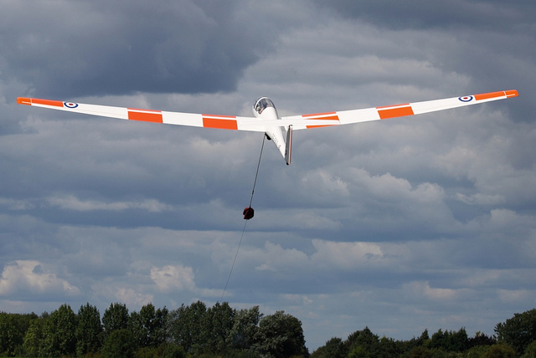
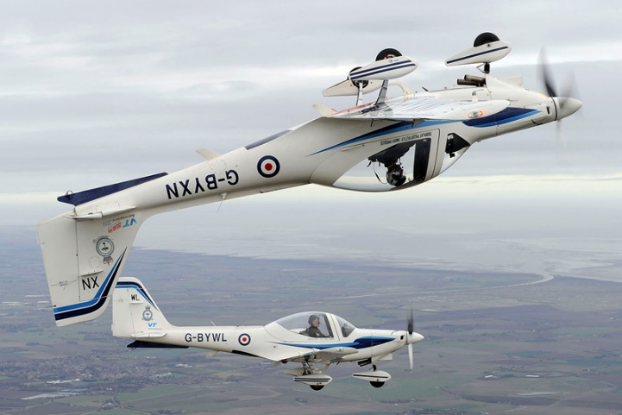
WHAT DO WE FLY?
Resource Book
Page 63-64
Grob 115e:
The ‘Tutor’ light aircraft.
Grob G103A Twin II Acro:
The ‘Viking’ glider.
Notes:
The Grob 115e is a light aircraft and was given the name ‘Tutor’ by the RAF.
The Grob G103A Twin II Acro is a winch launched glider and was given the name ‘Viking’ by the RAF.

Slide 4
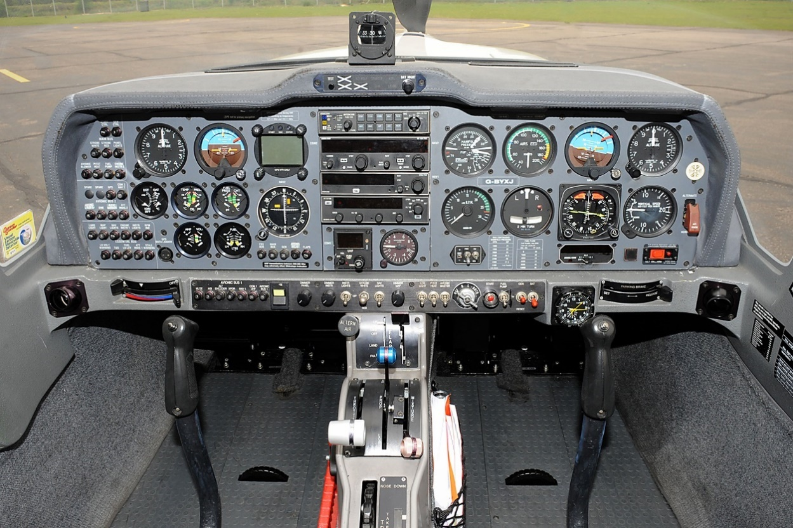
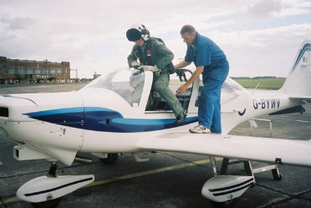
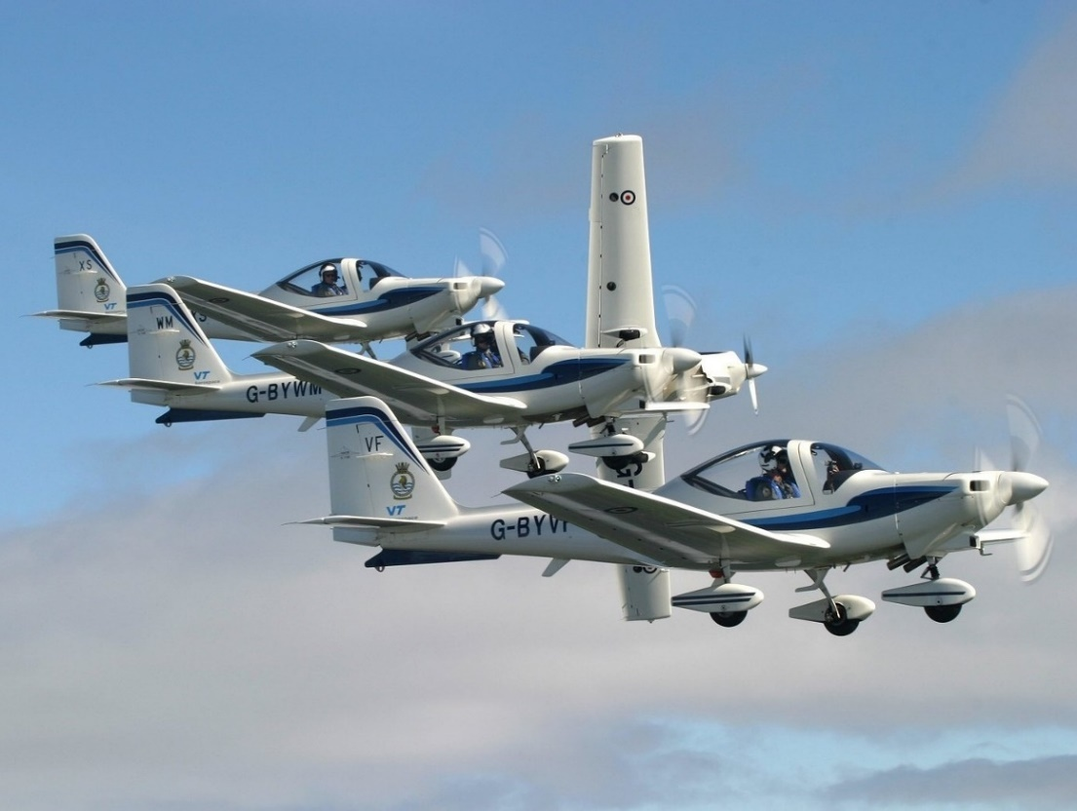
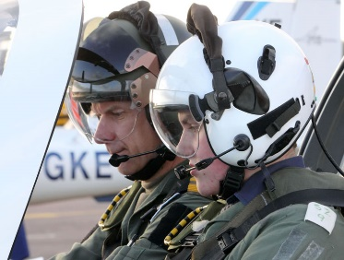
THE TUTOR
Resource Book
Page 63
Grob 115e light aircraft.
Air Experience Flying with the Air Cadets.
Also used by University Air Squadrons for basic flying training and the RAF for elementary flying training.
Notes:
The Grob Tutor is used for Air Experience Flying with the Air Cadets at various locations all over the country. These locations are called Air Experience Flights (AEF).
It is also used for basic flying training at University Air Squadron’s (UAS) . Sometimes UAS’ share Aircraft with AEF’s
The RAF use Tutors for their elementary flying training for new pilots, but the aircraft is being phased out for this type of training.

Slide 5
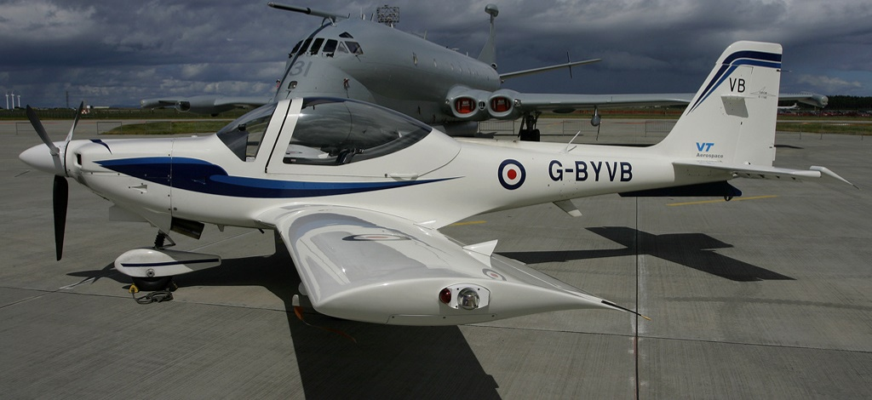
THE TUTOR
Resource Book
Page 63
All round vision. Dual controls. | Three bladed propeller. Fixed undercarriage.
Pilot and passenger sit side by side.
Key Statistics
Crew: Length: Wingspan: Height: Wing area: Make take off weight: Empty weight: | 2 7.59m 10m 2.8m 12.2m² 990kg 690kg
Tutor G-BYVB at RAF Kinloss
© Mark McEwan, used with permission
Notes:
The Tutor cockpit has very good all-round visibility.
It has dual controls so both pilot and passenger can have a go at flying the aircraft and pilot and passenger sit side by side. The pilot sits on the right of the aircraft.
It has a three bladed propeller that can be pitch controlled and it has a fixed undercarriage which cannot be retracted.

Slide 6
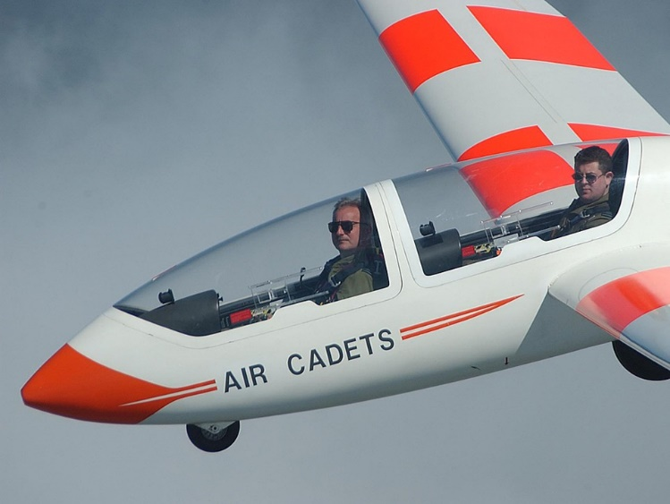
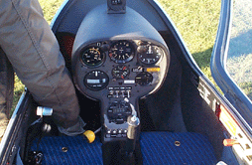
THE VIKING
Resource Book
Page 64
Grob G103A Twin II Acro glider.
Gliding training with the Air Cadet Organisation.
Based nationwide at Volunteer Gliding Squadrons and the Central Gliding School, RAF Syerston.
Notes:
The Grob Viking is used for basic flying training with the Air Cadets. They are based throughout the county at Volunteer Gliding Squadrons (VGS). You will also find them at Central Gliding School at RAF Syerston.
Syerston is the only location where the Viking is ‘Aero Towed’ by an aircraft into the air. Vikings at VGS’s are winch launched by a specially designed winch vehicle.

Slide 7
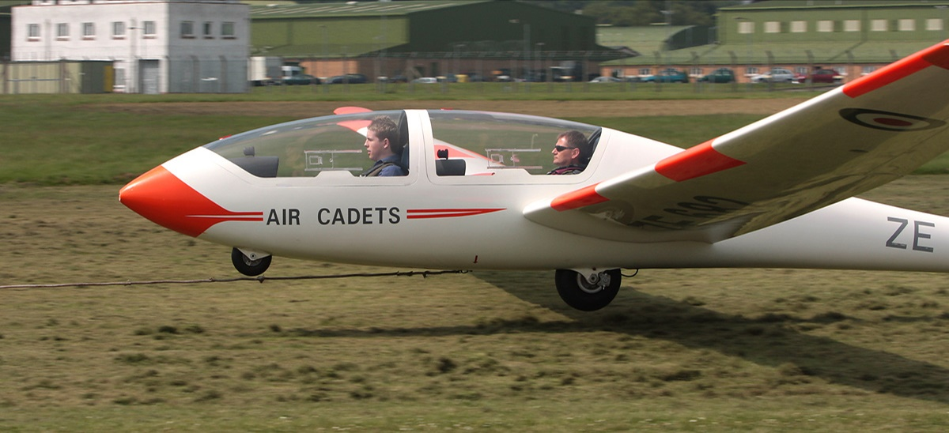
THE VIKING
Resource Book
Page 64
Dual controls. Pilot sits behind passenger. | Not powered. Normally winch launched but can be Aero towed
Made of glass reinforced plastic.
Key Statistics
Crew: Length: Wingspan: Height: Wing area: Make take off weight: Empty weight: | 2 8.18m 17.5m 1.55m 17.8m² 580kg 395kg
Viking ZE682-YS at RM Condor
© Mark McEwan, used with permission
Notes:
The Viking has dual controls so both pilot and passenger can have a go at flying the aircraft. The pilot sits behind the passenger in this aircraft.
It’s not powered, so has to be launched by a winch. At RAF Syerston, it is towed into the air by another aircraft.

Slide 8
ANY QUESTIONS?
Are there any final questions?
?
Notes:
A chance to ask or answer any final questions.

Slide 9
LEARNING OUTCOMES
LO3: Know the features and types of aircraft used for air experience flights and gliding.
Describe key features of Tutor and Viking aircraft.
Notes:
LO3: Know the features and types of aircraft used for Air Cadet flying and gliding
P6: Describe key features of Tutor, Vigilant and Viking aircraft.

Slide 10
AIR CADET AIRCRAFT TASK
Logbook
Page 14
Name the two aircraft the Air Cadets use.
Describe what each aircraft is used for and identify some of their features.
When this is complete your instructor should check and sign page 14 of your First Class Logbook.
Notes:
This task covers the mandatory requirement for objectives P6 for LO3.
Cadets must label the Tutor and Viking aircraft, identify their use and describe their key features.
Once satisfied that all cadets have an understanding of the topic, instructors must check and sign:
Page 14 of the cadet’s first class log book.

Slide 11
GROUP DISCUSSION
Logbook
Page 14
What are the key features of the aircraft used by the Air Cadet Organisation?
When this is complete your instructor should sign page 14 of your First Class Logbook and fill in the P6 Activity 2 Airmanship log sheet.
Notes:
This task covers the mandatory requirement for objectives P6 for LO3.
Instructors should ask questions about each aircraft type in a group type discussion, based on the information provided in the slides and the First Class Resource book.
Once satisfied that all cadets have an understanding of the topic, instructors must fill in:
Page 14 of the cadet’s first class log book.
Task P6 Activity 2 Airmanship log sheet. This can be found on Ultilearn.

Slide 12
LEARNING OUTCOMES
LO3: Know the features and types of aircraft used for air experience flights and gliding.
Identify important aircraft control surfaces used in flight.
Notes:
LO3: Know the features and types of aircraft used for Air Cadet flying and gliding
P7: Identify important aircraft control surfaces used in flight.

Slide 13
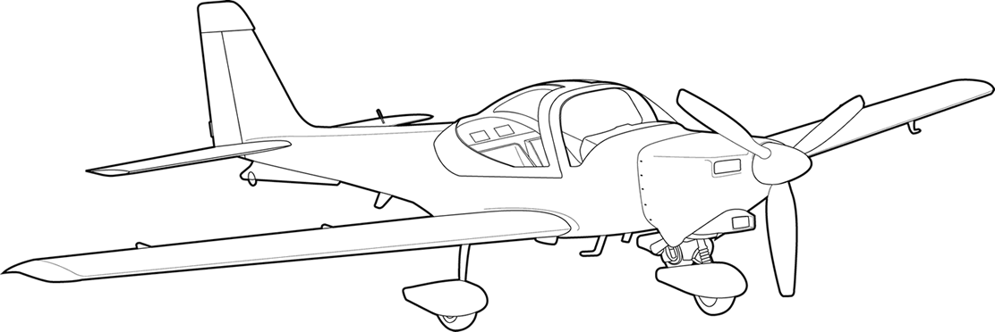
AIRCRAFT MOVEMENTS
Resource Book
Page 65
Roll
Pitch
Yaw
Notes:
Approximate movements of an aircraft. Demonstrate with a model aircraft if possible.
PITCH is the movement of the aircraft relative to the horizon and can be seen as simply the aircraft gaining or losing height. It’s nose pitches up or down.
ROLL is where the aircraft banks to the left or right. To roll the aircraft, one wing will be higher than the other as one wing produces more lift.
YAW moves the nose of the aircraft from side to side.

Slide 14
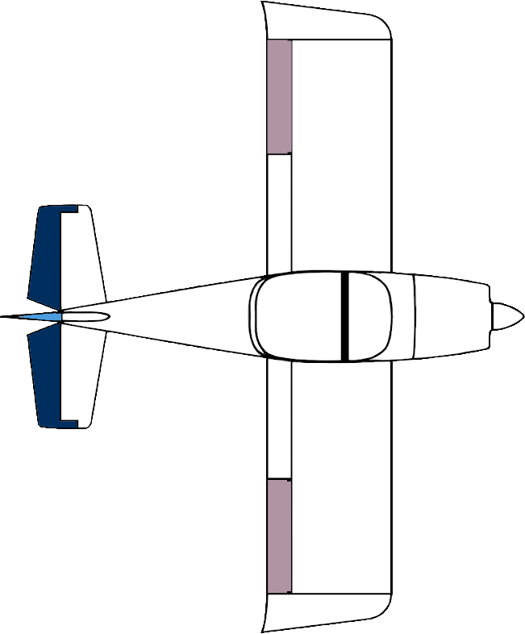
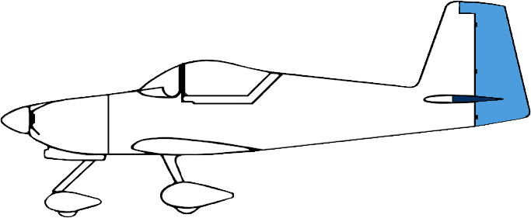
CONTROL SURFACES
Resource Book
Page 65
Control surfaces control an aircraft’s movement.
Ailerons
Elevators
Rudder
Rudder
Controls Yaw Moves the nose and tail left or right. This is controlled by pushing the rudder pedals forward and back.
Elevators
Controls Pitch Changes the vertical direction the aircraft is pointing using the control column forward or back.
Ailerons
Controls Roll Roll is used to turn the aircraft using the control column by moving it left or right.
Notes:
Aileron
Controls Roll. Roll is used to turn the aircraft using the control column by moving it left or right.
Elevator
Controls Pitch. Changes the vertical direction the aircraft is pointing using the control column forward or back.
Rudder
Controls Yaw. Moves the nose and tail left or right. This is controlled by pushing the rudder pedals forward and back.

Slide 15
EFFECTS OF AIRCRAFT CONTROLS
Resource Book
Page 65
Notes:
EFFECTS OF AIRCRAFT CONTROLS
An optional video illustrating the effects of the aircraft controls on a real aircraft. This video will also help answer the DISTINCTION level question D2 Activity 1.
The video is 3 minutes long. Please allow for this when planning session lengths.

Slide 16
ANY QUESTIONS?
Are there any final questions?
?
Notes:
A chance to ask or answer any final questions.

Slide 17
LEARNING OUTCOMES
LO3: Know the features and types of aircraft used for air experience flights and gliding.
Identify important aircraft control surfaces used in flight.
Notes:
LO3: Know the features and types of aircraft used for Air Cadet flying and gliding
P7: Identify important aircraft control surfaces used in flight.

Slide 18
CONTROL SURFACE TASK
Logbook
Page 16
Name some aircraft control surfaces.
When this is complete your instructor should check and sign page 16 of your First Class Logbook.
Notes:
This task covers the mandatory requirement for objectives P7 for LO3.
Cadets must label three aircraft control surfaces.
Once satisfied that all cadets have an understanding of the topic, instructors must check and sign:
Page 16 of the cadet’s first class log book.

Slide 19
INSTRUCTOR INFORMATION
This presentation is provided free of charge with the 1st class cadet training system with no warranty or support.
Every effort has been made to ensure the information is correct, but the author accepts no responsibility for any errors or omissions.
Official information on Ultilearn or Bader SharePoint should be checked before using these presentations.
These presentations may be distributed to other Air Cadet squadrons free of charge, but do not place them on the internet.
For best results, use with the 1st class resource book and 1st class instructor handbook, available from cadetdirect.com.
Version 19/04

