Slide 1
Notes:
Part 4 of 4. This presentation covers the information required to complete PASS criteria of the LO4 Principles of Airmanship topic.
For best results, these instructor notes should be read in conjunction with this presentation and the lesson plan.

Slide 2
LEARNING OUTCOMES
LO4: Know processes used to launch gliders and maintain flight.
Describe processes used to launch gliders.
Notes:
LO4: Know processes used to launch gliders and maintain flight.
P8: Describe processes used to launch gliders.

Slide 3
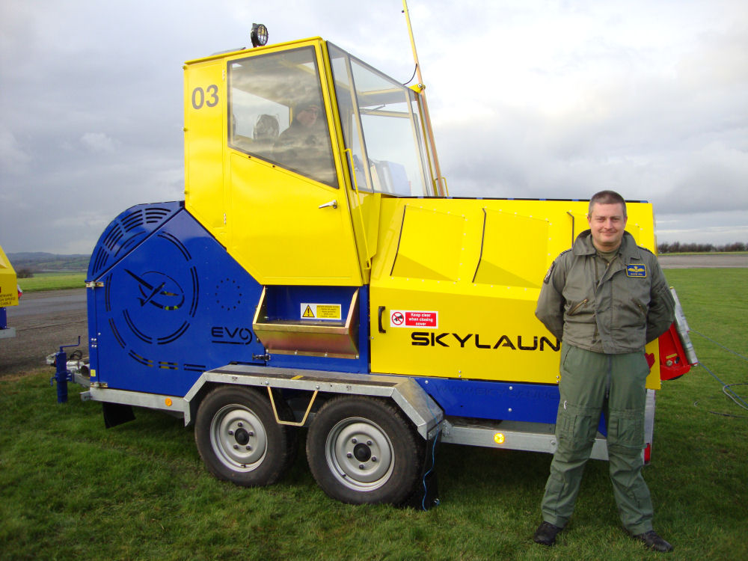
WINCH LAUNCHING
Resource Book
Page 66
The Viking glider is not powered.
Needs to be ‘launched’ into the air by a winch.
Can also be towed by another aircraft.
There are several steps to winch launch a glider.
Notes:
A winch is a drum on which is wound about 1,500 metres of strong, flexible cable. The drum is turned by a powerful engine which the winch driver controls through an automatic gearbox.
The winch is normally sited close to the upwind boundary of the airfield. The cable is attached to the rear of a motor vehicle and drawn out to the launch point at the other end of the airfield, downwind of the winch.
At the Central Gliding School at RAF Syerston, the Vigilant is towed by another aircraft and does not launch with a winch.
The next slides detail the steps needed to winch launch a glider.

Slide 4
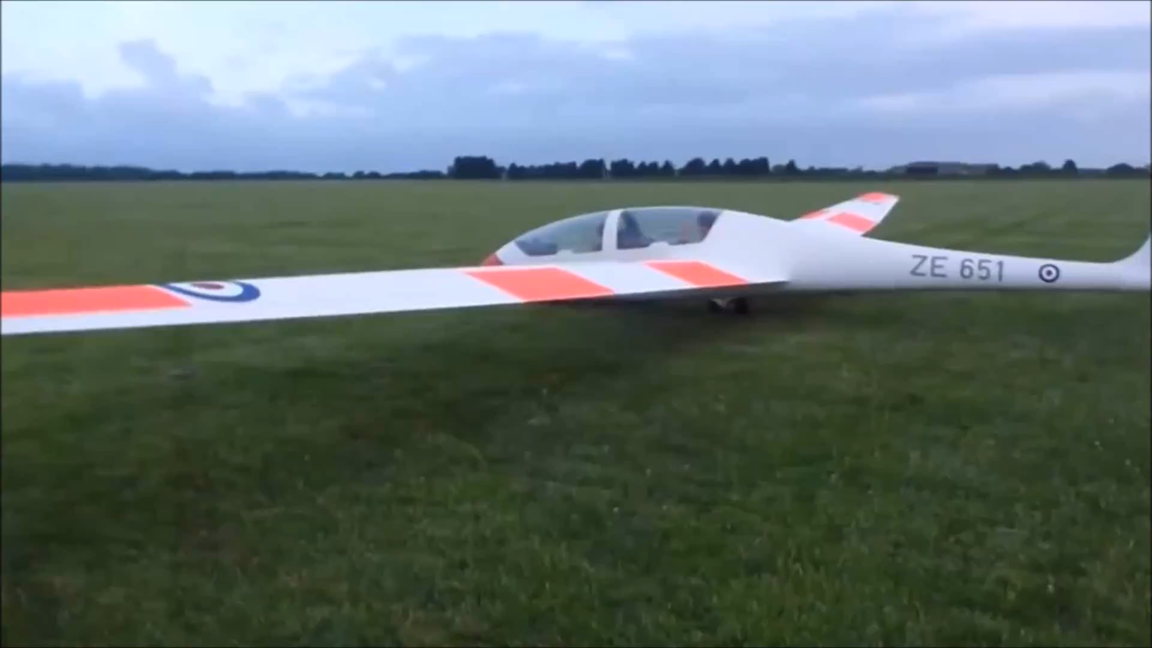
LAUNCHING A VIKING GLIDER
Notes:
VIKING WINCH LAUNCH
An optional video showing two Viking winch launches.
The video is 1 minute long.

Slide 5
LAUNCHING A VIKING GLIDER
1 ‘ALL CLEAR UP AND BEHIND’
Cable attached. Pilot and wing tip holder check above and behind the glider to check it is clear.
2 ‘TAKE UP SLACK’
Winch Driver slowly reels cable in until taut. Pilot puts up one finger.
3 ‘ALL OUT’
Signaller signals winch driver. Pilot puts up two fingers. Cable wound in and aircraft become airborne.
Notes:
1. When the pilot is ready the cable is attached to the glider. The pilot checks there are no hazard from behind, by asking the wing tip holder “ALL CLEAR ABOVE AND BEHIND?”
2. When the pilot is satisfied everything is clear he issues the command “TAKE UP SLACK”. This instruction is passed to the winch driver by a signaller using either lamp signals or large bats. On receiving the signal the winch driver slowly reels in the cable until it is taut.
3. When the pilot is satisfied that the slack has been taken up the order “ALL OUT” is given. The signaller signals this to the winch driver who then opens the winch throttle to wind the cable in. The cable pulls the glider forward and after a short distance it becomes airborne. Initially the glider climbs gently, but the attitude quickly steepens and height is gained rapidly. When the cable is about 70° to the horizontal, the pilot releases it and is then free to commence the gliding exercise.
When released, the cable falls to earth, steadied by a small parachute. It is then reeled in by the winch driver ready for the next launch. The height achieved from a winch launch varies with wind strength, the speed at which the cable is being wound onto the drum, and the length of cable being used. However, as a rough estimate the height gained is usually about one third of the cable length being used (e.g. 1,000 metres of cable gives a launch height of 1,000 feet). A winch launched flight normally lasts for 6-10 minutes, giving the pilot ample time to complete some exercises and a standard circuit of the airfield.

Slide 6
ANY QUESTIONS?
Are there any final questions?
?
Notes:
A chance to ask or answer any final questions.

Slide 7
LEARNING OUTCOMES
LO4: Know processes used to launch gliders and maintain flight.
Describe processes used to launch gliders.
Notes:
LO4: Know processes used to launch gliders and maintain flight.
P8: Describe processes used to launch gliders.

Slide 8
GLIDER LAUNCHING TASK
Logbook
Page 14
Name the three commands used to launch a Viking glider.
What happens when each command is used?
When this is complete your instructor should check and sign page 18 of your First Class Logbook.
Notes:
This task covers the mandatory requirement for objectives P8 for LO3.
Cadets must name the three commands used to launch a Viking glider from the ground and describe what happens in each stage. They can use their First Class Resource book to help them.
Once satisfied that all cadets have an understanding of the topic, instructors must check and sign:
Page 18 of the cadet’s first class log book.

Slide 9
INSTRUCTOR INFORMATION
This presentation is provided free of charge with the 1st class cadet training system with no warranty or support.
Every effort has been made to ensure the information is correct, but the author accepts no responsibility for any errors or omissions.
Official information on Ultilearn or Bader SharePoint should be checked before using these presentations.
These presentations may be distributed to other Air Cadet squadrons free of charge, but do not place them on the internet.
For best results, use with the 1st class resource book and 1st class instructor handbook, available from cadetdirect.com.
Version 19/04

