Slide 1
Notes:
Part 1 of 4. This presentation covers the information required to complete PASS criteria of the LO1 Initial Expedition Training topic.
For best results, these instructor notes should be read in conjunction with this presentation and the lesson plan.

Slide 2
LEARNING OUTCOMES
LO1: Know how to plan and prepare for safe walking expeditions.
Describe factors for consideration when planning a walking expedition.
Notes:
LO1: Know how to plan and prepare for a walking expedition.
P1: Describe factors for consideration when planning a walking expedition.

Slide 3
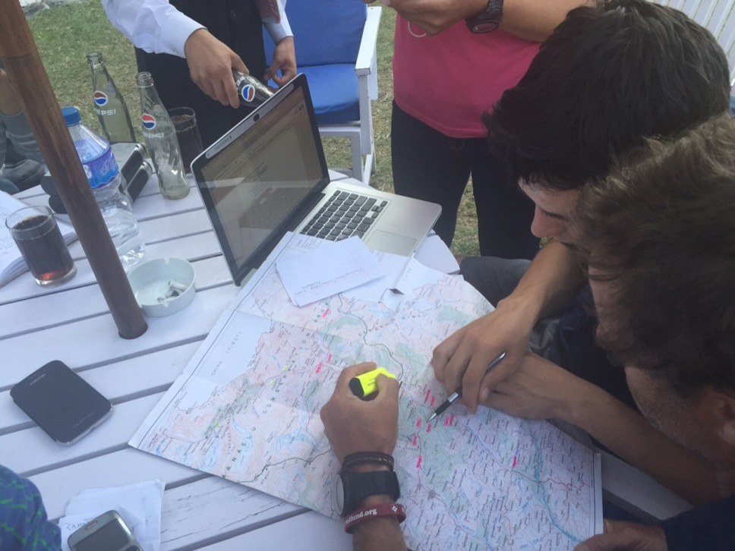
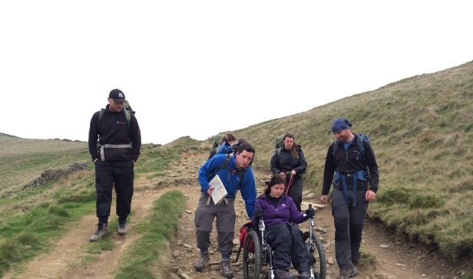
EXPEDITION PLANNING
Resource Book
Page 80
When planning an expedition you must consider:
Expedition factors:
  The length of your route
  Type of ground you are covering
  Weather conditions
Personnel factors:
  Age of the group
  Experience of the group
  Fitness of the group as a whole
  Number of people in the group

Slide 4
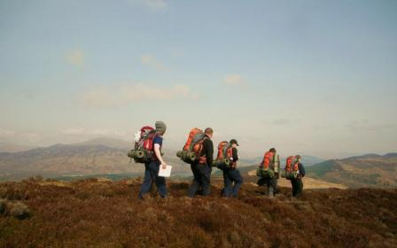
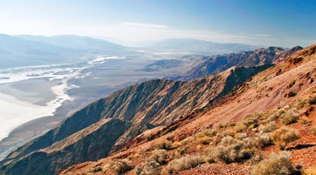
EXPEDITION FACTORS
Resource Book
Page 80
Length of Route:
Is the route too short or too easy? Does it meet the requirements of the DofE if it is a DofE expedition?
Is the route too long or difficult for the people taking part?
Type of Ground:
Is the terrain suitable for the people taking part?
Notes:
Cadets must consider expedition factors during the planning phase of an expedition.
Length of route: Is the route long enough – for example DofE routes must be a certain distance, will the expedition they are planning satisfy the criteria of the DofE Award they are completing. Or, is the route too long, taking into account terrain, personnel factors (see later), etc, would the route be too long.
Type of ground: Is the ground suitable terrain for an expedition; for example planning a mountain expedition in tough, steep terrain, would not be appropriate for a DofE Bronze practice. Consider the environment you will be operating in and whether it is suitable.

Slide 5

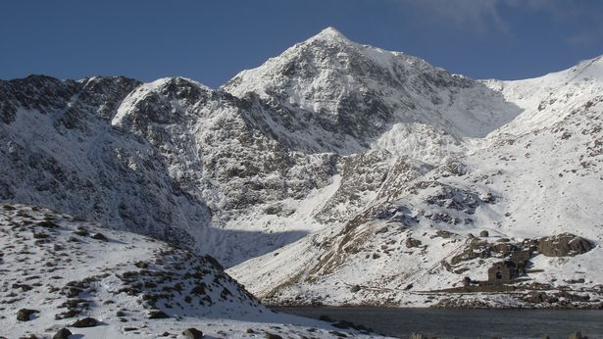
EXPEDITION FACTORS
Resource Book
Page 80
Weather:
Check the weather before you leave.
Don’t be afraid to change plans if the weather becomes poor.
Certain times of year may be unsuitable for an expedition, especially if you are camping.
Notes:
Cadets must consider expedition factors during the planning phase of an expedition.
Weather: Nearer the date of the expedition you will have a clearer idea of the actual weather during your expedition, however you know certain things from just the date, for example during the Winter it will be cold; would a cold and potentially wet expedition be suitable for the group you are planning the expedition with?

Slide 6
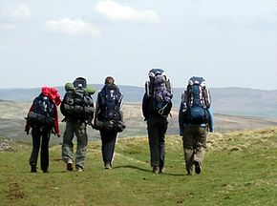
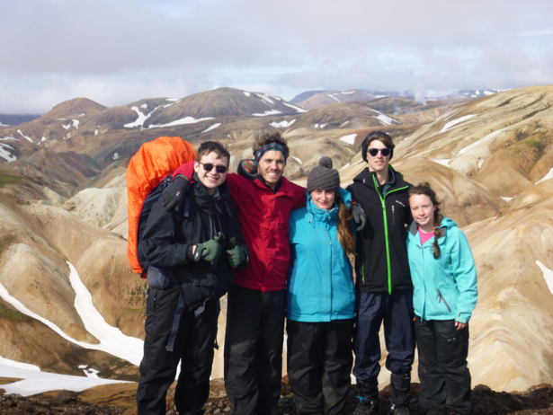
PERSONNEL FACTORS
Resource Book
Page 81
Age of the Group:
Very young or old people may not be able to walk long distances.
Experience of the Group:
Has your group walked in a similar environment before?
Inexperienced cadets would not suit long, complicated expeditions.
Notes:
Cadets must consider personnel factors during the planning phase of an expedition.
Age of the group: younger children are often not suited to huge walks and long expeditions, likewise some older people would be unsuited to long expeditions, consider the group you have in order to make a good choice about the time of route.
Experience of the group: Consider what experience your group has in different environments, a first class cadet who has barely finished IET would not be suitable for a tough mountain day involving difficult conditions.

Slide 7
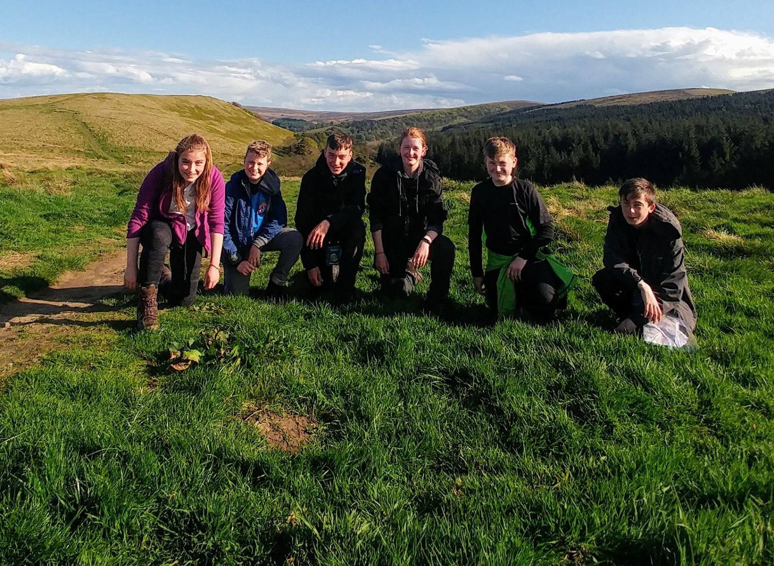
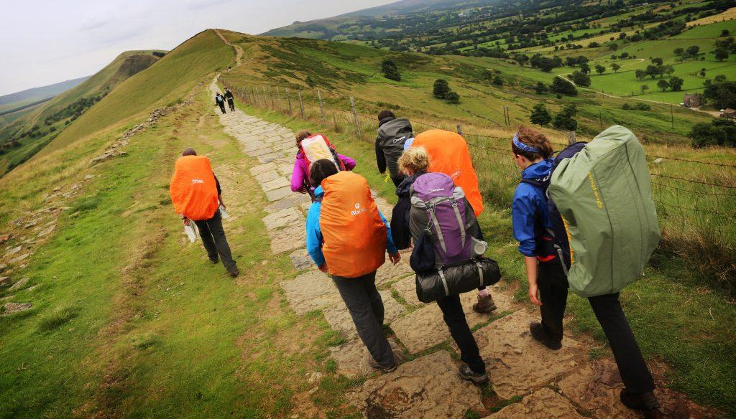
PERSONNEL FACTORS
Resource Book
Page 81
Fitness of the Whole Group:
Everyone must be able to complete the expedition.
If one person is unfit it affects the rest of the team.
Number of People in Group:
DofE groups must contain more than 4 but less than 8.
Staff supervision also must be considered.
Notes:
Cadets must consider personnel factors during the planning phase of an expedition.
Fitness of the group as a whole: When planning consider the fitness of the group as a whole, i.e. consider everyone's ability not just 1 or 2 people. If one person is unfit for a certain route or area then the whole group will be unable to complete it.
Number of people in the group: this is often a requirement of DofE (group must be more than 4 and less than 7), additionally consider the route you are going, is it appropriate for a large group? Staffing ratios are important here too, you need the right amount of qualified staff for a large group – sometimes this isn’t possible.

Slide 8
ANY QUESTIONS?
Are there any final questions?
?
Notes:
A chance to ask or answer any final questions.

Slide 9
LEARNING OUTCOMES
LO1: Know how to plan and prepare for safe walking expeditions.
Describe factors for consideration when planning a walking expedition.
Notes:
LO1: Know how to plan and prepare for a walking expedition.
P1: Describe factors for consideration when planning a walking expedition.

Slide 10
EXPEDITION PLANNING TASK
Logbook
Page 30
Identify 4 factors that should be considered at the initial planning stage of an expedition.
When this is complete your instructor should check and sign page 30 of your First Class Logbook.
Notes:
This task covers the mandatory requirement for objectives P1 for LO1.
Cadets must list four things to consider when planning an expedition; preferably two expedition factors and two personnel factors.
Once satisfied that all cadets have an understanding of the topic, instructors must check and sign:
Page 30 of the cadet’s first class log book.

Slide 11
LEARNING OUTCOMES
LO1: Know how to plan and prepare for safe walking expeditions.
List the Countryside Code
Notes:
LO1: Know how to plan and prepare for a walking expedition.
P2: List the Countryside Code.

Slide 12

THE COUNTRYSIDE CODE
Resource Book
Page 82
Notes:
THE COUNTRYSIDE CODE
The video is 1 minute long.
A video summarising the countryside code.

Slide 13
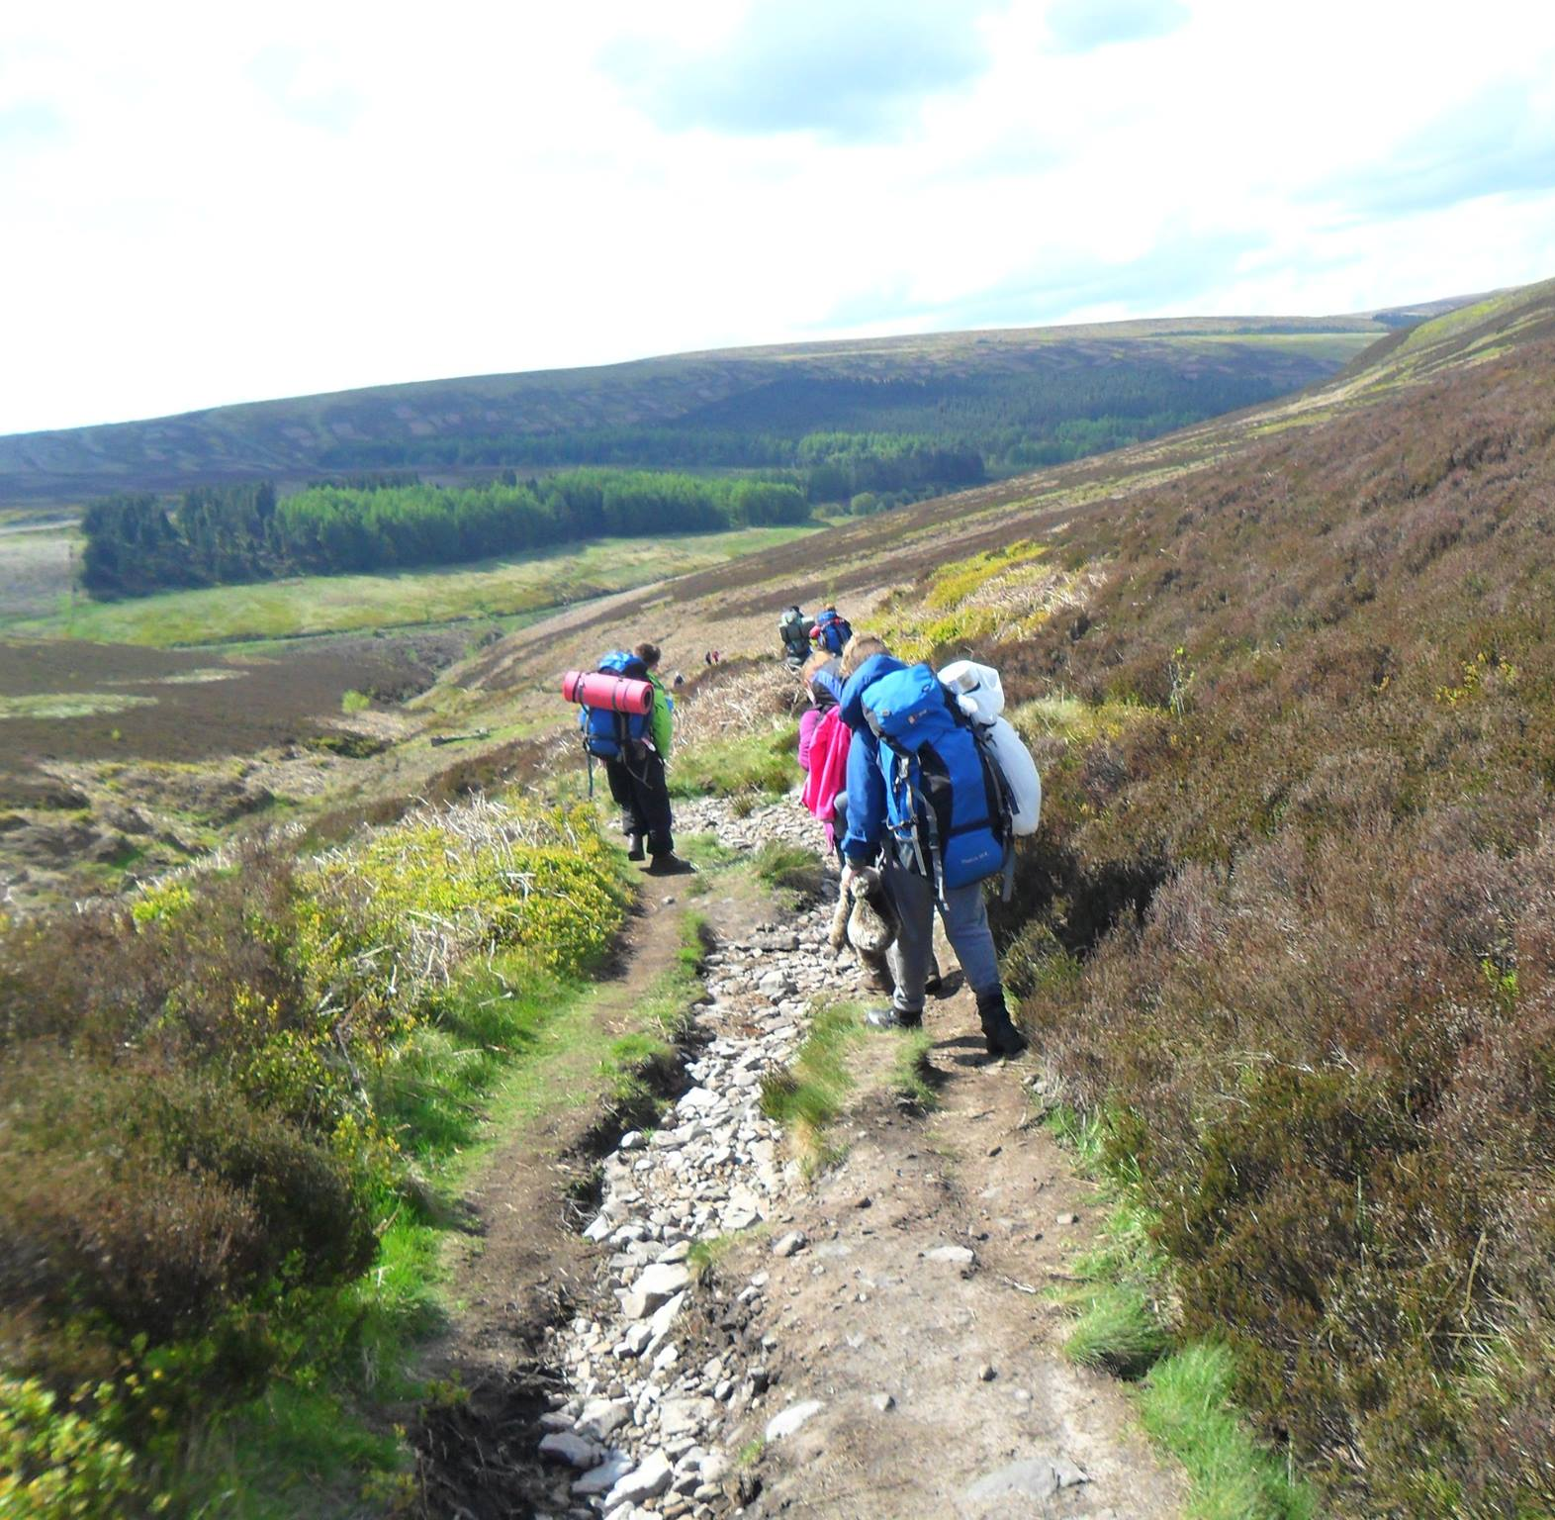
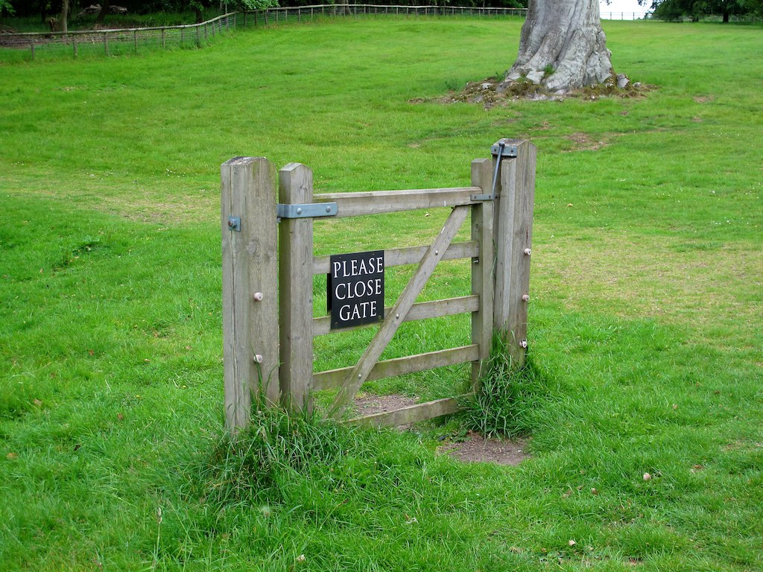

RESPECT OTHER PEOPLE
Resource Book
Page 82
Consider the local community and other people enjoying the outdoors.
Leave gates and property as you fund them and follow paths unless wider access is available.
Notes:
Consider the local community and other people enjoying the outdoors.
Co-operate with people at work in the countryside. For example, keep out of the way when farm animals are being gathered or moved and follow directions from the farmer.
Leave gates and property as you find them and follow paths unless wider access is available.
Countryside Code Leaflet can be found here with more information:
https://www.gov.uk/government/uploads/system/uploads/attachment_data/file/558112/countryside-code.pdf

Slide 14
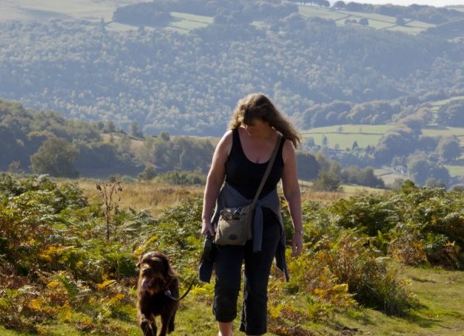
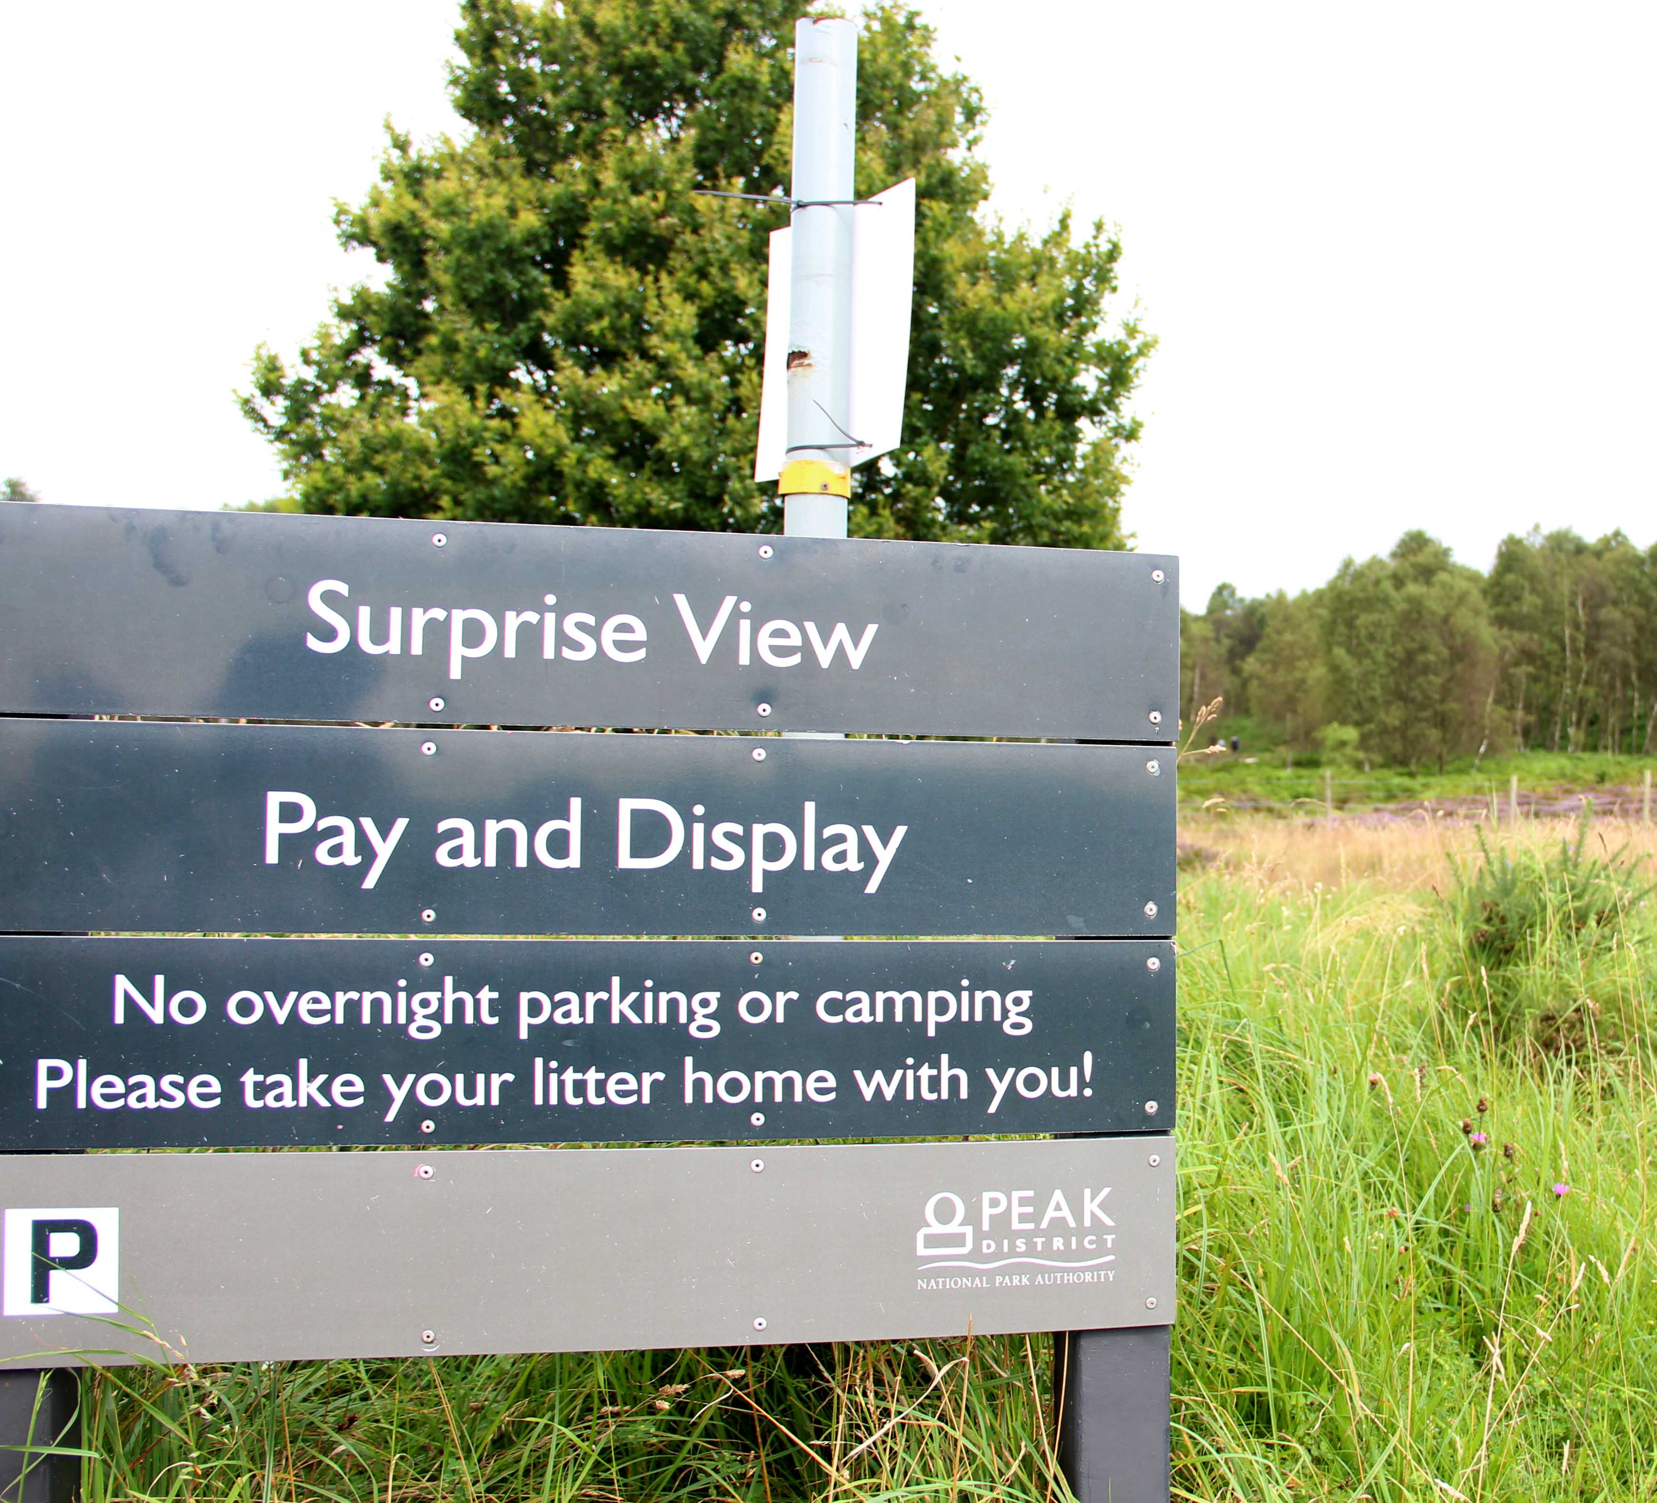
PROTECT THE NATURAL ENVIRONMENT
Resource Book
Page 82
Leave no trace of your visit and take your litter home.
Keep dogs under effective control.
Notes:
Take special care not to damage, destroy or remove features such as rocks, plants and trees. They provide homes and food for wildlife, and add to everybody’s enjoyment of the countryside.
Leave no trace of your visit and take your litter home. Litter and leftover food is ugly and can be dangerous to wildlife and farm animals.
Be very careful with naked flames and stoves. Avoid cooking on dry grass or vegetation. Fires can be as devastating to wildlife and habitats as they are to people and property.
Countryside Code Leaflet can be found here with more information:
https://www.gov.uk/government/uploads/system/uploads/attachment_data/file/558112/countryside-code.pdf

Slide 15
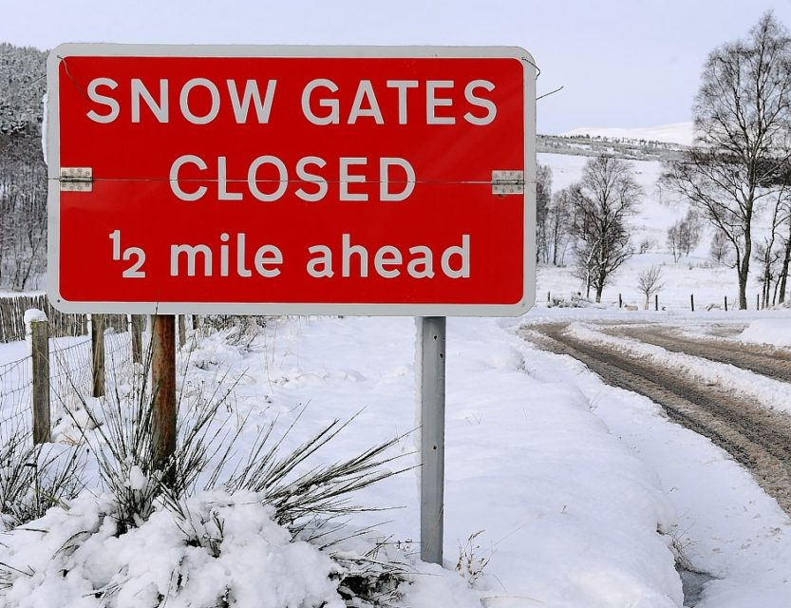
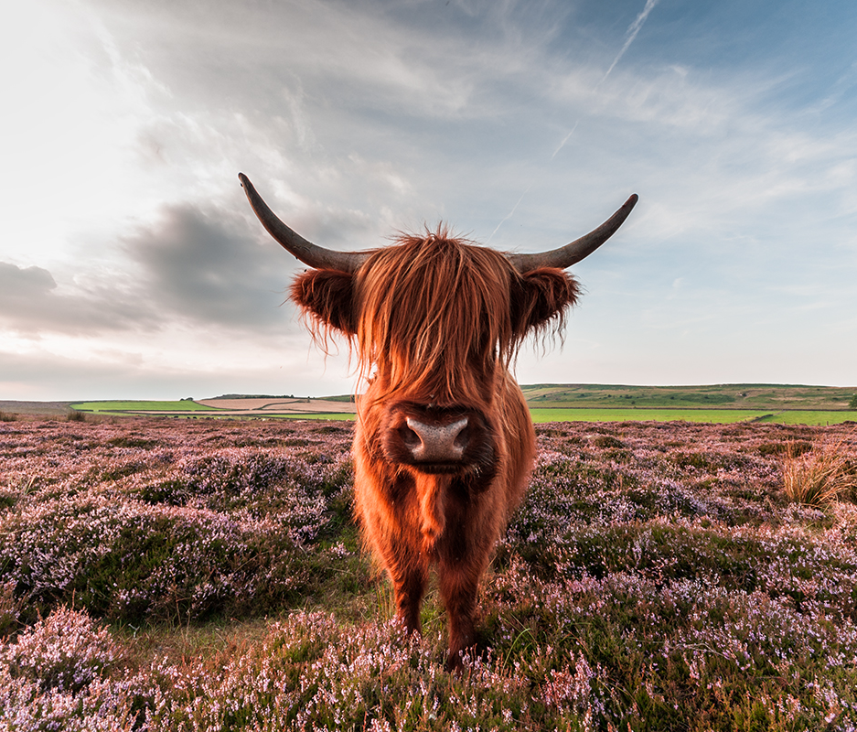
ENJOY THE OUTDOORS
Resource Book
Page 82
Plan ahead and be prepared.
Follow advice and local signs.
Notes:
Plan ahead and be prepared.
Wild animals, farm animals and horses can behave unpredictably if you get too close, especially if they’re with their young - so give them plenty of space.
Check weather forecasts before you leave and be prepared to change plans, as weather can change quickly.
Countryside Code Leaflet can be found here with more information:
https://www.gov.uk/government/uploads/system/uploads/attachment_data/file/558112/countryside-code.pdf

Slide 16
ANY QUESTIONS?
Are there any final questions?
?
Notes:
A chance to ask or answer any final questions.

Slide 17
LEARNING OUTCOMES
LO1: Know how to plan and prepare for safe walking expeditions.
List the Countryside Code
Notes:
LO1: Know how to plan and prepare for a walking expedition.
P2: List the Countryside Code.

Slide 18
COUNTRYSIDE CODE TASK
Logbook
Page 31
List the 5 main points of the countryside code.
When this is complete your instructor should check and sign page 31 of your First Class Logbook.
Notes:
This task covers the mandatory requirement for objectives P2 for LO1.
Cadets must list the 5 main points of the countryside code.
Once satisfied that all cadets have an understanding of the topic, instructors must check and sign:
Page 31 of the cadet’s first class log book.

Slide 19
LEARNING OUTCOMES
LO1: Know how to plan and prepare for safe walking expeditions.
Describe the purpose of a route card in a walking expedition.
Notes:
LO1: Know how to plan and prepare for a walking expedition.
P3: Describe the purpose of a route card in a walking expedition.

Slide 20
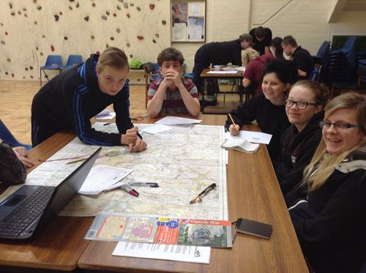
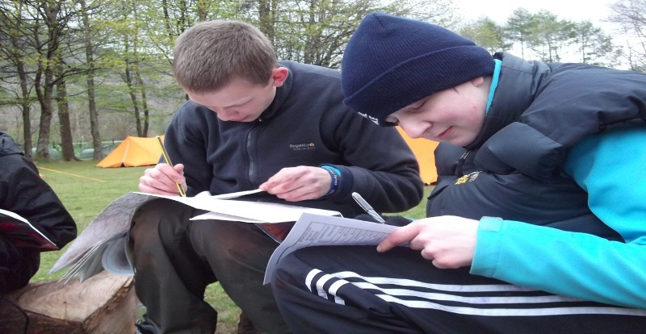
WHAT IS A ROUTE CARD FOR?
Resource Book
Page 83
Structure for planning the day, including route.
Details of who's in the group and their emergency points of contact and escape routes shown in case of emergency.
Enable you to keep track of progress during the day.
A copy of your route and timings to allow staff to know where you should be, and keep track of your movements.
Notes:
Structure for planning your day in the hills, including the route for staff and cadets: This is useful to keep yourself on track, and avoid being stuck in darkness because you’ve taken too long to complete a route.
Details of who's in the group and their emergency points of contact: This isn’t necessarily included on all route cards but is a useful addition.
Enable you to keep track of progress during the day: For staff and cadets, in addition lets you know if you need to slow down/speed up, particularly where there is a minimum time to be out on expedition e.g. DofE expeditions.
Escape routes shown in case of emergency: These can be referred to as required.
A copy of your route and timings to allow staff to know where you should be, and keep track of your movements: This is crucial in staff being able to monitor and if necessary track down your group.

Slide 21
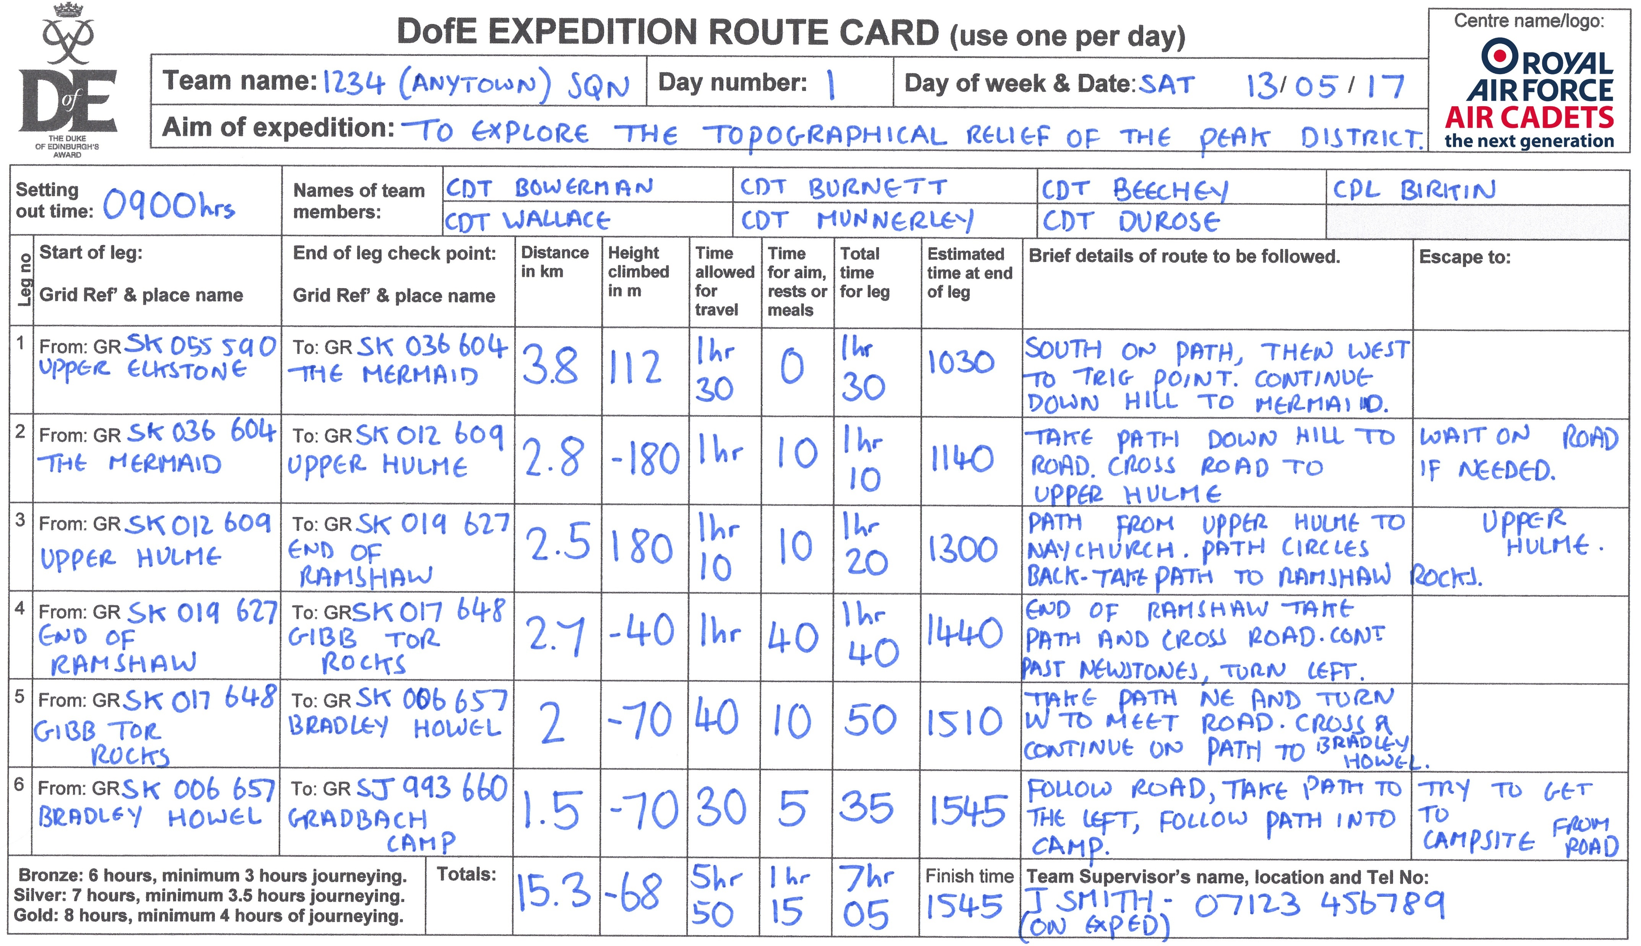
ROUTE CARD EXAMPLE
Resource Book
Page 83
Notes:
An example route card for a bronze DofE expedition.
The following slides describe each section of the card and why it is used.

Slide 22
ROUTE CARDS
LEGS
Resource Book
Page 83
You must decide how long each section of your journey should be and where to stop.
Pick landmarks to stop at.
Pick turnings and junctions as end of legs.
Don’t make legs too long.
Notes:
First you need to decide how long a leg should be and how many legs your journey should be broken into. Generally you don't want to break your day into more legs than there are on one sheet when planning a bronze expedition. On Silver or Gold you might need to use more than one sheet per day.
Generally speaking a leg is a section of a journey which follows a certain path or feature or travels between two obvious landmarks or it could be a section of journey which essentially travels in one direction. So if you follow a stream, path or road then make this part just one leg. If you come to a junction and continue on the same path in the same direction do not make a new leg but if you turn off your path and follow a different path, road or stream for example then you need to start a new leg. If you are striking off across open ground and need to make a major directional change at some point then you should start a new leg when you change direction. Don't make legs too long (no more than 2-3 kilometres)
The idea is: one person is navigating with the map and one holds the route card. When you arrive at the end of a leg, the one holding the route card should be able to glance at it and then at the landscape and say: 'Yeah I'm pretty sure this is it, we should now go into the woods and follow the path.' The one with the map can then confirm this. This might seem complicated but is actually quicker and more accurate than just using the map. A good navigator, using the map and the route card together will be less likely to get lost.

Slide 23
ROUTE CARDS
DISTANCE
Resource Book
Page 83
Use string to work out distance on a map.
Measure it using the edge of your compass or a roamer.
Make sure the string follows twists and turns.
Notes:
Use a piece of string or shoelace and measure it using the edge of your compass which corresponds to the size of map you are using. For example if using a 1:25,000 map measure out 1000m and mark your string with a pen. Then you can measure your leg using the string which will bend easily along the twists and turns of your route. Don't be too accurate or you will be there forever.

Slide 24
ROUTE CARDS
HEIGHT CLIMBED
Resource Book
Page 83
Contour lines usually at 10m intervals, but Sometimes 5m – check!
Count the difference from the two points.
Take going up then down again into account.
Page 74 of your resource book will help you.
Notes:
The contour lines on your map are usually at 10m intervals so just count them up. Some areas with steep hills have contour lines of 5m, so check on the map where it will tell you if they are.
If you go up and down then up again you need to add all the up together because you need to know how much height you have walked up as this will affect your walking speed.

Slide 25
ROUTE CARDS
TRAVELLING TIME
Resource Book
Page 83
Find out the normal walking speed of your group.
Always go by the slowest person.
Around 2-4 km/h.
Add 1min for every contour line walked up.
Notes:
Estimate the normal walking speed of your group. A fit person on flattish ground carrying only a small rucksack can walk at 5kmph. Taking into account the size of your rucksack and your fitness you will be travelling at around 2-4kmph. Use this formula to calculate your time for journeying then add 1 minute for every contour line you walk up. It is impossible to work out what your real walking speed will be until you have had a go at it. This is what only your practice expedition can teach you.

Slide 26
ROUTE CARDS
REST TIME
Resource Book
Page 83
Remember to factor in rest time!
You will get tired.
Give your self more rest than you think you might need.
Should be travelling for at least 3 hours.
Notes:
Exploring means doing the things you need to do to complete your aim. You should give yourself rest periods on top of this. If you are unsure give yourself more rest than you think you need then you might surprise yourself and get in early. Remember unless you have special dispensation you should be travelling for at least 50% of the day (3hrs for bronze, 3.5hrs for silver and 4hrs for gold).

Slide 27
ROUTE CARDS
ARRIVAL TIME
Resource Book
Page 83
Add up total times for Travel and rests.
Then use this to work out the estimated times you think you will arrive.
You can add notes to help stop you getting lost.
Notes:
Don't fill in this column until you have finished working out all your legs and how long you think they will take. If you change your mind about something you will have to change everything in this column so leave it until last.

Slide 28
ANY QUESTIONS?
Are there any final questions?
?
Notes:
A chance to ask or answer any final questions.

Slide 29
LEARNING OUTCOMES
LO1: Know how to plan and prepare for safe walking expeditions.
Describe the purpose of a route card in a walking expedition.
Notes:
LO1: Know how to plan and prepare for a walking expedition.
P3: Describe the purpose of a route card in a walking expedition.

Slide 30
ROUTE CARD TASK
Logbook
Page 31
Complete a route card for an imaginary or actual expedition.
Explain verbally why each part is important.
When this is complete your instructor should sign page 31 of your First Class Logbook and fill in the Task P3 Activity 1 Initial Expedition Training log sheet.
Notes:
This task covers the mandatory requirement for objectives P3 for LO1.
Cadets must create a route card. A photocopiable example route and route card template is available in the First Class Instructor Guide. The journey should comprise at least three legs. When complete, the cadet must explain each part of the Route Card and how it is used.
Once satisfied that all cadets have an understanding of the topic, instructors must fill in:
Page 31 of the cadet’s first class log book.
Task P3 Activity 1 log sheet. This can be found on Ultilearn.

Slide 31
LEARNING OUTCOMES
LO1: Know how to plan and prepare for safe walking expeditions.
Identify how to prepare expedition equipment and clothing suitable for the walk being planned.
Notes:
LO1: Know how to plan and prepare for a walking expedition.
P4: Identify how to prepare expedition equipment and clothing suitable for the walk being planned.

Slide 32
CLOTHING AND LAYERS
Resource Book
Page 85
It is better to wear lots of thin layers of clothing than one thick layer.
Base Layer:
  Lightweight layer designed to allow sweat and body heat to pass freely, keeping your cool and dry.
Mid Layer:
  A good mid layer keeps heat in but allows moisture (sweat) out.
Outer Layer:
  Also known as hard shell, this allows sweat out, but keeps wind and rain out.
Notes:
Base Layer: examples include ‘wicking base layers’, thermal base layers (if you want to keep more heat in), Helly Hanson style base layers etc.
Mid layer: These include fleeces, soft shell jackets etc. Some mid layers can also be water resistant, and wind proof, which make them ideal for days on the hill where rain is unlikely but there is high wind.
Outer layer: The outer layer is the waterproof layer, it is usually thin. These include waterproof materials such as GoreTex.

Slide 33
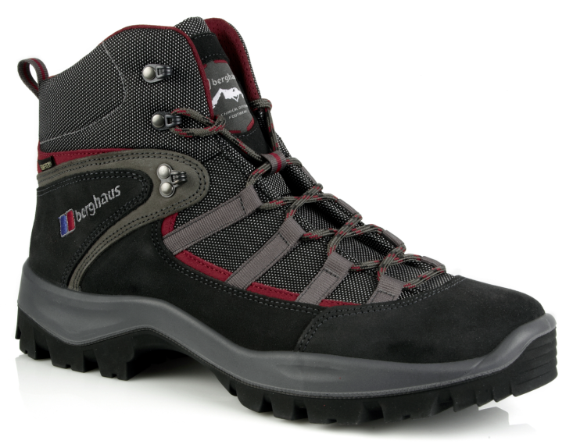
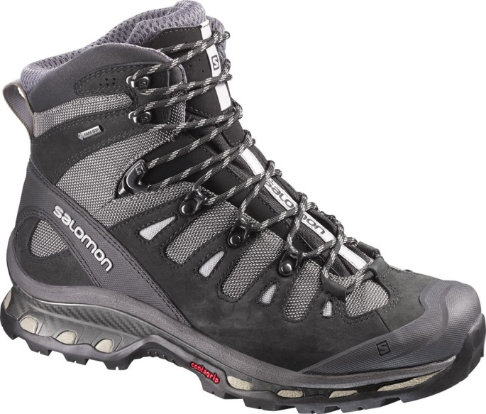
BOOTS
Resource Book
Page 85
Walking boots are an essential piece of kit. Make sure you get the right ones – consult your squadron staff if you need help.
Boots MUST support your ankle, approach shoe style trainers are NOT appropriate.
Wear your boots before your expedition to get them to begin to mould to your foot.
Make sure they fit – try them in store, don’t just blindly buy boots online.
Notes:
Boots generally can’t be issued from squadron so must be purchased.
Must support the ankle – this is due to the additional weight be carried, without ankle support they risk serious ankle injury if they slip with a full expedition pack on their back.
Break boots in by wearing them before hand.
Check they fit, try them on with a sock in store – they can always buy them online later if they know the make, model and size that fits.

Slide 34
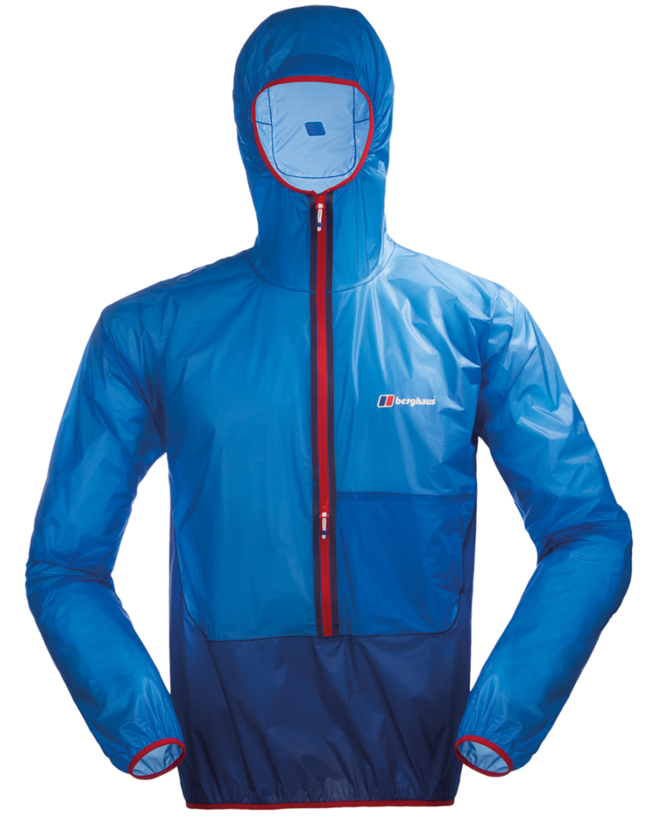
WATERPROOF CLOTHING
Resource Book
Page 85
A good waterproof jacket is important, it protects you from the wind and rain.
Materials like GoreTex are seen as ‘the best’ but cheaper waterproof jackets can be just as good.
Make sure the hood is comfortable.
Make sure you try the jacket on with layers underneath; don’t buy one that’s too small when worn with layers.
Notes:
Military waterproofs should not normally be worn on an expedition.
GoreTex is just a brand, there are other waterproof brands available that work just as well!
Try the jacket on with layers underneath to ensure a good fit.

Slide 35
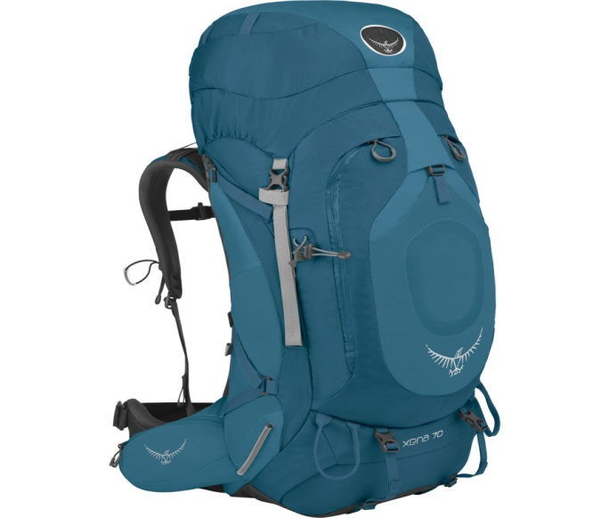
RUCKSACK
Resource Book
Page 86
Make sure that your rucksack is comfortable – most stores will let you try the rucksack with some weight in – this will help you get a feel for how the rucksack will be when it’s got all your kit in.
Make sure the rucksack is at least 65L, any smaller and you may not be able to fit all your kit in.
There are gender specific rucksacks available – these can be more comfortable.
Notes:
A good rucksack must fit well, the better the fit, the more comfortable it will be when carrying a heavy load.
If borrowing a squadron rucksack then get the rucksack issued ahead of time to pack and practice carrying.
Make sure the straps are adjusted and the weight is sitting equally on hips and shoulders – as staff for help as required.

Slide 36
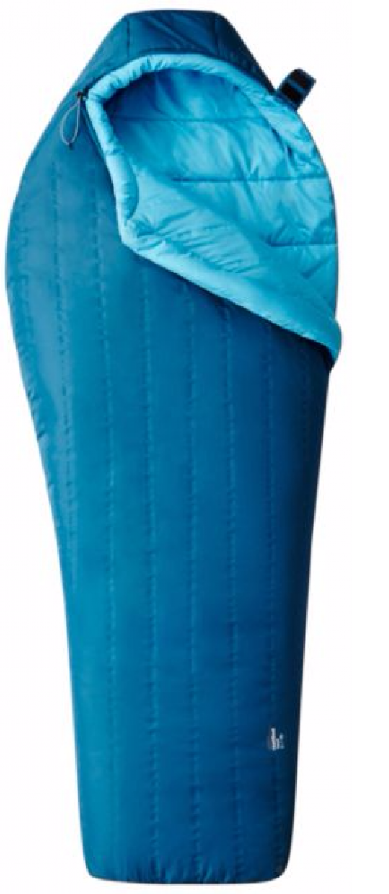
SLEEPING BAG
Resource Book
Page 86
A good sleeping bag will ensure you have a comfortable nights sleep while on expedition!
Sleeping bags have a rating to tell you how warm they are, it will either say “3 season” or will state a temperature range. A 3 season bag will be suitable for most expeditions, 4 season bags are designed for winter use and are typically very expensive.
Make sure your sleeping bag has a hood and a ‘mummy’ style bag.
Notes:
Sleeping bag ratings tell them how warm a sleeping bag is:
1 season; Summer use only, very light
2 season: Summer and early autumn/late spring.
3 season: All year except Winter
4 season: All year round
Or the sleeping bag will have a temperature rating usually including a comfort rating and extreme rating.
Comfort: means the user will be comfortably warm in that temperature.
Extreme: means the sleeping bag would keep the user alive in that temperature but they would not be comfortable.
Also ensure cadets understand that a mummy sleeping bag is required.

Slide 37
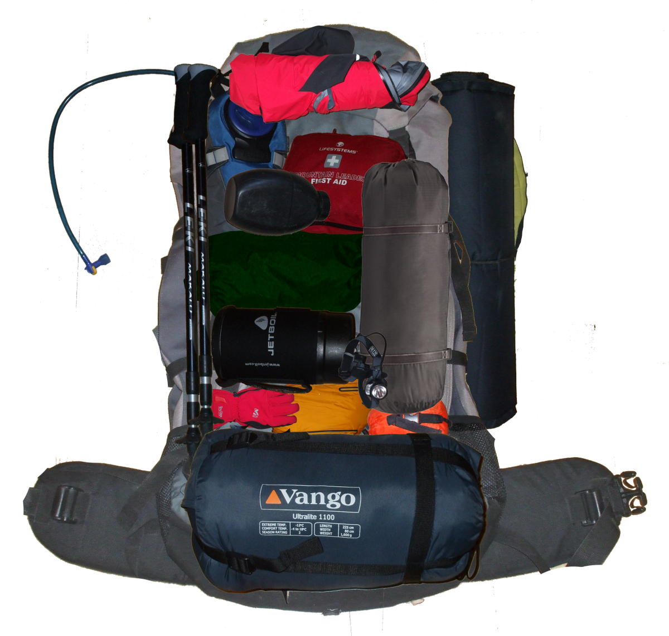
OTHER EQUIPMENT
Resource Book
Page 86
Personal first aid kit.
Roll mat or inflatable mat.
Tent.
Map and Compass.
Notes:
There is additional equipment required and to consult kit list as issued for full list, this may include:
Personal first aid kit: Including painkillers they would usually take.
Roll mat or inflatable mat: Essential as it provides insulation from the cold ground.
Tent: Appropriate size for the group, pop tents and festival tents are not appropriate.
Map and Compass: Print outs are useful but also take a full OS map for the area you are in.
There should be at least one of these available in the group:
Group shelter
Group first aid kit
Mobile phone
A GPS could also be considered as a tool to use in an emergency. The ‘OS locate’ mobile phone app is a good emergency tool and works even when there is no mobile phone signal.

Slide 38
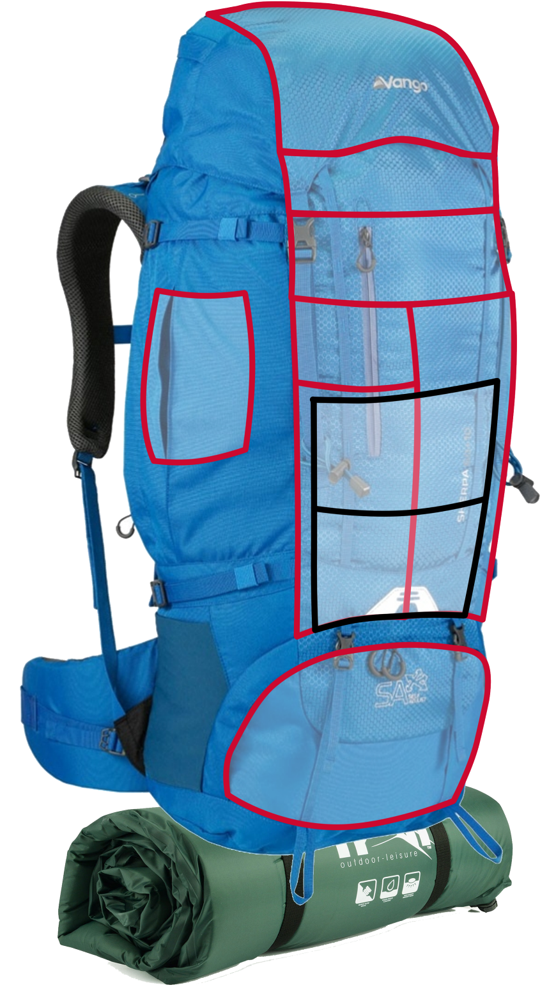
PACKING A RUCKSACK
Snacks
First Aid Kit
Head Torch
Sun-cream
Pocket Tool
Toilet Paper
Resource Book
Page 84
Loading a bag correctly is all about weight distribution and making sure frequently used items are close at hand.
Putting items in the correct place will make your bag much more comfortable to wear.
Waterproofs
Hat and Gloves
Food
Wash Kit
Survival Bag
Water
Tent
Sleeping Bag
Camping Kit
Clothes
Gas
Cooking Equipment
Stove
Camping Mat
Notes:
Equipment you need quickly: place this close to the top or in a lid pocket to avoid having to empty your bag out to get things you will need frequently.
Heavier equipment: best at the bottom, putting it at the top will mean that you are being off-balanced by the weight being higher up.
Water: water bottles in side pockets or use a hydration system such as a camelbak.
Roll mat: stored outside wherever is best, consider covering it in a bag to avoid it getting soaked.
Liquid fuel: outside and ideally waterproofed.

Slide 39
ANY QUESTIONS?
Are there any final questions?
?
Notes:
A chance to ask or answer any final questions.

Slide 40
LEARNING OUTCOMES
LO1: Know how to plan and prepare for safe walking expeditions.
Identify how to prepare expedition equipment and clothing suitable for the walk being planned.
Notes:
LO1: Know how to plan and prepare for a walking expedition.
P4: Identify how to prepare expedition equipment and clothing suitable for the walk being planned.

Slide 41
EXPEDITION EQUIPMENT TASK
Logbook
Page 31
Prepare a presentation about how to prepare expedition equipment.
Present this to the rest of the group.
When this is complete your instructor should sign page 31 of your First Class Logbook and fill in the Task P4 Activity 1 Initial Expedition Training log sheet.
Notes:
This task covers the mandatory requirement for objectives P4 for LO1.
In order to complete the assessment for this task, cadets must give a presentation in which they describe and demonstrate how equipment can be prepared for a two day expedition. The cadet should prepare and bring in a bag of equipment suitable for a two day expedition. They must unpack the bag and explain the reason why each item has been included.
THIS CAN BE PAIRED WITH TASK P6 for LO2.
Once satisfied that all cadets have an understanding of the topic, instructors must fill in:
Page 31 of the cadet’s first class log book.
Task P4 Activity 1 log sheet. This can be found on Ultilearn.

Slide 42
INSTRUCTOR INFORMATION
This presentation is provided free of charge with the 1st class cadet training system with no warranty or support.
Every effort has been made to ensure the information is correct, but the author accepts no responsibility for any errors or omissions.
Official information on Ultilearn or Bader SharePoint should be checked before using these presentations.
These presentations may be distributed to other Air Cadet squadrons free of charge, but do not place them on the internet.
For best results, use with the 1st class resource book and 1st class instructor handbook, available from cadetdirect.com.
Version 19/04

