Slide 1
Notes:
Part 3 of 4. This presentation covers the information required to complete PASS criteria of the LO3 Initial Expedition Training topic.
For best results, these instructor notes should be read in conjunction with this presentation and the lesson plan.

Slide 2
LEARNING OUTCOMES
LO3: Understand the principles of safe camp craft on an expedition.
Describe the principles of warmth and comfort in camp.
Notes:
LO3: Understand the principles of safe camp craft on an expedition.
P7: Describe the principles warmth and comfort in camp.

Slide 3
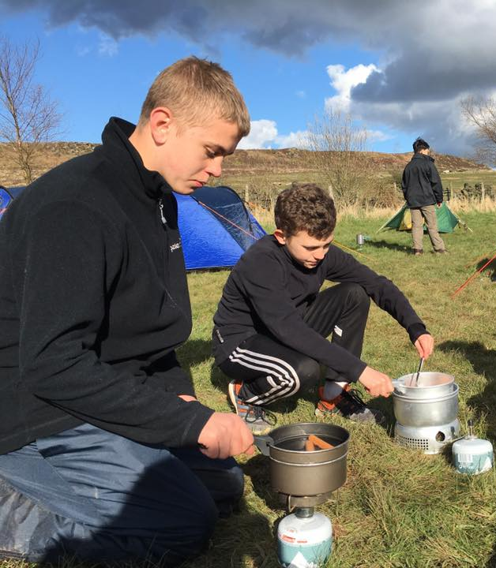
WARMTH AND COMFORT ON CAMP
Resource Book
Page 88
When you arrive at camp and have set up your tent:
Change out of wet clothing and put on dry socks.
Change your footwear if you have it.
Keep extra layers on – you have stopped walking and may feel colder now you aren’t exercising.
Have a hot drink if you aren’t ready for evening meal.

Slide 4
ANY QUESTIONS?
Are there any final questions?
?
Notes:
A chance to ask or answer any final questions.

Slide 5
LEARNING OUTCOMES
LO3: Understand the principles of safe camp craft on an expedition.
Describe the principles of warmth and comfort in camp.
Notes:
LO3: Understand the principles of safe camp craft on an expedition.
P7: Describe the principles warmth and comfort in camp.

Slide 6
WARMTH AND COMFORT TASK
Logbook
Page 34
Identify 4 things that can improve warmth or comfort on a campsite.
When this is complete your instructor should check and sign page 34 of your First Class Logbook.
Notes:
This task covers the mandatory requirement for objectives P7 for LO3.
Cadets must list four things to improve warmth and/or comfort on a campsite.
Once satisfied that all cadets have an understanding of the topic, instructors must check and sign:
Page 34 of the cadet’s first class log book.

Slide 7
LEARNING OUTCOMES
LO3: Understand the principles of safe camp craft on an expedition.
Describe the essentials of siting, pitching and striking a camp.
Notes:
LO3: Understand the principles of safe camp craft on an expedition.
P8: Describe the essentials of siting, pitching and striking a camp.

Slide 8
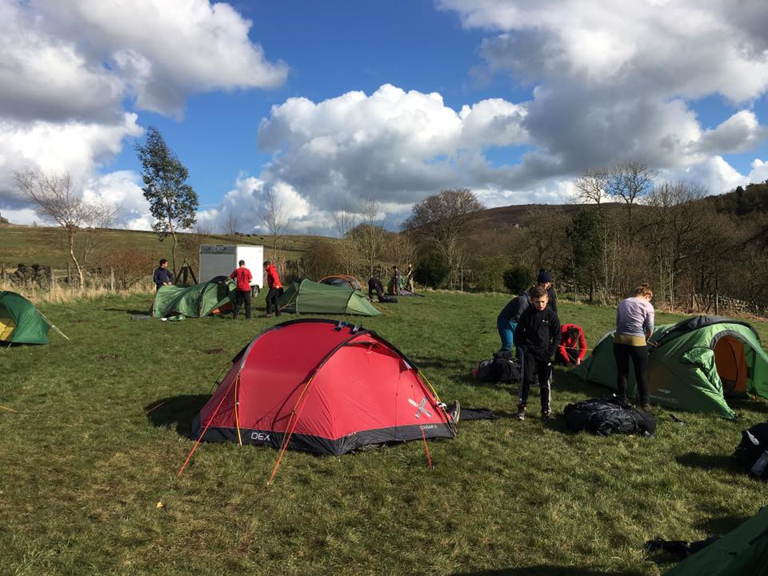
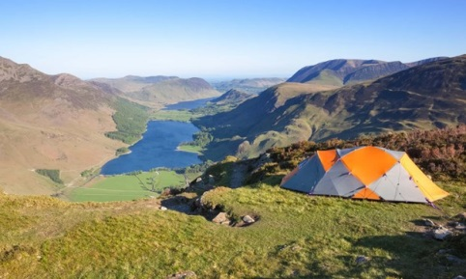
SITING YOUR CAMP
Resource Book
Page 87-88
Choose an area that is flat.
Do not pitch your tent under a tree or close to water.
If there are no toilets ensure you allocate appropriate toilet areas for male and female. Dig toilet holes.
When pitching tents ensure your tent is a good distance away from other tents.
Notes:
Choose an area that is flat (pitching on a slope will be uncomfortable).
Do not pitch your tent under a tree – branches may fall in high winds, which would demand the tent and possibly cause injury.
Do not pitch your tent close to water – in the event of heavy rain overnight this may flood.
(Wild camping) ensure you allocate appropriate toilet areas for male and female. Dig toilet holes.
When pitching tents ensure your tent is a good distance away from other tents (at least 5m – although this varies between sites).

Slide 9
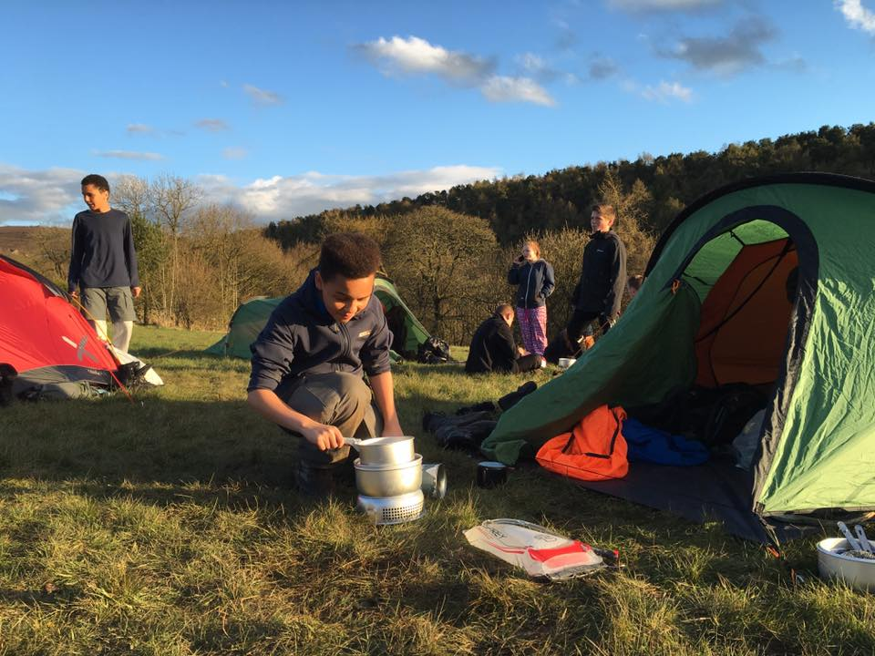
ON THE CAMPSITE
Resource Book
Page 88
Always put litter in a bin.
Make sure no food is left out overnight and keep the campsite and your tents tidy.
Keep noise to a minimum and respect other campsite users.
Do not light any campfires unless the campsite owner has given you permission.
Cook outside and never in tents. This is a real fire risk.
Notes:
Always put litter in a bin if there is one, or keep it with you until you find a bin or finish the expedition. Leaving litter can harm wildlife.
Make sure no food is left out overnight. This often attracts unwelcome wildlife in the middle of the night like foxes.
Keep the campsite and your tents tidy. Don’t leave equipment outside as it may get damaged or stolen by other campers.
Keep noise to a minimum and respect other campsite users.
Do not light any campfires unless the campsite owner has given you permission. If they have, be careful and follow all the sites safety rules. Ensure the fire is out before you go to bed.
Cook outside and never in tents. This is a real fire risk.

Slide 10
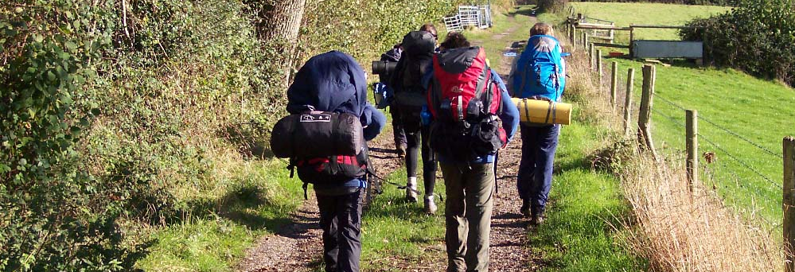
LEAVING THE CAMPSITE
Resource Book
Page 88
Pick up any rubbish, especially food waste and packaging.
When wild camping fill in toilet holes and burn any waste paper.
Check to make sure you haven’t left anything behind – leave the campsite in a better condition than when you found it!

Slide 11
ANY QUESTIONS?
Are there any final questions?
?
Notes:
A chance to ask or answer any final questions.

Slide 12
LEARNING OUTCOMES
LO3: Understand the principles of safe camp craft on an expedition.
Describe the essentials of siting, pitching and striking a camp.
Notes:
LO3: Understand the principles of safe camp craft on an expedition.
P8: Describe the essentials of siting, pitching and striking a camp.

Slide 13
CAMPSITE TASK 1
Logbook
Page 35
Describe things to consider with siting, pitching and striking a camp.
When this is complete your instructor should check and sign page 35 of your First Class Logbook.
Notes:
This task covers the mandatory requirement for objectives P8 for LO3.
Cadets must list things to consider with siting, pitching and striking a camp.
Once satisfied that all cadets have an understanding of the topic, instructors must check and sign:
Page 35 of the cadet’s first class log book.

Slide 14
CAMPSITE TASK 2
Logbook
Page 35
Practice siting, pitching and striking a camp.
When this is complete your instructor should sign page 35 of your First Class Logbook and fill in the Task P8 Activity 2 Initial Expedition Training log sheet.
Notes:
This task covers the mandatory requirement for objectives P8 for LO3.
Cadets must demonstrate siting, pitching and striking a camp.
Once satisfied that all cadets have an understanding of the topic, instructors must fill in:
Page 35 of the cadet’s first class log book.
Task P8 Activity 2 log sheet. This can be found on Ultilearn.

Slide 15
LEARNING OUTCOMES
LO3: Understand the principles of safe camp craft on an expedition.
Explain food and cooking safety considerations for expeditions.
Notes:
LO3: Understand the principles of safe camp craft on an expedition.
P9: Explain food and cooking safety considerations for expeditions.

Slide 16
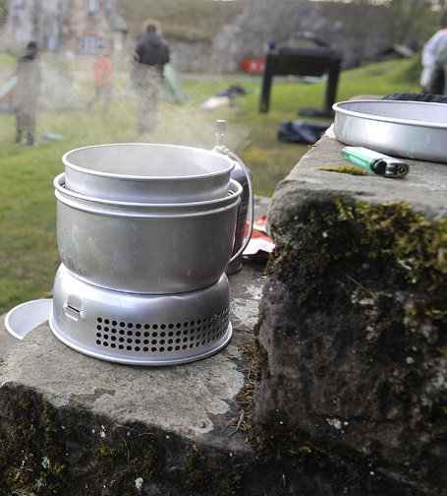
CHOOSING THE RIGHT FOOD
Your choices of expedition food are important, the fuel you put in your body is what will keep you going during long periods of walking.
Do not just buy pot noodles, super noodles etc, these do not provide sufficient energy to fuel you during expeditions.
Whatever you take needs to be suitable to cook on a camp stove or trangia.
Consider group cooking when planning an expedition.

Slide 17
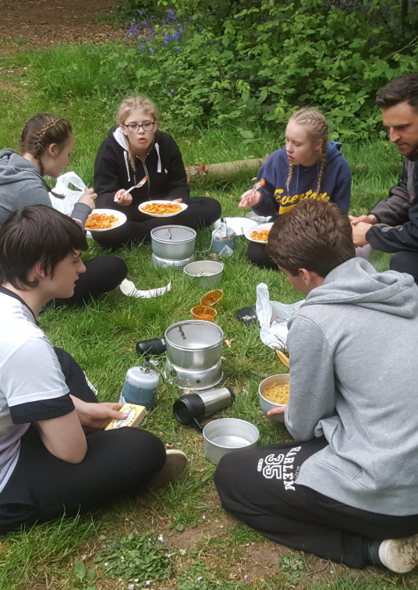
FOOD DO’S
Choose filling foods with plenty of carbohydrates, for example pasta or rice.
Plan your meals beforehand and take snacks to keep your energy levels up throughout the day.
Make sure you take sufficient breakfasts to provide you with energy throughout the day.
Consider how you are going to cook the meals you are taking.

Slide 18
FOOD DON’TS
Don’t take raw meat, you have no way of storing it safely and are likely to make yourself ill.
Don’t take pot noodles and similar snacks as main meals – they do not contain enough energy.
Don’t’ just eat chocolate and sweets, these provide short term energy only, and not the energy required to keep you going all day.

Slide 19
COOKING SAFETY CONSIDERATIONS
Resource Book
Page 89
Never cook in your tent, this produces a build up of carbon monoxide that will kill you.
Never cook close to your tent – you may set it on fire.
Never play games or fool around while cooking.

Slide 20
COOKING SAFETY CONSIDERATIONS
Resource Book
Page 89
Always take care when moving hot pans and food.
Always ensure you know how to safely operate the stove you are using.
Always light your stove correctly – never ever try to light a stove from another stove.

Slide 21
ANY QUESTIONS?
Are there any final questions?
?
Notes:
A chance to ask or answer any final questions.

Slide 22
LEARNING OUTCOMES
LO3: Understand the principles of safe camp craft on an expedition.
Explain food and cooking safety considerations for expeditions.
Notes:
LO3: Understand the principles of safe camp craft on an expedition.
P9: Explain food and cooking safety considerations for expeditions.

Slide 23
COOKING TASK
Logbook
Page 36
Practice cooking some food that could be eaten on an expedition.
When this is complete your instructor should sign page 36 of your First Class Logbook and fill in the Task P9 Activity 1 Initial Expedition Training log sheet.
Notes:
This task covers the mandatory requirement for objectives P9 for LO3.
Cadets must demonstrate how to prepare and cook food to be used on an expedition. This could be turned into a competition, which staff/
Once satisfied that all cadets have an understanding of the topic, instructors must fill in:
Page 36 of the cadet’s first class log book.
Task P9 Activity 1 log sheet. This can be found on Ultilearn.

Slide 24
INSTRUCTOR INFORMATION
This presentation is provided free of charge with the 1st class cadet training system with no warranty or support.
Every effort has been made to ensure the information is correct, but the author accepts no responsibility for any errors or omissions.
Official information on Ultilearn or Bader SharePoint should be checked before using these presentations.
These presentations may be distributed to other Air Cadet squadrons free of charge, but do not place them on the internet.
For best results, use with the 1st class resource book and 1st class instructor handbook, available from cadetdirect.com.
Version 19/04

