Slide 1
Notes:
Part 4 of 4. This presentation covers the information required to complete PASS criteria of the LO4 Initial Expedition Training topic.
For best results, these instructor notes should be read in conjunction with this presentation and the lesson plan.

Slide 2
LEARNING OUTCOMES
LO4: Recognise and treat the effects of hypothermia and heat excess.
Explain the symptoms of hypothermia and heat excess.
Describe how to treat hypothermia and heat excess.
Notes:
LO4: Recognise and treat the effects of hypothermia and heat excess.
P10: Explain the symptoms of hypothermia and heat excess.
P11: Describe how to treat hypothermia and heat excess.

Slide 3
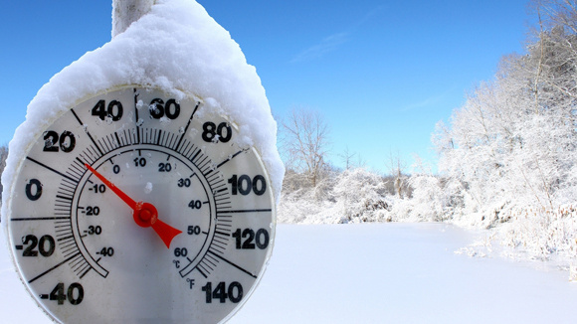
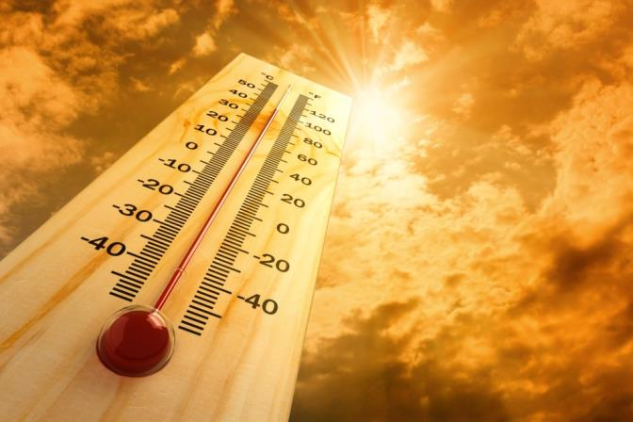
HYPOTHERMIA VS HYPERTHERMIA
Resource Book
Page 90-91
Hypothermia and Hyperthermia are both examples of conditions resulting from temperature.
Hypothermia results from prolonged exposure to cold.
Hyperthermia results from prolonged exposure to heat.
Notes:
Hypo for low temperature.

Slide 4
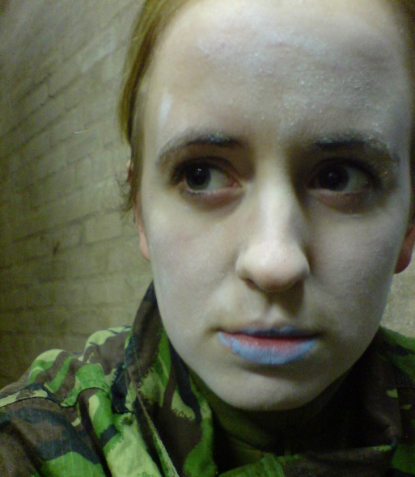
HYPOTHERMIA
Resource Book
Page 90
Symptoms can include:
  Shivering.
  Slurring words.
  Lack of co-ordination.
  Irrational behaviour.
  Inability to recall simple facts.
  Quiet and withdrawn.
  Blue lips.
  Change in usual behaviour.
Someone suffering from hypothermia may not have all of these, equally one symptom alone may not represent hypothermia.
Notes:
Shivering :in severe hypothermia shivering may have stopped
Slurring words: sounding like you’re drunk
Lack of co-ordination: stumbling over, lack of balance.
Irrational behaviour: stubbornness and failure to appreciate anything is wrong.
Inability to recall simple facts (e.g. Address): a simple test for hypothermia can be asking someone a serious of simple questions to see if they are able to answer.
Quiet and withdrawn : this usually represents a change in behaviour, someone is outgoing and loud acting very differently.
Blue lips
Change in usual behaviour: as above, has the person starting acting different to normal.

Slide 5
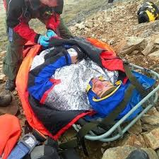
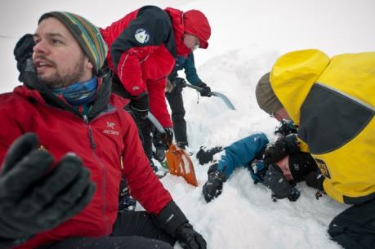
HYPOTHERMIA TREATMENT
Resource Book
Page 92
The casualty needs to be warmed slowly.
Shelter the casualty (tent or group shelter).
Insulate them with sleeping bag(s) or extra layers.
If they are in wet clothes these need to be removed and replaced with dry ones.
Warm (not hot) drink if available and sugar to replace energy.
Notes:
Warmed: it is crucial that this is slower, warming someone too quickly could result in an even more serious issue.
Shelter: If the weather is bad getting the casualty out of the weather is crucial
Extra layers: if they are dry then adding extra layers or sleeping bags, starting with 1 or 2, and adding more as they start to warm up.
Warm drink: to warm them from the inside
Sugar: hypothermia uses a lot of the bodies energy reserves in shivering – replace this to aid recovering.
Important note: as with anything, when out on expedition if any issue occurs staff need to be informed and/or mountain rescue. In addition when treating a casualty ensure all members of the groups add extra layers, lengthy treatment of casualties can result in others who are standing around doing nothing having the same issue!

Slide 6

HYPERTHERMIA
Resource Book
Page 91
Symptoms can include:
  Severe headache.
  Slurring words.
  Lack of co-ordination.
  Cramps .
  Rapid shallow breathing.
  Lack of sweating despite heat.
  Dizziness.
  Unconsciousness.
Someone suffering from hyperthermia may not have all of these, equally one symptom alone may not represent hyperthermia.
Notes:
Heat Exhaustion is where you become very hot and start to lose water or salt from your body which leads to a general feeling of being unwell. It may develop into heat stroke if not treated.
Heat Stroke (Hyperthermia) is where the body is no longer able to cool itself and a person's body temperature becomes dangerously high. Heatstroke is less common, but more serious. It can put a strain on the brain, heart, lungs, liver and kidneys, and can be life-threatening.
Staff must be informed if you think someone has developed a heat injury.
Severe headache: resulting from heat and lack of sufficient fluids
Slurring words: sounds like they are drunk
Lack of co-ordination: stumbling over things, lack of balance, walking very difficult.
Cramps: and pain resulting from lack of fluids in the body
Rapid shallow breathing: and rapid shallow pulse.
Lack of sweating despite heat: body has given up sweating
Dizziness: this could lead to a lack of co-ordination as outlined above.
Unconsciousness

Slide 7
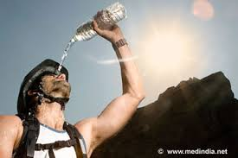
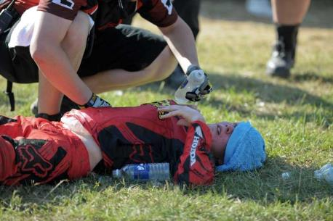
HYPERTHERMIA TREATMENT
Resource Book
Page 92
Get out of the sun into shelter (under tree etc).
Use cool water to cool the casualty. If possible submerse casualty completely.
Unlike hyperthermia the casualty can be cooled rapidly.
Get casualty to drink water.
Seek help immediately.
Notes:
Shelter: Remove the direct sunlight to help aid recovery
Cool water: This can be any water from streams, water bottles etc
Drink: None carbonated none alchoholic.
Important note: When out on expedition if any issue occurs staff need to be informed and/or mountain rescue. Delay in getting help can be fatal. In addition when treating a casualty ensure all members of the groups shelter and drink fluids, lengthy treatment of casualties can result in others who are standing around in the sun doing nothing having the same issue!

Slide 8
SEEKING HELP
Hypothermia and Hyperthermia are both potentially fatal and very dangerous.
In any cases of either condition you must seek help from staff and/or mountain rescue, any delay in seeking help could be life threatening.

Slide 9
ANY QUESTIONS?
Are there any final questions?
?
Notes:
A chance to ask or answer any final questions.

Slide 10
LEARNING OUTCOMES
LO4: Recognise and treat the effects of hypothermia and heat excess.
Explain the symptoms of hypothermia and heat excess.
Describe how to treat hypothermia and heat excess.
Notes:
LO4: Recognise and treat the effects of hypothermia and heat excess.
P10: Explain the symptoms of hypothermia and heat excess.
P11: Describe how to treat hypothermia and heat excess.

Slide 11
HOT AND COLD INJURIES TASK
Logbook
Page 37-38
Explain the symptoms of hypothermia, heat excess and heat stroke (hyperthermia).
When this is complete your instructor should check and sign page 37 and 38 of your First Class Logbook.
Notes:
This task covers the mandatory requirement for objectives P10 for LO3.
Cadets must fill in the sections on page 37-38 of the first class logbook concerning symptoms of hypothermia, heat excess and heat stroke
Once satisfied that all cadets have an understanding of the topic, instructors must check and sign:
Page 37-38 of the cadet’s first class log book.

Slide 12
INSTRUCTOR INFORMATION
This presentation is provided free of charge with the 1st class cadet training system with no warranty or support.
Every effort has been made to ensure the information is correct, but the author accepts no responsibility for any errors or omissions.
Official information on Ultilearn or Bader SharePoint should be checked before using these presentations.
These presentations may be distributed to other Air Cadet squadrons free of charge, but do not place them on the internet.
For best results, use with the 1st class resource book and 1st class instructor handbook, available from cadetdirect.com.
Version 19/04

