Slide 1
Uncontrolled copy not subject to amendment
Basic Radio L01 & LO3
Understand types of radio equipment used within the Air Cadet Organisation
Be able to follow procedures needed for the safe use of radio
Version 2.10 OCT 2014

Slide 2
Types of Equipment
Equipment ranges from:
  HF (High Frequency)
  VHF (Very High Frequency)
  UHF (Ultra High Frequency)
VHF and UHF are more popular
Radio sets often referred to as transceivers
They contain both a transmitter and a receiver
Notes:
Types of Equipment
Radio Sets
Although some Squadrons or Units have HF equipment, VHF and UHF radio sets are more popular and will be dealt with here. Radio sets are generally known as transceivers as each set contains both a transmitter and a receiver

Slide 3
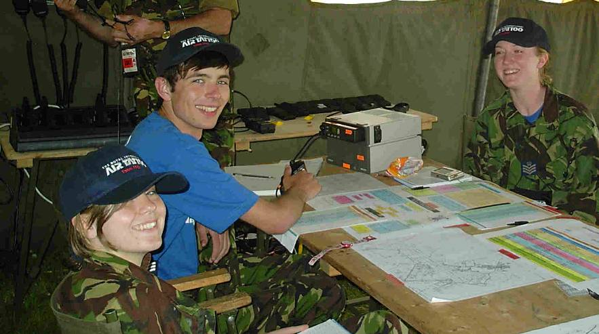
Base Stations
Fixed Installations
VHF and UHF range of around 50 Km
HF is UK wide and further
Notes:
Base Stations
Fixed installations at Squadron, Unit HQs or temporary locations are known as Base Stations. Base Station equipment is chosen for its reliability, stability and power output. The range for UHF or VHF Base Stations may exceed 50 Km.

Slide 4
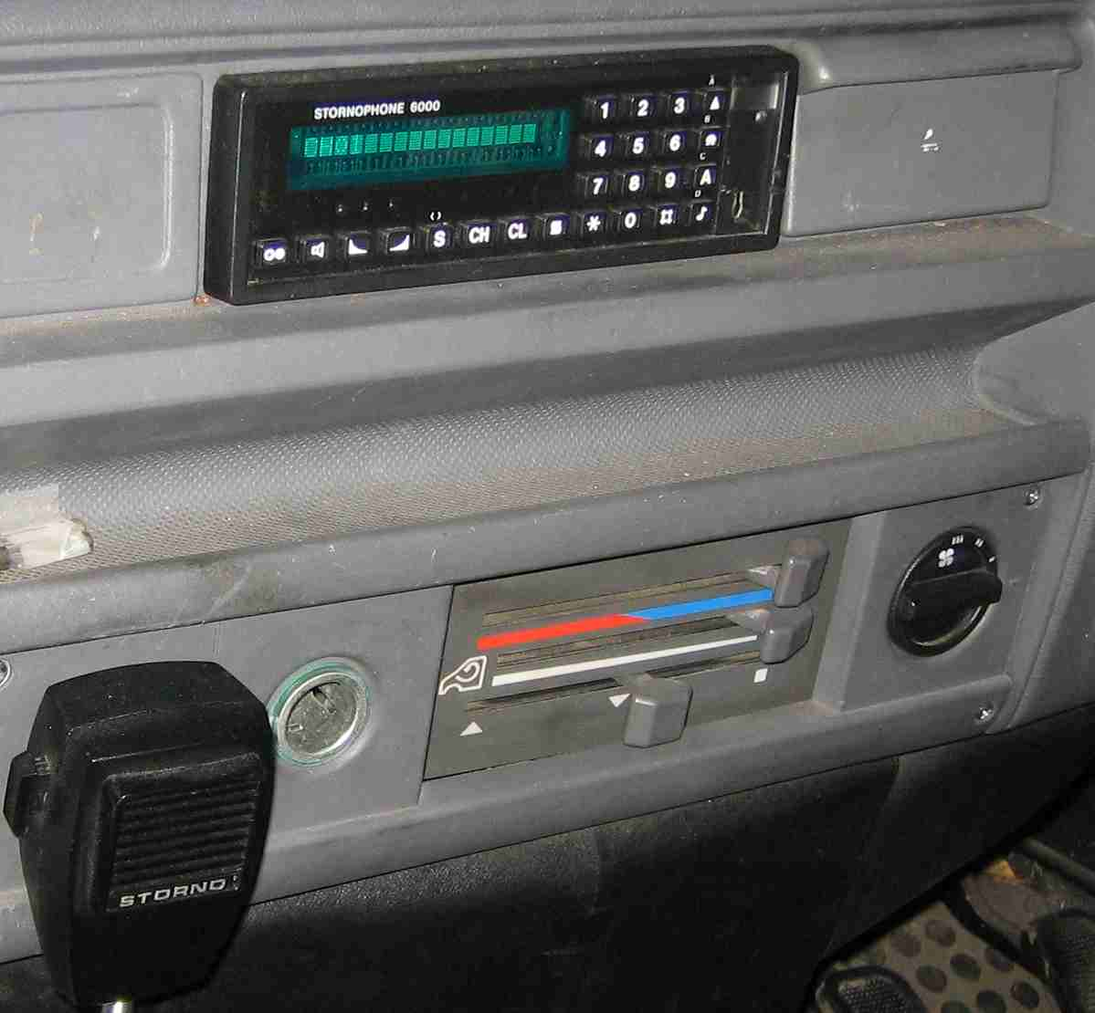
Vehicle Equipment
A typical vehicle installation:
  Uses the vehicle’s battery
  Has a better aerial than a hand held radio
  Has a power output a little less than a Base Station
  Has a range of up to 30 km
Notes:
Vehicle Equipment
For vehicle equipment, referred to as mobile equipment, reliability is a most important criterion coupled with a requirement for robustness to withstand vibration and shock loads. Vehicle equipment is also reasonably efficient as it is usually powered from the vehicle’s battery and has a better aerial than hand held equipments. Power output requirements are not as high as for base station equipment. The effective range is usually less, perhaps up to about 30 Km.

Slide 5
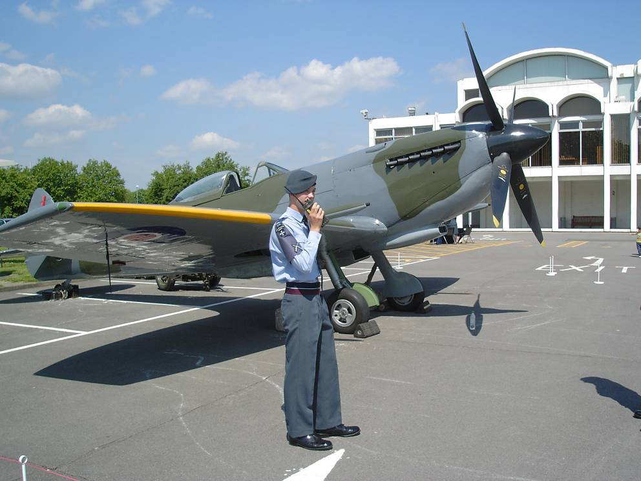
Hand Portable
Has a very short range (about 1 to 5 km)
Uses a rechargeable battery
Has a battery life of around 6-8 hours
Notes:
Hand Portable Equipment
As with vehicle mobile equipment, reliability and robustness are most important. Good quality commercial equipment is designed for heavy use but should be treated with care.
Most hand portable transceivers will only have a range of about 1-5 km and dependent upon the terrain. They use a rechargeable battery and the normal life of a battery in good condition is about 6-8 hours on a full charge.

Slide 6
Hand Portable
To extend the battery’s life:
  Keep transmissions short
  Use the low power setting whenever possible
Notes:
Battery Life
A transceiver will reduce the power in the battery more quickly when it is transmitting rather than receiving. Therefore you should keep transmissions as brief as possible to conserve battery life. If the transceiver has a lower power setting and communications can be maintained on this setting, then this setting should be used to save battery power. If contact is lost, high power can be selected to try and regain contact with the other station. It is particularly important to save battery life when operating away from your base, such as when undergoing adventurous training.

Slide 7
Safety Precautions
NEVER:
Carry loose batteries in pockets or bags
Short the terminals together
ALWAYS:
Cover battery terminals in transit or when not in use
Charge with the correct type of charger for correct time
Notes:
Safety precautions
The type of batteries used for hand held and mobile equipments require a high current capacity. In view of this, when they are not attached to the radio, they should be handled with care. You are reminded of the following points:
NEVER
 Carry loose batteries in pockets or bags.
 Short the terminals together.
ALWAYS
 Cover battery terminals in transit or when not in use.
 Charge with the correct type of charger.

Slide 8

Safety Precautions
Batteries
Contain substances harmful to environment
They must be disposed of responsibly
Notes:
Batteries contain substances which are harmful to the environment. When they have reached the end of there useful life they must be disposed of responsibly.

Slide 9
Operating Range
The main factors affecting operating range include:
Frequency
Power
Receiver
Aerial efficiency
Atmospheric conditions
Position of aerial
Notes:
Operating Range
The effective range of a radio depends upon a combination of several factors. The main factors, which will affect the range you will be able to achieve, are:
a. The frequency band in use.
b. The power output of the transmitter.
c. The sensitivity of the receiver.
d. The efficiency of the aerial system.
e. The prevailing atmospheric conditions.
f. The position of the aerial.
Many of these you will be unable to change but some you will be able to influence, for example a fully charged battery in a portable will mean maximum power output during transmission.

Slide 10
Aerial Position
Factors that can reduce operating range include:
Buildings
Metal objects
Hills
Trees in leaf
Notes:
Aerial Position
The Aerial positioning can have a marked effect on range. Standing too close to metal objects or buildings can restrict range dramatically. Since the UHF and VHF bands are effectively limited to line of sight communication, the aerial should be positioned as high as safely possible to achieve the greatest range. When using hand held equipments you should expect to have less range when operating in a valley.

Slide 11
Aerial Position
To Increase operating range, you should:
Use high ground
Use a professionally installed mast
Position the aerial away from power lines
.... and ensure proper supervisions at all times!
Notes:
Aerial Position
One of the more common ways to increase the range of a base station is to put up a mast type aerial. A properly designed and erected aerial can be extremely effective. However, care must again be taken. A falling mast has the potential to cause great injury or damage to property. Masts may present some unforeseen hazards. They may be blown over in a high wind, struck by lightning, touch nearby power lines or you could even trip over the guy ropes. All these problems can be avoided with care and planning. You must always consider the hazards, identify the risks and plan accordingly. It is important that all training involving the setting up of aerial systems are properly supervised at all times.

Slide 12

Radio Relay

Slide 13
Equipment
NEVER:
Hold Set by the aerial
Leave a radio unattended
Alter settings unless instructed
Transmit close to another radio
ALWAYS:
Switch off after use
Keep dry and clean
Turn off other sets at same location on same channel
Notes:
Use and treatment
Radio equipment is expensive to buy and maintain. You should take care of any equipment entrusted to you. A few pointers are set below:
NEVER
 Hold a set by the aerial
 Leave a radio unattended
 Alter the settings of the controls unless instructed
 Transmit close to another radio
ALWAYS
 Switch off after use
 Keep dry and clean
 Turn off additional radios at the same location on the same channel

Slide 14
Safety
Keep equipment safe
Do not take unnecessary risks
Be responsible for everyone's safety
Risk Assessments must be in place
Familiarise yourself with the Risk Assessments
Notes:
Safety
With a little thought and common sense Radio operating is a safe and enjoyable activity. However, like any other activity, taking unnecessary risk could put yourself and others in danger. It is important that we all take responsibility for everyone’s safety. Every Air Cadet Unit with Radio equipment must have all the necessary risk assessments in place. Your Instructors will have drawn up these assessments. It is import that everyone involved, from the most junior Cadet to the Commanding Officer, must have the content of these assessments explained to them.

Slide 15
Any questions?

