Slide 1
Uncontrolled copy not subject to amendment
Basic Radio Communications
LO2 Part 1
Be able to send messages on the Air Cadet radio network
Version 2.10 OCT 2014

Slide 2
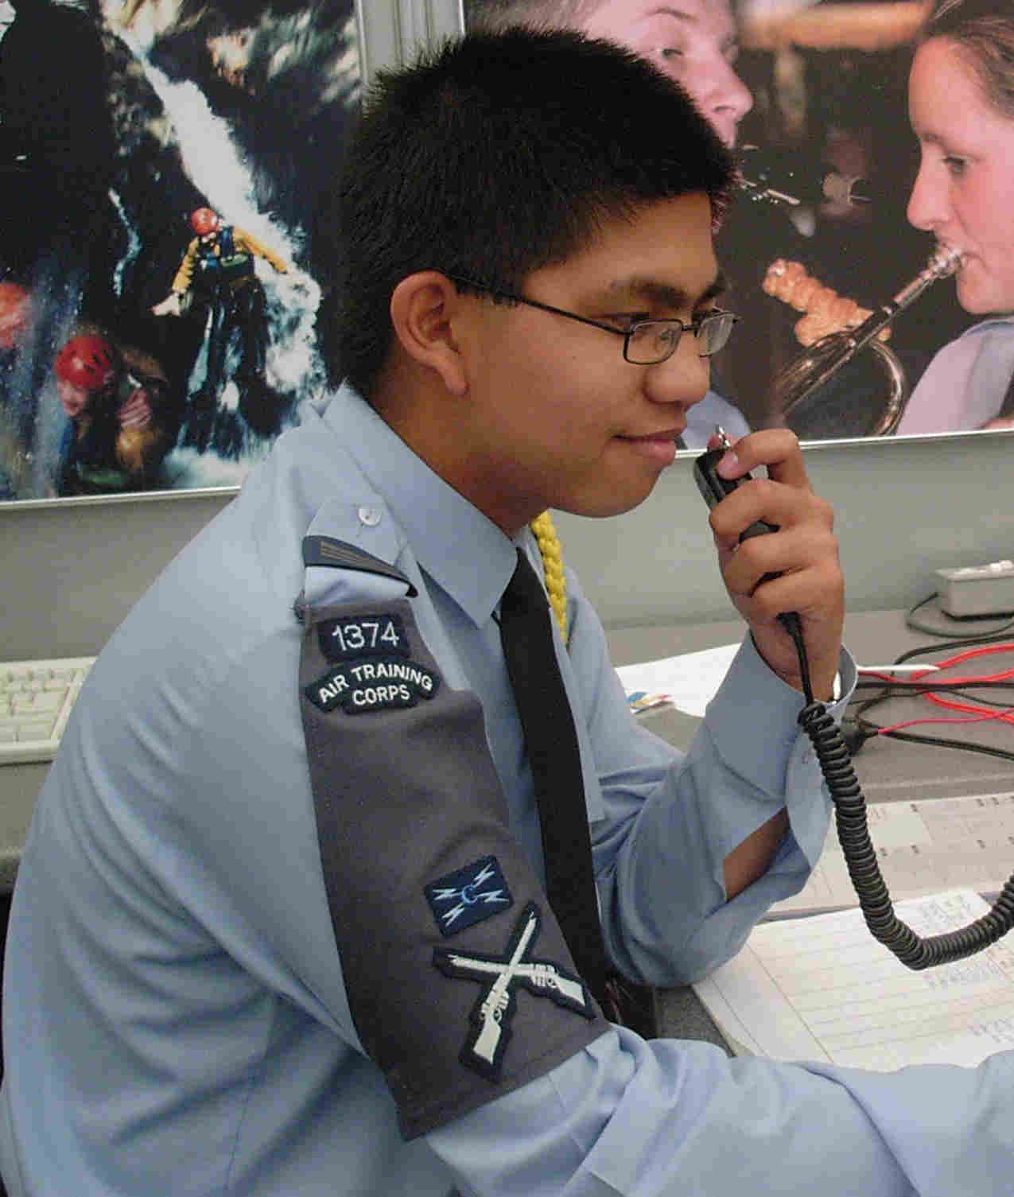
Part 1 Radio Procedures
Notes:
Radio Procedures
This Section Deals with:
Aspects of Security
Accuracy
Prowords

Slide 3
Radio Procedures
S
A
D
ECURITY
CCURACY
ISCIPLINE
Notes:
Introduction
SAD Stands for
Correct radio procedures can be remembered using "SAD".
The letters stand for:
Security
Accuracy
Discipline

Slide 4
Callsigns
MRA 23
M Callsign allocated to the UK
R Associated with the RAF
A Indicates geographical location
23 Serial number issued by HQ AC
MRA 23 A1
Issued by local unit
Notes:
Security
The identity of a station must be kept as secret as possible. This is done by using a unique callsign allocated to each station, in accordance with International Regulations. Air Cadet Callsigns primarily consist of three letters followed by two numbers. For example:
MRA 23
M - Denotes that the Callsign is allocated to the United Kingdom.
R - Indicates that the station is associated with the RAF.
A - Is an indication of the geographical location.
23 - A serial number issued to the station by HQ Air Cadets.
There is a list of Air Cadet Callsigns which is available to Units and one should be available in every Radio Communications Room.
If a station has equipment which is used elsewhere, such as hand held radios or a vehicle set, they are given an extension to the parent station's callsign .

Slide 5
Main Station Callsign
This is given using the phonetic alphabet
So, the Main Station Callsign MRA 99:
Mike Romeo Alpha Nine Nine
is pronounced
Mike Romeo Alpha Nine-er Nine-er
Notes:
Main Station Callsign
When referring to a callsign it must, on all occasions, be given using the Phonetic Alphabet. (We will learn this Alphabet later in the book) Therefore, a callsign would be sent as follows:
“Mike Romeo Alpha Nine-er Nine-er”

Slide 6
Non Main Station Callsign
This is used away from the Main Station
The local unit should add either:
  One alpha character
  One alpha character and one number
  Two alpha characters
AC and CC should be avoided
Notes:
Non Main Station Callsign
Alpha or Alpha/Numeric characters may be added. One Letter, one letter and one number or two letters may be used.
Examples
MRA 99 A MRA 99 A1 MRA 99 AA
MRA 99 B MRA 99 A2 MRA 99 AB
MRA 99 G MRA 99 B9 MRA 99 BG
MRA 99 X MRA 99 Y1 MRA 99 PQ
Note: The combination of AC and CC should be avoided.
See next slide

Slide 7
Non Main Station Callsign examples
MRA 99 A MRA 99 A1 MRA 99 AA
MRA 99 B MRA 99 A2 MRA 99 AB
MRA 99 G MRA 99 B9 MRA 99 BG
MRA 99 X MRA 99 Y1 MRA 99 PQ
Reminder:
The combination of AC and CC should be avoided
Notes:
Non Base Station Callsign Examples

Slide 8
Abbreviated Callsigns
These are used for:
The ease of sending
To speed up sending
Used when instructed
Abbreviated Callsigns should not be used:
If conditions are poor
If there is a risk of duplication
Notes:
Abbreviated Callsign
For ease of sending and to speed up the passing of messages the callsign can be abbreviated by omitting the first two characters. Therefore MRA 99 A would become A 99 A. If conditions are poor there is a likelihood of any duplication of Callsigns on net, or you are instructed by the Net Control Station, full Callsigns are to be used.

Slide 9
Security
The Sender
The Listeners
The Interceptors
Notes:
Radio Security
The fact that there may be more than one listener highlights another very important point. One or more of the listeners may be unauthorised. Unauthorised listeners are called interceptors. You must always assume that for every transmission there are three elements:
a. The sender.
b. The listeners.
The interceptors.
Service radio procedures have been developed to safeguard the meaning of a message from an interceptor and also to ensure that all authorised listeners understand the message. These procedures also enable transmissions to be short, thus saving power (essential for mobile units) and allowing more stations to use the network.

Slide 10
Security
Never
Use unauthorised codenames
Use personal names or nicknames
Use slang or jargon
Transmit aircraft types, roles or weapon loads in clear speech
Transmit details of arms or ammunition and particularly their movement
Transmit unit locations in clear speech
Notes:
Security Don'ts
When using a radio you should always consider security and the following list will help you:
NEVER
 Use unauthorised codenames.
 Use personal names or nicknames.
 Use slang, jargon.
 Transmit aircraft types, roles or weapon loads in clear speech.
 Transmit details of arms or ammunition, particularly their movements.
 Transmit unit locations in clear speech.

Slide 11
Security
Always
Use your callsign at the start of a transmission
Use only authorised appointment titles
Ask a station to “authenticate” if you think it may not be genuine
Notes:
Security do’s
When using a radio you should always consider security and the following list will help you:
ALWAYS
 Use your callsign at the start of a transmission.
 Use only authorised appointment titles.
(Examples are shown at Annex B)
 Ask a station to “Authenticate” if you think it may not be a genuine Station calling.

Slide 12
Security
Authentication
Is a way to help protect your communications
How to do this is described later
Notes:
Security
Authentication is a security aid designed to protect communications against transmissions by unauthorised persons. Details of how this is done is given in the next chapter.

Slide 13
Security
Additional aids to security
Codes
Appointment Titles
Veiled Speech
Notes:
Security
There are several other aids to security including the use of Codes, Common Appointments and Veiled Speech.
a. Codes: There are many codes which enable information to be transmitted in a way that leaves an interceptor unaware of the message content. For codes to work effectively it is necessary for senders and listeners to have made prior arrangements, so that they both use the same code system. The only code system used by Air Cadets is a code known as Codex which you may learn more about if you continue with radio training.
b. Appointment Titles: An Appointments Title is a specific word chosen to indicate the holder of a particular appointment and these titles are not codewords. They are an aid to security by concealing the level of command. Each title is specific to the Callsign in use. (see Annex B for list of common titles)
c. Veiled Speech: This simple method of conveying information is used when both the listener and sender are aware of the subject matter e.g.
“Meet me at the same time and place as last week”.

Slide 14
Accuracy
Before transmitting
Listen and check that you can not hear another station
Know how to use microphone
Keep hands away from the front of the microphone
Hold the microphone 50 mm from your mouth ready to speak across it
Do not hold the boom of a head set or desk microphone
Notes:
Accuracy
Voice messages over the radio should be clear, logical and brief. The following techniques will assist you in making sure that your transmitted speech is clearly and satisfactorily received.
Before transmitting listen out on the frequency to ensure that there will be no interference with a transmission from another station.
b. Be familiar with the operation of your microphone and do not turn your head away from it whilst talking. Try not to vary the distance between the microphone and your mouth.
c. Do not touch the microphone with anything whilst transmitting, even your lips can cause severe distortion.
d. Do not talk too close to the microphone. The microphone should be about 50 mm (2 inches) away from your mouth and you should speak across it rather than directly into it.
e. Do not hold the microphone or boom of a combined headset/ microphone system.
.

Slide 15
Accuracy
Whilst transmitting
Speak clearly and distinctly
Pause before and after numbers
Avoid hesitations such as “er” or “um”
Only press the PTT button when ready
Do not release PTT until you have finished speaking
When finished check that the PTT button has released correctly
Notes:
Whilst Speaking:
f. Use a normal conversational tone, speak clearly and
distinctly.
g. A slight pause before and after numbers will make them easier to understand.
h. Do not use hesitation sounds such as "er" or "um".
Only press the Press To Transmit (PTT) switch when ready to speak, and ensure that you press it fully before speaking. If you stop speaking during your message, release the PTT switch until you are ready to start speaking again - such breaks in transmission should be avoided.
j. Do not release the switch until you have finished talking, this will ensure that the message is complete, and not clipped.
k. Always ensure that the PTT switch has released correctly and that there is no likelihood of it being inadvertently switched on. This would avoid the potentially dangerous and irritating situation of a "stuck" microphone blocking out all other transmissions

Slide 16
Part 2 Use of Microphone

Slide 17
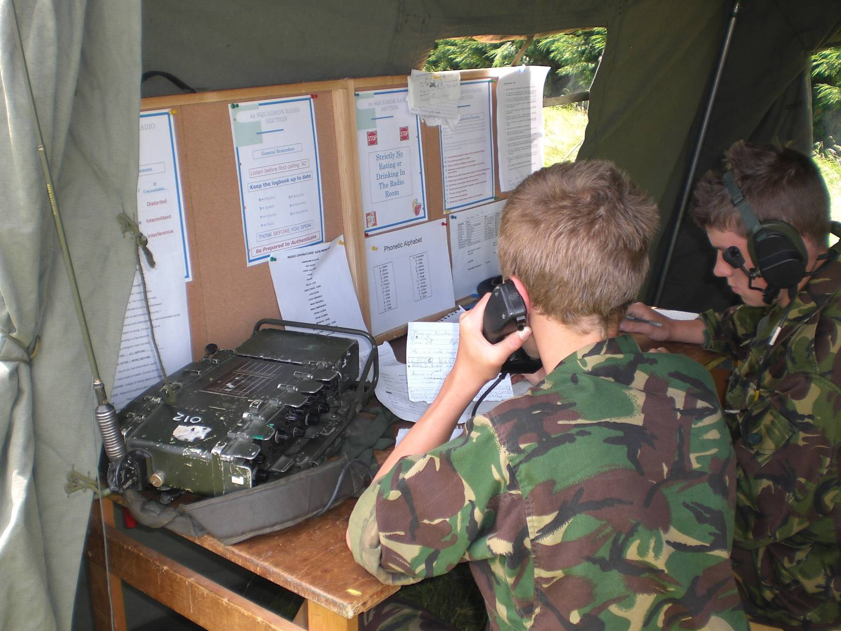
Accuracy
R
Rhythm
S
Speed
V
Volume
P
Pitch
Notes:
Accuracy
The letters RSVP will help you remember how to talk on the radio. They have the following meaning:
R - Rhythm. You should try to develop a natural rhythm when speaking, and divide the message into sensibly sized sections.
S - Speed. You should use an even rate of speaking, slightly slower than normal. This will aid understanding and give you time to think. When you know that the contents of a message will have to be written down by the listener, speak at an even slower rate. If your message is long, break it down into smaller more manageable parts and use standard Prowords (see below) to shorten the message where possible.
V - Volume. You should maintain your speaking volume at a constant level. There is no need to shout but you should ensure that it is loud enough to overcome any background noise. It is far better to reduce the background noise than it is to shout louder.
P - Pitch. The voice should be pitched slightly higher than normal. Female operators, and those with a naturally higher pitched voice may not need to increase their pitch noticeably.

Slide 18
Prowords
THIS IS The callsign of the sender follows
OVER This is the end of my present transmission
A reply is required
OUT This is the end of my transmission
No reply is expected
Notes:
Prowords
By using standardised words and phrases it is possible to keep voice transmissions brief and clear. Whole sentences can be replaced by easily pronounced and widely recognisable prowords that convey a specific meaning.
THIS IS Indicates the callsign of the sender is about to follow.
OVER This is the end of my present transmission to a listener - a reply or acknowledgement is required.
OUT This is the end of my transmission - no reply is expected.

Slide 19
Prowords
WAIT OUT Your transmission has been received
A reply will follow later
WILCO Message received, understood
I will comply with your instructions
ROGER I have received your last transmission
Notes:
Prowords
WAIT OUT Your transmission has been received, a reply will follow later.
WILCO Message received, understood and I will comply with your instructions.
ROGER I have received your last transmission satisfactorily.

Slide 20
Prowords
SAY AGAIN Request for repetition of all or part of
a message
I SPELL I shall spell the next word
MESSAGE The transmission to follow will need
to be written down
Notes:
Prowords
SAY AGAIN Request for repetition of a whole, or part of a message.
I SPELL I shall spell the next word phonetically.
MESSAGE The transmission to follow will require to be written down.

Slide 21
Prowords
FIGURES Used before groups of numbers sent
digit by digit
GRID Used before grid reference are sent in
clear speech
SPEAK SLOWER Transmit at a slower speed
TIME The following group is a time group,
or a date/time group
Notes:
Prowords
FIGURES Used before groups of numbers sent digit by digit.
GRID Used before a grid reference sent in clear speech.
SPEAK SLOWER Transmit at a lower speed.
TIME The following group is a time group or a date time group.

Slide 22
Prowords
UNKNOWN STATION
Used when calling a Station whose
identity is not known
CORRECT You are correct, or what you have
transmitted is correct
WRONG Your last transmission was incorrect
The correct version is...
Notes:
Prowords
UNKNOWN STATION Used when calling a Station whose identity is not known.
CORRECT You are correct, or what you have transmitted is correct.
WRONG Your last transmission was incorrect. Correct version is...

Slide 23
Phonetics
Phonetics are used:
When reception is poor
  The signal is weak
  There is high background noise
Words are difficult to pronounce
The operator has a strong accent
Notes:
Phonetics
Sometimes it may be necessary to spell out words in a clear, deliberate and unmistakable way. You may need to do this when radio reception is weak, interrupted, background noise is high, the word is difficult to pronounce, or perhaps when a radio operator has a strong accent. The system of representing vocal sounds and spellings the same way is called the phonetic alphabet and the standard is internationally accepted and understood.

Slide 24
Phonetics
Letter Word Pronunciation
A Alpha Al - Fah
B Bravo Brah - Voh
C Charlie Char - Lee
D Delta Del - Tah
Notes:
Phonetic Pronunciation
Phonetic pronunciation can be used for both letters and numbers; the individual letters being replaced with a single word. The first letter of the word is the same as the letter it represents, and the words are specially chosen to be unmistakable. The numbers also have a single distinctive word to represent them and a list of letters, numbers, words and the appropriate pronunciations are given in (Annex A) a small selection is shown below.
Letter Word Pronunciation
A Alpha AL FAH
B Bravo BRAH VOH
C Charlie CHAR LEE
D Delta DELL TAH

Slide 25
Phonetics
Other examples:
Letter Word Pronunciation
M Mike Mike
R Romeo Row - Mee - Oh
V Victor Vik - Tah
There is a full list in the separate Self Teach Presentation
Notes:
By looking at these examples you will see that any message containing phonetics is going to be much longer than one that does not. As a result you should always use phonetics with care, being aware that transmission time will be increased, reducing battery life on portable equipment and net availability.
Certain parts of a transmission are vital and should always be sent using phonetics to prevent any misunderstanding. For example, the callsign of a station, map references, times and Air Cadet channel numbers. Callsigns are sent using phonetics so that the listener can be sure they are being called.

Slide 26
Map References
The Proword “Grid” precedes a Grid Ref
Example: TQ 123 456
This should be sent as follows:
GRID (short pause)
Tango Quebec (short pause)
Wun Too Tree (short pause)
Fower Fife Six
When sending Grid References they should be sent more slowly than normal
Notes:
Map References
Grid References
Map References should always be preceded by the Proword GRID to alert the listener that the phonetic numbers that follow are a map reference. It is most likely that the map reference will be written down so it should be given at a slower speed than normal. It will assist you as a sender if you write the grid reference down yourself so you can repeat it if necessary.
Example
Grid reference TQ 123 456 would be given:
“GRID Tango Quebec Wun Too Tree Fower Fife Six”.

Slide 27
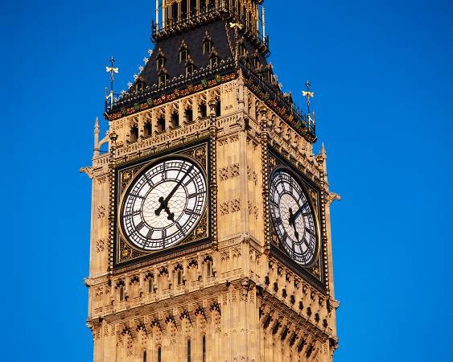
Time
Time is preceded by the Proword “Time” and is given using the 24-hour clock
Example: 1340 Hours
This should be sent as follows
Time (short pause)
Wun Tree (short pause)
Fower Zero
Notes:
Time
Particular care should be taken when a message contains timings or reference to time. The recipient of a message should be under no illusion as to the units of time to be used, hours, minutes or even seconds.
The time of day should always be given using the 24-hour clock.
Example
Time 13 40 Hours would be given “Time thirteen forty hours” or if conditions are difficult:
“TIME Figures Wun Tree Fower Zero”

Slide 28
Discipline
ALWAYS
Use correct voice operating procedure
Maintain a constant radio listening watch
Ensure correct channel/frequency is selected
Answer all your calls correctly
Think before transmitting and make sure you know your message
Release the PTT switch as soon as you have finished speaking and ensure the set returns to receive
Notes:
Discipline
Poor discipline degrades communications efficiency, accuracy and security. You should always try to follow these guidelines:
ALWAYS
 Use correct voice operating procedure.
 Maintain a constant listening radio watch.
 Ensure the correct frequency or channel is selected and used.
 Answer all your calls correctly.
 Think before transmitting and make sure that you know your message.
 Release the transmit switch as soon as you have finished speaking and make sure that the set returns to receive.

Slide 29
Discipline
NEVER
Compromise classified information by using plain language
Make unnecessary, over long or unofficial transmissions
Identify yourself or your unit by name
Swear or lose your temper
Notes:
NEVER
Compromise classified information by using plain language.
Make unnecessary, over-long or unofficial transmissions.
Identify yourself or your unit by name.
Swear or lose your temper.
Disclose Air Cadet Frequencies.
Disclose telephone numbers or addresses.
Personal details about yourself or others.

Slide 30
Discipline
NEVER
Disclose frequencies
Give telephone numbers or addresses
Personal details about yourself or others
Play music
Notes:
NEVER
Disclose Air Cadet Frequencies.
Disclose telephone numbers or addresses.
Personal details about yourself or others.
Play Music

Slide 31
Any questions?

