Slide 2
LEARNING OUTCOMES
LO1: Have an appreciation of the history of lighter-than-air craft and the methods of control applied to airships.
Identify the key milestones in the history of lighter-than-air craft.
Notes:
LO1: Have an appreciation of the history of lighter-than-air craft and the methods of control applied to airships.
P1: Identify the key milestones in the history of lighter-than-air craft.

Slide 3
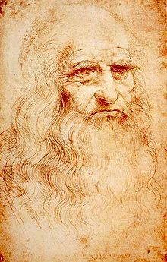
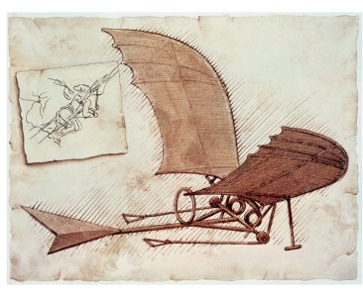
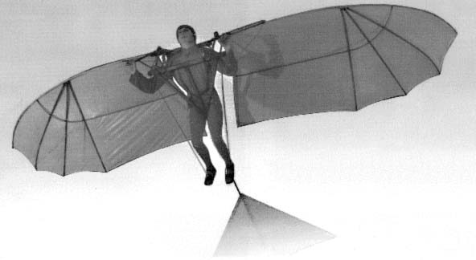
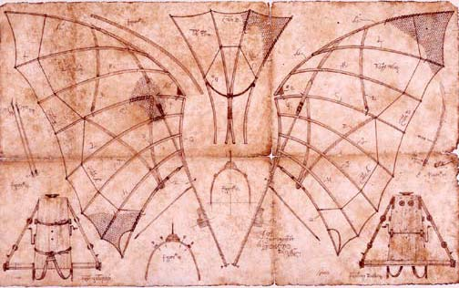
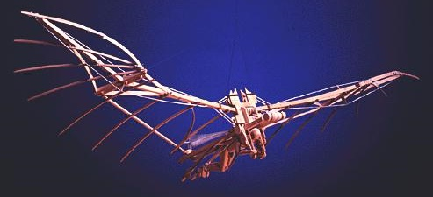
LEONARDO DA VINCI
Resource Book
Page 46
1452 – 1519.
An Italian artist and inventor who produced many designs for aircraft which relied on flapping wings.
Why wouldn’t the designs have worked?
Notes:
Leonardo Da Vinci designed an aircraft inspired by the flight of winged animals such as bats and birds.
His flying machine had a wingspan of 33 feet.
Although his ideas would seem to be capable of flight, they were very heavy.
The pilot would operate the machine through pulleys and rods attached to his feet.
His feet would move rather like riding a bicycle to imitate the flapping of wings.
Also man was not powerful enough to operate the wings.
He soon realised that imitating the way a bird glided was preferable than trying to move wings.
His wing shapes were bird or bat-like and moved through cables attached to handles.

Slide 4
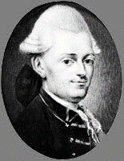
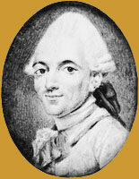
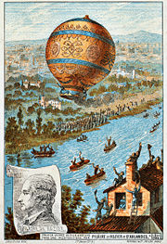
THE MONTGOLFIER BROTHERS
Resource Book
Page 46
The Montgolfier brothers built the first hot air balloon.
First Flight in France – 25 April 1783 – 1000ft climbed.
In September 1783 a sheep, duck and cockerel became airborne in the balloon.
At the end of 1783 two passengers flew in the balloon for 25 minutes, travelling 9km.
Notes:
The Montgolfier Brothers created the first ever hot air balloon which was made of silk and lined with paper. The balloon was around 12 metres and rose over 1000 feet.
In September 1783 a further demonstration saw the balloon lift a sheep, a duck and a cockerel - the first living creatures to become artificially airborne. There were no injuries and the sheep just ate straw and the duck and cockerel were too frightened to care.
Later in the same year Francois Pilatre de Rozier accompanied by the Maquis d’Arlandes made the first free flight in the balloon, remaining airborne for 25 minutes and travelling a distance of 9km.

Slide 5
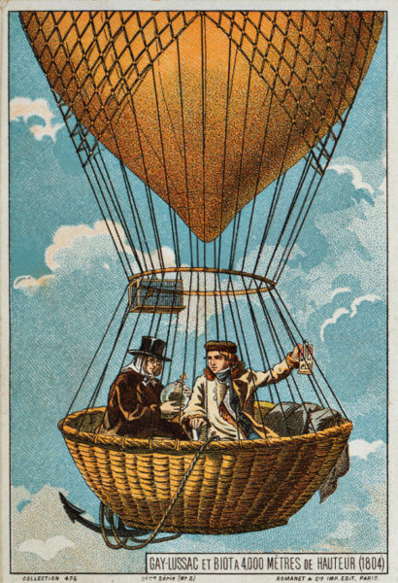
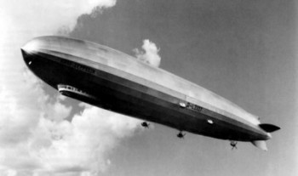
AIRSHIPS
Resource Book
Page 46
J Charles designed the first airship, also in 1783.
A 27 mile free flight was made by J. Charles and his assistant from Paris.
In the 1900s airships were considered the way forward for air travel. As they were comfortable, controllable and used little fuel.
What advantages do airships have over balloons?
Notes:
Although this was the beginning of manned flight, it was also the end of the Montgolfier balloon; almost immediately superseded by a much superior and practical hydrogen-filled balloon developed by J Charles. The design was so good that modern airships use the same system today, but they are now filled with helium instead of hydrogen.
After the flight the balloon was attacked by terrified peasants who thought it was a monster from the sky! 10 days after the Montgolfier brothers flight on 21 Nov 1783, Charles along with 2 brothers Nicholas and Aine Jean Robert, became the first humans to ascend in a hydrogen filled balloon. up to 3000 mts nearly 10,000 ft.
Airships are not very common nowadays but in the early 1900s they were considered by many people to be the way forward for air travel. They were quiet and provided passengers with a high degree of comfort. Their ability to remain stationary relative to the ground while using very little fuel made them ideal for scientific and military work. Their size and lifting capacity enabled them to carry large cargoes relatively cheaply. Unfortunately, they were filled with hydrogen gas which made them extremely dangerous - hydrogen gas can be ignited with a tiny spark and will explode with tremendous force.

Slide 6
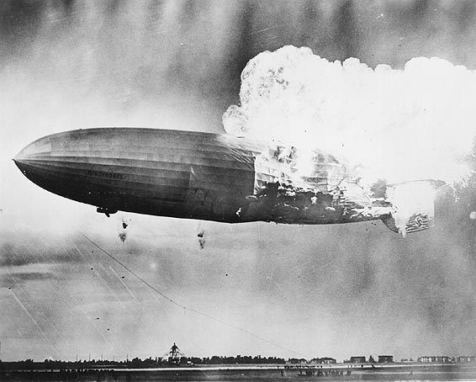
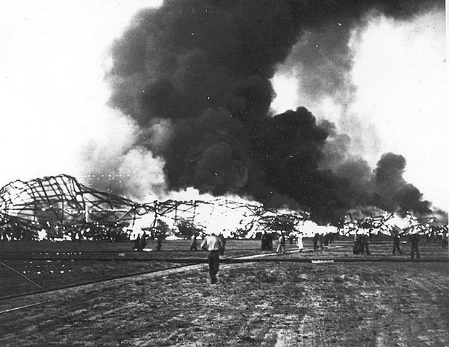
THE HINDENBURG DISASTER
Resource Book
Page 47
On Thursday, May 16th 1937, a the Hindenburg was destroyed.
36 were killed.
Electrostatic discharge (a spark), ignited the fuel, causing the airship to be swallowed in flames.
This disaster caused the end of the airship era.
Airships are now filled with helium which is not flammable.
Notes:
On 6 May 1937 as the Hindenburg was approaching Lakehurst Naval Air Station, it encountered a storm. Although the crew delayed landing, the captain decided to land. At 6pm it was raining heavily, but 115 mins later it was reported that conditions were favourable. During the approach the airship was tail heavy, so water ballast was dropped, actually on spectators!
At 7.21pm an attempt to land was made. Most passengers stood by the windows. A flame was seen on the tail of the airship which rapidly spread.
Some passengers jumped to their death from 300ft. Amazingly only 35 out of 97 people died, plus one crew member.
Modern airships are now filled with helium, which is lighter than air, but not flammable.

Slide 7
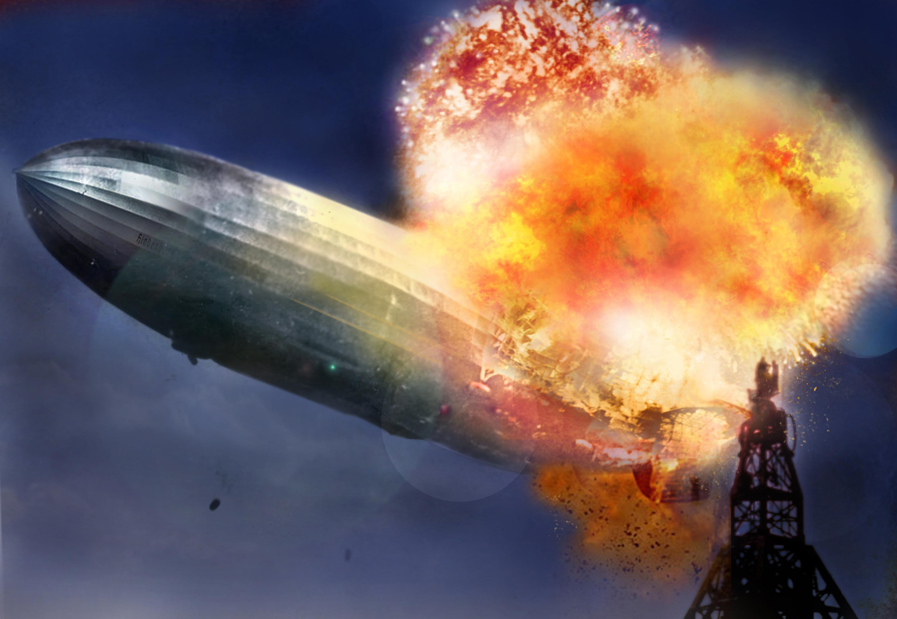
THE HINDENBURG DISASTER
Resource Book
Page 47

Slide 8
ANY QUESTIONS?
Are there any final questions?
?
Notes:
A chance to ask or answer any final questions.

Slide 9
LEARNING OUTCOMES
LO1: Have an appreciation of the history of lighter-than-air craft and the methods of control applied to airships.
Identify the key milestones in the history of lighter-than-air craft.
Notes:
LO1: Have an appreciation of the history of lighter-than-air craft and the methods of control applied to airships.
P1: Identify the key milestones in the history of lighter-than-air craft.

Slide 10
LEARNING OUTCOMES
LO1: Have an appreciation of the history of lighter-than-air craft and the methods of control applied to airships.
Describe how airships are controlled.
Notes:
LO1: Have an appreciation of the history of lighter-than-air craft and the methods of control applied to airships.
P2: Describe how airships are controlled.

Slide 11
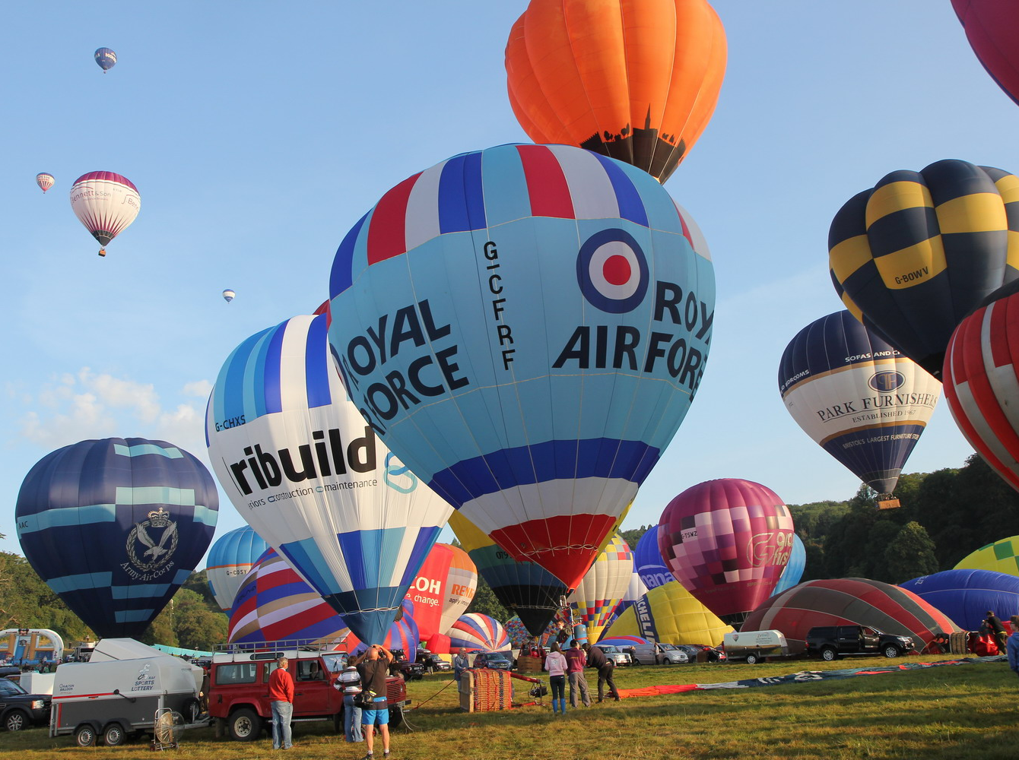
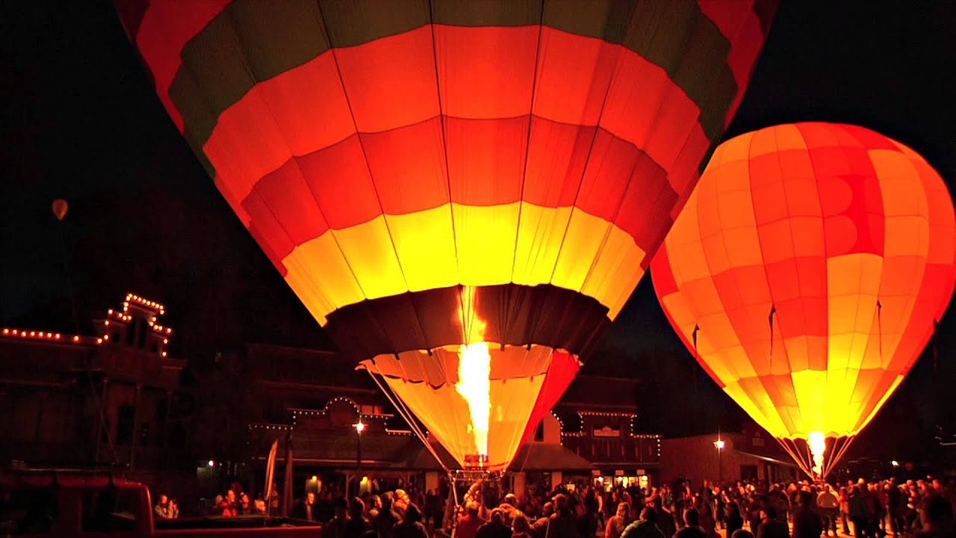
HOT AIR BALLOONS
As air is heated in the balloon, it expands.
This means the air inside the balloon becomes lighter than the air outside, causing the balloon to rise.
The balloon is carried by the wind.
Airships were designed to work like hot air balloons but with directional control instead of being carried by the wind.
Notes:
An inflated balloon displaces its own volume of air, so experiences lift or up-thrust.
A Helium balloon inflated to about the size of a house would contain half a tonne of gas and would displace the same volume of air weighing 4 tonnes.
Therefore a lifting force is generated.

Slide 12
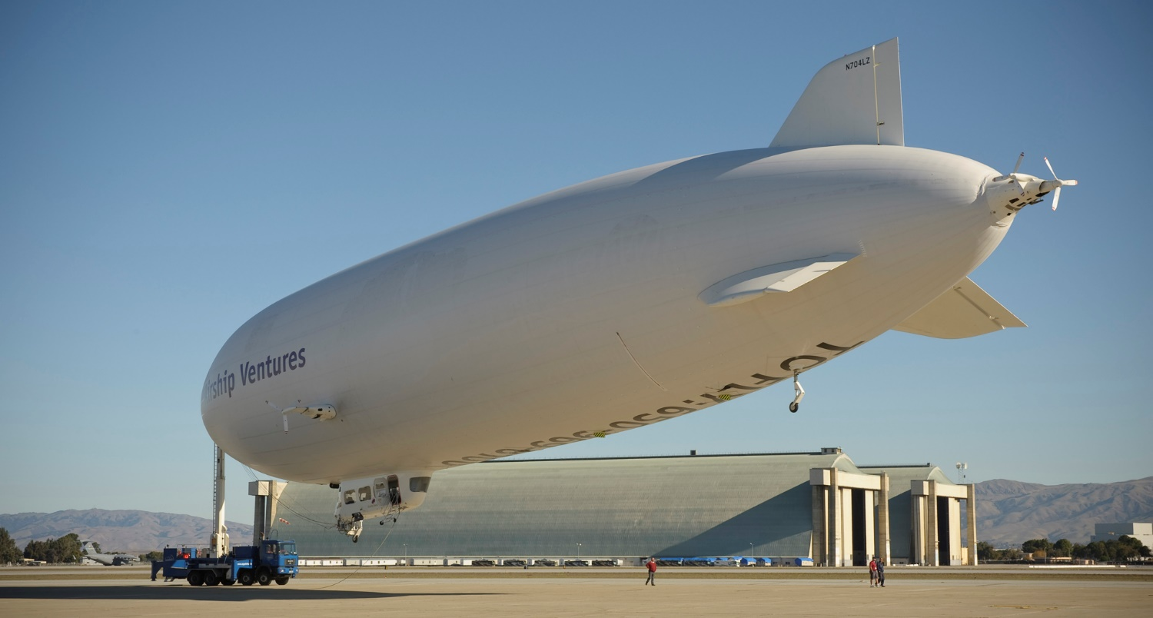
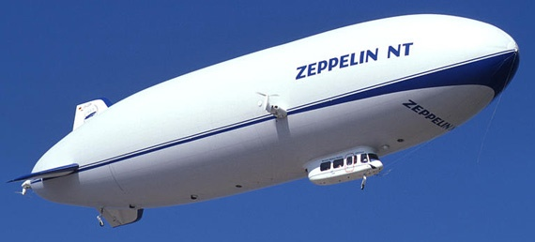
AIRSHIP CONTROL
Resource Book
Page 48
Airships usually contain 2 balloons, called ballonets, which are filled with air and cased by an outer balloon filled with helium.
Valves change the amount of air in the airship which, in turn, allows the helium to expand and contract.
Notes:
Inside the main balloon are two ballonets - inflatable air bags that keep the pressure of the helium gas slightly higher than atmospheric pressure. This prevents the balloon from over inflating as the airship rises, or sagging as it descends. Also, pumping air from one ballonet to the other trims the airship balance.

Slide 13
AIRSHIP CONTROL
Resource Book
Page 48
To make the airship go up, the air is let out in order for the helium to expand.
In order to go down, more air is let in in order to supress the helium and force it to contract.
AIR
AIR
Notes:
To get the airship to rise, valves release air from the ballonets into the atmosphere, reducing the weight of the airship and allowing the helium gas to expand - giving more lift.
To make the airship descend, pumps force air into the ballonets, increasing the airship’s weight and compressing the helium gas so that lift is reduced.

Slide 14
ANY QUESTIONS?
Are there any final questions?
?
Notes:
A chance to ask or answer any final questions.

Slide 15
LEARNING OUTCOMES
LO1: Have an appreciation of the history of lighter-than-air craft and the methods of control applied to airships.
Describe how airships are controlled.
Notes:
LO1: Have an appreciation of the history of lighter-than-air craft and the methods of control applied to airships.
P2: Describe how airships are controlled.

Slide 16
QUESTION 1
In which year did the Montgolfier brothers first fly their hot air balloon?
a. 1673
b. 1783
c. 1883
d. 1973
Notes:
In which year did the Montgolfier brothers first fly their hot air balloon?
Answer: b. 1783

Slide 17
QUESTION 1
In which year did the Montgolfier brothers first fly their hot air balloon?
a. 1673
b. 1783
c. 1883
d. 1973
Notes:
In which year did the Montgolfier brothers first fly their hot air balloon?
Answer: b. 1783

Slide 18
QUESTION 2
Who first flew a man-carrying Hydrogen-filled Balloon?
a. Leonardo da Vinci.
b. Montgolfier.
c. Charles.
d. De Rozier.
Notes:
Who first flew a man-carrying Hydrogen-filled Balloon?
Answer: c. Charles

Slide 19
QUESTION 2
Who first flew a man-carrying Hydrogen-filled Balloon?
a. Leonardo da Vinci.
b. Montgolfier.
c. Charles.
d. De Rozier.
Notes:
Who first flew a man-carrying Hydrogen-filled Balloon?
Answer: c. Charles

Slide 20
QUESTION 3
What are modern Airships filled with?
a. Helium.
b. Hydrogen.
c. Butane.
d. Propane.
Notes:
What are modern Airships filled with?
Answer: a. Helium

Slide 21
QUESTION 3
What are modern Airships filled with?
a. Helium.
b. Hydrogen.
c. Butane.
d. Propane.
Notes:
What are modern Airships filled with?
Answer: a. Helium

Slide 22
QUESTION 4
An Airship rises when:
a. The Ballonets empty and the Helium gas expands.
b. The Ballonets empty and the Helium gas is compressed.
c. The Ballonets are filled with air and the Helium gas is compressed.
d. The Ballonets are filled with air and the Helium gas expands.
Notes:
An Airship rises when:
Answer: a. The Ballonets empty and the Helium gas expands.

Slide 23
QUESTION 4
An Airship rises when:
a. The Ballonets empty and the Helium gas expands.
b. The Ballonets empty and the Helium gas is compressed.
c. The Ballonets are filled with air and the Helium gas is compressed.
d. The Ballonets are filled with air and the Helium gas expands.
Notes:
An Airship rises when:
Answer: a. The Ballonets empty and the Helium gas expands.

Slide 24
INSTRUCTOR INFORMATION
This presentation is provided free of charge with the 1st class cadet training system with no warranty or support.
Every effort has been made to ensure the information is correct, but the author accepts no responsibility for any errors or omissions.
Official information on Ultilearn or Bader SharePoint should be checked before using these presentations.
These presentations may be distributed to other Air Cadet squadrons free of charge, but do not place them on the internet.
For best results, use with the 1st class resource book and 1st class instructor handbook, available from cadetdirect.com.
Version 19/04

