Slide 2
LEARNING OUTCOMES
LO2: Have an appreciation of the history and application of heavier-than-air craft.
Identify the key milestones in the history of heavier-than-air craft.
Notes:
LO2: Have an appreciation of the history and application of heavier-than-air craft
P3: Identify the key milestones in the history of heavier-than-air craft.

Slide 3
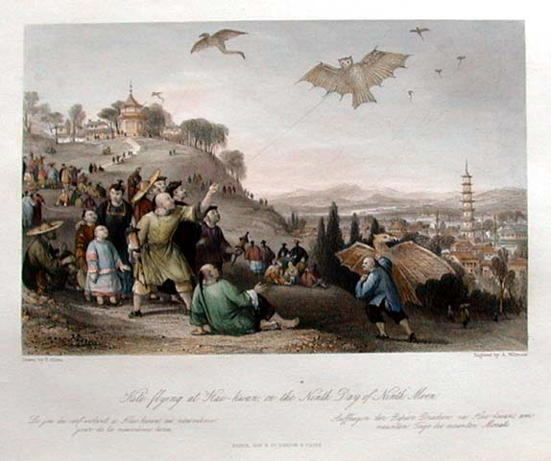
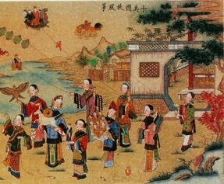
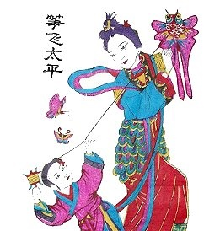
KITES
Resource Book
Page 49
3000 years ago, the Chinese flew kites as signalling devices.
The technology of kite flying quickly spread throughout the world.
Notes:
It is believed that the first man-made flying object climbed skyward at least 3000 years ago on the end of a piece of string.
The early Chinese people flew kites most probably as signalling devices or military banners heralding the approach of their armies. The technology of kite flying quickly spread throughout the world, with some kites almost certainly built large enough to lift a man used as a military observer.

Slide 4
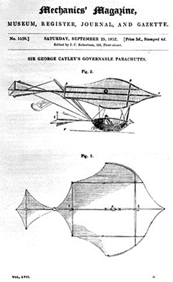
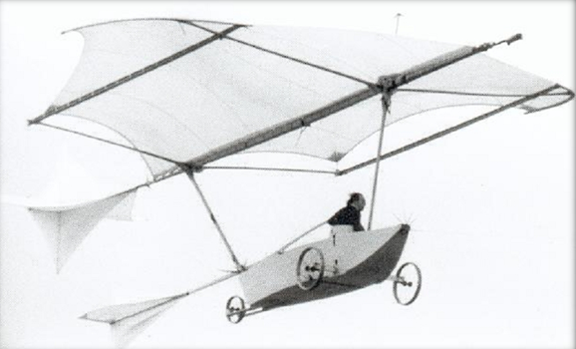
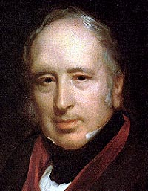
SIR GEORGE CALEY
Resource Book
Page 49
1804.
Sir George Cayley built the very first glider. It was able to carry a small boy.
No way of controlling the craft in flight.
Notes:
In 1804 the English Baronet Sir George Cayley built what is generally considered to be the first model glider. It was little more than a broomstick, to which was mounted a kite shaped wing at one end and vertical and horizontal tail surfaces at the other; nevertheless it was capable of stable flight over many metres.
The air supports the weight of the kite. With this device Cayley was able to confirm that the principles of heavier-than-air flight were definitely possible. From this first model he evolved a glider that was capable of carrying a small boy, although there was no way of controlling this craft in flight.

Slide 5
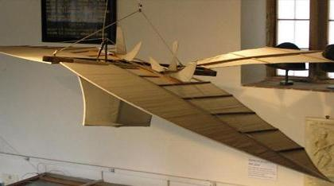
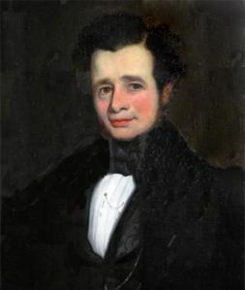
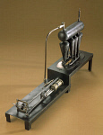
JOHN STRINGFELLOW
Resource Book
Page 49
June 1848.
Steam engines at that time were heavy.
John Stringfellow developed a small steam engine.
Flew the first powered flight in a 10ft wingspan model.
Model had special propellers to add to the stability.
Notes:
In June 1848, John Stringfellow from Chard in Somerset successfully flew his 10-foot wingspan model, powered by a tiny steam engine, across a long room in a disused lace mill. Attempts to make larger versions of steam powered craft were unfortunately unsuccessful. The problems of suitable engines dogged aviation pioneers for many years.

Slide 6
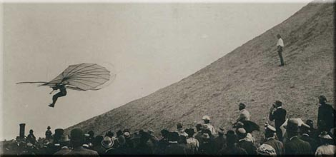
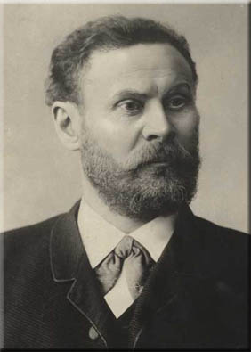
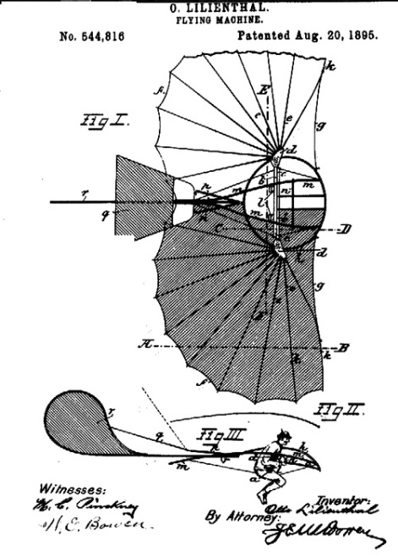
OTTO LILIENTHAL
Resource Book
Page 50
1948 – 1896.
Otto Lilienthal was the first person to make repeated glider flights and developed Hang Gliders.
He made 18 gliders and was inspiration to the Wright Brothers.
Died in a flying accident In 1896.
Notes:
German Otto Lilienthal (1848-1896) built extremely lightweight gliders enabling him to make many thousands of flights. His gliders were the forerunners of the modern hang-glider, designed so that the mass of the body could be moved to allow some degree of control.
Despite many successful flights Lilienthal was killed in a flying accident on 9th August 1896, when he was 48 years old. He proved to be an inspiration to the Wright Brothers.

Slide 7
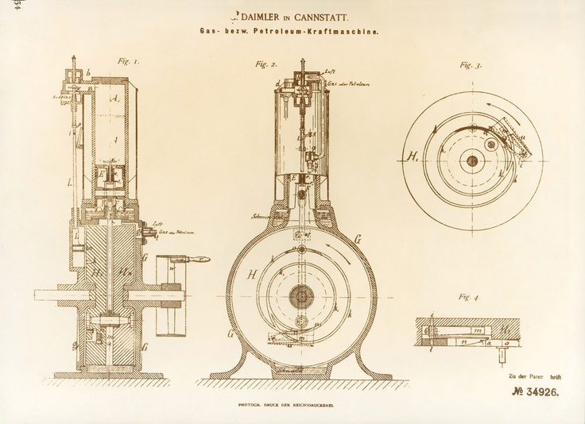
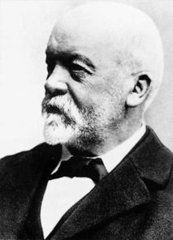
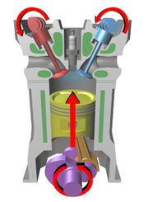
GOTTLIEB DAIMLER
Resource Book
Page 50
1885.
Gottlieb Daimler developed the 4 stroke cycle engine, still used in cars.
He modified it to make a lightweight single cylinder engine which could be used for aircraft propulsion.
Notes:
In 1885 a German by the name of Gottlieb Daimler developed the world’s first single cylinder internal combustion engine which produced a power-to-weight ratio far superior to any other form of engine available for aircraft propulsion – the long awaited power plant for aircraft had finally arrived.

Slide 8
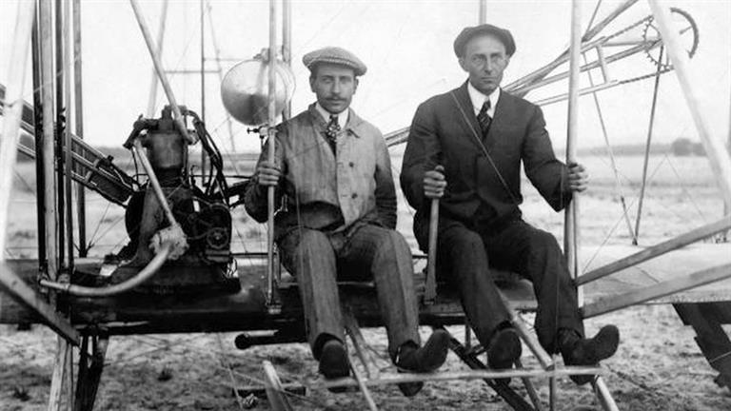
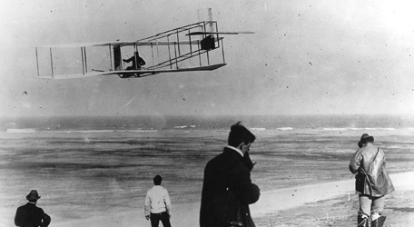
THE WRIGHT BROTHERS
Resource Book
Page 50
17th November 1903 the Wright brothers achieved the first powered, sustained and controlled airplane flight.
Orville and Wilbur Wright took their first ‘Flyer’ for its flight test.
The flyer flew 120ft in a controlled flight.
They improved their design and ended up setting a world record in 1908 with a 2hr 20 minute flight that flew 77 miles.
Notes:
On the 17th December 1903 Orville and Wilbur Wright rolled out their ‘Flyer’ for the first test flight. With Orville at the controls the Flyer flew a full 120 feet in controlled flight. Three other test flights followed, the last and the best of that day covering 260m (852 ft) and ending with the elevator being damaged as the Flyer landed.
With improvements to the design of the Flyer, by the end of 1908 and flying from Auvours in France, Wilbur Wright had made more than 100 flights, totalling in excess of 25 flying hours. His last flight of the year, on 31st December lasted 2 hours 20 minutes during which time he covered a distance of 77 miles (124 km) to set a new world record and win the Michelin prize.
While Wilbur was busy in Europe, Orville was demonstrating the Flyer at Fort Myer in Virginia. These demonstrations attracted and thrilled many thousands of people who came from miles around to see an areoplane in flight. Tragically they ended after only a few weeks when the aircraft crashed, seriously injuring Orville and killing his passenger - Lt Thomas E Selfridge - the first man in the world to be killed in a powered aircraft accident.

Slide 9
THE WRIGHT BROTHERS
Resource Book
Page 50
https://www.youtube.com/watch?v=Wfyvspnko04
Notes:
Video available here: https://www.youtube.com/watch?v=Wfyvspnko04

Slide 10
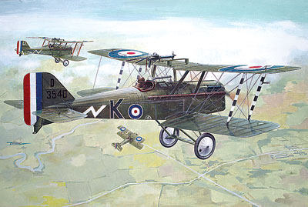
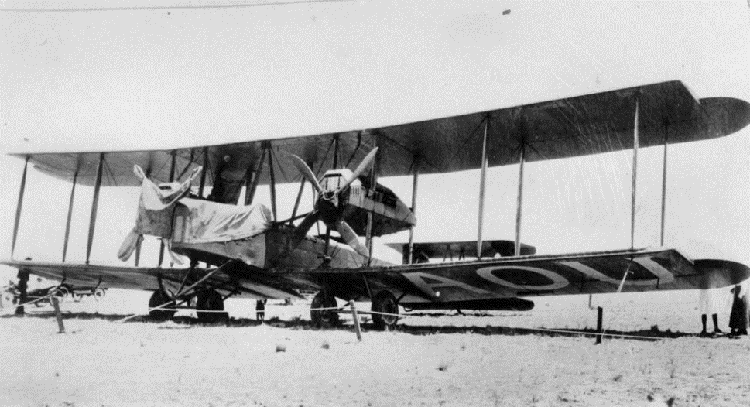
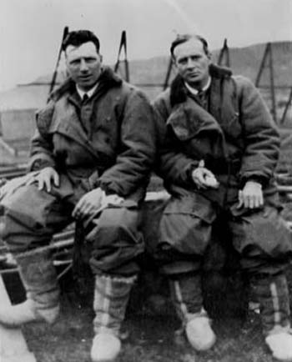
WORLD WAR I & 1919
Resource Book
Page 51
During WW1 (1914-1918) technology developed rapidly and many armed forces began using aircraft.
Gun technology improved on many aircraft.
In 1919 a converted Vickers Vimy bomber was the first aircraft to cross the Atlantic. Flown by Alcock and Brown.
Notes:
By the time war was declared in August 1914, the leading nations’ armed forces had already established air arms. The stimulus of war accelerated the development of aeroplanes and engines and the industry expanded rapidly. Skirmishes between observation aircraft early in the war led to the development of more sophisticated gun technology.
Bombing was adopted to a limited extent, with little military effect, but stimulated the design of much larger twin-engined aircraft. Some of these designs provided the basis for the first post-war airliners.
After World War One, new uses for aircraft were pioneered. The machine which made the biggest impact in 1919 was the Vickers Vimy bomber. A converted Vimy flown by Alcock and Brown made the first non-stop crossing of the Atlantic. This was the first of many feats which showed the growing potential of aviation.

Slide 11
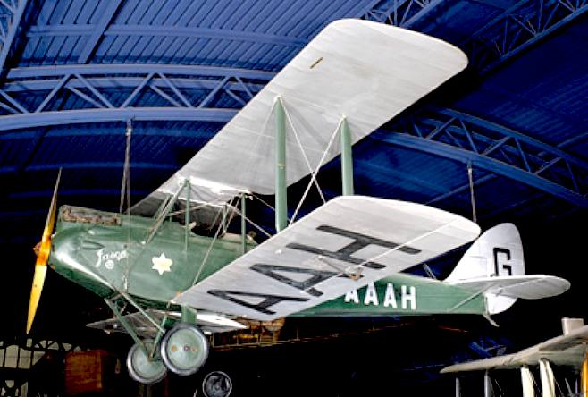
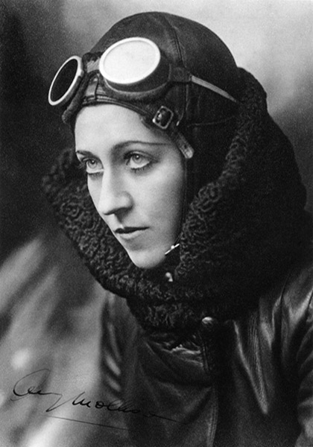
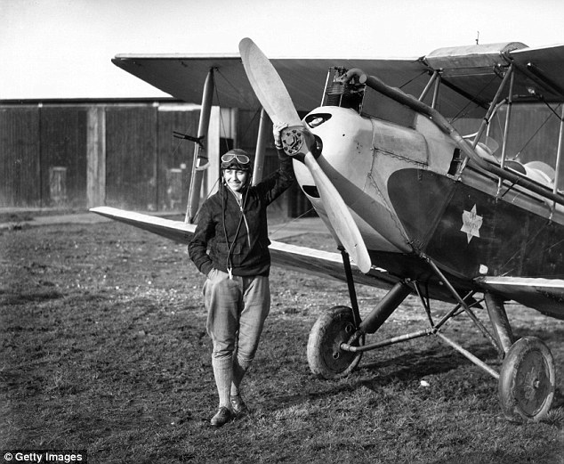
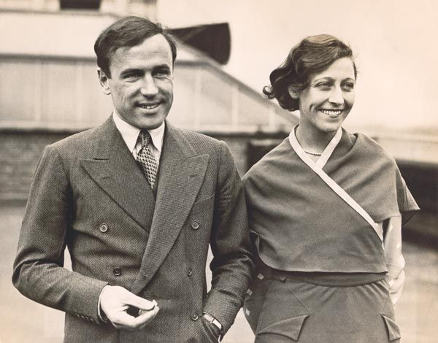
AMY JOHNSON
Resource Book
Page 51
First solo flight from England to Australia by a woman in 1930.
She set numerous long-distance records during the 1930s.
Notes:
Amy Johnson flew a Gipsy Moth when in 1930 she made the first solo flight from England to Australia by a woman. There was a growth in popular flying and flying clubs multiplied. The Gipsy Moth was typical of the practicable, sturdy aircraft used for the purpose, and evolved into a whole family of de Havilland light aircraft including the famous Tiger Moth, which became the Royal Air Force’s trainer in World War Two. Flying solo or with her husband, Jim Mollison, she set numerous long-distance records during the 1930s. She flew in the Second World War as a part of the Air Transport Auxiliary and died during a ferry flight.

Slide 12
ANY QUESTIONS?
Are there any final questions?
?
Notes:
A chance to ask or answer any final questions.

Slide 13
LEARNING OUTCOMES
LO2: Have an appreciation of the history and application of heavier-than-air craft.
Identify the key milestones in the history of heavier-than-air craft.
Notes:
LO2: Have an appreciation of the history and application of heavier-than-air craft
Identify the key milestones in the history of heavier-than-air craft.

Slide 14
LEARNING OUTCOMES
LO2: Have an appreciation of the history and application of heavier-than-air craft.
Demonstrate the principle of heavier-than-air flight.
Notes:
LO2: Have an appreciation of the history and application of heavier-than-air craft
Demonstrate the principle of heavier-than-air flight.

Slide 15
HOW DOES AN AIRCRAFT FLY?
Resource Book
Page 52
Bernoulli principle:
Air flows around wing.
Air travels faster over the top of the wing than the bottom.
Makes pressure lower on top of wing.
High pressure is generated underneath wing – aircraft is ‘pushed’ up.
Faster Moving Air
Lift
Wing
Slower Moving Air
Notes:
According the Bernoulli principle air "splits" at the front of a wing, and recombines at the rear of it. Because the air recombines, if the top of a wing is longer than the bottom, air travels faster over the top of a wing than over the bottom (this is referred to as the "principle of equal transit times"). According to the Bernoulli effect, the quicker the air is moving, the lower the pressure. This means that there is lower pressure on the top than the bottom. This causes air on the bottom to try to move upward, pushing the wing upward with it.

Slide 16
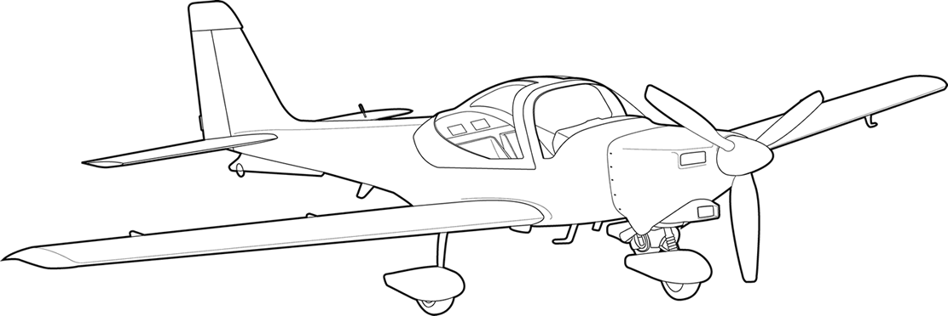
HOW DOES AN AIRCRAFT FLY?
Once airborne, the pilot uses the elevators to control the aircraft’s pitch, ailerons to control the roll and the rudder to control the aircraft in yaw.
Roll
Pitch
Yaw
Notes:
The engine propels the aircraft forwards and, as the airspeed increases, the aircraft’s wings generate lift as a result of Bernoulli’s principal (as airspeed increases, the lift increases) and, hence, the aircraft becomes airborne.
Once airborne, the pilot uses the elevators to control the aircraft’s pitch, ailerons to control the roll and the rudder to control the aircraft in yaw.

Slide 17
ANY QUESTIONS?
Are there any final questions?
?
Notes:
A chance to ask or answer any final questions.

Slide 18
LEARNING OUTCOMES
LO2: Have an appreciation of the history and application of heavier-than-air craft.
Demonstrate the principle of heavier-than-air flight.
Notes:
LO2: Have an appreciation of the history and application of heavier-than-air craft
P4: Demonstrate the principle of heavier-than-air flight.

Slide 19
QUESTION 1
Who is thought to have produced the first Model Glider
in 1804?
a. Wright Brothers.
b. Sir George Cayley.
c. Louis Bleriot.
d. John Stringfellow.
Notes:
Who is thought to have produced the first Model Glider in 1804?
Answer: b. Sir George Cayley.

Slide 20
QUESTION 1
Who is thought to have produced the first Model Glider
in 1804?
a. Wright Brothers.
b. Sir George Cayley.
c. Louis Bleriot.
d. John Stringfellow.
Notes:
Who is thought to have produced the first Model Glider in 1804?
Answer: b. Sir George Cayley.

Slide 21
QUESTION 2
Otto Lilienthal is known for?
a. Building controllable Gliders, considered to be the
forerunner of the modern hang glider.
b. Developing the world’s first single cylinder internal
combustion engine.
c. Flying non-stop from London to Paris for the first time.
d. Building the first heavier-than-air powered aircraft
large enough to carry a man.
Notes:
Otto Lilienthal is known for?
Answer: a. Building controllable Gliders, considered to be the forerunner of the modern hang glider.

Slide 22
QUESTION 2
Otto Lilienthal is known for?
a. Building controllable Gliders, considered to be the
forerunner of the modern hang glider.
b. Developing the world’s first single cylinder internal
combustion engine.
c. Flying non-stop from London to Paris for the first time.
d. Building the first heavier-than-air powered aircraft
large enough to carry a man.
Notes:
Otto Lilienthal is known for?
Answer: a. Building controllable Gliders, considered to be the forerunner of the modern hang glider.

Slide 23
QUESTION 3
Who achieved the first powered, sustained and controlled airplane flight?
a. Wright Brothers.
b. Sir George Cayley.
c. Louis Bleriot.
d. John Stringfellow.
Notes:
Who achieved the first powered, sustained and controlled airplane flight?
Answer: a. Wright Brothers.

Slide 24
QUESTION 3
Who achieved the first powered, sustained and controlled airplane flight?
a. Wright Brothers.
b. Sir George Cayley.
c. Louis Bleriot.
d. John Stringfellow.
Notes:
Who achieved the first powered, sustained and controlled airplane flight?
Answer: a. Wright Brothers.

Slide 25
QUESTION 4
What does the pilot use to control pitch?
a. The ailerons.
b. The rudder.
c. The airbrake.
d. The elevators.
Notes:
What does the pilot use to control pitch?
Answer: d. The elevators.

Slide 26
QUESTION 4
What does the pilot use to control pitch?
a. The ailerons.
b. The rudder.
c. The airbrake.
d. The elevators.
Notes:
What does the pilot use to control pitch?
Answer: d. The elevators.

Slide 27
INSTRUCTOR INFORMATION
This presentation is provided free of charge with the 1st class cadet training system with no warranty or support.
Every effort has been made to ensure the information is correct, but the author accepts no responsibility for any errors or omissions.
Official information on Ultilearn or Bader SharePoint should be checked before using these presentations.
These presentations may be distributed to other Air Cadet squadrons free of charge, but do not place them on the internet.
For best results, use with the 1st class resource book and 1st class instructor handbook, available from cadetdirect.com.
Version 19/04

