Slide 1
Notes:
Part 1 of 3. This presentation covers the information required to complete PASS criteria of the LO1 Map Reading topic.
For best results, these instructor notes should be read in conjunction with this presentation and the session plan.

Slide 2
LEARNING OUTCOMES
LO1: Know the scales and features of Ordnance Survey maps.
Describe the types and uses of maps.
Notes:
LO1: Know scales and features of Ordnance Survey maps.
P1: Describe the types and uses of maps.

Slide 3
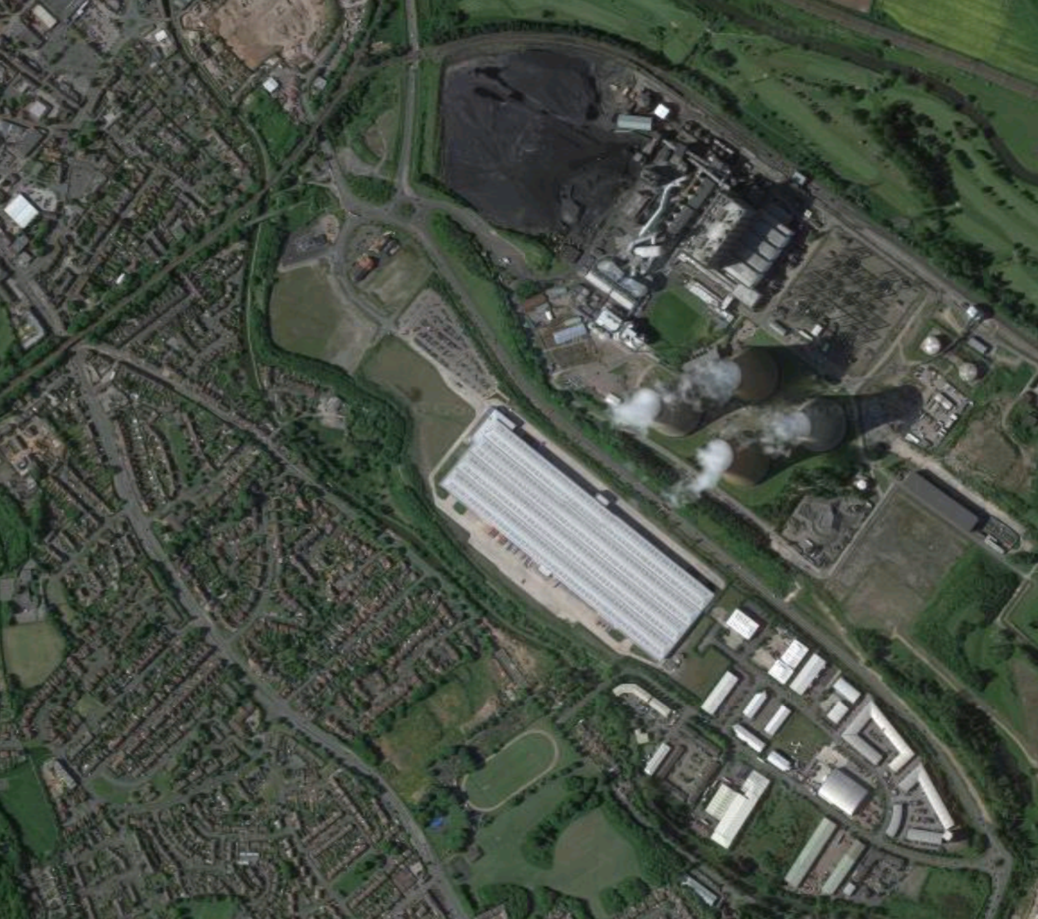
WHAT IS A MAP?
Resource Book
Page 68
A map is a flat representation of the earth and its features.
Satellite Picture
1:25,000 Scale OS Map
Notes:
Dictionary Definition: Flat representation of the earth or some part of it with its physical or political features or of the heavens.
Explain that a map is a ‘birds’ eye view of the world around us, printed flat. They are lots of different types of map that we will learn about later. The map shown is a 1:25000 scale ordinance survey map of the area show by the satellite photograph on the left.
Ask cadets why maps are used.

Slide 4
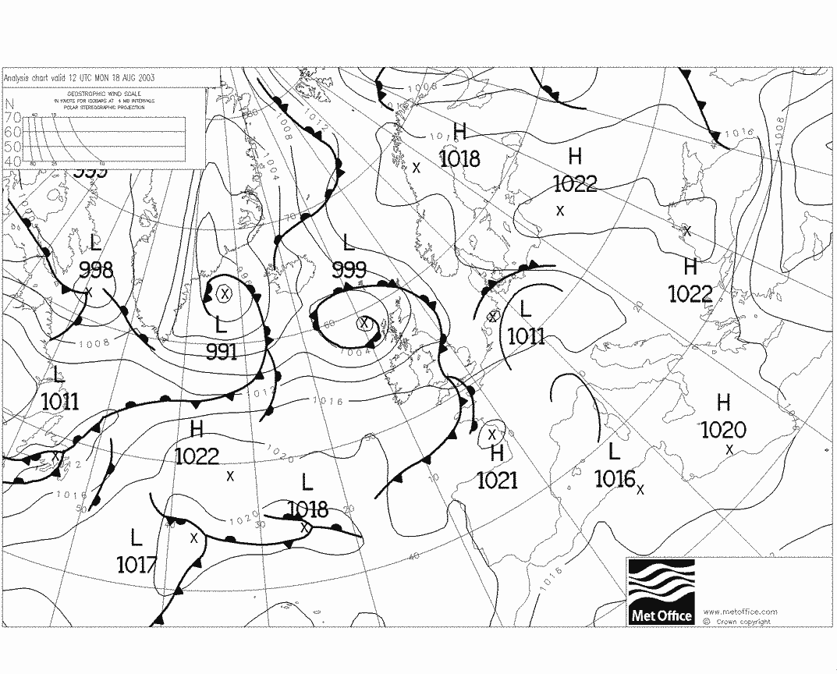
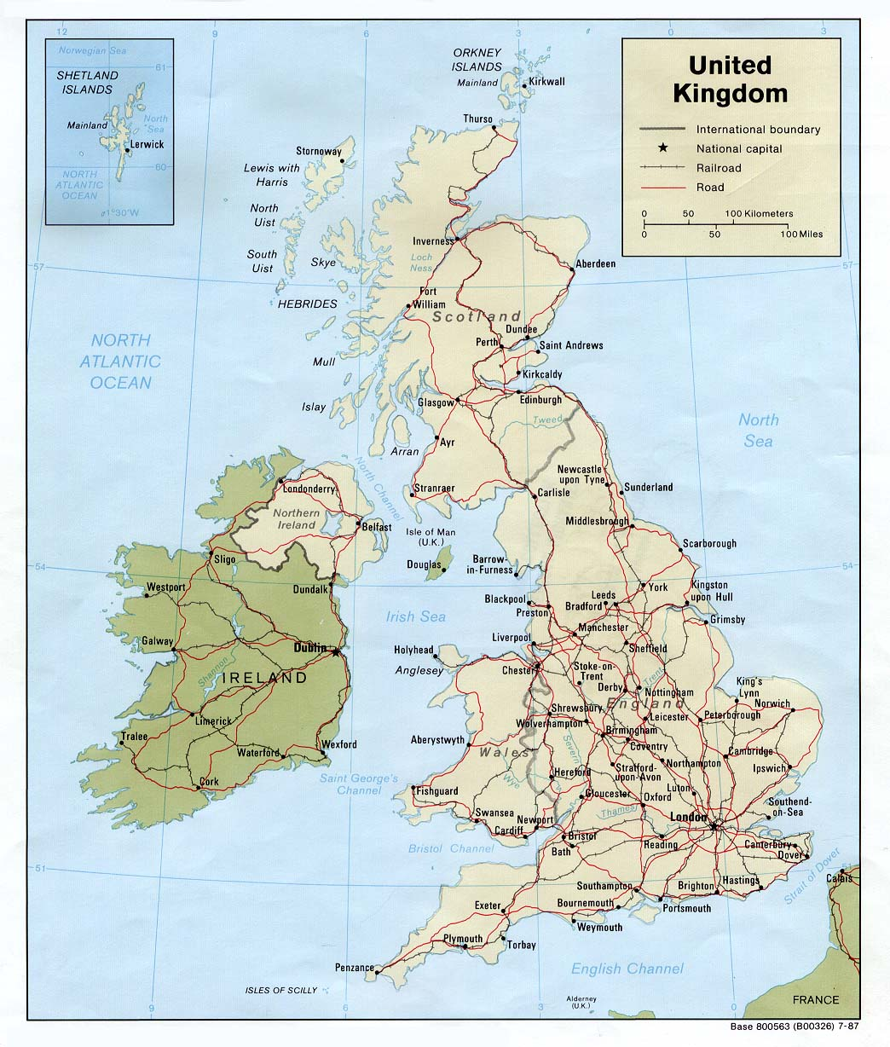
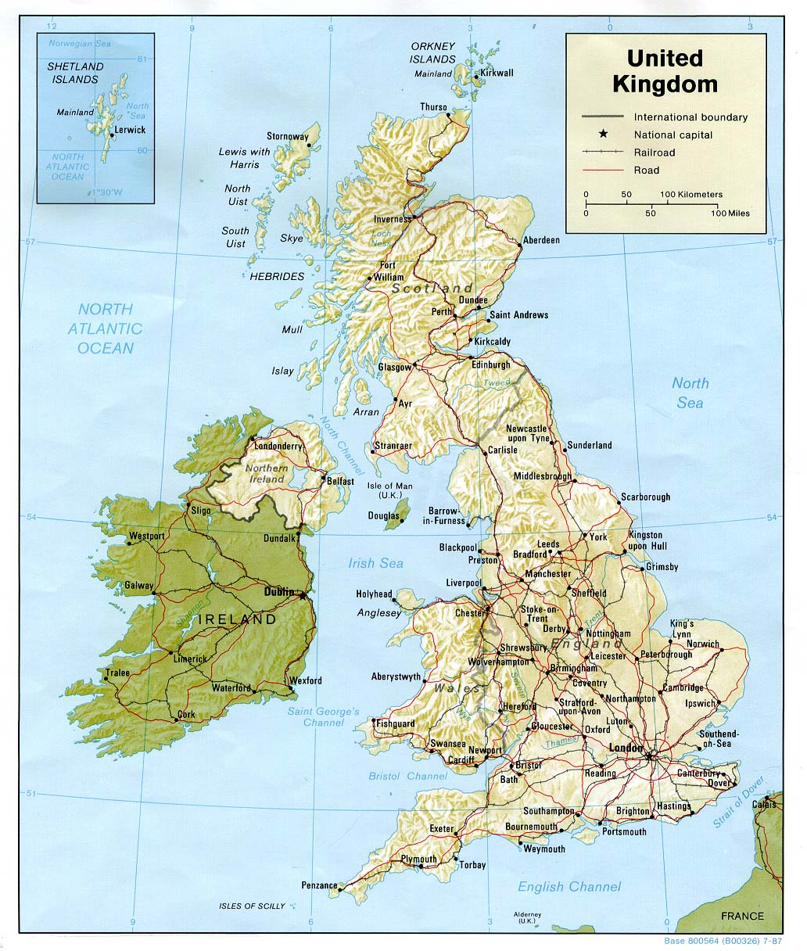
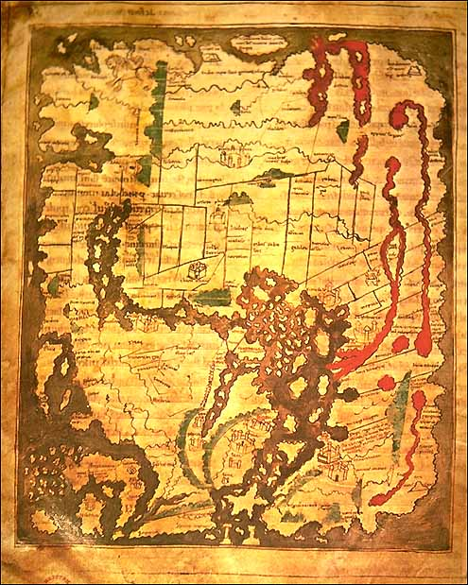
TYPES OF MAP
Resource Book
Page 68
Many different types of map are available:
Topographic – shows shape of land
Demographic – shows population info
Synoptic – shows weather info
Political – shows boundaries, major cities
Historical, marine, outline
Notes:
TOPOGRAPHIC MAP: A topographic map shows how the ground is shaped and provides a way to calculate the height of the features on the map. A type of map that shows heights that you can measure. A traditional topographic map will have all the same elements as a non-topographical map such as scale, legend, and north arrow.
DEMOGRAPHIC MAP: A demographic map shows data on population characteristics by region or geographic area. Demographic maps sometimes use interactive technology, allowing users to customize the data to their needs, to view changes over time or select regions for comparison.
SYNOPTIC MAP: A synoptic chart is the scientific term for a weather map. Synoptic charts provide information on the distribution, movement and patterns of air pressure, rainfall, wind and temperature. This information is conveyed using symbols, which are explained in a legend.
POLITICAL MAP: Political maps are designed to show governmental boundaries of countries, states, and counties, the location of major cities, and they usually include significant bodies of water.
HISTORICAL MAP: A historical map is a modern map made to illustrate some past geographical situation or event.

Slide 5
TYPES OF MAP
Resource Book
Page 68
Notes:
ORDINANCE SURVEY: CHOOSING THE RIGHT MAP
The video is 1 minute and 15 seconds long. Please allow for this when planning session lengths. This video is from Ordinance Survey; more can be found on their YouTube channel.
Explain that other types of map are available, other than those from the Ordinance Survey, but these maps are the most popular.
The Ordnance Survey are the leading provider of maps in the United Kingdom and their maps come in a variety of different scales (level of detail) to suit different uses. A map with a higher scale number covers a larger area but is less detailed than a map with a lower scale number covering a smaller area. Some different type of maps and their uses are listed in the video and on the next slides.

Slide 6
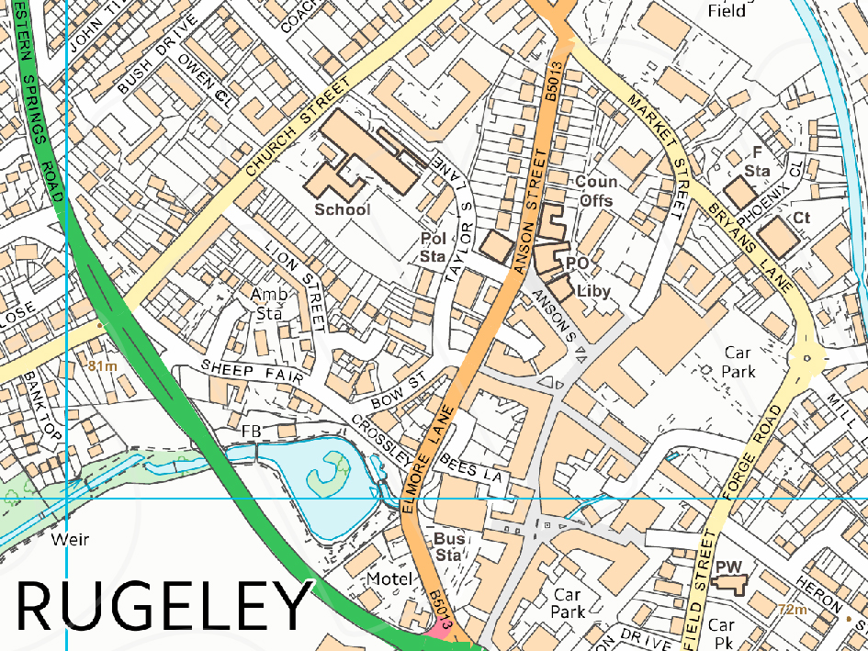
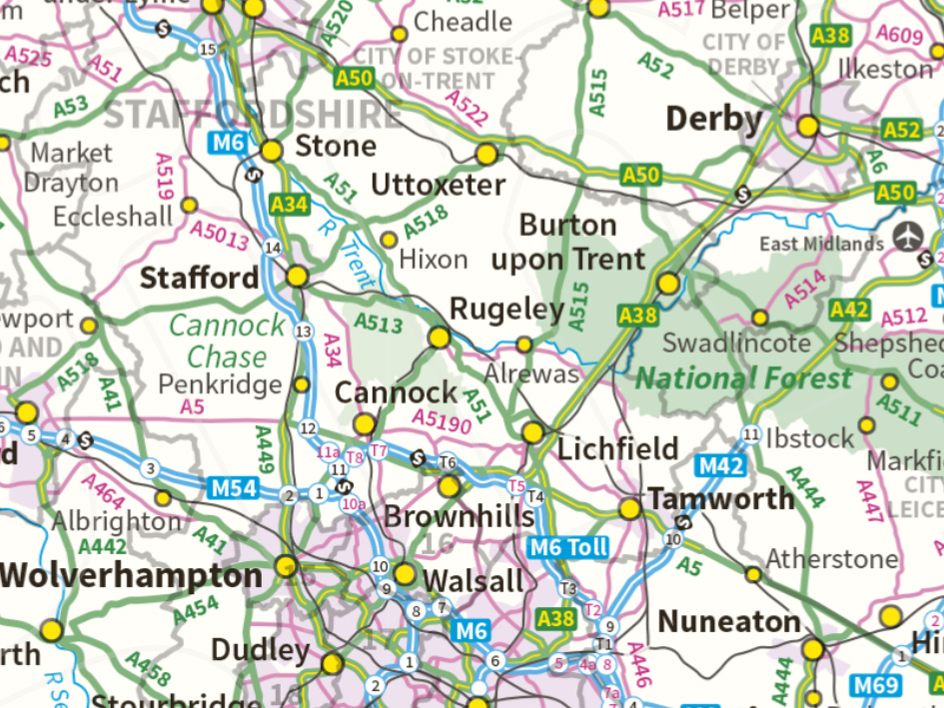
MAP SCALES
Resource Book
Page 68-70
The relationship between distance on the ground and distance on the map is known as the scale of the map.
The higher the number on the right of the scale the bigger the area covered but the lower the detail.
1: 10,000 scale map
1:1,000,000 scale map
Notes:
A 1:10,000 map can be used for detailed town planning. It contains lots of fine detail, but covers a small area.
A 1:1,000,000 map only contains major details like roads or rivers but can cover a much larger area. These can be used for long distance route planning.
More details on the scale of common maps can be found on the next slides.

Slide 7
MAP SCALES
Resource Book
Page 68-70
Scale | Map to Ground | Main Use
1: 10, 000 | 1cm = 100m | Orienteering/ Town planning
1 : 25,000 | 1cm = 250m | Standard walking map
1 : 50,000 | 1cm = 500m | General purpose map
1 : 100,000 | 1cm = 1km | Cycling route planning
1 : 250,000 | 1cm = 2.5km | Vehicle route planning
1 : 1,000,000 | 1cm = 10km | UK Map

Slide 8
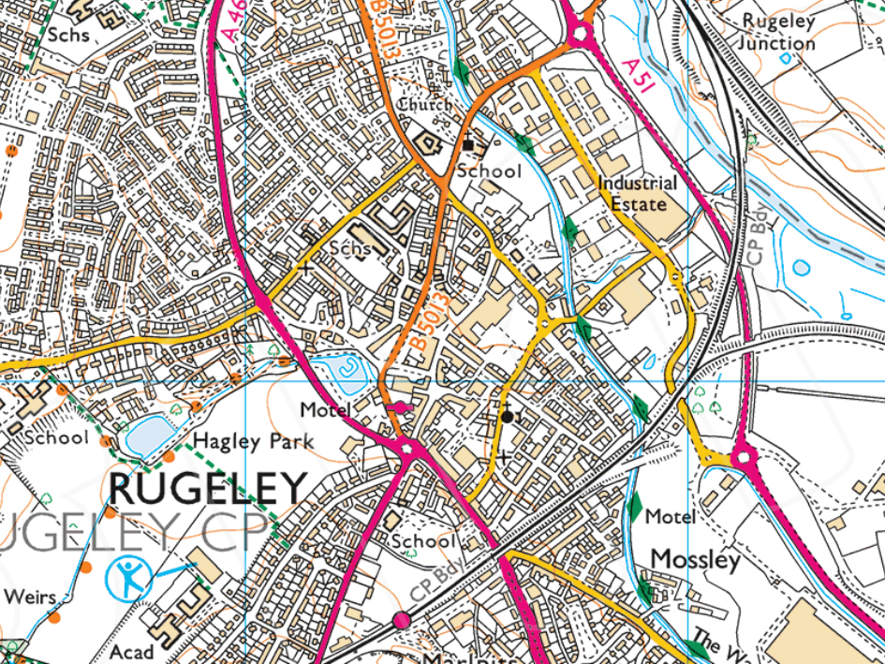
TYPES OF OS MAPS
Resource Book
Page 69
Scale- 1: 10,000
1cm on map = 100m on land.
Very detailed maps covering small areas often used for orienteering or town planning.
Scale- 1: 25,000
1cm on map = 250m on land.
The map most commonly used for walking and Duke of Edinburgh expeditions. Lots of detail, including building outlines, roads and paths.

Slide 9
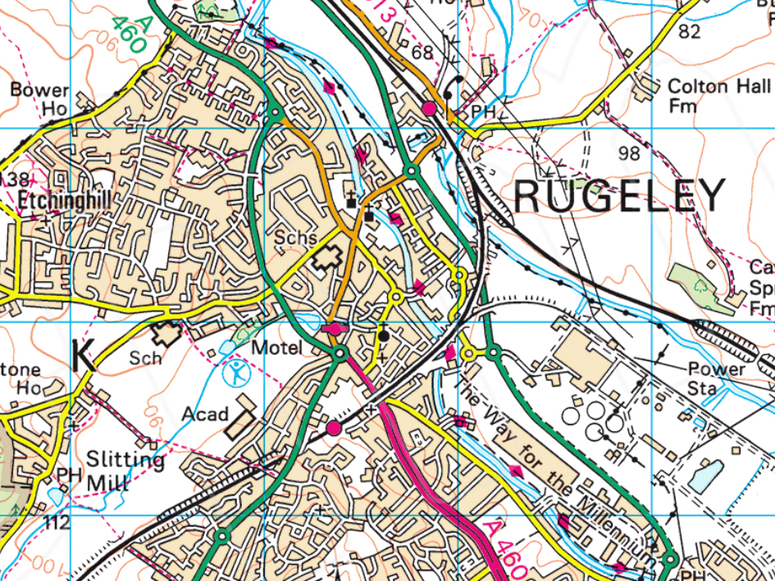
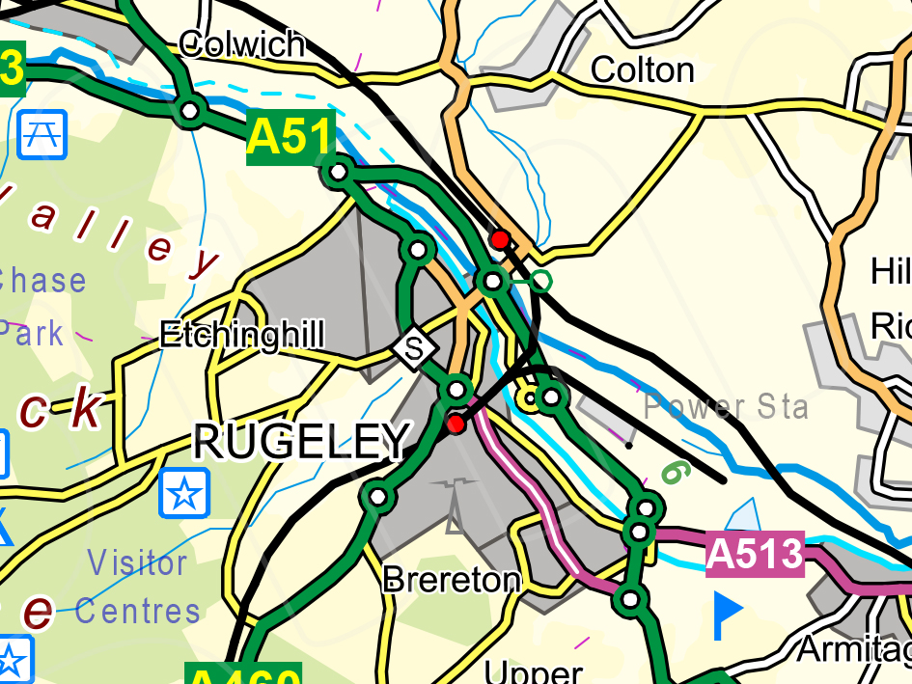
TYPES OF OS MAPS
Resource Book
Page 69-70
Scale- 1: 50,000
1cm on map = 500m on land.
A good general purpose map. Still detailed and can be used for longer journeys like cycling, longer distance walking or small car journeys.
Scale- 1: 100,000
1cm on map = 1km on land.
This map covers large areas but includes enough detail to plan routes or travel shorter distances.

Slide 10
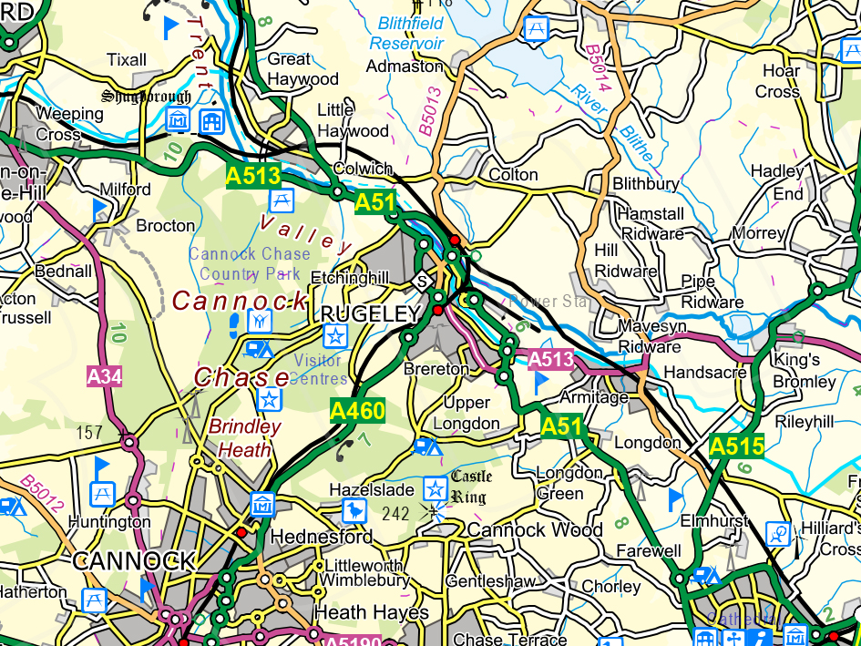
TYPES OF OS MAPS
Resource Book
Page 70
Scale- 1: 250,000
1cm on map = 2.5km on land.
Most commonly used as maps for driving longer distances on a car or motorbike.
Scale- 1: 1,000,000
1cm on map = 10km on land.
This map is large enough to cover the whole of the UK. Could be used as a long distance driving map as it shows motorways and major roads.

Slide 11
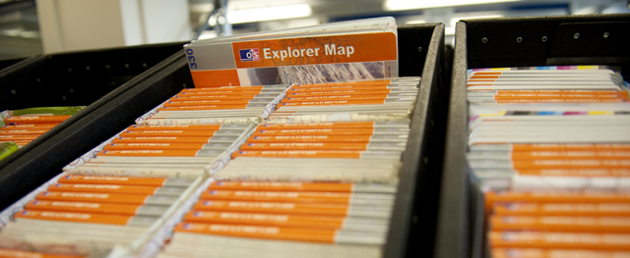
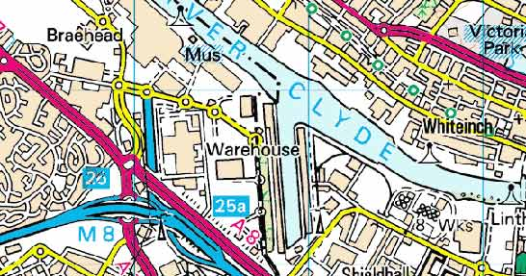
MAP REVISIONS
Maps get changed on a regular basis.
Towns expand or change or rivers get diverted or dammed etc.
Make sure your map is as up-to-date as possible by checking the revision date of the map.
Notes:
The revision date of a map can usually be found on the front cover, or in a corner inside of the map. Even if a map has a recent date printed on it, it doesn’t mean it is correct as features change all the time.
The OS website talks about revision dates of maps here: https://www.ordnancesurvey.co.uk/blog/2011/07/how-often-do-we-update-our-paper-maps/
Scan the QR code below to access the website:

Slide 12
ANY QUESTIONS?
Are there any final questions?
?
Notes:
A chance to ask or answer any final questions.

Slide 13
LEARNING OUTCOMES
LO1: Know the scales and features of Ordnance Survey maps.
Describe the types and uses of maps.
Notes:
LO1: Know scales and features of Ordnance Survey maps.
P1: Describe the types and uses of maps.

Slide 14
GROUP DISCUSSION
Logbook
Page 20
What different types of maps are there?
What are they used for?
When this is complete your instructor should sign page 20 of your First Class Logbook and fill in the Task P1 Activity 1 Map Reading log sheet.
Notes:
This task covers the mandatory requirement for objectives P1 for LO1.
Cadets must discuss the different scales of maps and what their common uses are.
Once satisfied that all cadets have an understanding of the topic, instructors must fill in:
Page 20 of the cadet’s first class log book.
Task P1 Activity 1 log sheet. This can be found on Ultilearn.

Slide 15
LEARNING OUTCOMES
LO1: Know the scales and features of Ordnance Survey maps.
Identify the main symbols on Ordinance Survey maps.
Notes:
LO1: Know scales and features of Ordnance Survey maps.
P2: Identify the main symbols on Ordinance Survey maps.

Slide 16
MAP SYMBOLS
Resource Book
Page 71
Notes:
ORDINANCE SURVEY: MAP SYMBOLS
The video is 1 minute long. Please allow for this when planning session lengths. This video is from Ordinance Survey; more can be found on their YouTube channel.
Ordnance Survey interpret both man made and natural features on the map, through a system of symbols. Every Ordnance Survey map has a key showing the definition of each symbol to help you. We will look at a few of the more common symbols later.

Slide 17
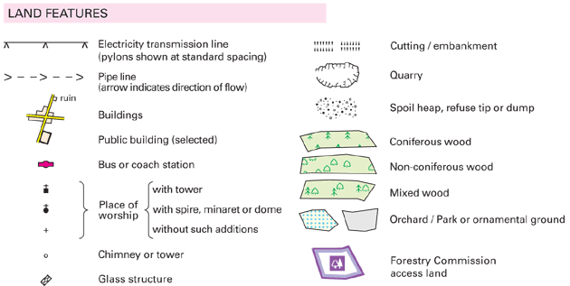
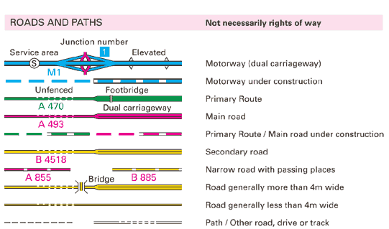
THE MAP KEY
Resource Book
Page 71
All OS maps have a key.
Shows you what the symbols on the map mean.
Symbols are relevant only to the map you are using.
If in doubt about a symbol, check the key!
Notes:
The key of an OS map is usually found on the edge of the map. Remember, that the symbols are relevant only to the map you are using. Symbols change across different manufacturers maps, and may even change across different versions. If in doubt about a symbol, check the key!

Slide 18
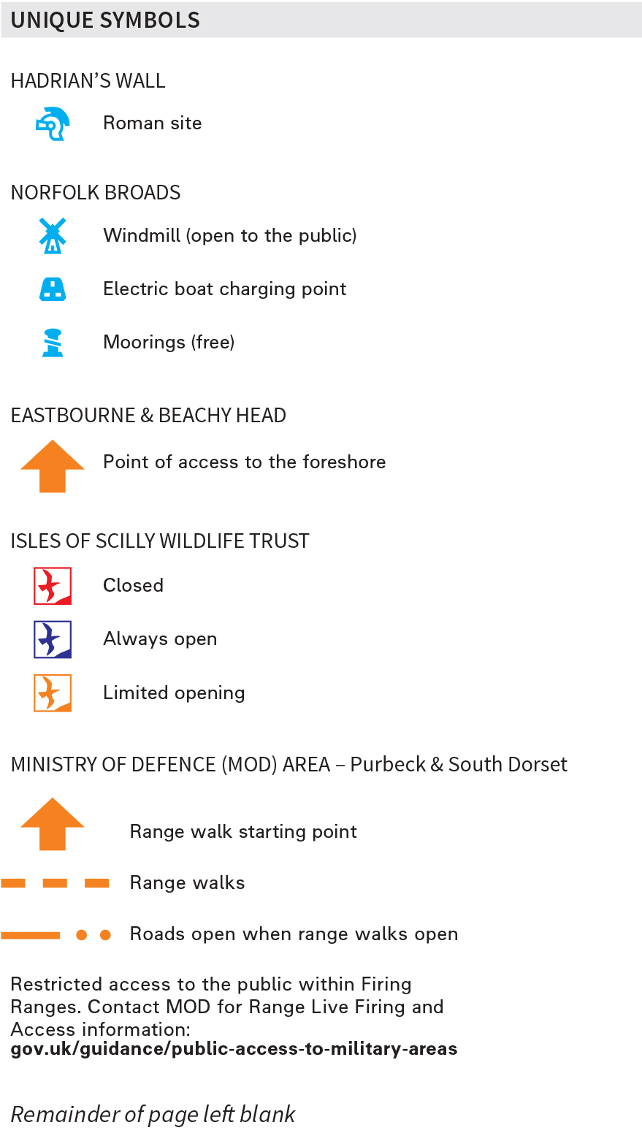
1:25,000 KEY
Resource Book
Page 71
The following slides contain all of the symbols and features found on a 1:25,000 OS explorer map.
Notes:
Go through each group of map symbols and explain what they mean. Using real maps where available, ask cadets to find as many symbols in a specific group that they can. This could become a competition between two or more groups of cadets.
PDF of the symbols can be found here: https://www.ordnancesurvey.co.uk/docs/legends/25k-raster-legend.pdf
Scan the QR code below to access the website:

Slide 19
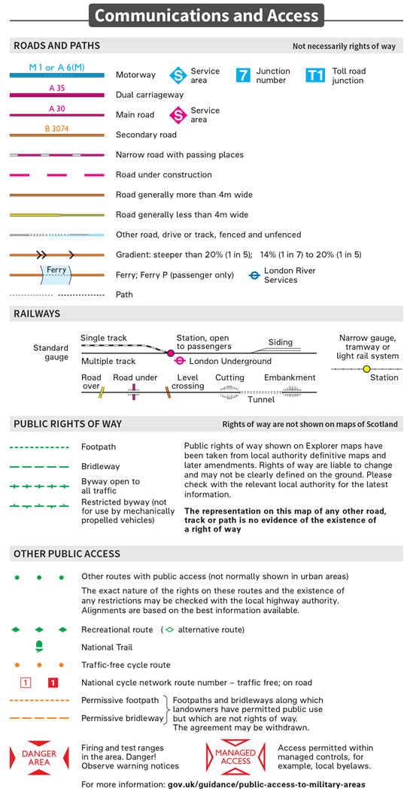
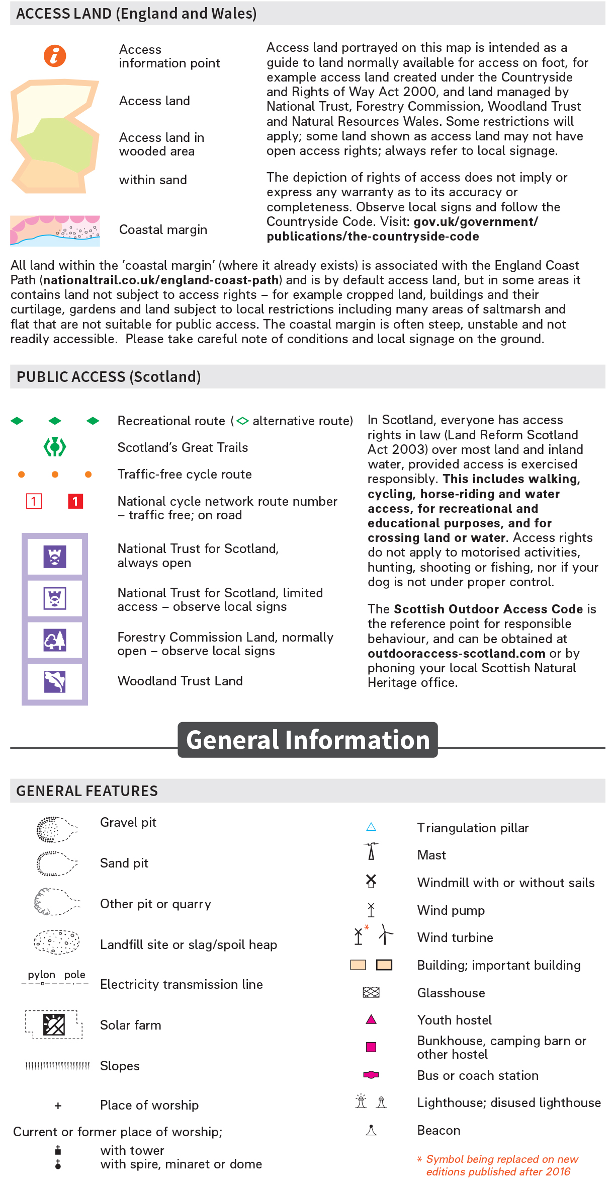
Notes:
Go through each group of map symbols and explain what they mean. Using real maps where available, ask cadets to find as many symbols in a specific group that they can. This could become a competition between two or more groups of cadets.
PDF of the symbols can be found here: https://www.ordnancesurvey.co.uk/docs/legends/25k-raster-legend.pdf
Scan the QR code below to access the website:

Slide 20
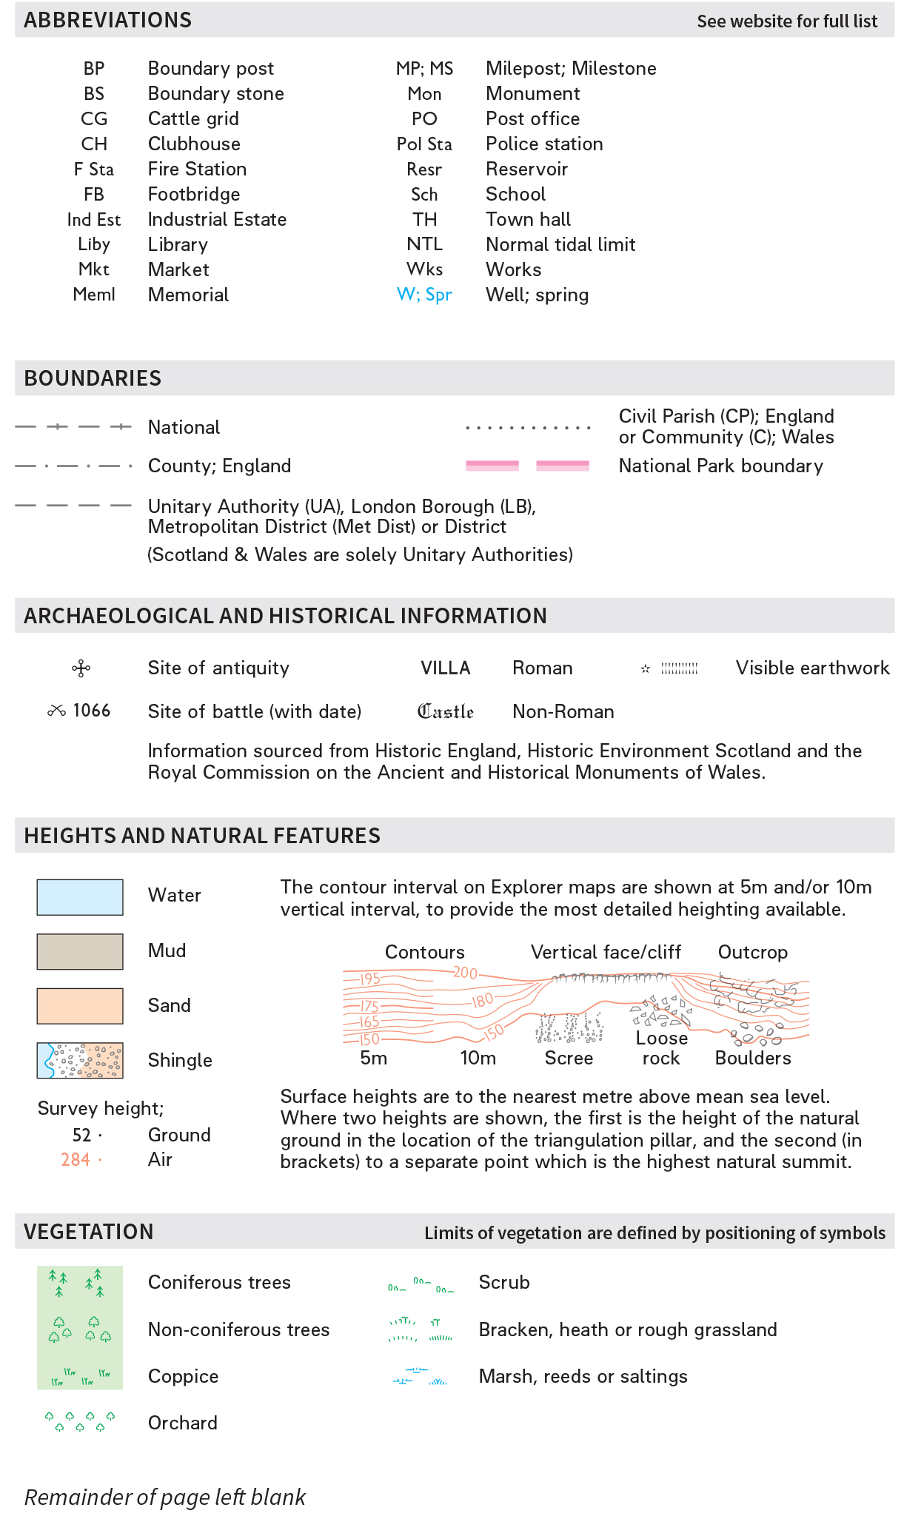
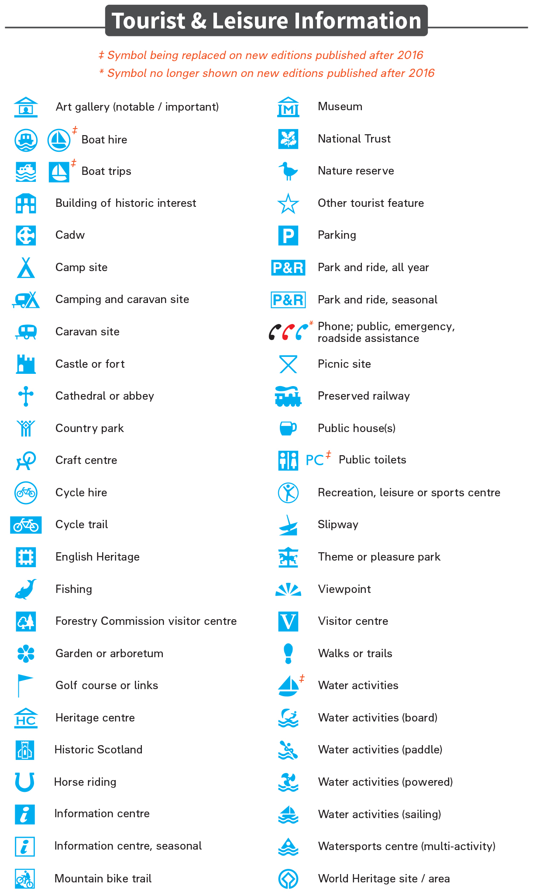
Notes:
Go through each group of map symbols and explain what they mean. Using real maps where available, ask cadets to find as many symbols in a specific group that they can. This could become a competition between two or more groups of cadets.
PDF of the symbols can be found here: https://www.ordnancesurvey.co.uk/docs/legends/25k-raster-legend.pdf
Scan the QR code below to access the website:

Slide 21
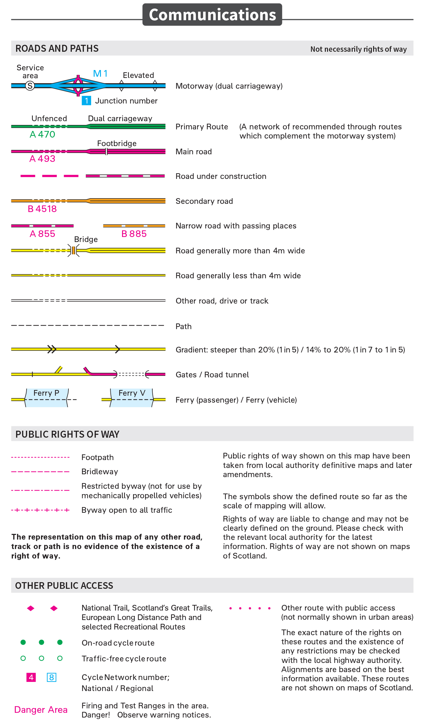
1:50,000 KEY
Resource Book
Page 71
The following slides contain all of the symbols and features found on a 1:50,000 OS Landranger map.
Notes:
Go through each group of map symbols and explain what they mean. Using real maps where available, ask cadets to find as many symbols in a specific group that they can. This could become a competition between two or more groups of cadets.
PDF of the symbols can be found here: https://www.ordnancesurvey.co.uk/docs/legends/50k-raster-legend.pdf
Scan the QR code below to access the website:

Slide 22
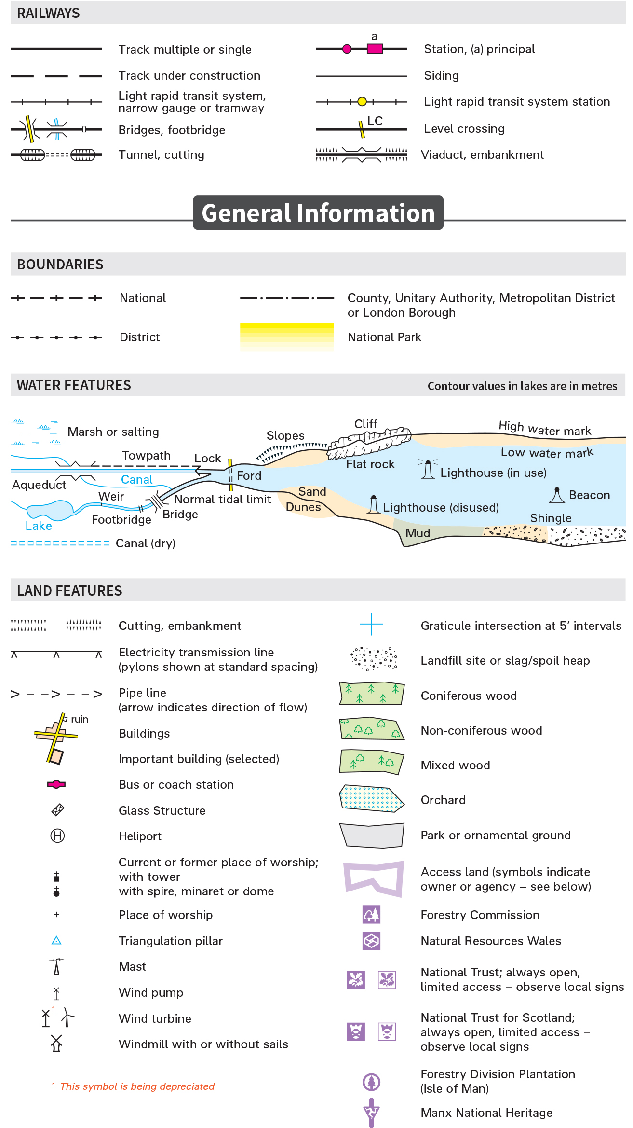
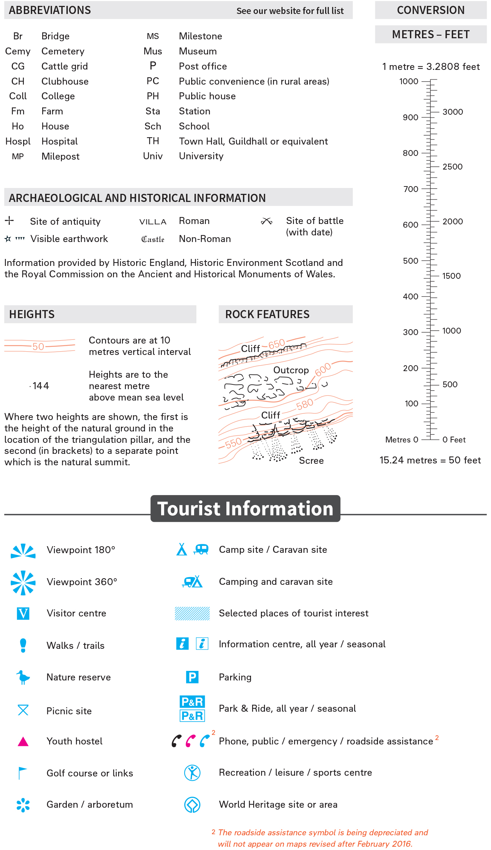
Notes:
Go through each group of map symbols and explain what they mean. Using real maps where available, ask cadets to find as many symbols in a specific group that they can. This could become a competition between two or more groups of cadets.
PDF of the symbols can be found here: https://www.ordnancesurvey.co.uk/docs/legends/50k-raster-legend.pdf
Scan the QR code below to access the website:

Slide 23
FOLDING A MAP
Notes:
ORDINANCE SURVEY: HOW TO FOLD A MAP
The video is 1 minute long. Please allow for this when planning session lengths.
An electronic copy can be found in the Map Reading folder on your USB stick for those having trouble accessing the video from the presentation.
Maps must be folded correctly to prevent damage. The video shows you how to do this. Also see the image below:

Slide 24
ANY QUESTIONS?
Are there any final questions?
?
Notes:
A chance to ask or answer any final questions.

Slide 25
LEARNING OUTCOMES
LO1: Know the scales and features of Ordnance Survey maps.
Identify the main symbols on Ordinance Survey maps.
Notes:
LO1: Know scales and features of Ordnance Survey maps.
P2: Identify the main symbols on Ordinance Survey maps.

Slide 26
MAP SYMBOL TASK 1
Logbook
Page 20
Can you identify 1:25,000 and 1:50,000 map symbols?
Match the flashcards to the correct symbols.
When this is complete your instructor should sign page 20 of your First Class Logbook and fill in the Task P2 Activity 1 Map Reading log sheet.
Notes:
This task covers the mandatory requirement for objectives P2 for LO1.
Instructors are to lead a group of cadets in one of three possible quizzes in which they match flashcards in order to demonstrate their understanding of the symbols found on 1:50,000 and 1:25,000 maps.
Flashcards can be downloaded from here: https://www.ordnancesurvey.co.uk/education/map-symbol-flashcards.html
Once satisfied that all cadets have an understanding of the topic, instructors must fill in:
Page 20 of the cadet’s first class log book.
Task P2 Activity 1 log sheet. This can be found on Ultilearn.

Slide 27
MAP SYMBOL TASK 2
Logbook
Page 20
Identify the 1:25,000 and 1:50,000 map symbols found in your logbook.
When this is complete your instructor should check and sign page 20 of your First Class Logbook.
Notes:
This task covers the mandatory requirement for objectives P2 for LO1.
Cadets must write what they think the map symbols pictured mean. They can use the keys from OS maps to help them.
Once satisfied that all cadets have an understanding of the topic, instructors must check and sign:
Page 21 of the cadet’s first class log book.

Slide 28
INSTRUCTOR INFORMATION
This presentation is provided free of charge with the 1st class cadet training system with no warranty or support.
Every effort has been made to ensure the information is correct, but the author accepts no responsibility for any errors or omissions.
Official information on Ultilearn or Bader SharePoint should be checked before using these presentations.
These presentations may be distributed to other Air Cadet squadrons free of charge, but do not place them on the internet.
For best results, use with the 1st class resource book and 1st class instructor handbook, available from cadetdirect.com.
Version 19/04

