Slide 1
Notes:
Part 3 of 3. This presentation covers the information required to complete PASS criteria of the LO3 Map Reading topic.
For best results, these instructor notes should be read in conjunction with this presentation and the session plan.

Slide 2
LEARNING OUTCOMES
LO3: Be able to plan routes using Ordnance Survey map features and contour lines.
Describe the main land features found on Ordnance Survey maps when planning routes.
Use the contour lines shown on an Ordnance Survey map to plan routes.
Notes:
LO3: Be able to plan routes using Ordinance Survey map features and contour lines.
P4: Describe the main land features found on Ordinance Survey maps when planning routes.
P5: Use contour lines found on Ordinance Survey maps to plan routes.

Slide 3
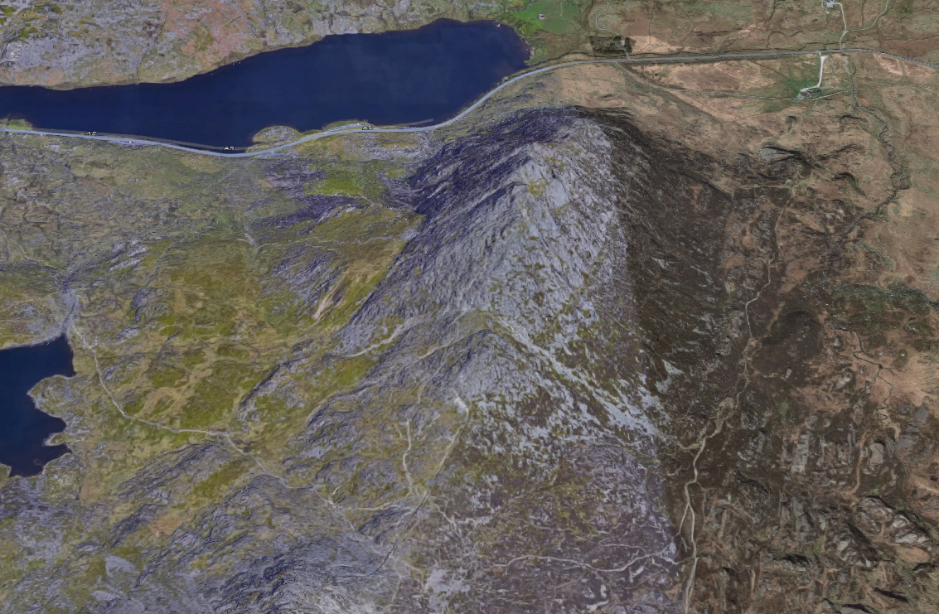
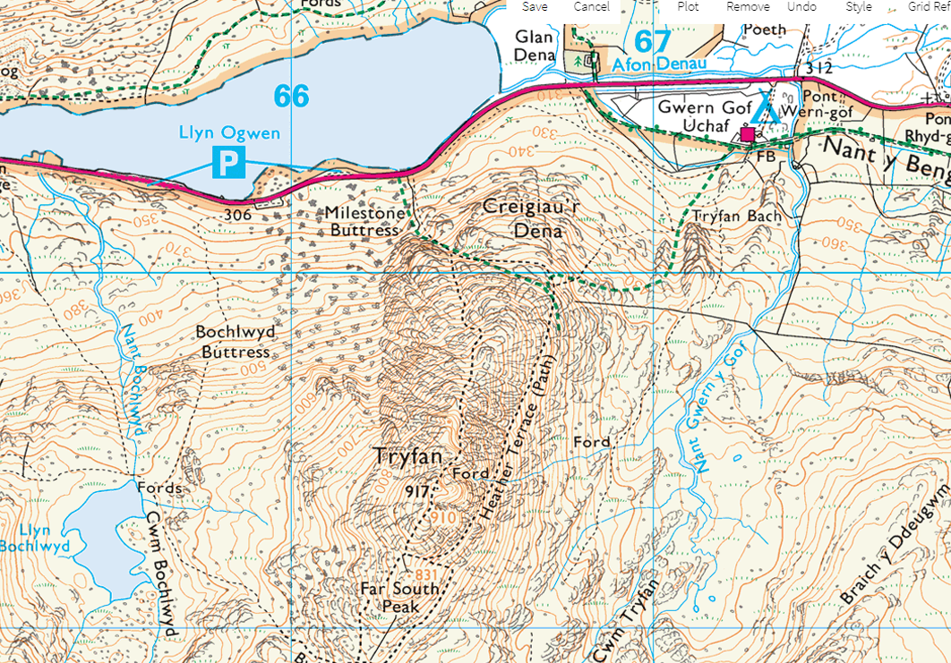
VISUALISING THE LAND
Maps are only 2D representations of the 3D ground.
Rise and fall of the ground is called ‘relief’.
Contour lines show to relief of the terrain on an OS map.
Notes:
The word “relief” means the rise and fall of the ground or, in other words such features as hills and valleys. This involves both the height and the shape of the land. As a map is drawn on a flat sheet of paper the representation of height and shape is difficult. Map makers have various ways of doing this, but whatever method, it is left to the reader (you!) to interpret the information.
Other methods of showing height on a map include: a. Spot heights and triangulation points, which are used to give an accurate height above sea level at given points. They give an indication of height but not shape. b. Layer tinting, which uses colours that may vary depending on the type of map you are using. For example, land up to 60 metres may be coloured green, rising higher ground may be light brown and higher ground still may be in dark brown. If this system is in use on a map you will find a key legend for the colours in the margin. Layer tinting gives you some idea of the shape as well as height and its main advantage is that it gives a quick impression of the highest and lowest ground. However, because of its general nature it is best to use it only as a rough guide.

Slide 4
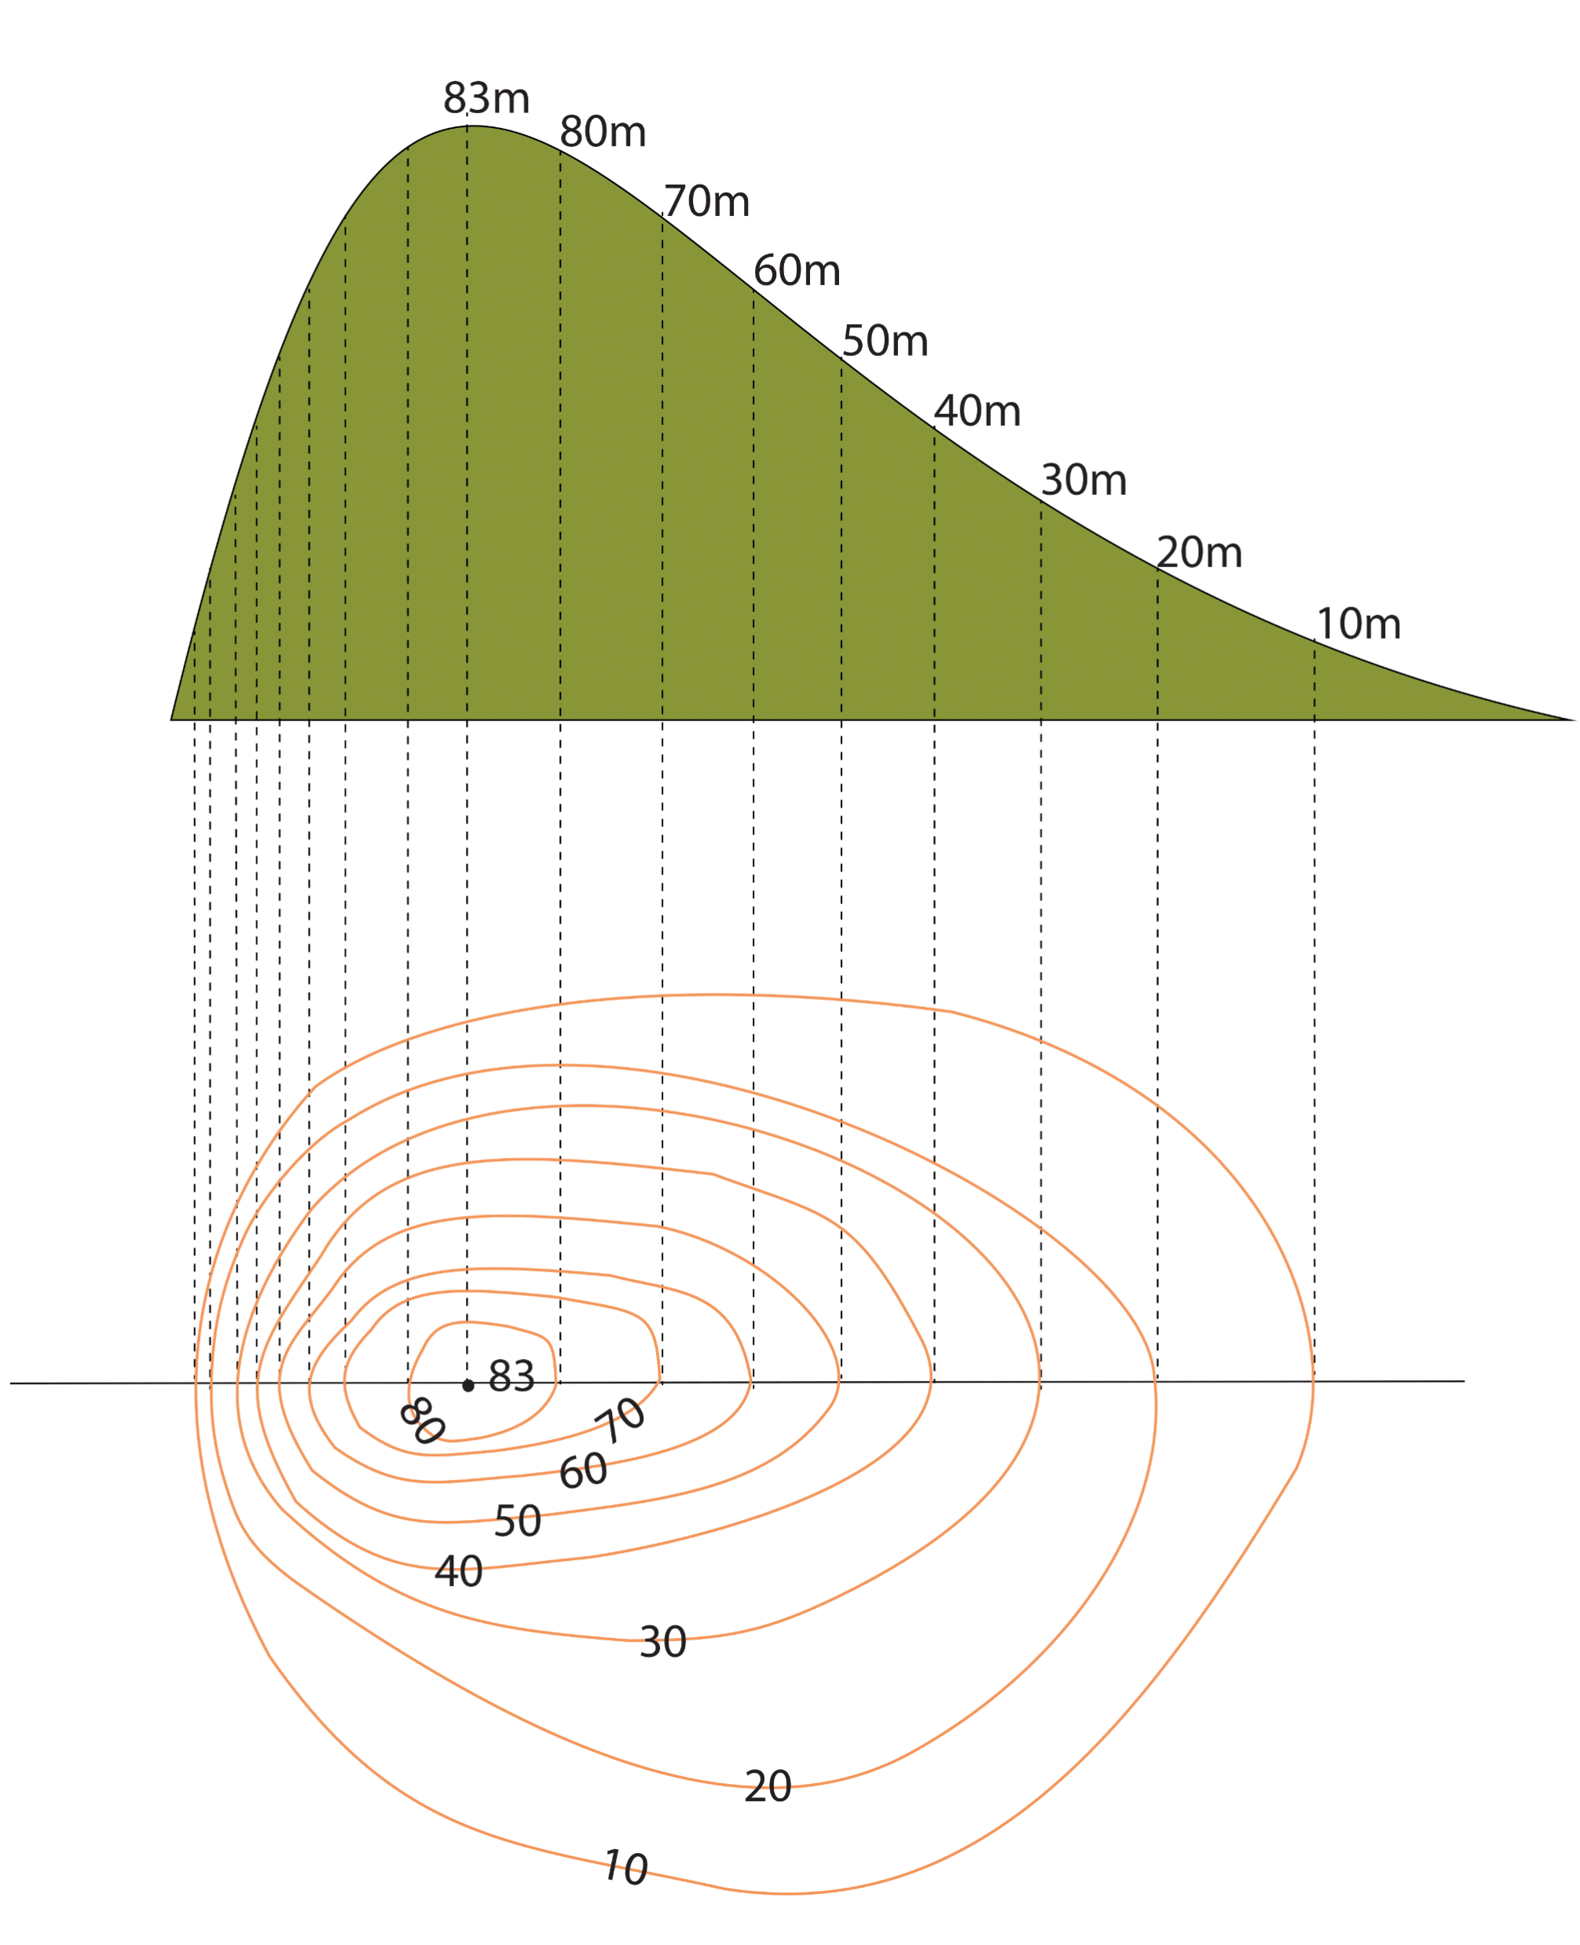
CONTOUR LINES
Resource Book
Page 74
Link points of equal height on a map at 5m intervals.
Sometimes 10m in areas of steep land, but it will say on the map if this is the case.
Shows how many metres land is above sea level.
Heights on lines printed so that if it is read the right way up you are facing uphill.
Notes:
Contour lines represent an area on the ground and can be thought of as a plan of that ground. If you take a map and look at the contour lines you will see something like the plan view shown below (bottom part of the image). From this representation you can build up a picture in your minds eye as to what it will look like on the ground (side view). The perspective (top part of the image) is the combination of plan and side views and gives both the shape and height of the object.

Slide 5
CONTOUR LINES
Resource Book
Page 74
Notes:
ORDINANCE SURVEY: UNDERSTANDING CONTOUR LINES
The video is 1 minute and 14 seconds long. Please allow for this when planning session lengths. This video is from Ordinance Survey; more can be found on their YouTube channel.
An introduction to contour lines.

Slide 6
WORKING OUT HEIGHT
Resource Book
Page 74
Take away the difference from the highest point and lowest point.
This gives you the difference in height.
The hill on the diagram is 83m tall. If I have already climbed 30m, the difference in height from where I am to the top would be:
83m – 30m = 53m
Notes:
To work out differences in height, take away the highest point from the lowest point. This will give you the height difference.

Slide 7
SHAPE OF THE LAND
Resource Book
Page 75
There are two common slopes, convex and concave.
A convex hill’s contours are closer together at the bottom of the hill.
A concave hill’s contours are further apart at the bottom.
Notes:
As well as being gradual or steep, slopes may be convex or concave.
A slope is convex because the contours are closer together at the bottom.
If the contours are further apart at the bottom the slope is concave.
It follows that if the contour lines are more evenly spaced, then the slope will be relatively uniform or straight.

Slide 8
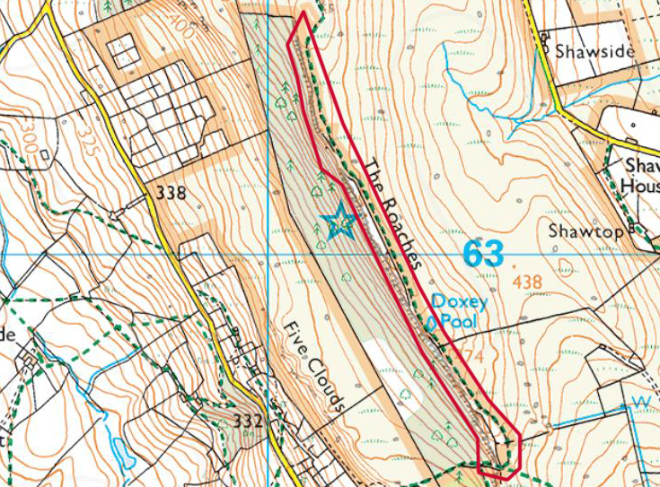
LAND FEATURE
RIDGE
Resource Book
Page 76
Photo ©Bird(cc-by-sa/2.0)
A ridge is a long narrow hilltop or mountain range.
Ridges contain saddles and cols.
Notes:
A ridge is a long narrow stretch of elevated ground; it is also known as a saddle. Where a ridge has a peak at each end, the lower part of the ridge between the summits is called a col.

Slide 9
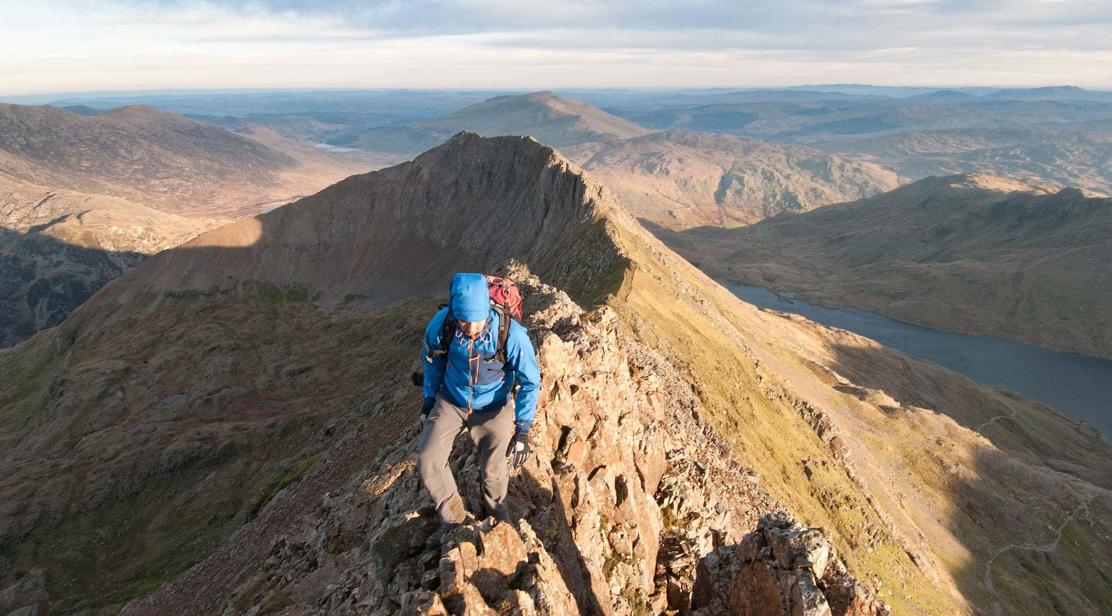
LAND FEATURE
RIDGE
Resource Book
Page 76
Notes:
A ridge is a long narrow stretch of elevated ground; it is also known as a saddle. Where a ridge has a peak at each end, the lower part of the ridge between the summits is called a col.

Slide 10
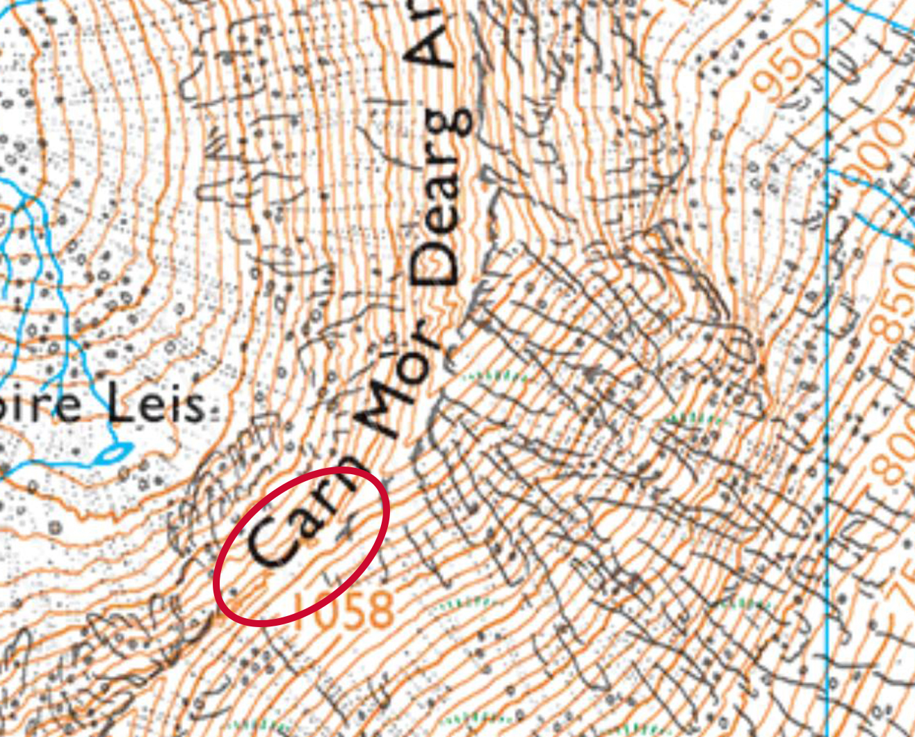
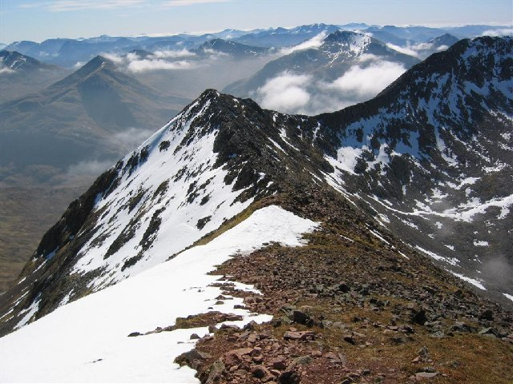
LAND FEATURE
SADDLE AND COL
Resource Book
Page 76
Photo ©Crocker(cc-by-sa/2.0)
A dip between two peaks on a ridge.
The lowest point of a saddle is called a Col.
Notes:
A ridge is a long narrow stretch of elevated ground; it is also known as a saddle. Where a ridge has a peak at each end, the lower part of the ridge between the summits is called a col.

Slide 11
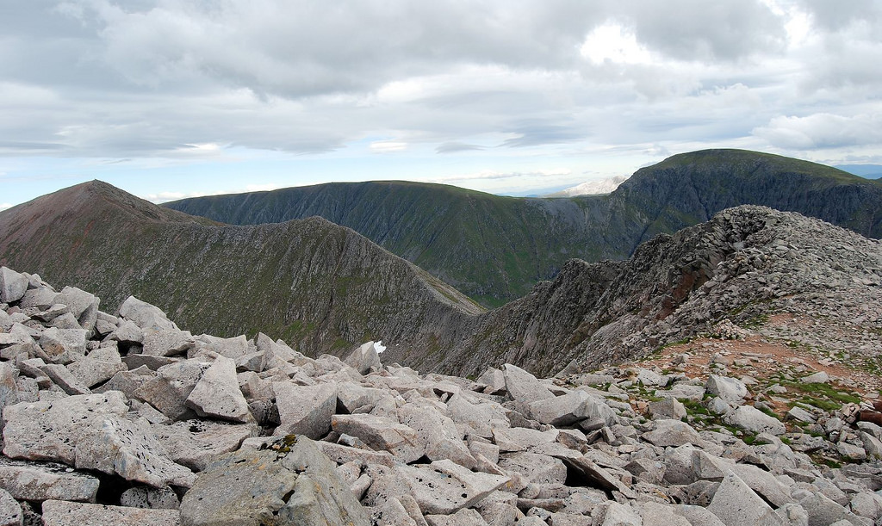
LAND FEATURE
SADDLE AND COL
Resource Book
Page 76
Notes:
A ridge is a long narrow stretch of elevated ground; it is also known as a saddle. Where a ridge has a peak at each end, the lower part of the ridge between the summits is called a col.

Slide 12
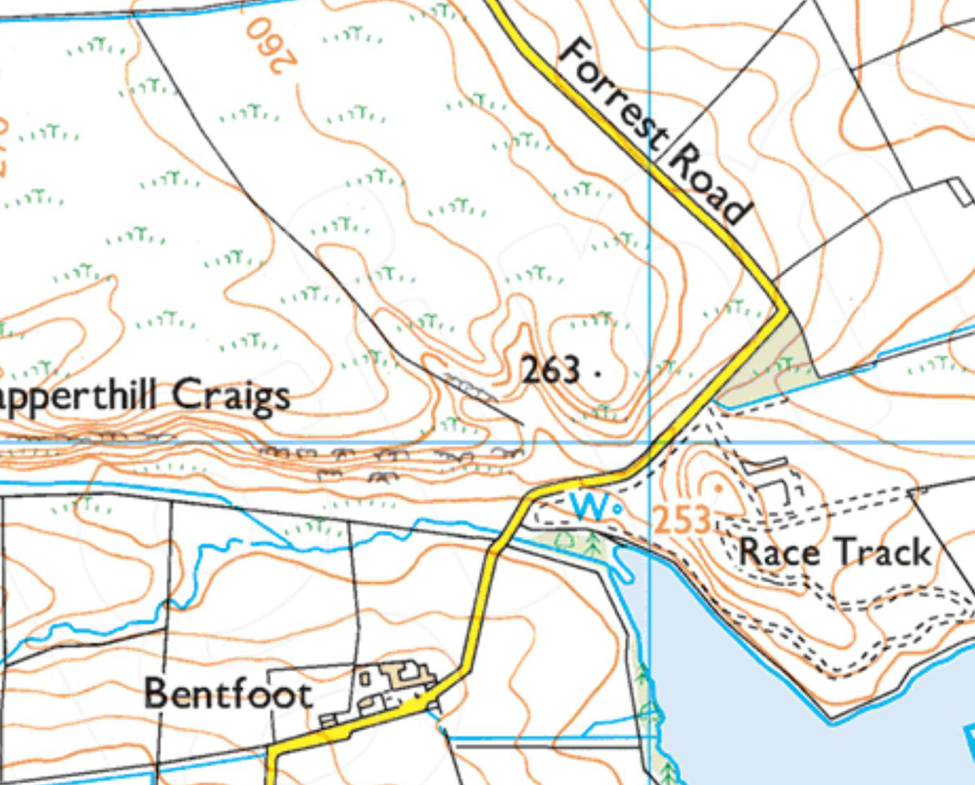
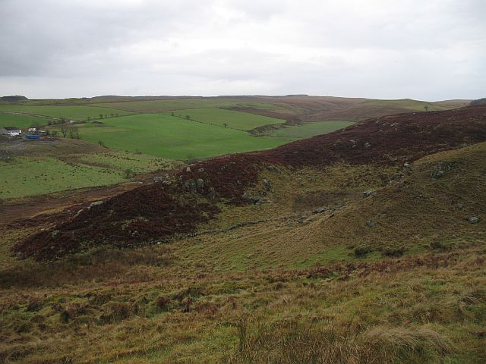
LAND FEATURE
SPUR AND RE-ENTRANT
Resource Book
Page 77
Re-entrant
Spur
Spur
Photo ©Webb(cc-by-sa/2.0)
A spur is a gently sloping ‘tongue’ of ground from high to low.
The re-entrant is the low point between two spurs.
Notes:
A spur is a piece of high ground jutting from a range of hills into lower ground. It is a projection or "nose" rising from the surrounding ground.
A re-entrant is a narrow valley closed at one end, separating two spurs. A kind of valley closed at one end. A re-entrant is an "entering" of the land into the hill .
They are very similar on the map because the contours for both will have a hairpin shape.

Slide 13
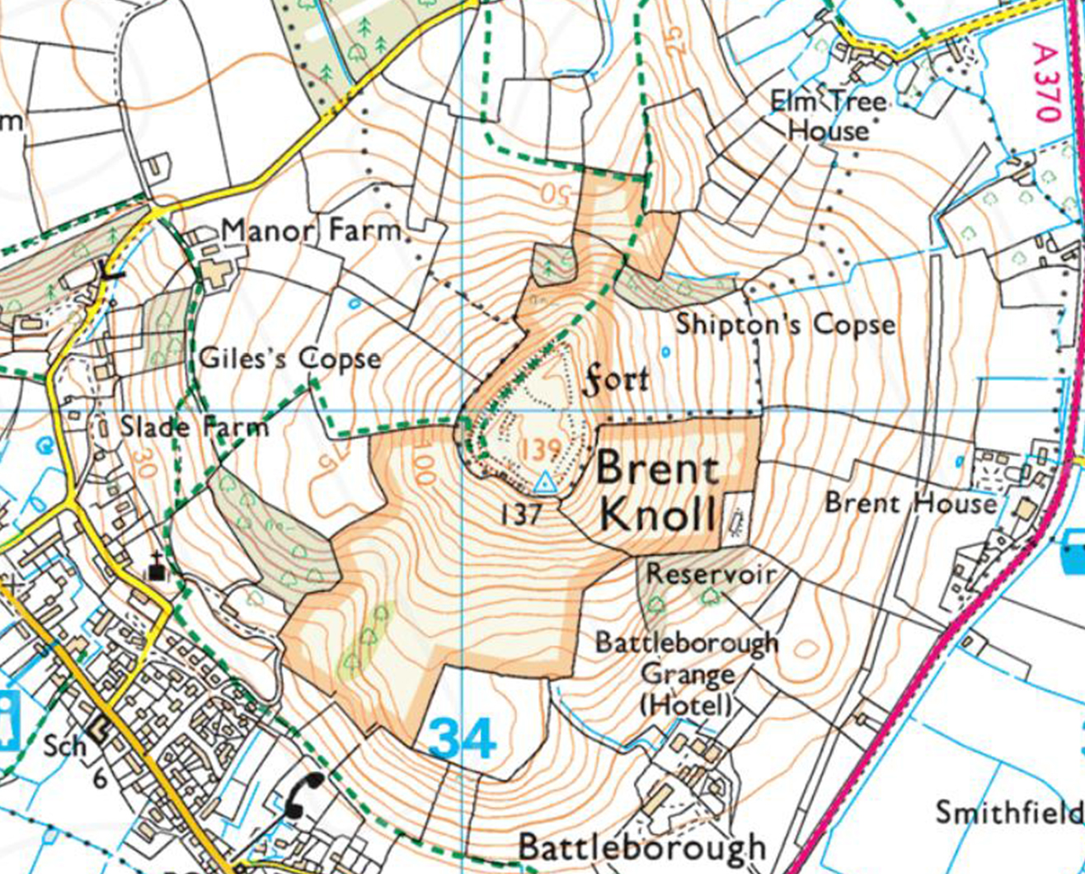
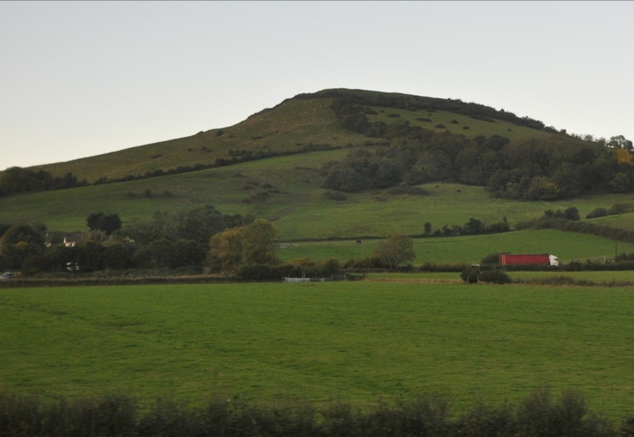
LAND FEATURE
KNOLL
Resource Book
Page 77
Photo ©Clarke(cc-by-sa/2.0)
A knoll is an isolated hill with its own round contour lines.
Notes:
A knoll is a small isolated hill. May be shown with its own contour line or with a small brown dot.

Slide 14
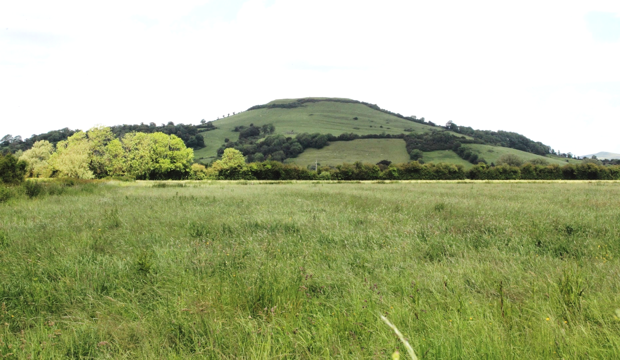
LAND FEATURE
KNOLL
Resource Book
Page 77
Notes:
A knoll is a small isolated hill. May be shown with its own contour line or with a small brown dot.

Slide 15
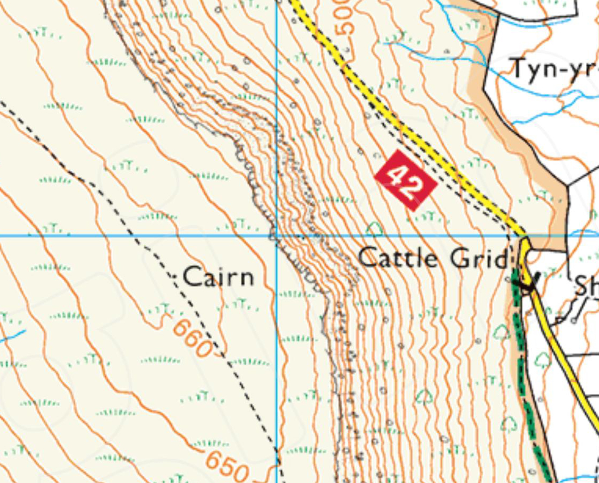
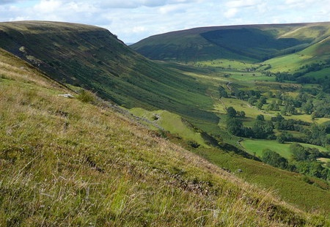
LAND FEATURE
ESCARPMENT
Resource Book
Page 77
Photo ©Park(cc-by-sa/2.0)
An escarpment is a hill with one steep side and a shallower side.
Notes:
An escarpment is a landform with sides sloping in opposite directions consisting of a steep scarp slope and a more gentle dip or back slope.

Slide 16
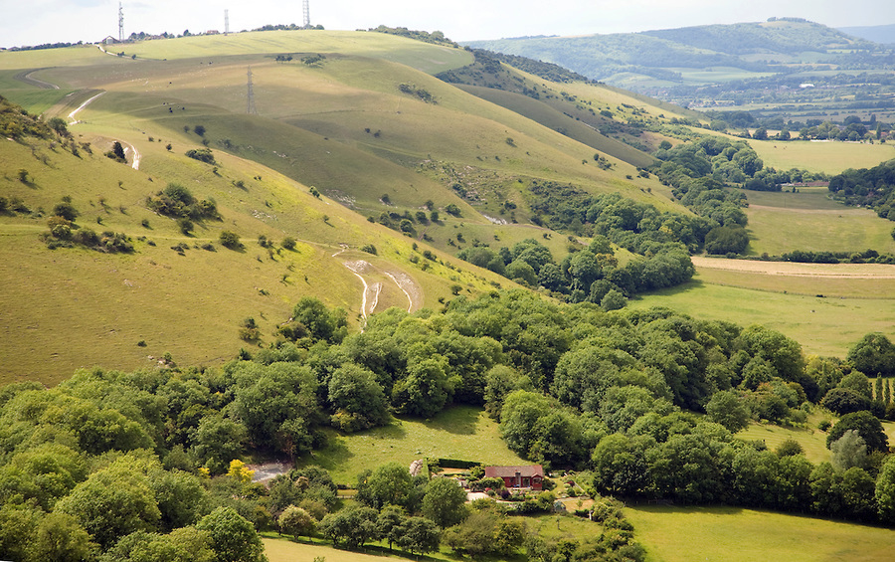
LAND FEATURE
ESCARPMENT
Resource Book
Page 77
Notes:
An escarpment is a landform with sides sloping in opposite directions consisting of a steep scarp slope and a more gentle dip or back slope.

Slide 17
ANY QUESTIONS?
Are there any final questions?
?
Notes:
A chance to ask or answer any final questions.

Slide 18
LEARNING OUTCOMES
LO3: Be able to plan routes using Ordnance Survey map features and contour lines.
Describe the main land features found on Ordnance Survey maps when planning routes.
Use the contour lines shown on an Ordnance Survey map to plan routes.
Notes:
LO3: Be able to plan routes using Ordinance Survey map features and contour lines.
P4: Describe the main land features found on Ordinance Survey maps when planning routes.
P5: Use contour lines found on Ordinance Survey maps to plan routes.

Slide 19
LAND FEATURES TASK 1
Logbook
Page 24
Use an OS map to find some land features.
When this is complete your instructor should sign page 24 of your First Class Logbook and fill in the Task P4 Activity 1 Map Reading log sheet.
Notes:
This task covers the mandatory requirement for objectives P3 for LO3.
Cadets must use an OS map to find some of the land features discussed in this presentation.
Once satisfied that all cadets have an understanding of the topic, instructors must fill in:
Page 24 of the cadet’s first class log book.
Task P4 Activity 1 log sheet. This can be found on Ultilearn.

Slide 20
LAND FEATURES TASK 2
Logbook
Page 24-25
Use the Rùm map to answer the questions on land features and contour lines.
When this is complete your instructor should check and sign page 24 and 25 of your First Class Logbook.
Notes:
This task covers the mandatory requirement for objectives P4 and P5 for LO3.
Cadets must used to provided map to identify some land features.
The Rùm map can be found in the back of the First Class Log Book. A clearer version can be found in the First Class Cadet Instructor Handbook.
Once satisfied that all cadets have an understanding of the topic, instructors must check and sign:
Page 24 and 25 of the cadet’s first class log book.

Slide 21
INSTRUCTOR INFORMATION
This presentation is provided free of charge with the 1st class cadet training system with no warranty or support.
Every effort has been made to ensure the information is correct, but the author accepts no responsibility for any errors or omissions.
Official information on Ultilearn or Bader SharePoint should be checked before using these presentations.
These presentations may be distributed to other Air Cadet squadrons free of charge, but do not place them on the internet.
For best results, use with the 1st class resource book and 1st class instructor handbook, available from cadetdirect.com.
Version 19/04

