Slide 1
Notes:
Part 1 of 2. This presentation covers the information required to complete the LO1 Royal Air Force topic.
For best results, these instructor notes should be read and discussed with the cadets in conjunction with this presentation and the session plan.

Slide 2
LEARNING OUTCOMES
LO1: Know about the history and organisation of the Royal Air Force.
Identify key developments in the history of the RAF.
Notes:
LO1: Know about the history and organisation of the Royal Air Force.
P1: Identify key developments in the history of the RAF.

Slide 3
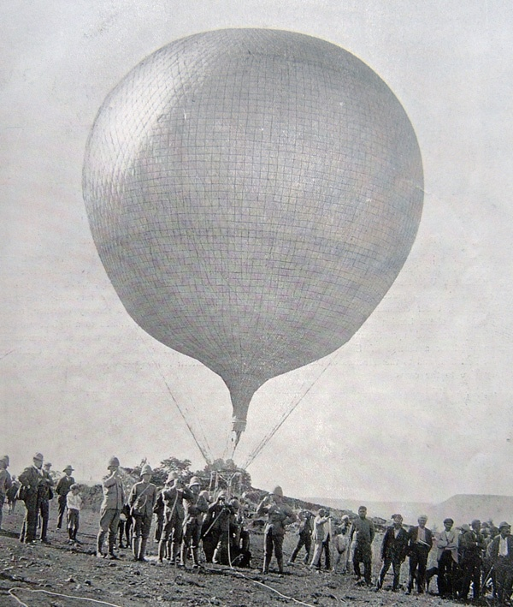
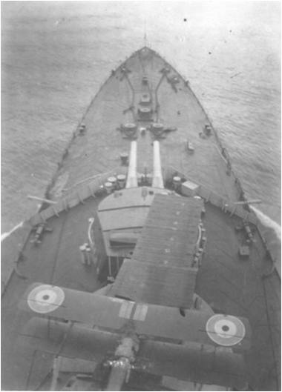
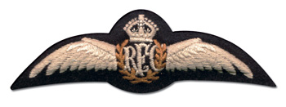
BEFORE THE ROYAL AIR FORCE
Resource Book
Page 38
The Royal Balloon School was the first “air force”.
Formation of the Royal Flying Corps on 13 Mar 1912.
Navy Wing splits to form Royal Navy Air Service in July 1914.
Notes:
The role of battlefield recognisance was first done by the Royal Flying Corps (RFC) (a part of the Army) which was founded on 12 Mar 1912.
The Navy felt that aircraft could be of use carrying bombs to devastate the enemy from far off and got their own Royal Navy Air Service (RNAS) in July 1914.

Slide 4
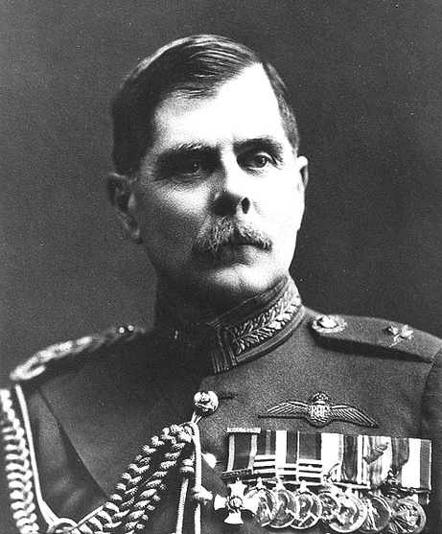
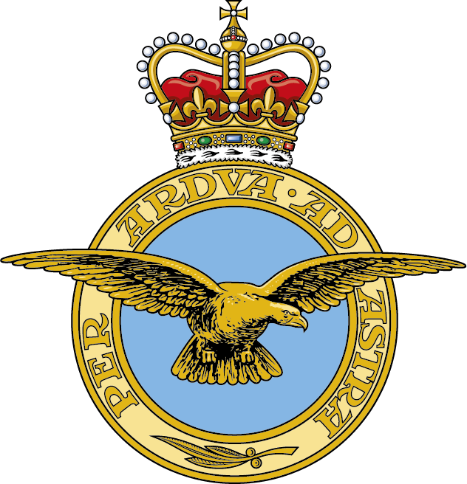
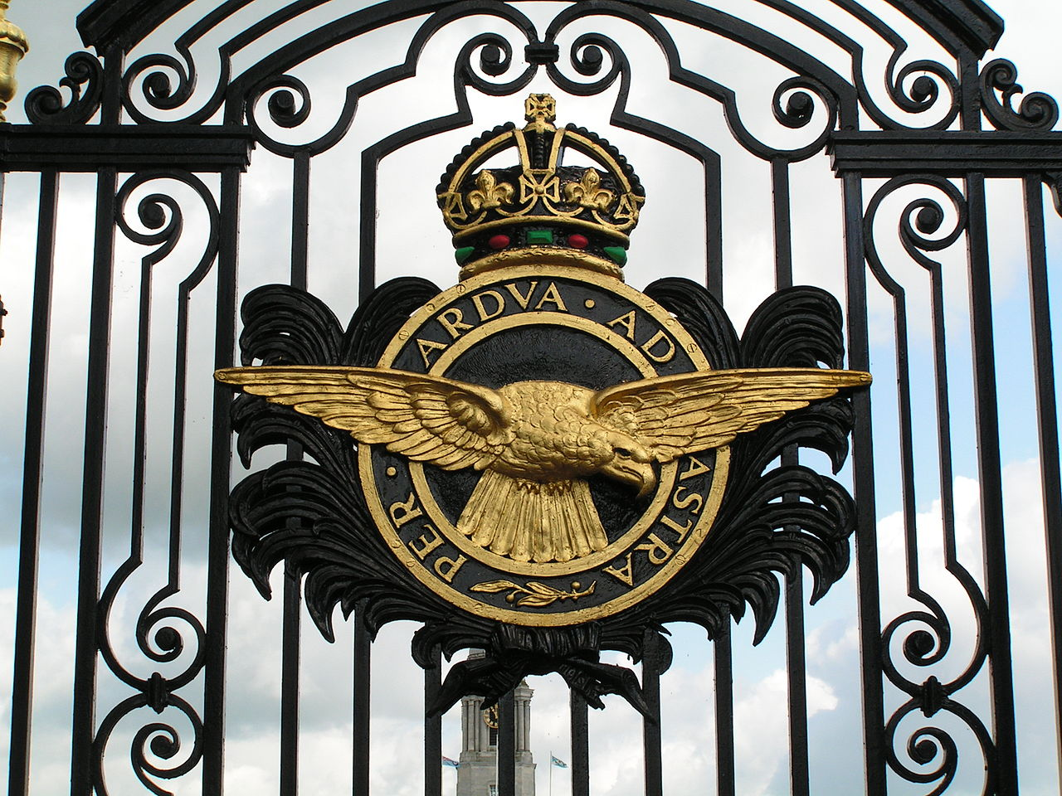
THE FORMATION OF THE RAF
Resource Book
Page 38
Formed on 1st of April 1918 and Lord Trenchard is appointed Chief of Air Staff.
The RAF gets a new crest.
The motto “Per Ardua ad Astra” means “Through Adversity to the Stars”.
Notes:
The Royal Air Force is formed from the RFC and RNAS on the 1st of April 1918. A man called Lord Trenchard was and was appointed the first Chief of Staff of the RAF. Today he is still referred to as the Father of the RAF. The RAF badge was originally topped with the kings crown. This can still be seen on the gates to RAF Cranwell, the ‘home of the RAF’.
During World War I air power was in its infancy. Although aircraft were firstly only used for recognisance and bombing the first world war saw the emergence of armed aircraft and the fighter.

Slide 5
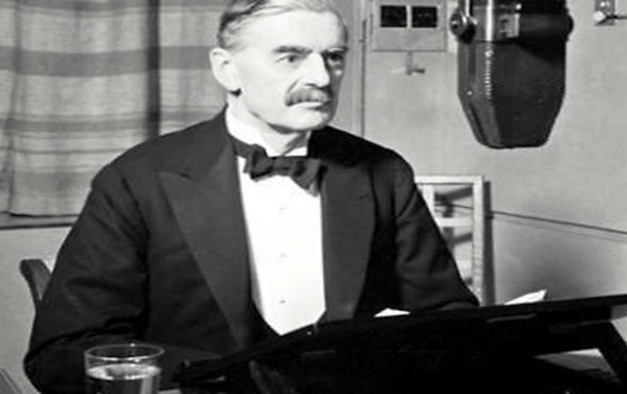
THE DECLARATION OF WORLD WAR II
The declaration of War in 1939 by Neville Chamberlain.
Hover over the picture and press play to listen to part of the radio broadcast given on the declaration of war on the 3 Sep 1939
World War II lasted until 1945.
Notes:
1 Sep 1939- Members of the RAF Reserve and RAF Volunteer Reserve are called out for permanent service. At 4.45am Germany commenced the invasion of Poland.
3 Sept 1939 - Britain, France, Australia & New Zealand declare war on Germany.
4 Sept 1939 – The Royal Air Force attacks the German Navy.
During the Second World War air power was to quickly mature into a most important tool of battle that would test the newly formed RAF to its limits.
War was declared in 1939 and the RAF was deployed to France and its reconnaissance role was expanded to include the bombing and harassment of the German supply areas.
Despite the huge skill and valiant efforts of the RAF the battle for France was lost and during the defence of Norway in mid 1940, 240 hurricane aircraft were lost. It was this that prompted Air Chief Marshal Dowding (Air Officer Commanding in Chief, Fighter Command) to refuse to send further aircraft to France as he feared it would weaken the later defence of Great Brittan.
Upon the Withdrawal from France at Dunkirk Winston Churchill made one of his most famous wartime speeches “The battle of France is over... The battle of Britain is about to begin. Let us therefore brace ourselves to our duties, and so bear ourselves that, if the British Commonwealth last for a thousand years, men will say, this was our finest hour.”

Slide 6
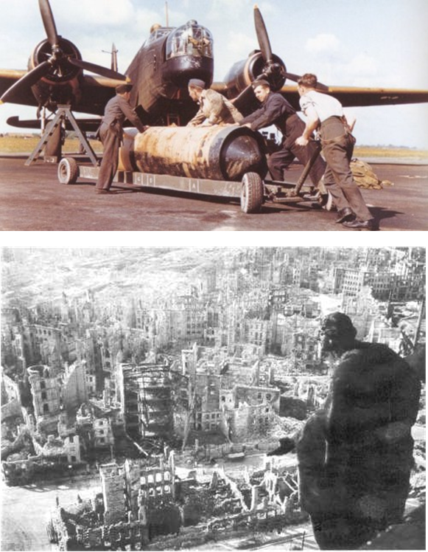
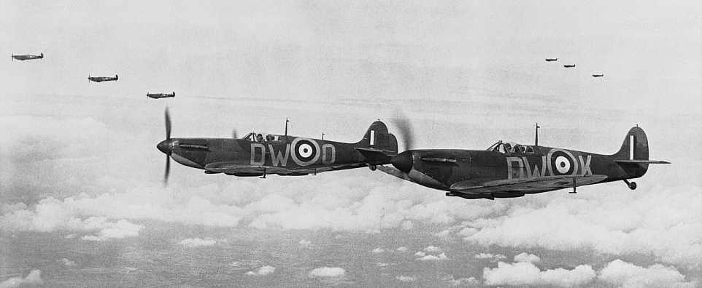
THE BATTLE OF BRITAIN
Resource Book
Page 38
The RAF defeats the Luftwaffe in the Battle of Britain.
The RAF lowers German moral and disrupts manufacture with a massive bombing campaign over Germany.
Notes:
Bomber Command, under the leadership of Air Chief Marshal ‘Bomber’ Harris took the battle to Germany.
Initially with daring daytime bombing raids and later with night bombing. The Germans had no real heavy, strategic, bomber but the RAF had the Halifax and Lancaster.
The Lancasters’ of 612 Squadron carried the RAF’s largest bomb the grand slam (22,000 pounds nearly 10 metric tones 10000 kg).
Between October and December 1944 the RAF doped 163,000 tones of bombs on Germany and that against the German city of Duisburg alone the RAF dropped more weight in bombs in 24 hours than the Luftwaffe dropped on London during the entire war.

Slide 7
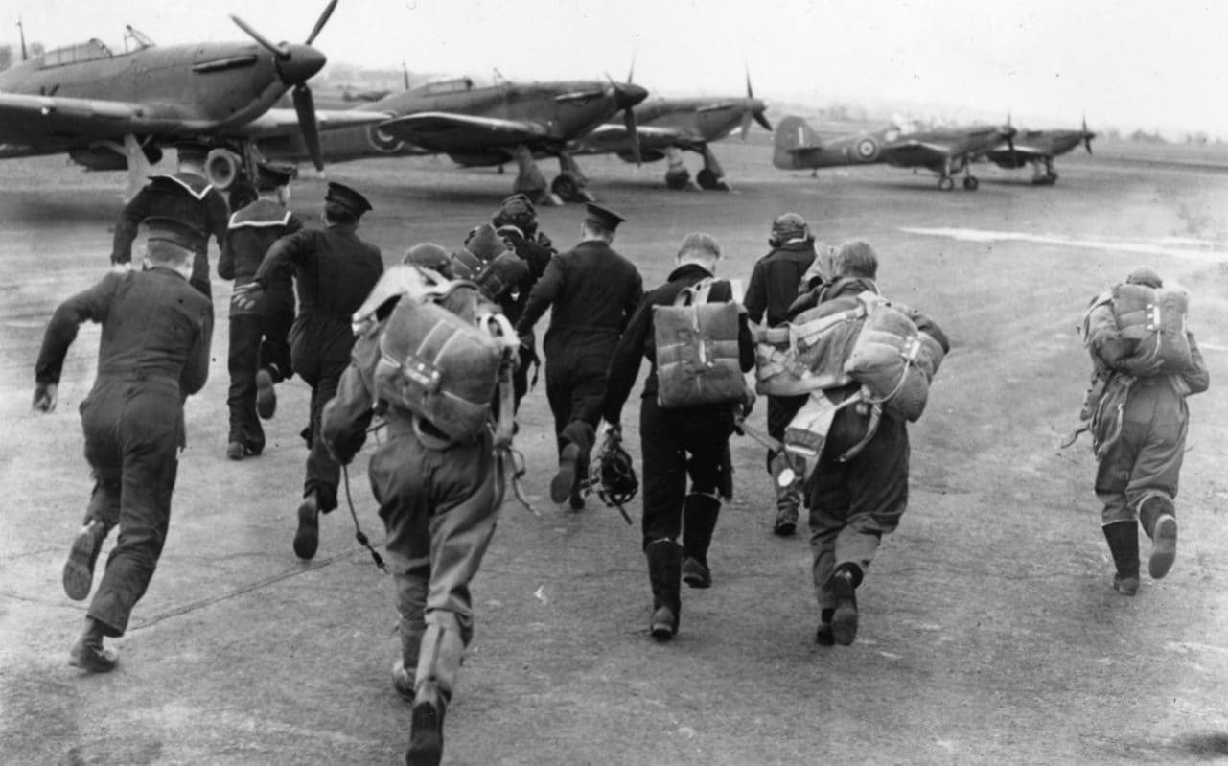
THE BATTLE OF BRITAIN
Resource Book
Page 38
Notes:
The direct effect on the Germans moral and the infrastructure of the German war machine was massive but more importantly the massive effort to protect the skies of Germany used great resources. (photo shows bombed Germany in 1945)
Albert Speer, the German Armaments minister said that “it opened a second front long before the invasion of Europe” (by the Allied forces), and the front needed equipment and ammunition. He described “every square meter of territory we controlled was kind of a front line”.
The RAF grew to the biggest it has ever been during the Second World War, constantly expanding and changing the very fabric of our landscape.
Almost every old airfield is a WW2 one as are most of our airfields and airports today

Slide 8
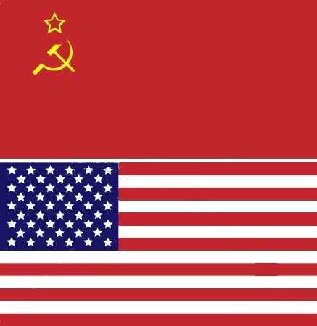
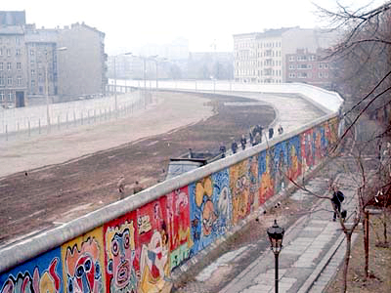
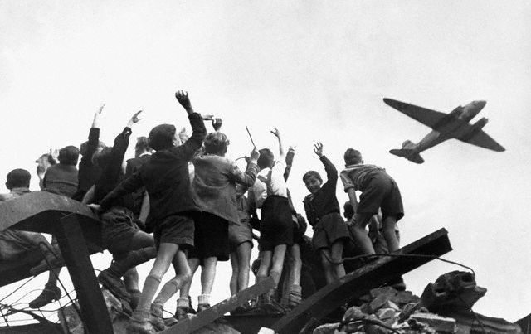
THE COLD WAR
Resource Book
Page 39
Began in 1947 – ended in 1991. Not really a war.
Between The USA and it’s allies (including Britain) and the USSR (Russia) and it’s allies.
A fear that one country might invade and take over the other. Between communism (Russia) and capitalism (The USA).
Notes:
The start of the Cold War in 1947 was due to a belief that all governments would become either communist or capitalist. The Western allies feared that the Soviet Union would use force to expand its influence in Europe, and was especially concerned that Soviet agents had obtained information on making the Atom Bomb after the war. Both groups of nations had opposed Nazi Germany. The Soviet Union had initially co-operated with Germany in the division of Poland in 1939, but turned against Germany in June 1941.
After WW2, Germany was divided into West and East (west controlled by the British, French and Americans and the East by Russia) by what Churchill referred to as an Iron Curtain which had descended across Europe. Berlin was also divided into two in a similar fashion but was in its entirety in the Russian controlled East Germany. In June 1948 relations finally broke down between Russia and the remaining Allied powers and all road and rail links were closed to West Berlin.
Because the two countries never fought each other directly, it was called a ‘cold’ war, meaning there was no physical fighting.

Slide 9
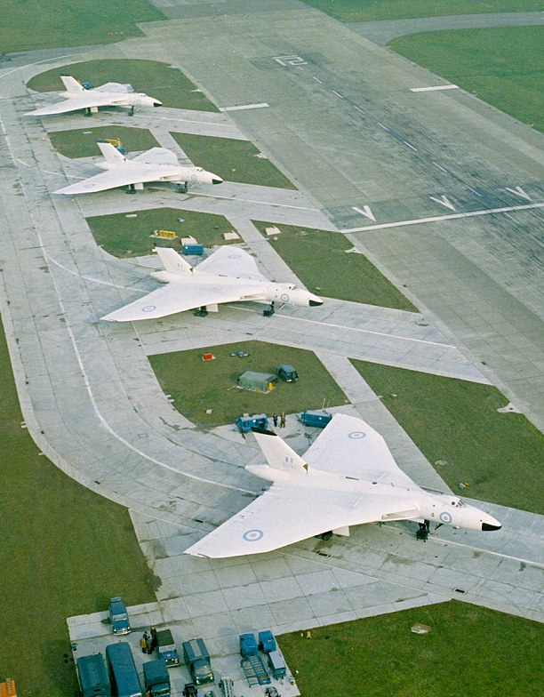
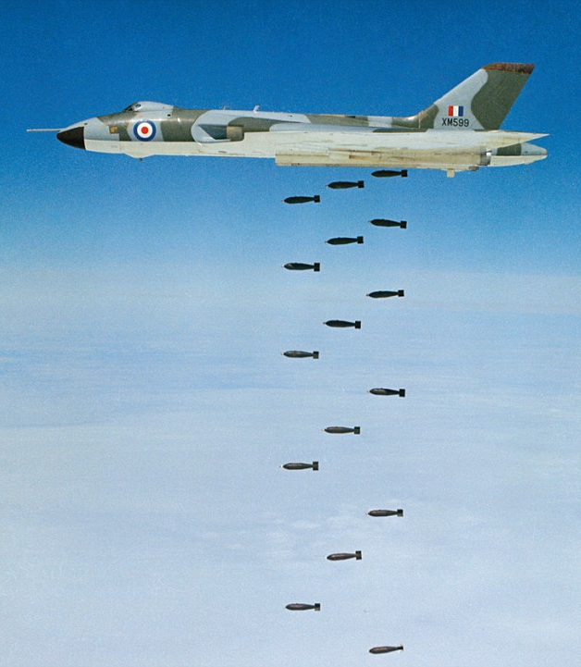
THE COLD WAR
Resource Book
Page 39

Slide 10
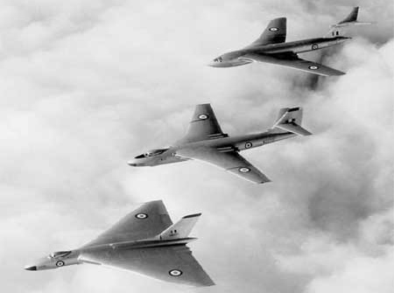
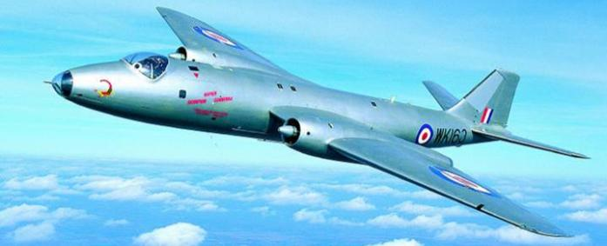
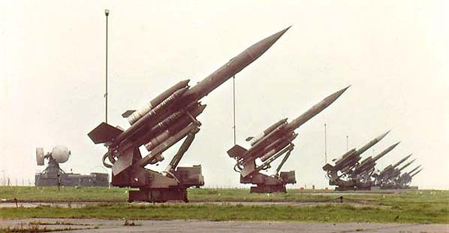
THE COLD WAR ARMS RACE
Resource Book
Page 39
The cold war created an arms race between the Allies and Russia.
The Canberra aircraft, V-force aircraft and Thor missiles were all put in place during the Cold War.
Notes:
Essentially the west was at a constant alert in standoff over the communist eastern side of Europe… the Union of Soviet Socialist Republics (USSR). This standoff created a technological arms race.
The first great development was the Canberra (the worlds first jet bomber) which went into service in 1951 becoming possibly the most successful British designed military aircraft of all time. The V-Force aircraft (The Valiant, The Victor and the Vulcan), and Brittan's ground launched nuclear missile Thor were put in place. In addition the Lightning fighter, capable of travailing twice the speed of sound and the Bloodhound missile were developed.

Slide 11
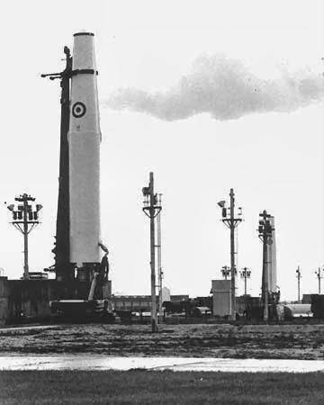
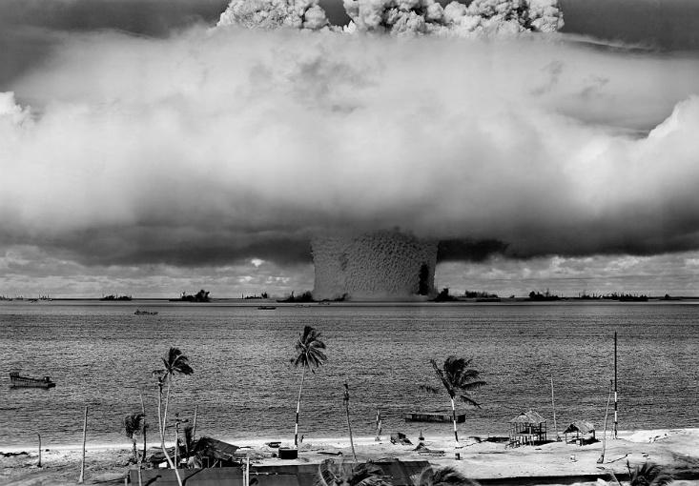
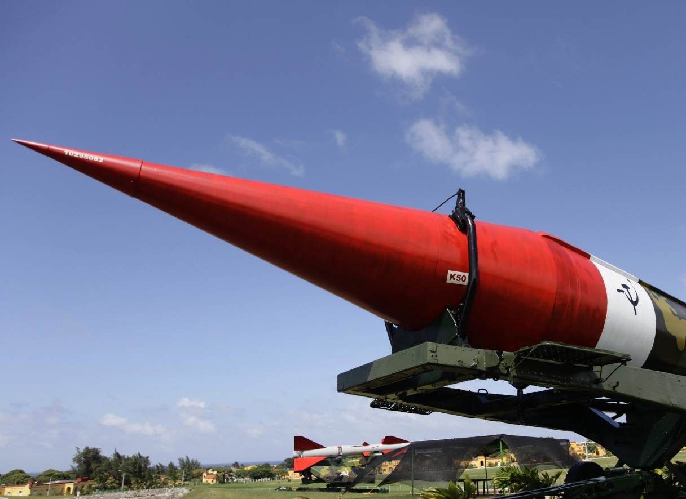
DURING THE COLD WAR
Resource Book
Page 39
The RAF became a largely standoff defence force as the country waited for war to come.
The V-Force were on constant standby, able to get airborne in 2 and a half minutes 24 hours a day.
Constant threat of nuclear attack.
Notes:
It is may be difficult for you to imagine now how real and frightening the treat of war was to the people of the mid 50s and early 60s. The V-Force were on constant standby, able to get airborne in 2 and a half minutes 24 hours a day. The entire country was protected by arrays of the Bloodhound missile and a great many fighters all on constant standby. A generation of young people were brought up with the feeling that war wound not be declared but would just happen and with such terrible force that the world as we know it would come to and end.
All this defence from communist nuclear threat, and the waiting game of the cold war created a largely static but ready to fight and defend RAF.

Slide 12
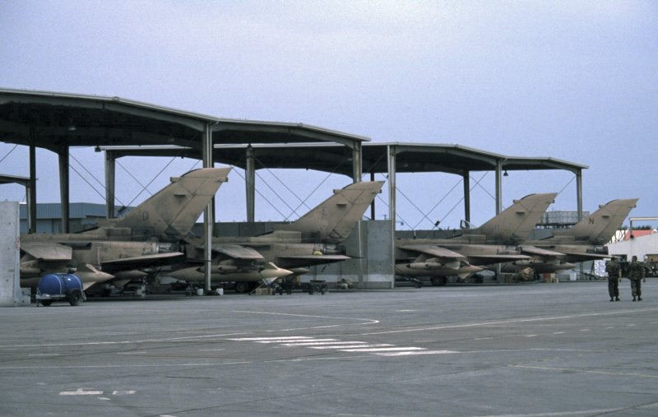
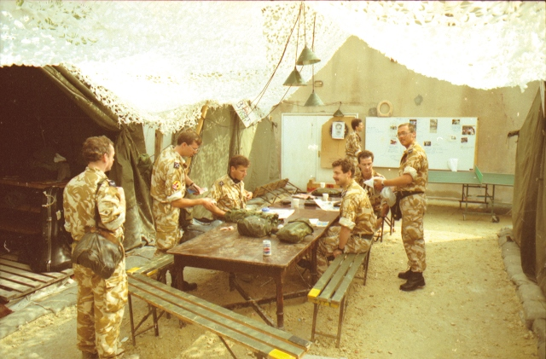
EXPEDITIONARY AIR FORCE
Resource Book
Page 39
The Falklands War in 1982 signalled the return to an Expeditionary Air Force.
The RAF undertook key roles in the Gulf.
The RAF helped Peacekeeping in Kosovo and Bosnia.
Notes:
The Falklands war started suddenly on the 2nd of April 1982 as a result of the Argentine invasion and occupation of the Falkland Islands.
The war presented problems for the British. The British task force base on Ascension island was 6000km away from the Falklands and England its self was 8000 miles away. Argentina, on the other hand was close to the Falklands and had it’s entire military strength close at hand. The RAF’s roles in the war were key and it was the first operational test of the Harrier ‘Jump Jet’ but two great and unique feats are worth special mention.
Four Chinook helicopters were sent to the Falklands but after the sinking of the merchant ship chartered for their transport by an Exocet Missile only one Chinook survived. This one Aircraft (Bravo November) logged over 109 flying hours before the surrender of the Argentine forces kept going with borrowed tools and ingenuity it not only performed supply flights but also engaged in a daring SAS support flight where she carried 3 light guns (one hung below and two in the back) and 22 troops.
Probably the most amazing feet of the Falklands war however was the Bombing mission undertaken by the Vulcan (Op BLACK BUCK). The was the longest distance ever bombing run from the Ascension Island to Argentina and back, an 8000 mile round trip. Each Black Buck mission required the support from 13 tankers. An amazing feat from both the pilots and the Vulcan which was just months from service withdrawal.

Slide 13
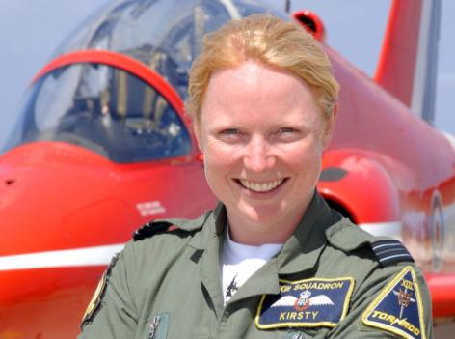
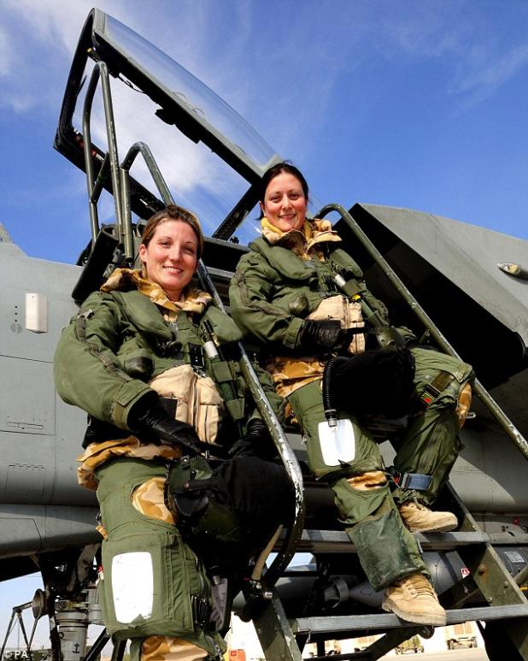
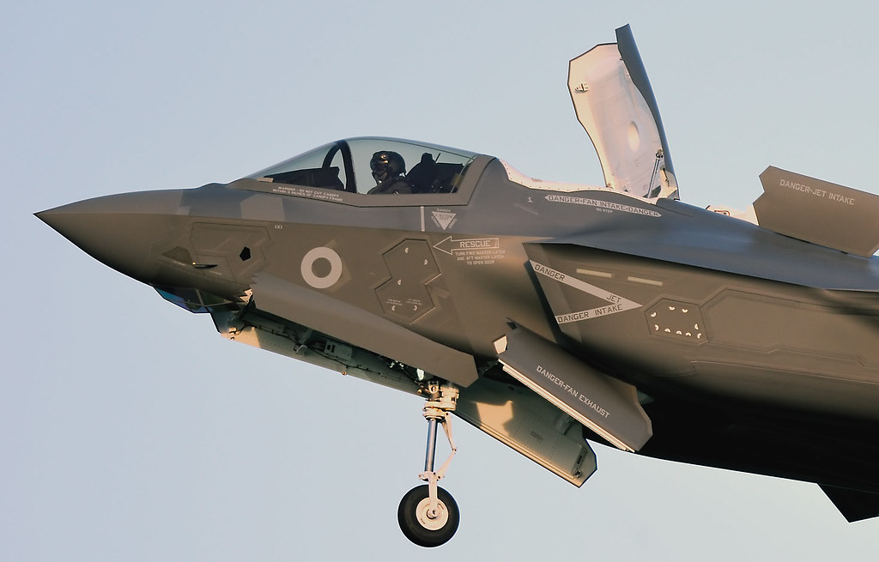
THE RAF TODAY
Resource Book
Page 39
The RAF has around 35,000 personnel.
Women now undertake front line jobs in the RAF.
Increasing reliance on the RAF reserve forces.
Notes:
Women can now undertake all roles in the Royal Air Force. Pilot Flight Lieutenant Juliette Fleming and Navigator Squadron Leader Nikki Thomas were the first all female fighter pair and fly with 31 Squadron from Royal Air Force Marham, and in 2009 the Red Arrows saw the selection of its first Female Pilot.
Flt Lt Michelle Goodman was captain of an Incident Reaction Team Merlin, when, on 1 June 2007, she flew into Basra at night using night vision and under heavy fire to evacuate a serious casualty, 20-year-old Rifleman Stephen Vause of the 4th Battalion The Rifles (who had 15 minutes to live following a mortar attack). Her DFC was gazetted on 7 March 2008, the first woman to receive this decoration.

Slide 14
ANY QUESTIONS?
Are there any final questions?
?
Notes:
A chance to ask or answer any final questions.

Slide 15
LEARNING OUTCOMES
LO1: Know about the history and organisation of the Royal Air Force.
Identify key developments in the history of the RAF.
Notes:
LO1: Know about the history and organisation of the Royal Air Force.
P1: Identify key developments in the history of the RAF.

Slide 16
QUESTION 1
Who is said to be the father of the RAF?
a. Adolf Hitler
b. Winston Churchill
c. JA Chamier
d. Lord Trenchard
Notes:
Who is said to be the father of the RAF?
Answer: d. Lord Trenchard

Slide 17
QUESTION 1
Who is said to be the father of the RAF?
a. Adolf Hitler
b. Winston Churchill
c. JA Chamier
d. Lord Trenchard
Notes:
Who is said to be the father of the RAF?
Answer: d. Lord Trenchard

Slide 18
QUESTION 2
The name of the organisation from which the RAF developed was?
a. Royal Naval Flying Corps (RNFC)
b. Royal Naval Air Service (RNAS)
c. Royal Flying Corps
d. Naval Flying Corps
Notes:
The name of the organisation from which the RAF developed was?
Answer: c. Royal Flying Corps

Slide 19
QUESTION 2
The name of the organisation from which the RAF developed was?
a. Royal Naval Flying Corps (RNFC)
b. Royal Naval Air Service (RNAS)
c. Royal Flying Corps
d. Naval Flying Corps
Notes:
The name of the organisation from which the RAF developed was?
Answer: c. Royal Flying Corps

Slide 20
QUESTION 3
When did the Cold War begin and end?
a. 1939 - 1945
b. 1947 - 1991
c. 1939 - 1980
d. 1918 - 1991
Notes:
When did the Cold War begin and end?
Answer: b. 1947 - 1991

Slide 21
QUESTION 3
When did the Cold War begin and end?
a. 1939 - 1945
b. 1947 - 1991
c. 1939 - 1980
d. 1918 - 1991
Notes:
When did the Cold War begin and end?
Answer: b. 1947 - 1991

Slide 22
QUESTION 4
Which aircraft was the first RAF jet engine bomber?
a. Canberra
b. Wellington
c. Meteor
d. Vulcan
Notes:
Which aircraft was the first RAF jet engined bomber?
Answer: a. Canberra

Slide 23
QUESTION 4
Which aircraft was the first RAF jet engine bomber?
a. Canberra
b. Wellington
c. Meteor
d. Vulcan
Notes:
Which aircraft was the first RAF jet engined bomber?
Answer: a. Canberra

Slide 24
LEARNING OUTCOMES
LO1: Know about the history and organisation of the Royal Air Force.
Outline the basic organisational structure of the RAF.
Notes:
LO1: Know about the history and organisation of the Royal Air Force.
P2: Outline the basic organisational structure of the RAF.

Slide 25
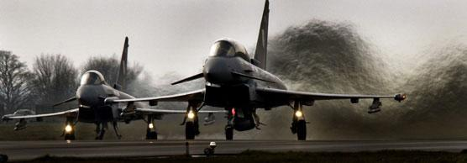
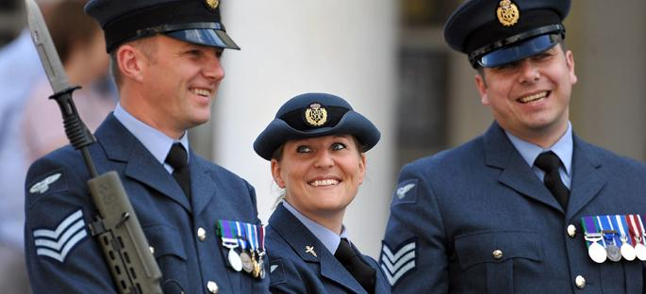
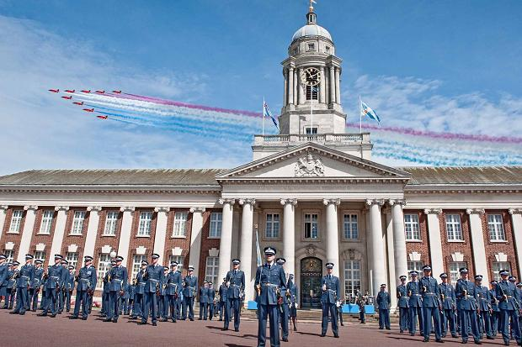
STRUCTURE OF THE RAF
Resource Book
Page 41
Defence Council
Air Force Board
RAF Air Command
1 Group
2 Group
22 Group
38 Group
RAF Air Cadets
Notes:
The Defence Council is a branch of the Ministry of Defence that contains the Chief of Defence staff, senior officers of the three armed services, the Secretary of State for Defence and other senior ministers. It manages the Armed services of the United Kingdom.
Within the defence council the Chief of Air Staff (an Air Chief Marshal) represents the RAF and has overall authority for its operations.
The Air force board is a sub committee of the Defence Council which manages the RAF.
The Chain of command for the day to day running for the RAF stops with the Commander in Chief Air who has two deputies one who is responsible for operations and the other personnel.
Under them Air Officers Commanding have responsibility for three Groups (1, 2 and 22 Group) which each look after the various Stations, Squadrons and Wings of the Royal Air Force.
We will now look at what each of the three Groups of Air Command do.

Slide 26
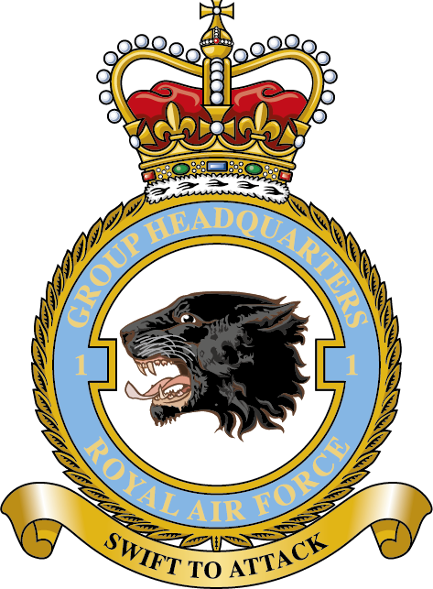
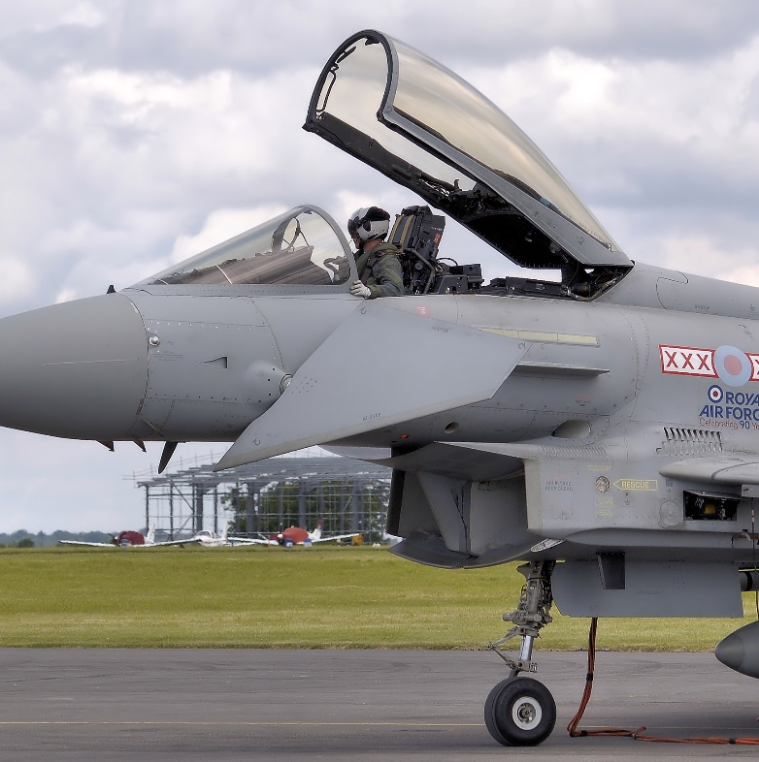
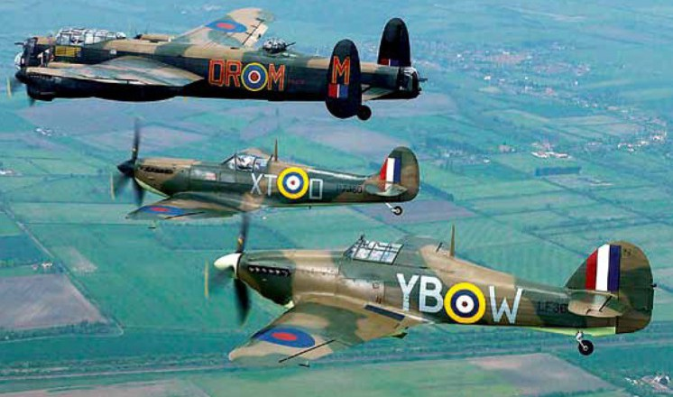
No. 1 GROUP– AIR COMBAT
Resource Book
Page 40
Units which come under 1 Group:
  Fast Jet Squadrons.
  The Battle of Britain Memorial Flight.
Notes:
Number 1 Group or the Air Combat Group controls the RAF’s combat fast jet aircraft and interestingly the Battle of Britain Memorial Flight at RAF Coningsby.
It is responsible for both Offensive and defensive roles. Defending British air space as well as performing ground and air attack roles.

Slide 27
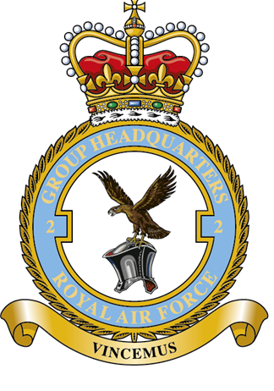
No. 2 GROUP – AIR COMBAT SUPPORT
Resource Book
Page 40
Units Which come under 2 Group:
  Force Protection which includes:
    RAF Regiment
    RAF Police
    Tactical Transport and Refuelling
    Combat Intelligence, Surveillance, Target Acquisition & Reconnaissance (CISTAR)
Notes:
Number 2 Group or the Air Combat Support Group manages all of the RAF’s support mechanism both on the ground and in the air.
All Tactical and non tactical transport, air to air refuelling is managed by 2 group. As are the Air bourn Early Warning and maritime reconnaissance squadrons (Nimrod and Sentry).
In addition the RAF regiment, police and all other support element come under 2 group.

Slide 28
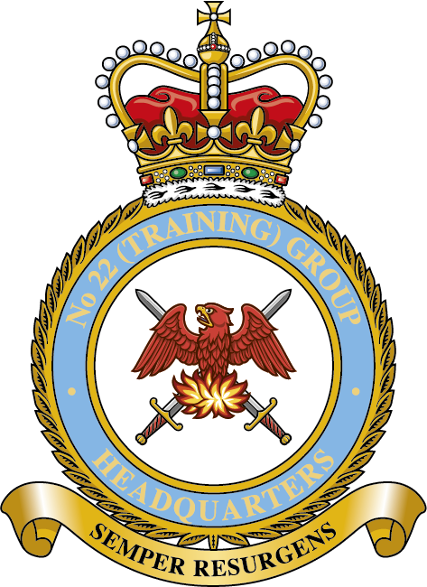
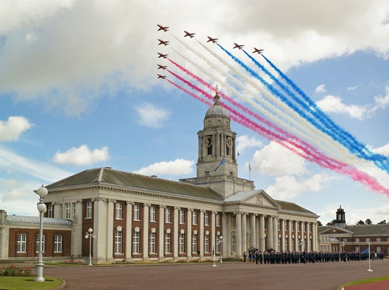
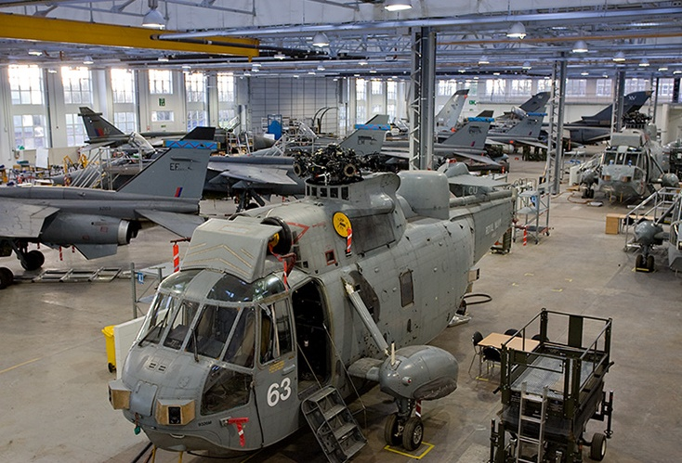
No. 22 GROUP – TRAINING
Resource Book
Page 40
Responsible for all Training including:
  RAF College Cranwell
  DSAE Cosford
  The Air Cadets
  Flying Training
Notes:
Number 22 Group (The Training Group) Is responsible for all aspects of Pilot, aircrew and ground crew training.
The Defence Aeronautical School of Engineering (DSAE), RAF College Cranwell and the other two Elementary Flight Training Squadrons all come under 22 Group.
In addition so do University Air Squadrons and the Air Training Corps.

Slide 29
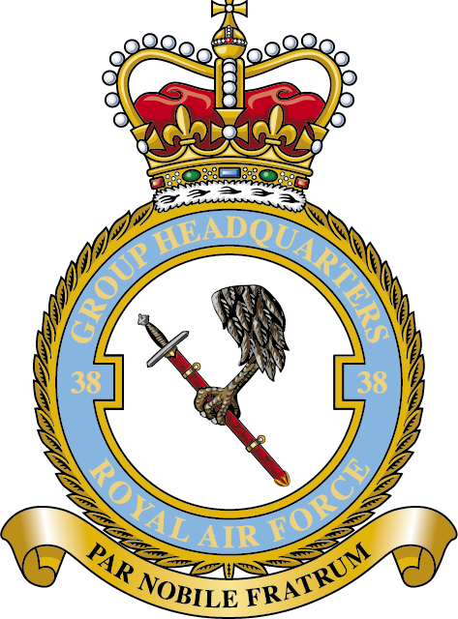
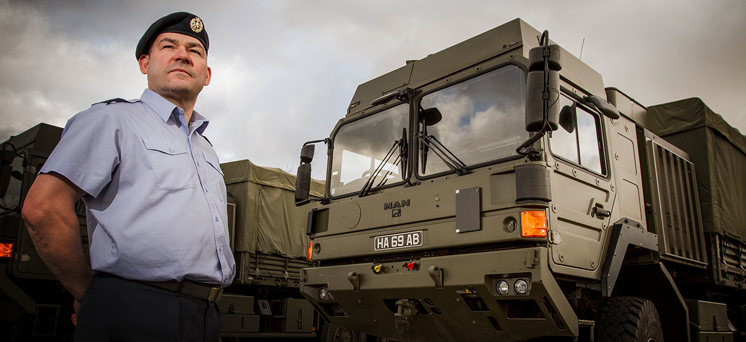
No. 38 GROUP – ENGINEERING, LOGISTICS, COMMUNICATION AND MEDICAL
Resource Book
Page 40
Reformed in 2014
Brings together the Royal Air Force units:
  Engineering
  Logistics
  Communications
  Medical Operations
Notes:
Number 38 Group comprises engineering and logistics, communications and Medical Operations Force Elements, in addition to units such as RAF Music Services.
Air Officer Commanding Number 38 Group has responsibility for UK-based United States Visiting Forces (USVF) units and for RAF personnel detached to other armed forces around the world.

Slide 30
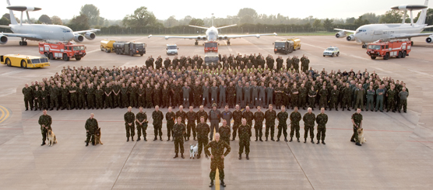
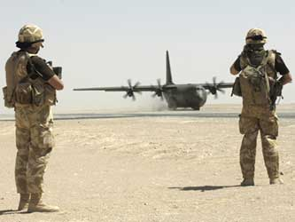
EXPEDITIONARY AIR WINGS (EAWs)
Expeditionary Air Wings are formed when needed and report directly to Air Command.
Notes:
The concept of Expeditionary Air Wings goes back to the second world war. Reformed in 2006 at a number of RAF stations thy form deployable units of aircraft, aircrew and support.
The idea being that the men and women of the wing get to know each other and used to working with each other before they are deployed. (Photo left 34 EAW at RAF Waddington) (Photo right a C130 of 903 AEW Afghanistan)

Slide 31
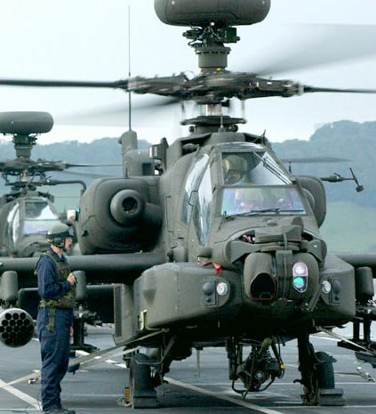
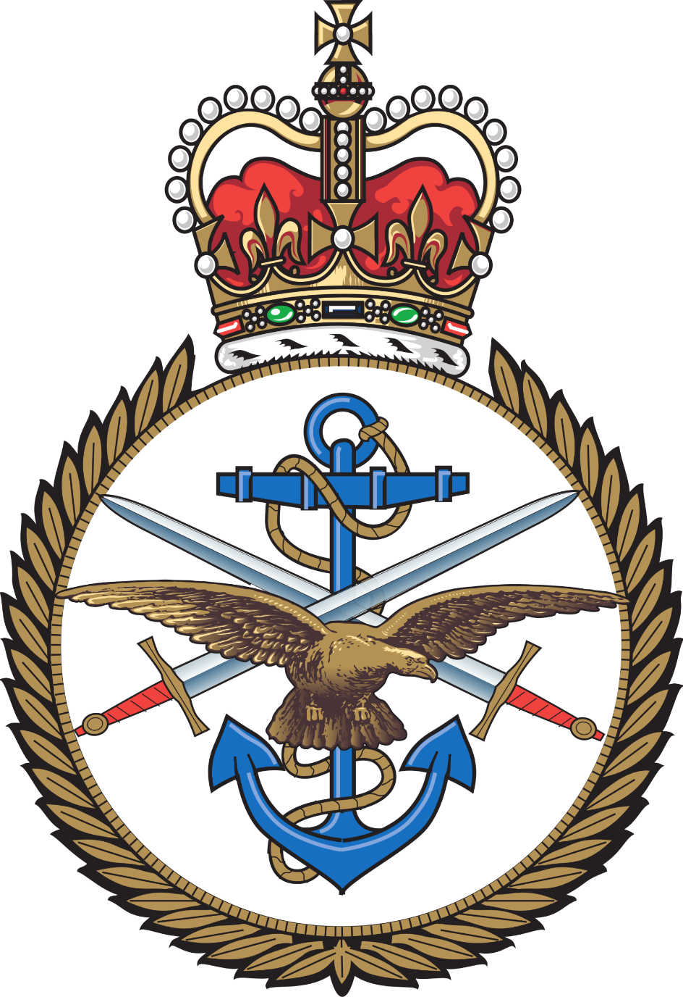
WORKING WITH OTHERS
Joint Service Organisations help the RAF work efficiently with its fellow services.
Notes:
There are now a significant number of Joint Service organisations within the British Military and a great number of them fall under the command of Air Command or one of it’s groups.
These units allow for better cooperation between the armed forces and also prevent duplication of resources.
As Part of this the RAF now provides almost all basic pilot training. In addition the RAF also provides all Aeronautical technical training at the Defence School of Aeronautical Engineering at RAF Cosford.
More specialist joint service training and support is apparent in the world of rotary wing aircraft.
The Joint Helicopter Support Squadron (JHSS) at RAF Odiham, for example, provides all the training relating to attaching equipment to helicopters for transport and also for Mobile Air Operations (this includes checking and preparing helicopter landing sites).
Finally the Joint Force Harrier (operates under 1 Group RAF) and Joint Helicopter Command (Operates under HQ Land Forces) are examples of operational joint command bodies.

Slide 32
ANY QUESTIONS?
Are there any final questions?
?
Notes:
A chance to ask or answer any final questions.

Slide 33
LEARNING OUTCOMES
LO1: Know about the history and organisation of the Royal Air Force.
Outline the basic organisational structure of the RAF.
Notes:
LO1: Know about the history and organisation of the Royal Air Force.
P2: Outline the basic organisational structure of the RAF.

Slide 34
QUESTION 1
What is the role of 1 Group?
a. Engineering, Logistics, Communications and Medical.
b. Air Combat
c. Training
d. Air Combat Support
Notes:
What is the role of 1 group?
Answer: b. Air Combat

Slide 35
QUESTION 1
What is the role of 1 Group?
a. Engineering, Logistics, Communications and Medical.
b. Air Combat
c. Training
d. Air Combat Support
Notes:
What is the role of 1 group?
Answer: b. Air Combat

Slide 36
QUESTION 2
What is the role of 2 Group?
a. Engineering, Logistics, Communications and Medical.
b. Air Combat
c. Training
d. Air Combat Support
Notes:
What is the role of 2 group?
Answer: d. Air Combat Support

Slide 37
QUESTION 2
What is the role of 2 Group?
a. Engineering, Logistics, Communications and Medical.
b. Air Combat
c. Training
d. Air Combat Support
Notes:
What is the role of 2 group?
Answer: d. Air Combat Support

Slide 38
QUESTION 3
What is the role of 22 Group?
a. Engineering, Logistics, Communications and Medical.
b. Air Combat
c. Training
d. Air Combat Support
Notes:
What is the role of 22 group?
Answer: c. Training

Slide 39
QUESTION 3
What is the role of 22 Group?
a. Engineering, Logistics, Communications and Medical.
b. Air Combat
c. Training
d. Air Combat Support
Notes:
What is the role of 22 group?
Answer: c. Training

Slide 40
QUESTION 4
What is the role of 38 Group?
a. Engineering, Logistics, Communications and Medical.
b. Air Combat
c. Training
d. Air Combat Support
Notes:
What is the role of 38 group?
Answer: a. Engineering, Logistics, Communications and Medical.

Slide 41
QUESTION 4
What is the role of 38 Group?
a. Engineering, Logistics, Communications and Medical.
b. Air Combat
c. Training
d. Air Combat Support
Notes:
What is the role of 38 group?
Answer: a. Engineering, Logistics, Communications and Medical.

Slide 42
INSTRUCTOR INFORMATION
This presentation is provided free of charge with the 1st class cadet training system with no warranty or support.
Every effort has been made to ensure the information is correct, but the author accepts no responsibility for any errors or omissions.
Official information on Ultilearn or Bader SharePoint should be checked before using these presentations.
These presentations may be distributed to other Air Cadet squadrons free of charge, but do not place them on the internet.
For best results, use with the 1st class resource book and 1st class instructor handbook, available from cadetdirect.com.
Version 19/04

